Slide 1
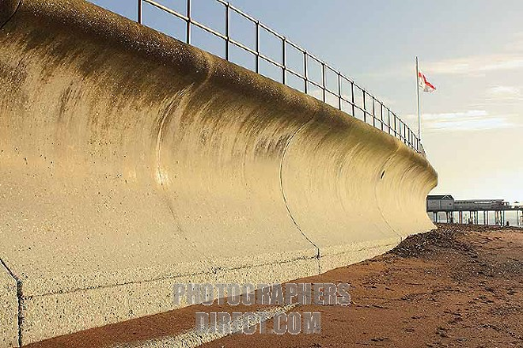
SEA WALL
Description
Concrete or rock barrier built at the foot of cliffs or at the top of a beach. Has a curved face to reflect the waves back into the sea. Usually 3-5m high
Cost
Up to £10 million per km
Advantages | Disadvantages
Effective at stopping the wave eroding the land. Often has a walkway or promenade for people to walk along | Can block views and is unnatural to look at Very expensive to build and look after

Slide 2
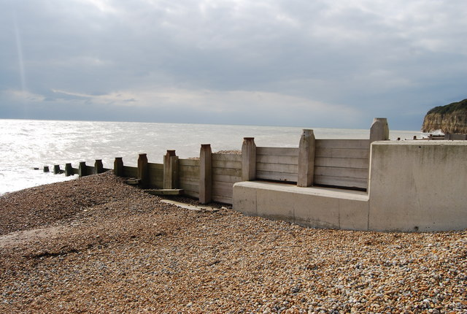
GROYNES
Description
Timber or rock structures built out to sea from the coast. They trap material being moved by long shore drift and so make the beach bigger. The wider beach acts as a buffer to reduce the effect of incoming waves, reducing wave attack on the coast.
Cost
Up to £5,000 per metre.
Advantages | Disadvantages
A bigger beach can attract more tourist. Provide useful structures for fishing Not too expensive | They stop other beaches from getting material and often lead to more erosion elsewhere. The problem is not so much solved but shifted Groynes are unnatural and can be unattractive

Slide 3
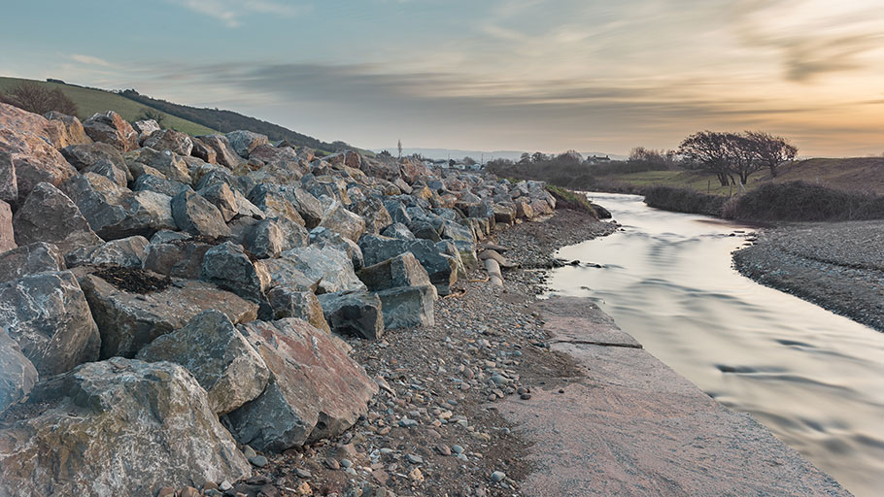
ROCK ARMOUR
Description
Piles of large boulders placed at the foot of a cliff. The rock force waves to break, absorbing their energy and protecting the cliffs.
Cost
Approximately £1000-£4000 per metre
Advantages | Disadvantages
Quite cheap and easy to look after Can look more natural if you use rocks from the local area | Rocks can be used from other parts of the coastline or even from abroad. (Can be expensive to transport.) They look unnatural and are not very attractive Make it more difficult for people to access the beach.

Slide 4
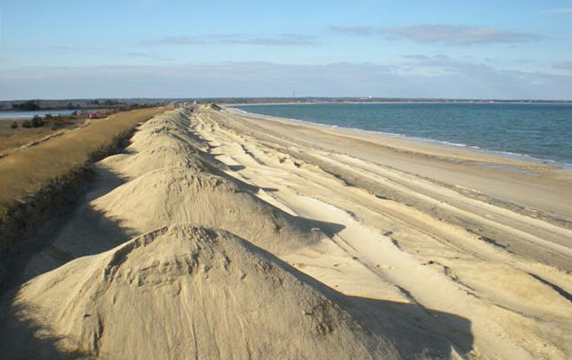
BEACH
NOURISHMENT
Description
Adding sand to a beach to make it higher or wider. If the beach is wider it protects the coastline from the erosion caused by the waves. The material is usually from local areas so that it blends in with the existing beach material.
Cost
Approximately £3000 per metre
Advantages | Disadvantages
Quite cheap Blends in with existing beach A bigger beach can attract more tourists | Needs to be constantly done unless structures are built to retain the beach such as groynes.

Slide 5
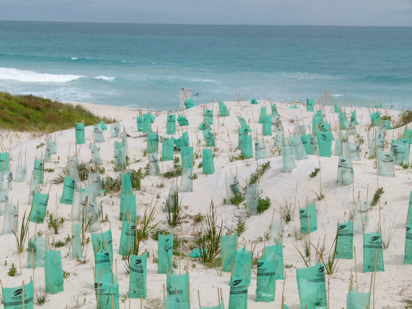
DUNE REGENERATION
Description
Sand dunes are good at stopping the waves from attacking the coast but they are easily damaged, especially by walkers. Tall grass can be planted to stabilise the dunes and help them grow. Areas can be fenced to keep people off newly planted dunes
Cost
Approximately £2000 per 100m
Advantages | Disadvantages
Keeps a natural costal environment that is popular with wildlife and people. Quite cheap | Takes a lot of time to plant the grass and fence of areas. People do not like being stopped from accessing certain areas Can be damaged by storms.

Slide 6
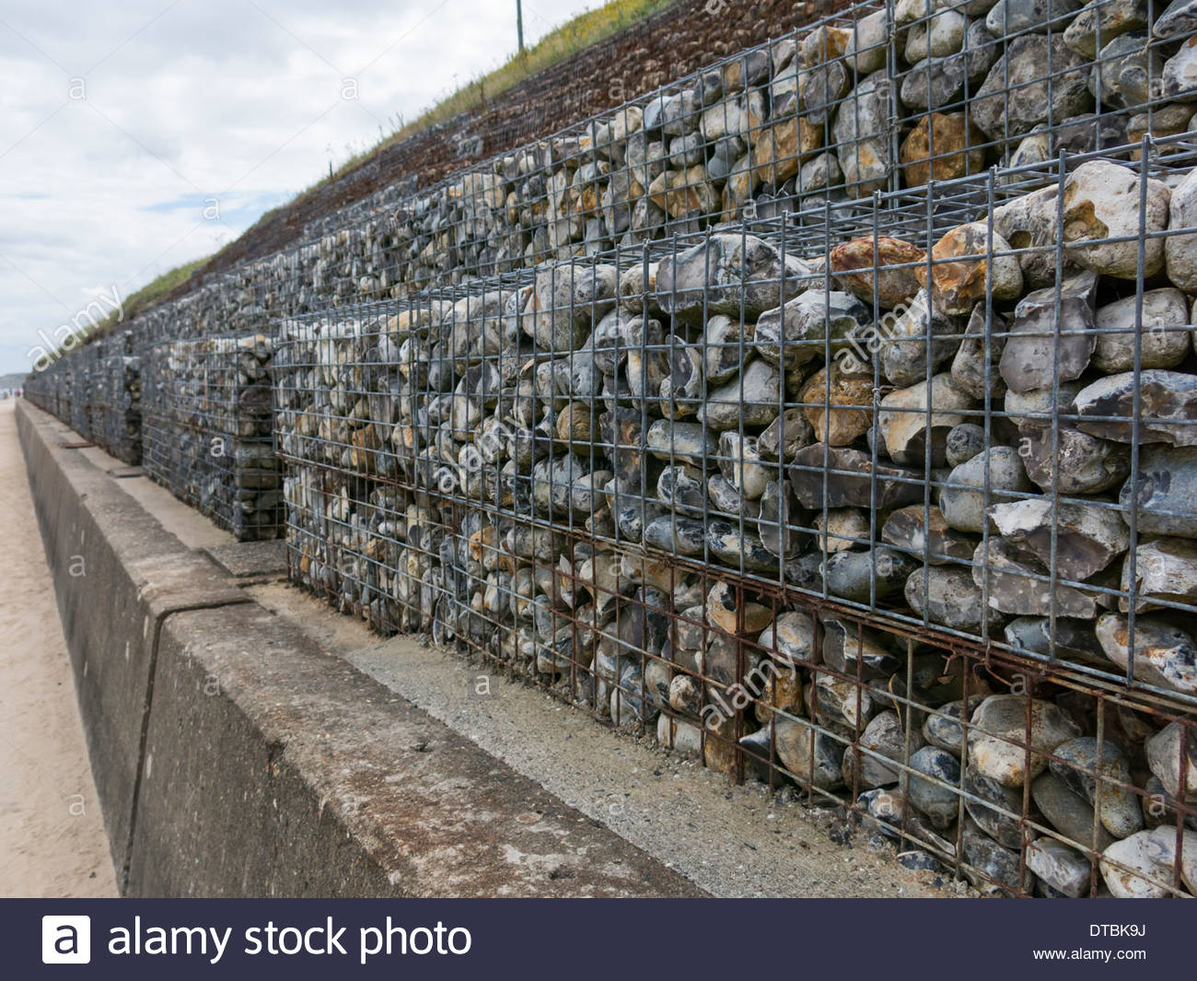
GABIONS
Description
Cages of boulders built into the cliff face consisting of smaller rocks. These small rocks help to absorb the wave energy and stop the waves from attacking the land.
Cost
Approximately £350 per metre.
Advantages | Disadvantages
Effective where severe erosion is taking place. Cheaper than a sea wall | Ugly (usually used in very large numbers) Unnatural Eventually need replacing when the small rocks have been eroded too much
Notes:
Use this as a bonus sea defences.

