Slide 1
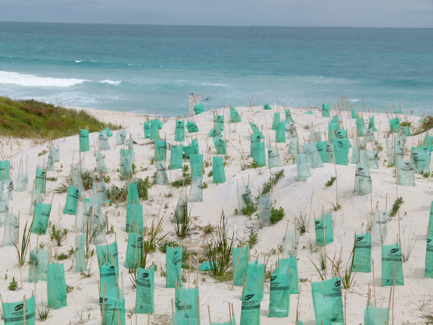
Dune Regeneration
Dune regeneration is soft engineering because it is natural and sustainable.
This defence works by planting grass and shrubs on top of the sand. By doing this the sand is trapped in the roots and will not be moved away by the waves (long shore drift).
Positive things about this defence is that it is relatively cheap and it looks very natural. Negatives include that it takes a long time to plant the grass/shrubs and they can be easily damaged.

Slide 2
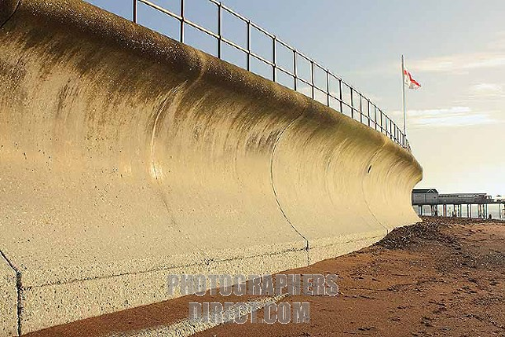
Sea Wall
A sea wall is an example of hard engineering because it is a big, expensive man-made structure which is unnatural.
This defence works by building a huge curved wall in front of the coast line so that the waves will hit this and not the land. The wall is curved in order to send the waves back to the sea more gently.
Positive things about this defence are that it protects the land from erosion and can be used by tourists to walk along. Negatives include that it is very expensive and can look very unnatural. It also takes a lot of time and money to look after.

Slide 3
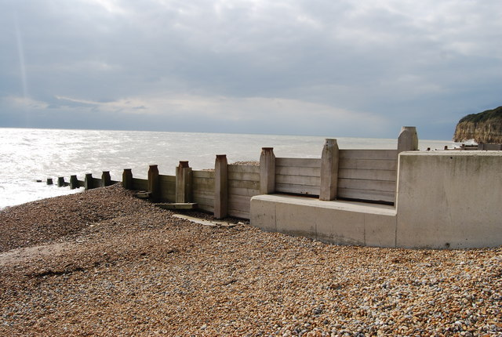
Groynes
Groynes are an example of hard engineering because they are man made and unnatural.
This defence works by building groynes (a bit like fences) vertically down the beach in order to trap the sand. This stops longshore drift from moving the sand away. As the beach gets bigger it protects the upper part of the coast from erosion.
Positive things about this defence are that it’s quite a cheap form of hard engineering and people can use the groynes for fishing. Also, because they make the beach bigger it can attract more tourists. Negatives include that some people think the groynes are ugly and ruin the look of the beach. Also, the groynes stop sand travelling down the coast which makes beaches further down much smaller!

Slide 4
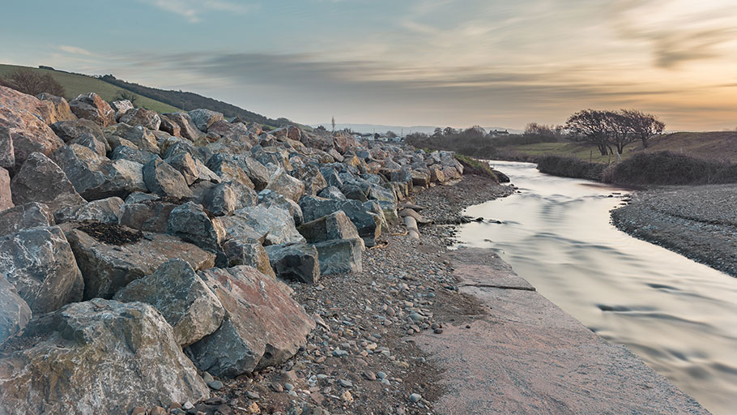
Rock Armour
Rock armour is an example of hard engineering because they are man made and unnatural.
This defence works by placing huge rocks at the bottom of the cliffs so that the waves cannot attach (and erode) the coast.
Positive things about this defence are that it is relatively cheap and easy to look after. It can also look more natural if rocks from the local area are used. Negatives include that often rocks from other places are used which looks unnatural and is expensive to transport. The big rocks also make it very difficult to access the beach which can put off tourists.

Slide 5
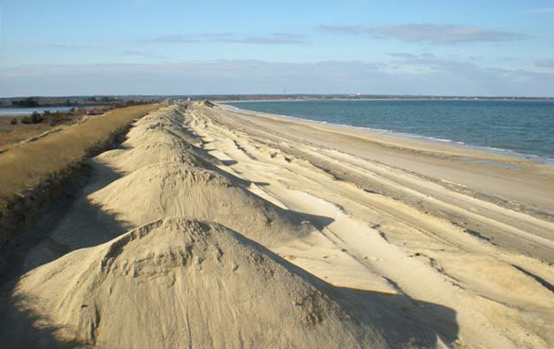
Beach Nourishment
Beach nourishment is an example of soft engineering because it is completely natural.
This defence works by placing huge rocks at the bottom of the cliffs so that the waves cannot attack (and erode) the coast.
Positive things about this defence are that it is really easy to do and relatively cheap. It also looks completely natural and makes the beach bigger which pleases tourists. Negatives include that, because the waves will continue to remove the sand, the process has to be repeated over and over again to keep the beach full. This will become very expensive in the long run.

Slide 6
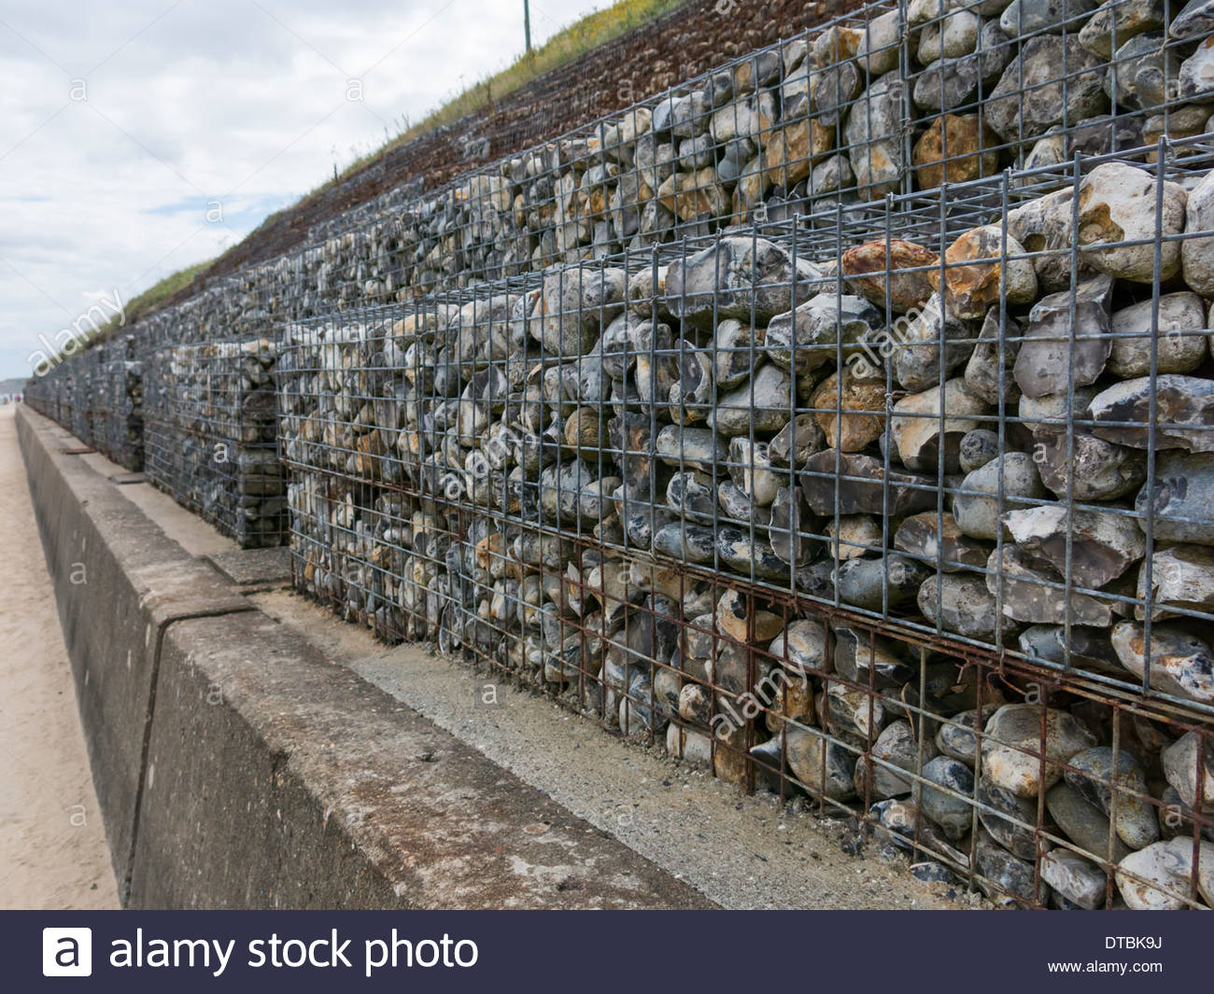
Gabions
Gabions are an example of hard engineering because they are man made and unnatural.
This defence works by creating cages filled with small rocks. The water hits the cages instead of the coastline and so it erodes the rocks inside the cages and not the land.
Positive things about this defence are that it is effective at protecting the coast and is much cheaper than building a sea wall. Negatives include that lots of people think gabions are unattractive and ruin the look of the coast because they are so unnatural. They also need to be replaced more often than a sea wall as the small rocks inside the cages will erode more quickly.

