Slide 1
Living at The Coast
Identify some impacts of living near to a coast…
Invent your own method to tackle the problems
Compare and contrast your inventions with what is actually used

Slide 2
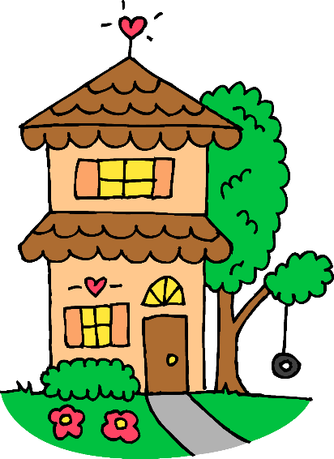
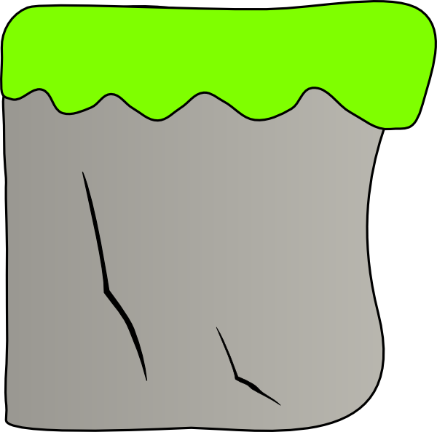
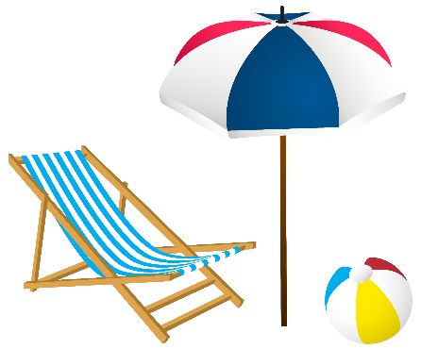

Identify some impacts of living near to a coast…

Slide 3
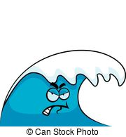
Identify some impacts of living near to a coast…

Slide 4
Identify some impacts of living near to a coast…

Slide 5
Identify some impacts of living near to a coast…

Slide 6
Your task:
Invent your own method to tackle the problems
Draw your own cliff, beach and house…
Then, come up with at least 3 different ways you are going to protect your home/beach
Add labels to explain how they would protect your land/house
Think about:
- How could you stop long shore drift or at least slow it down?
- How could you reduce the amount of erosion happening to the cliff?

Slide 7
Compare and contrast your inventions with what is actually used
Look at the images of real life coastal defences
Are any of them similar to what you invented?
Are they completely different?
How do you think they work??? This will be next week’s lesson!

Slide 8
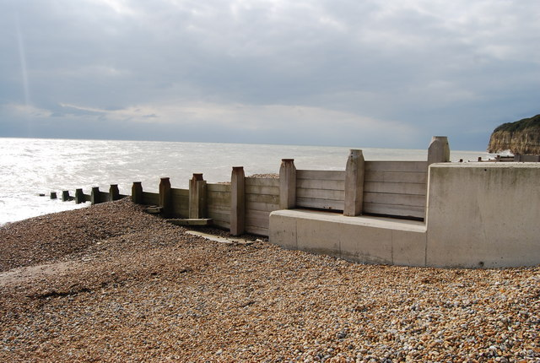
GROYNES
Notes:
Groynes

Slide 9
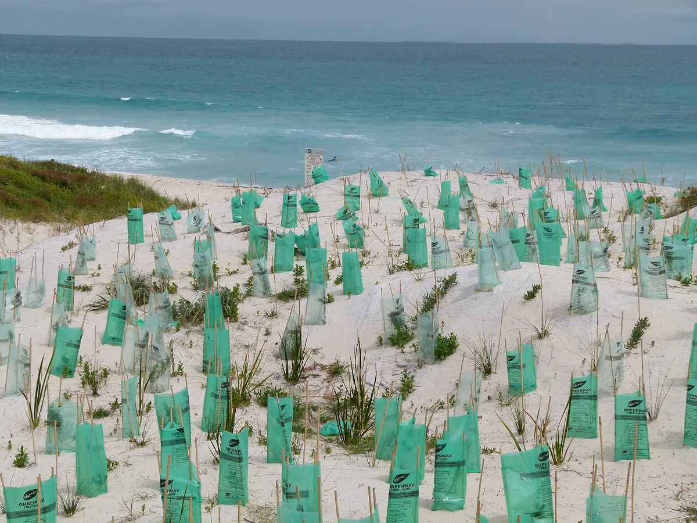
DUNE REGENERATION
Notes:
Dune regeneration

Slide 10
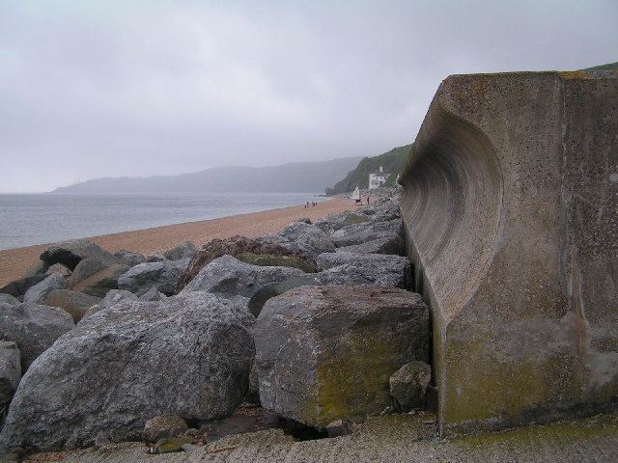
SEA WALL
Notes:
Sea Wall

Slide 11
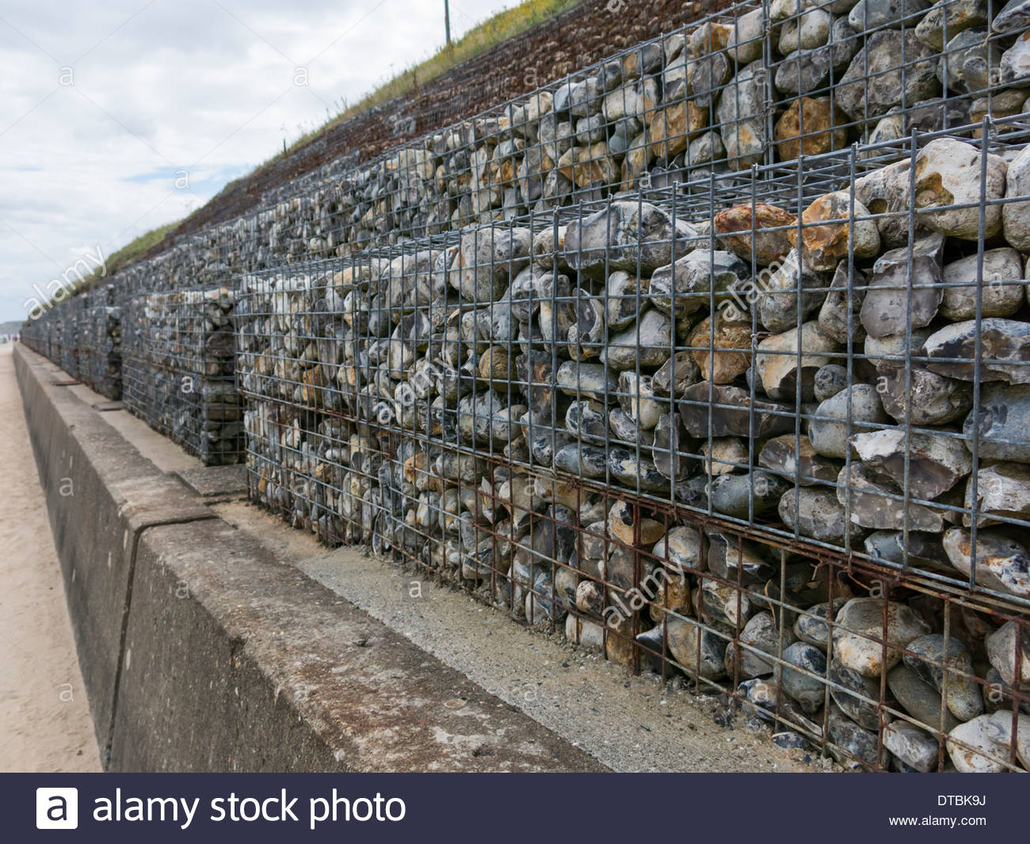
GABIONS

Slide 12
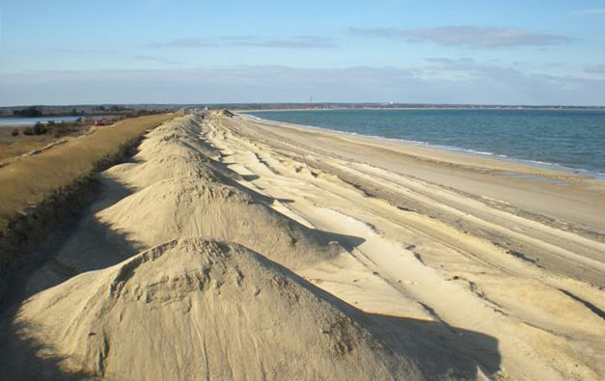
BEACH NOURISHMENT
Notes:
Beach nourishment

Slide 13
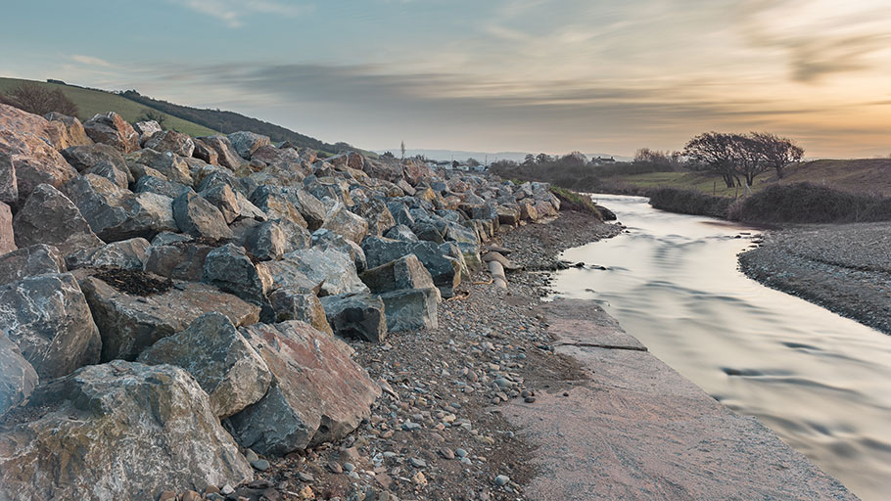
ROCK ARMOUR
Notes:
Rock Armour

