Slide 1
A Water Crisis?
Understand that there is only so much water in the world
Explain the two problems which could cause a water shortage
Recommend ways in which people could use less water

Slide 2
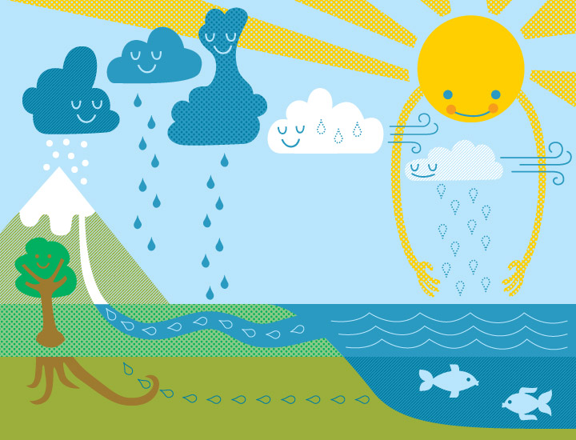
The water cycle always has the same amount of water in it, whether it is in the clouds, in the seas and rivers, in the air as vapour etc.
Understand that there is only so much water in the world

Slide 3


The two problems…
Explain the two problems which could cause a water shortage
POPULATION… | GLOBAL WARMING
What is population?
What is global warming?

Slide 4



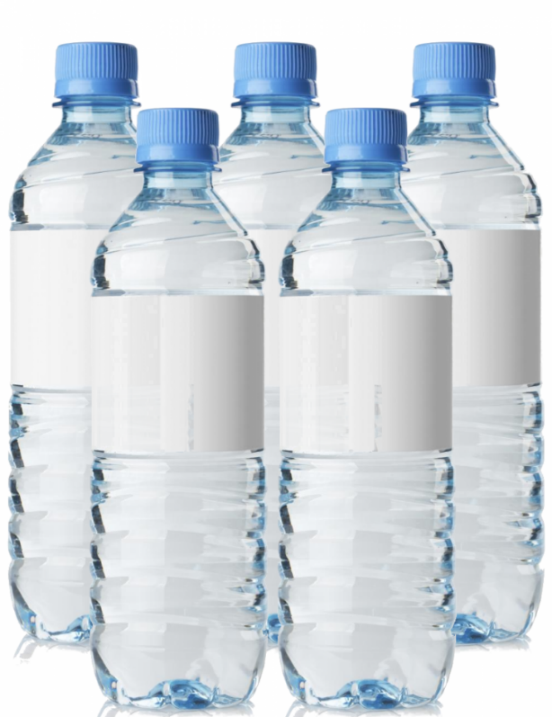
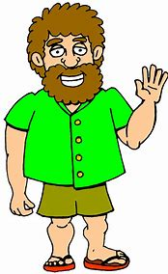

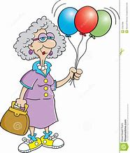
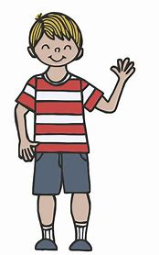
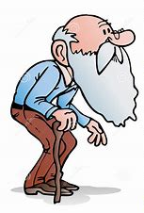
Population is the amount of people:
Imagine this is all the water we have, can you see a problem?

Slide 5
The amount of water we have always stays the same, but, the amount of people there are in the world is getting bigger and bigger…

Slide 6
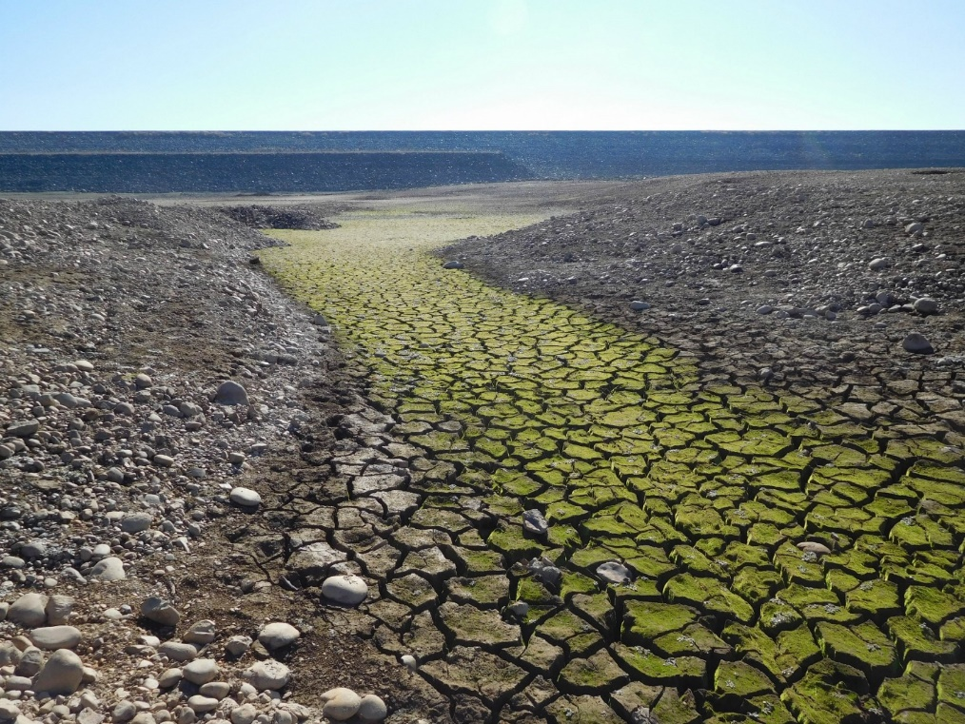
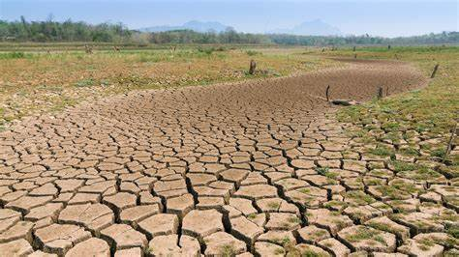
Explain the two problems which could cause a water shortage
Global Warming…
What used to be in the pictures? Where has it gone?
Killer Question: If the water is drying up, where does it go? What sort of weather might this give us that could cause lots of problems?

Slide 7
Global warming means the planet is getting hotter each year. This means water sources such as rivers, lakes etc. dry up more quickly during the summer months (when we need the most water!)
Killer Answer: The water is drying up because more evaporation is happening because of the hotter climate. This will mean there is more condensation which means more clouds! This will eventually mean more rainfall at one time which would increase the chance of a flood!

Slide 8
Population + Climate Change=
More people relying on less and less water
This is called a water shortage

Slide 9
Watch the short video:
Explain the two problems which could cause a water shortage
https://www.bing.com/videos/search?q=water+shortages&adlt=strict&view=detail&mid=318B0D6E5C3D79652BFC318B0D6E5C3D79652BFC&&FORM=VRDGAR
Make some notes about what you find out…

Slide 10
Task: Create a poster to help people understand the water crisis and what they could do to help!
Recommend ways in which people could use less water
 | Success Criteria:
Dev | Explain/show that there will always be the same amount of water in the world
Secure | Explain/show the two reasons why the world might not have enough water for everyone
Secure Plus | Recommend things that people can do to save water!

