Slide 1
Flooding
Describe how flooding occurs
Explain some of the factors which may increase flooding
Analyse and evaluate flood risks

Slide 2
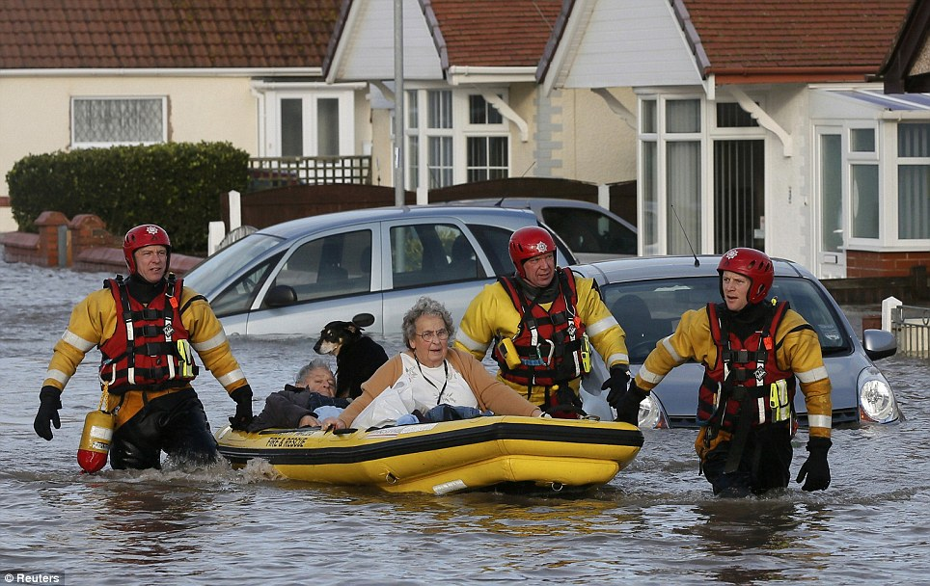
Ask 5 questions about this picture…
WHEN?
WHO?
WHY?
WHAT?
WHERE?
HOW?

Slide 3
What is a flood?
An overflow of a large amount of water beyond its normal limits, especially over what is normally dry land.
Describe how flooding occurs

Slide 4
How do floods happen?
Look at the stages shown on the next slide.
Try to put them in a sensible order to show how a flood would happen…
Describe how flooding occurs

Slide 5

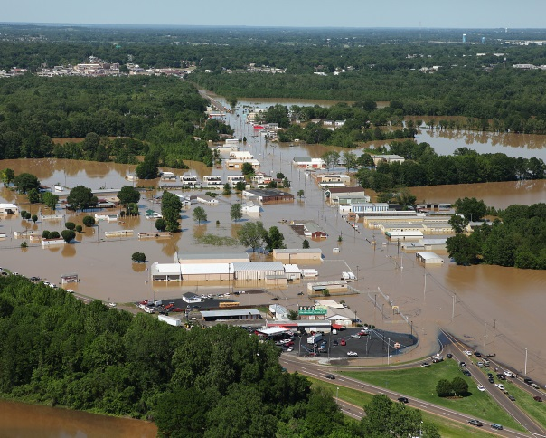

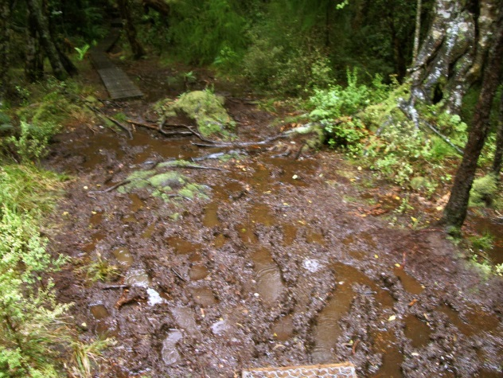
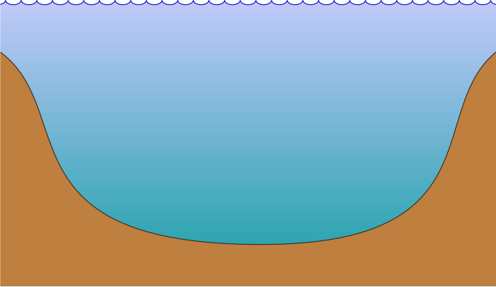
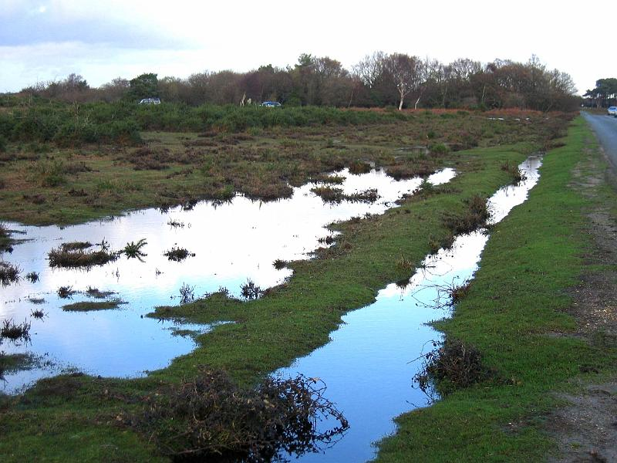
The river can no longer hold the water and it floods over land which is usually dry | The water reaches the river far more quickly than usual | Heavy rain, or lots and lots of rain
The level of the river rises very quickly | The water soaks into the ground | The water can no longer soak into the ground so travels over the land (surface water)

Slide 6
How did you do?
Let’s go through the stages in order…
Describe how flooding occurs

Slide 7
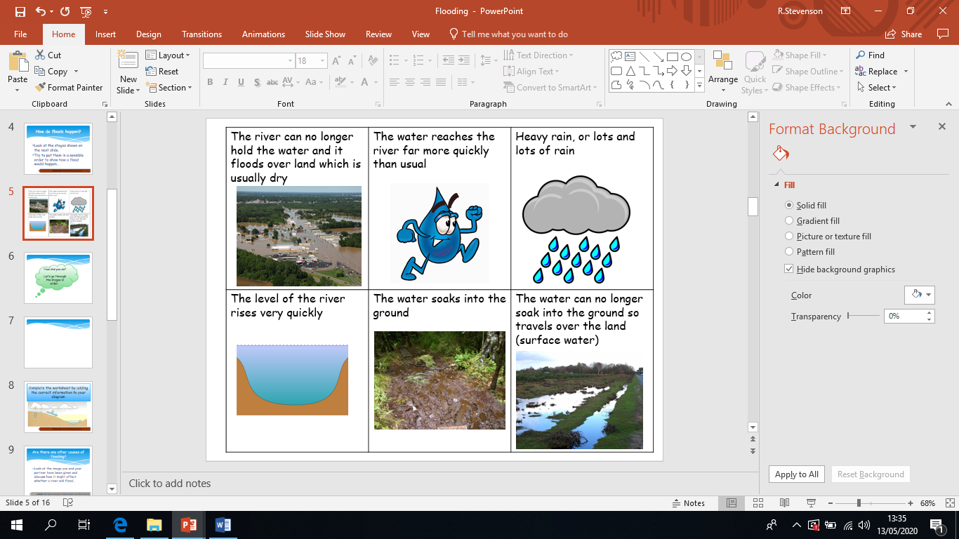
Flooding will happen if we have an unusually high amount of rain, or if it keeps on raining for a long time…
Describe how flooding occurs

Slide 8
When rain water falls on the ground, it will always try to soak into the ground (creating ground water)
Describe how flooding occurs

Slide 9
When the ground gets full of water no more water can possibly soak in (we say the ground is saturated).
This means that any more rain water falls onto the ground but stays on the top! This will create the big puddles like you can see in the picture.
Describe how flooding occurs

Slide 10
As you know, water does not like to stay still! So, when the water stays on top of the ground (rather than sinking underneath) it can travel much more quickly!
(Think about it- you’d get somewhere more quickly if you ran over the ground rather than having to tunnel underground!).
Don’t forget, water is always trying to get to the rivers so it can get to the seas and oceans. So, this means the water gets to the river far more quickly.
Describe how flooding occurs

Slide 11
As the water is getting to the river so quickly, the river gets more and more full! This makes the water level rise higher and higher.
Describe how flooding occurs

Slide 12
If the river gets too full of water, it will burst it’s banks which means that the water will escape from the river! We call this a flood.
Describe how flooding occurs

Slide 13
Test your knowledge: Developing
Complete worksheet 1
You need to explain the stages of a flood in each of the boxes

Slide 14
Are there any other causes of flooding?
Look at the images on the following slides.
Try to think about how everything you see might make a river flood more…
Explain some of the factors which may increase flooding

Slide 15
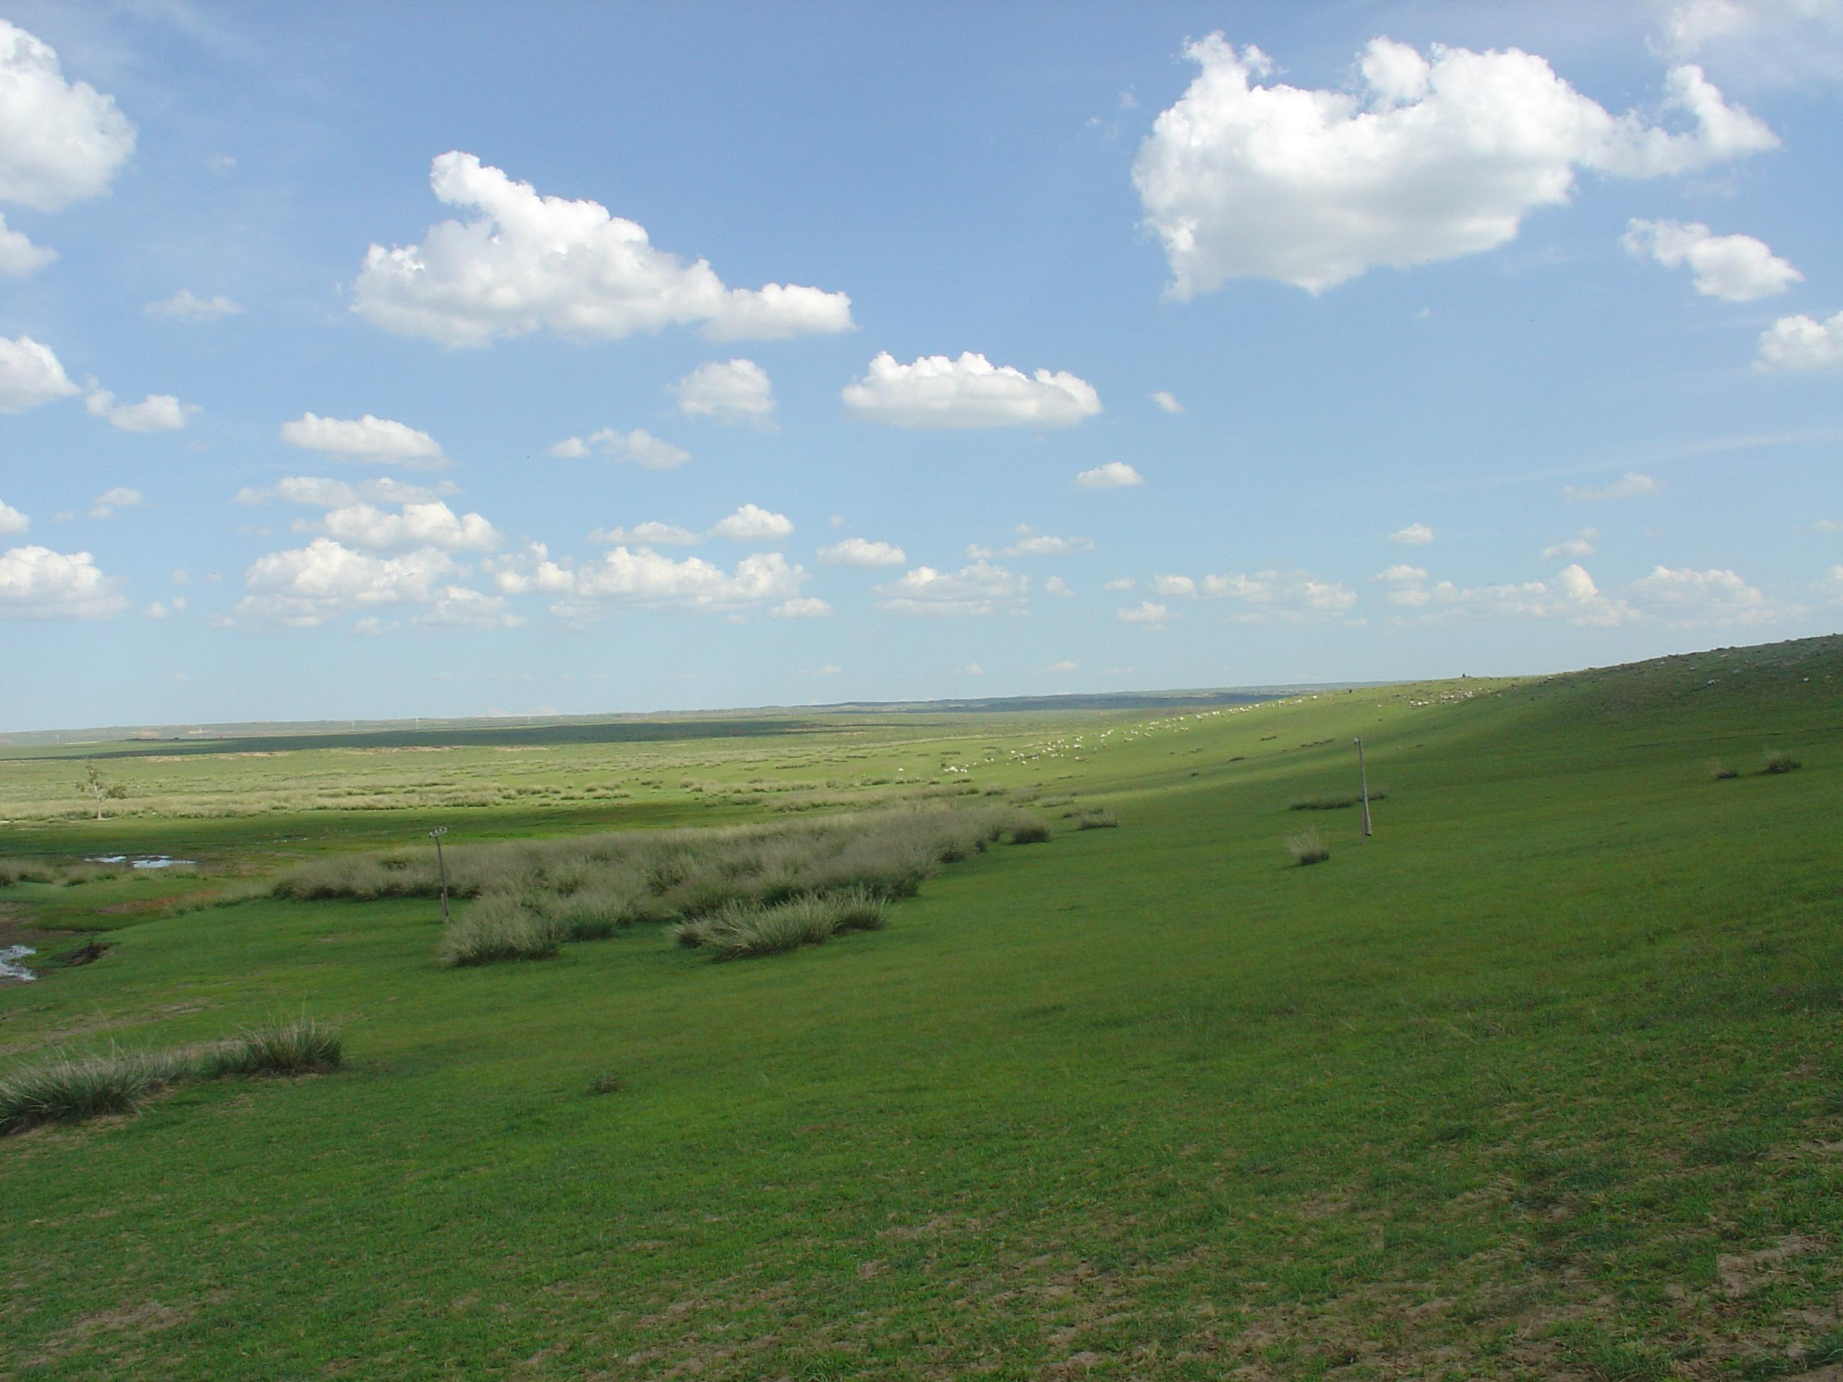
Explain some of the factors which may increase flooding
A lack of vegetation (trees, bushes, plants etc.)

Slide 16

Explain some of the factors which may increase flooding
If there are very few trees, bushes and plants etc. it means there is nothing stopping or slowing the water down!
This means it gets to the river more quickly which would increase the chance of flooding.
A lack of vegetation (trees, bushes, plants etc.)

Slide 17
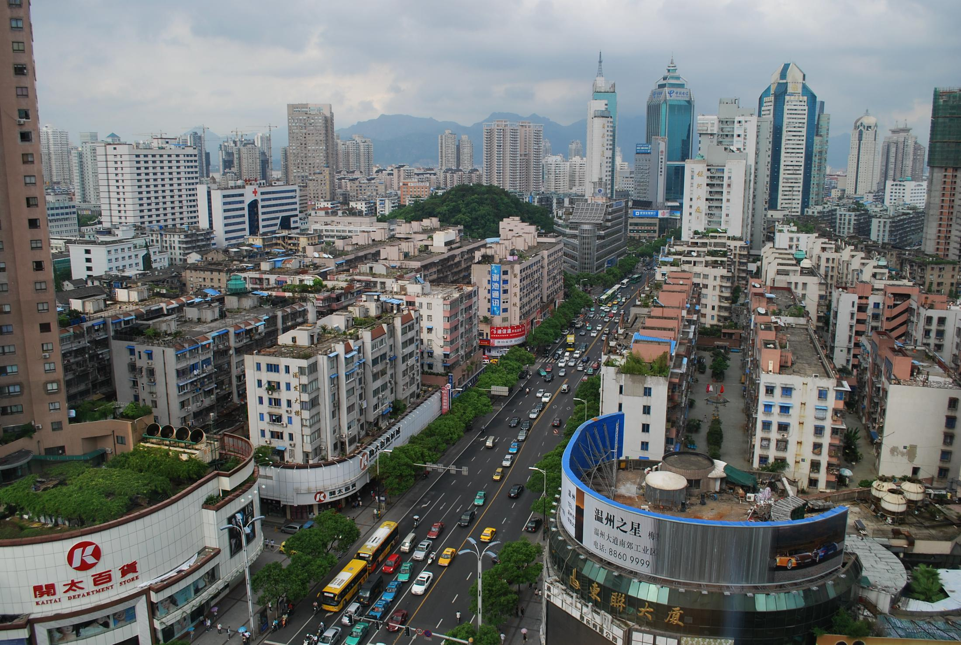
Explain some of the factors which may increase flooding
Urbanisation: The building of roads and buildings

Slide 18
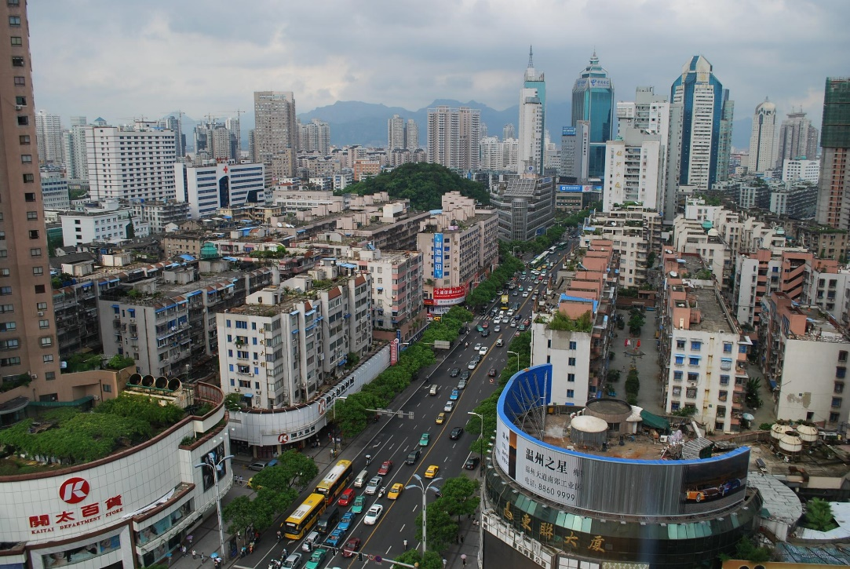
Explain some of the factors which may increase flooding
If people cover the land with concrete, the water cannot soak into the ground! So, it will have to go overground.
This means it gets to the river more quickly which would increase the chance of flooding.
Urbanisation: The building of roads and buildings

Slide 19
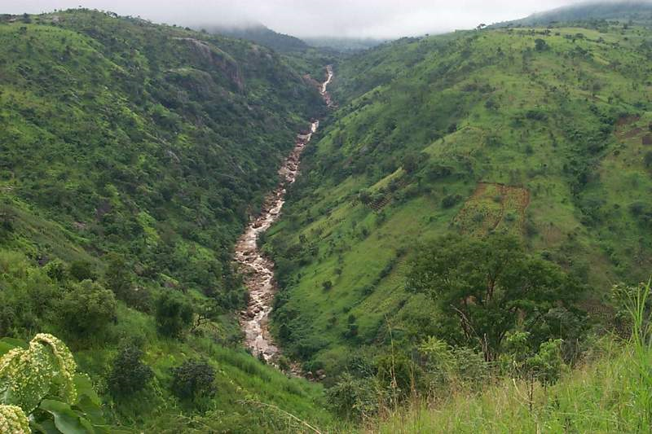
Explain some of the factors which may increase flooding
Steep slopes

Slide 20
Explain some of the factors which may increase flooding
Things travel more quickly down hills (including water).
This means it gets to the river more quickly which would increase the chance of flooding.
Steep slopes

Slide 21
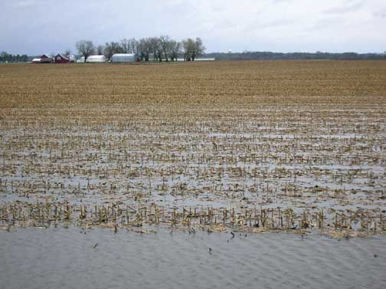
Explain some of the factors which may increase flooding
Very wet soil

Slide 22
Explain some of the factors which may increase flooding
If the ground is already full (remember we call that saturated) no more water can soak in, so it travels over ground.
This means it gets to the river more quickly which would increase the chance of flooding.
Very wet soil

Slide 23
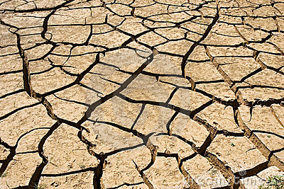
Explain some of the factors which may increase flooding
Very dry soil

Slide 24
Explain some of the factors which may increase flooding
If the ground is extremely dry, like in the picture, the ground acts a bit like concrete which means it is too hard for the water to soak into it!
This means it gets to the river more quickly which would increase the chance of flooding.
Very dry soil

Slide 25
The next two images are a little more tricky-
if you can work it out you’re definitely working at secure+

Slide 26
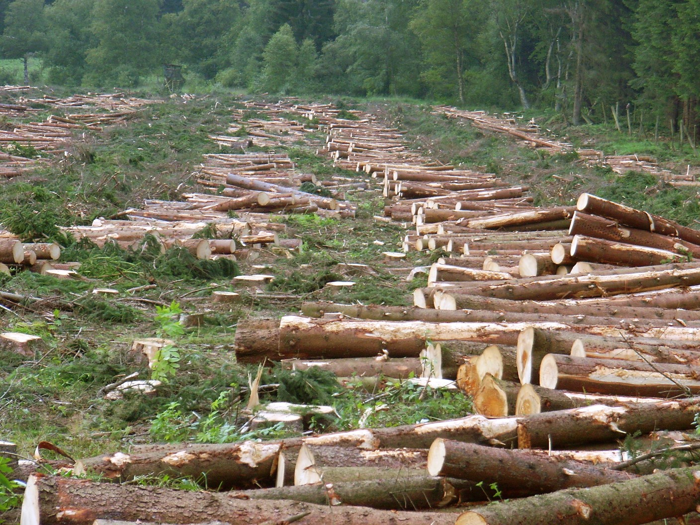
Explain some of the factors which may increase flooding
Deforestation

Slide 27
Explain some of the factors which may increase flooding
Deforestation means when people cut down the trees! If people cut down the trees there is nothing stopping the water from reaching the river! Trees act as a block to slow the rain, but they also use the water from themselves and soak it up trough their roots. Without trees there is more water getting to the river more quickly which would increase the chance of flooding.
Deforestation

Slide 28
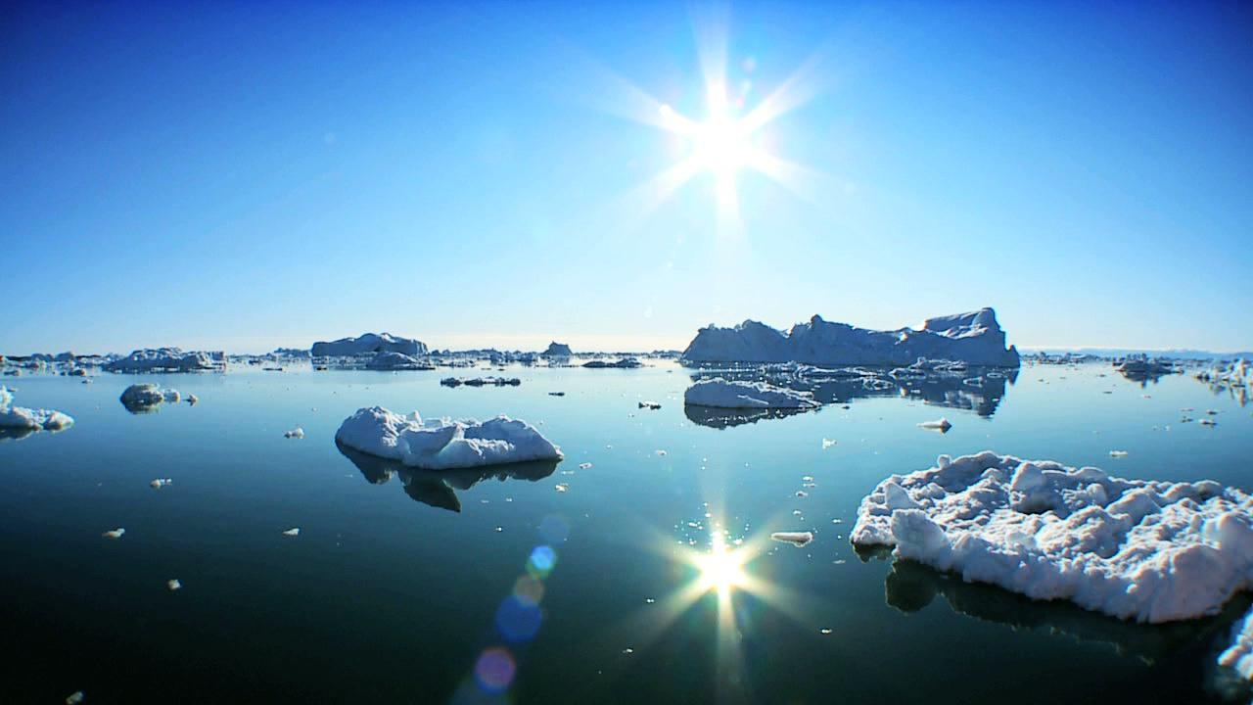
Explain some of the factors which may increase flooding
Climate Change: Global Warming

Slide 29
Explain some of the factors which may increase flooding
Climate change is being caused by people creating harmful gases. These gases make the world’s temperature warmer. This isn’t very good for the polar ice caps as it causes them to melt. If the ice melts there is more water in the water cycle. This will increase flooding.
Climate Change: Global Warming

Slide 30
Test your knowledge: Secure
2) Explain at least 4 factors which could increase the likelihood that a river will flood.

Slide 31
Stretch and Challenge Task:
Physical: something that happens naturally
Human: something that is man-made, or which humans cause
Physical Factors | Human Factors
Task: Add the 7 factors that increase flooding to the table in the correct column, then check your answers on the next slide…

Slide 32
Stretch and Challenge Task:
Physical: something that happens naturally
Human: something that is man-made, or which humans cause
Physical Factors | Human Factors
Very wet soil Very dry soil Steep slopes A lack of vegetation | Climate change Deforestation Urbanisation
How did you do?

Slide 33
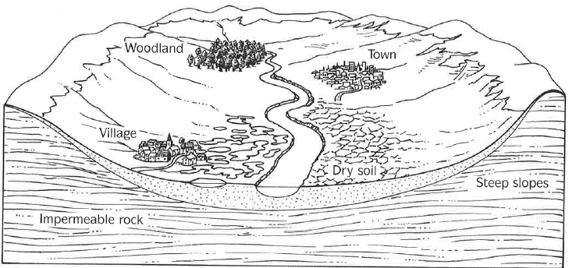
Test your knowledge: Secure+
3) Analyse the image below to find factors that will effect flooding:
You can describe at least 2 factors that will effect flooding.
You can explain at least 2 physical and 2 human factors that will effect flooding.
You can evaluate the flood risk, explaining at least 5 factors but you must include one factor which would reduce the risk of flooding!

