Slide 1
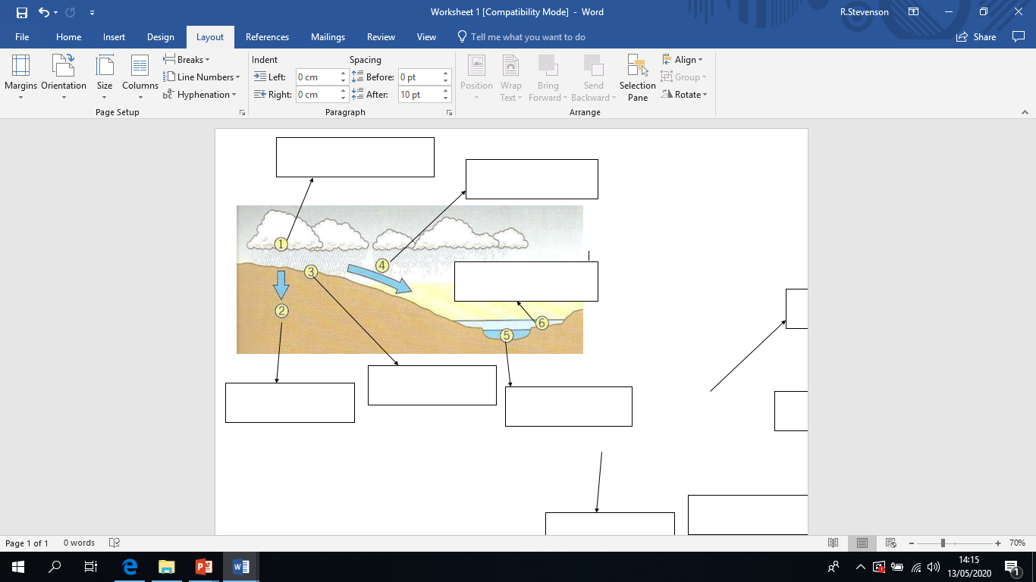
Test your knowledge: Developing
Heavy rain, or lots and lots of rain
The water travels over ground much more quickly
If the river gets too full it will flood
The water can no longer soak into the ground so it stays on top of the ground
The rain water soaks into the ground
The level of the river rises quickly

Slide 2
Test your knowledge: Secure
2) Explain at least 4 factors which could increase the likelihood that a river will flood.

Slide 3
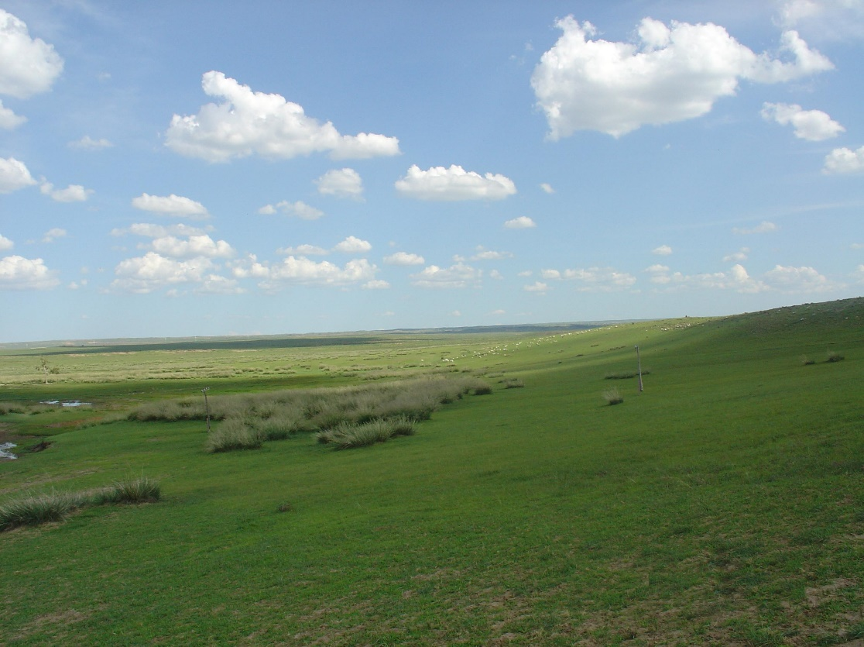
Consider the human and physical features which can affect flooding
If there are very few trees, bushes and plants etc. it means there is nothing stopping or slowing the water down!
This means it gets to the river more quickly which would increase the chance of flooding.
A lack of vegetation (trees, bushes, plants etc.)

Slide 4
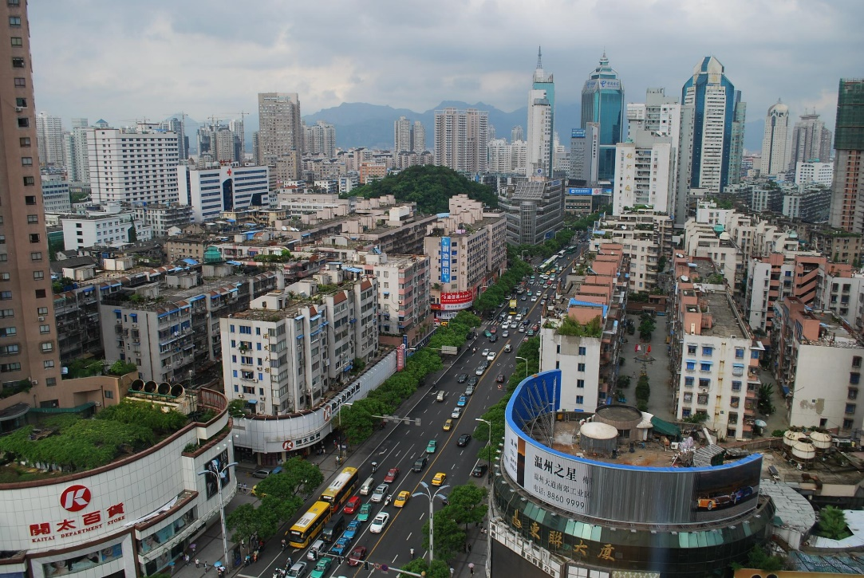
Consider the human and physical features which can affect flooding
If people cover the land with concrete, the water cannot soak into the ground! So, it will have to go overground.
This means it gets to the river more quickly which would increase the chance of flooding.
Urbanisation: The building of roads and buildings

Slide 5
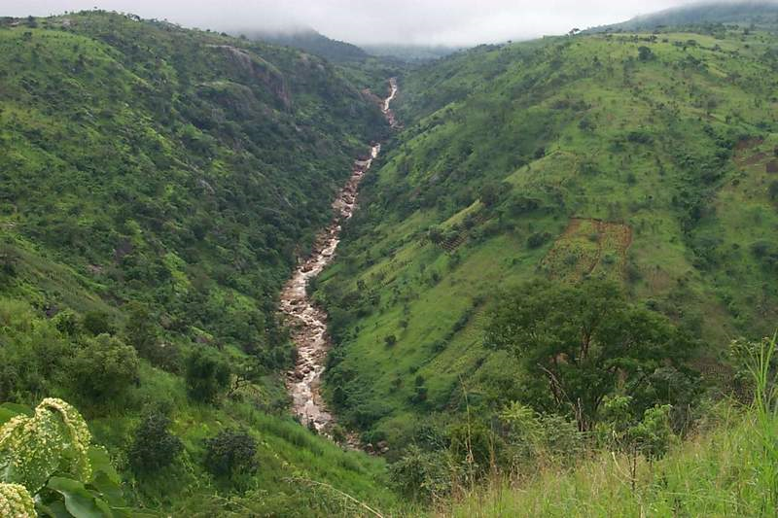
Consider the human and physical features which can affect flooding
Things travel more quickly down hills (including water).
This means it gets to the river more quickly which would increase the chance of flooding.
Steep slopes

Slide 6
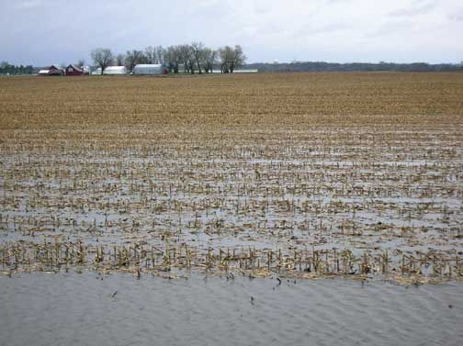
Consider the human and physical features which can affect flooding
If the ground is already full (remember we call that saturated) no more water can soak in, so it travels over ground.
This means it gets to the river more quickly which would increase the chance of flooding.
Very wet soil

Slide 7
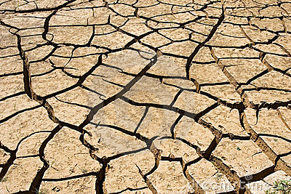
Consider the human and physical features which can affect flooding
If the ground is extremely dry, like in the picture, the ground acts a bit like concrete which means it is too hard for the water to soak into it!
This means it gets to the river more quickly which would increase the chance of flooding.
Very dry soil

Slide 8
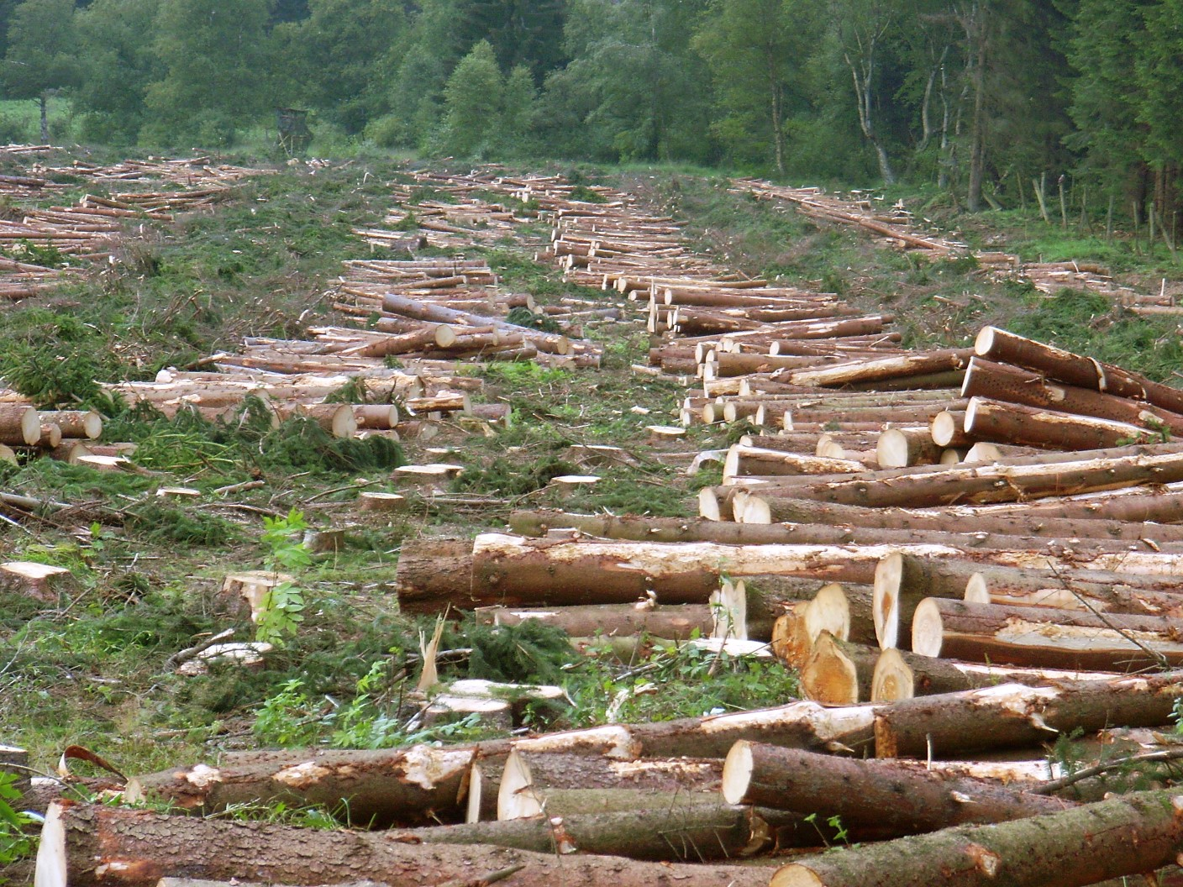
Consider the human and physical features which can affect flooding
Deforestation means when people cut down the trees! If people cut down the trees there is nothing stopping the water from reaching the river! Trees act as a block to slow the rain, but they also use the water from themselves and soak it up trough their roots. Without trees there is more water getting to the river more quickly which would increase the chance of flooding.
Deforestation

Slide 9
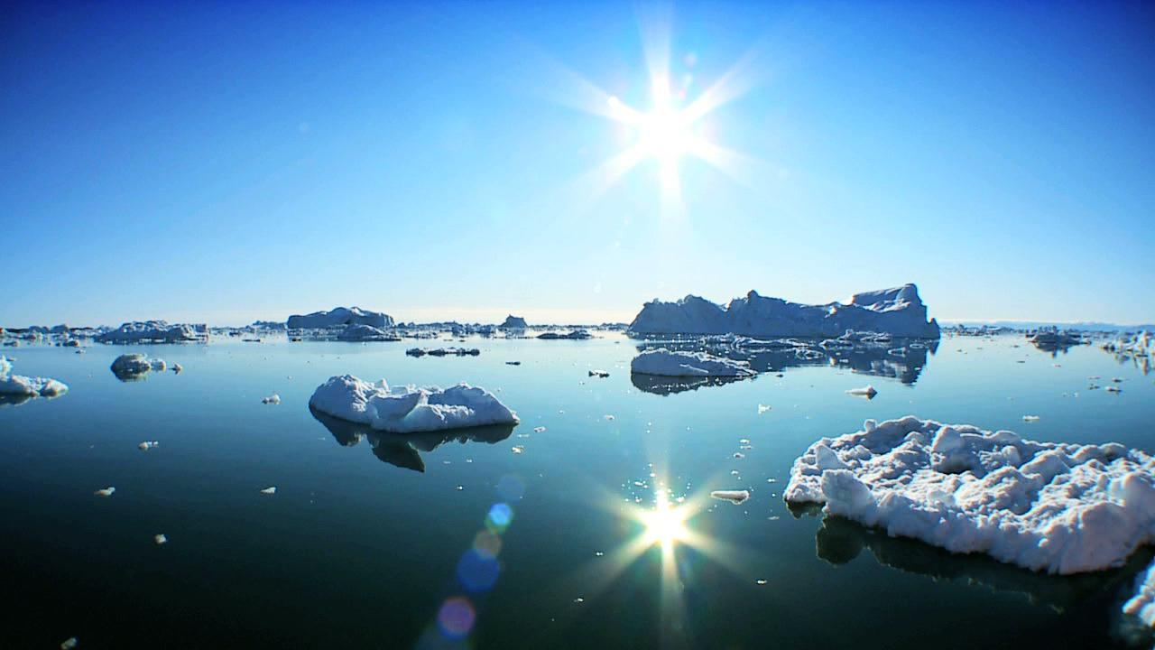
Consider the human and physical features which can affect flooding
Climate change is being caused by people creating harmful gases. These gases make the world’s temperature warmer. This isn’t very good for the polar ice caps as it causes them to melt. If the ice melts there is more water in the water cycle. This will increase flooding.
Climate Change: Global Warming

Slide 10
Test your knowledge: Secure+
The town and village (human): this is urbanisation which means the concrete will stop the water getting into the ground so it will travel over ground to the river more quickly, increasing the chance of flooding.
The very dry soil (physical) will act like concrete and not let the water soak in so it will travel to the river more quickly, increasing the chance of flooding.
Next to the village you can see big puddles. This means the ground is very wet (physical) and possibly saturated. This would mean no more water could soak in so the water would travel quickly over the ground to the river, increasing the risk of flooding.
The steep slopes (physical) either side of the river will make the water travel very quickly to the river, increasing the chance of a flood.
The woodland (physical) in the image would actually reduce the risk of flooding as the trees would slow the water down and stop as much water reaching the river as the trees would soak some up through their roots.
Bonus: impermeable rock (physical) means rock which water cannot soak into. Therefore this would increase the risk of flooding as the water cannot soak into the ground so will travel over ground more quickly.

