Slide 1
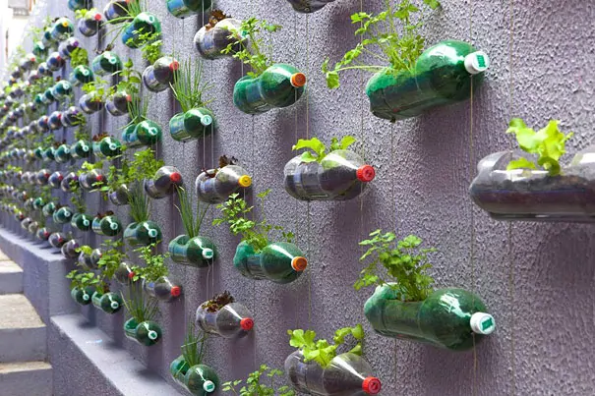
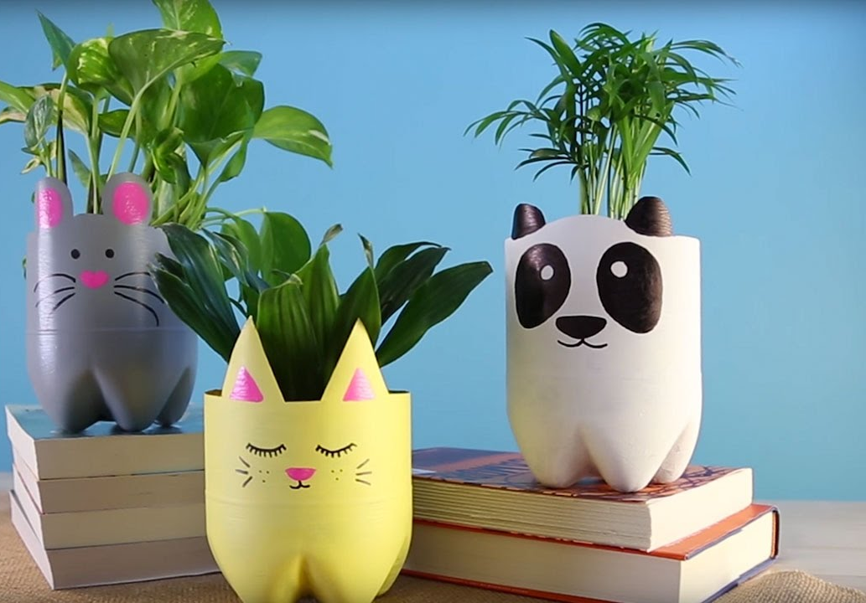
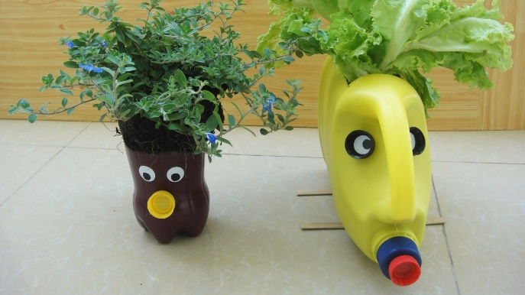
Planter Project
Lesson Objectives
To learn and apply effective research techniques.
To develop communication of ideas and apply creative thinking techniques.
To apply rapid prototyping skills to a physical model.
To evaluate effectiveness of design solutions and make improvements.

Slide 2

Research
Research is the essential starting point to any project. So first things first, what do we need to know before starting this project?
We probably need to work out the following things;
What is the impact of plastic bottles being disposed of?
why is food packaging being recycled?
Climate change.
What is sustainability?
What are the 6 r’s?
And that’s just to start!
Watch the following video clips
https://www.youtube.com/watch?v=_6xlNyWPpB8
https://www.youtube.com/watch?v=erGnf7ws20E
https://www.youtube.com/watch?v=glAPkpeKvfE

Slide 3
recycling
Not all things can be recycled, and sometimes recycling itself can harm the planet becaue of the energy needed to melt down and reform plastics.
Watch the following video
https://www.youtube.com/watch?v=-Yp1KKWpPpU
Ok, now we have a bigger picture view I want you to draw your own conclusions here; before moving to the next slide I want you to open your activity booklet – complete the first activity.

Slide 4
But why do we care?
https://www.youtube.com/watch?v=Ws81nMG290w
https://www.youtube.com/watch?v=G4H1N_yXBiA&t=3s
A huge impact on our environment is farming! There are so many people who need to eat that farming takes up an enormous amount of space taking away habitats for animals, it also uses a huge amount of chemical such as pesticides which are bad for the environment, also it uses a huge amount of water that also has a negative impact on the planet. However design technology is looking to fix these problems, check out this video below.
https://www.youtube.com/watch?v=3Ww2TP_tU7o

Slide 5
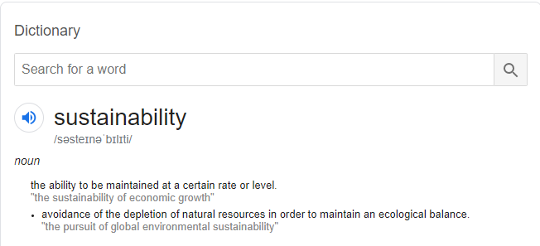
So recycling is ok? But what else can we do…
Here’s another video – the 6 R’s
https://www.youtube.com/watch?v=luE5Aeqjf1Q
In design terms, it means avoiding non renewable materials such as plastics and it also means reducing the impact the product has on the planet.
Now complete activity 2 in your work book.

Slide 6
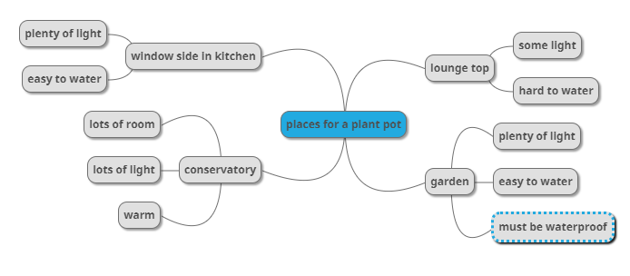
So we’ve done some basic research and now we understand the project better. But we need to do some very specific research now for our individual products.
By re-using some of our recycling materials to grow food at home we are achieving many of the 6 R’s of sustainability. Which ones do you think we are achieving?
Creating a mind map in your booklet will help you to identify were the product will go, this is important as we need to know how big the product could be and what features it might need.
Here’s an example, you can go to this website to create your own mind map and copy it into your booklet if you like. https://app.mindmup.com/

Slide 7

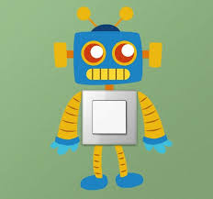

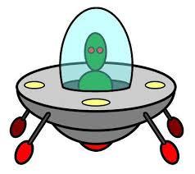
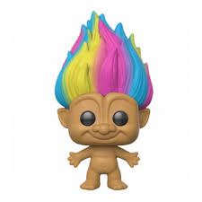
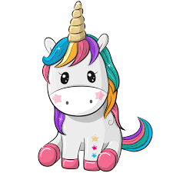
Now its time to get creative!
Not everyone can come up with ideas easily – a creative thinking technique called random input can be useful for getting ideas.
You get something random and then try to turn it into a product. Here’s a website that may help. You may need paper and a pencil or pen to complete this activity, then photograph your ideas and attach them to the ideas page in your book.
To do that you can use the camera on your phone, then email the picture to your email address and transfer it to your page. Or ask a parent for help – as long as they are not busy!
Complete your ideas page
Some random things to get you going

Slide 8
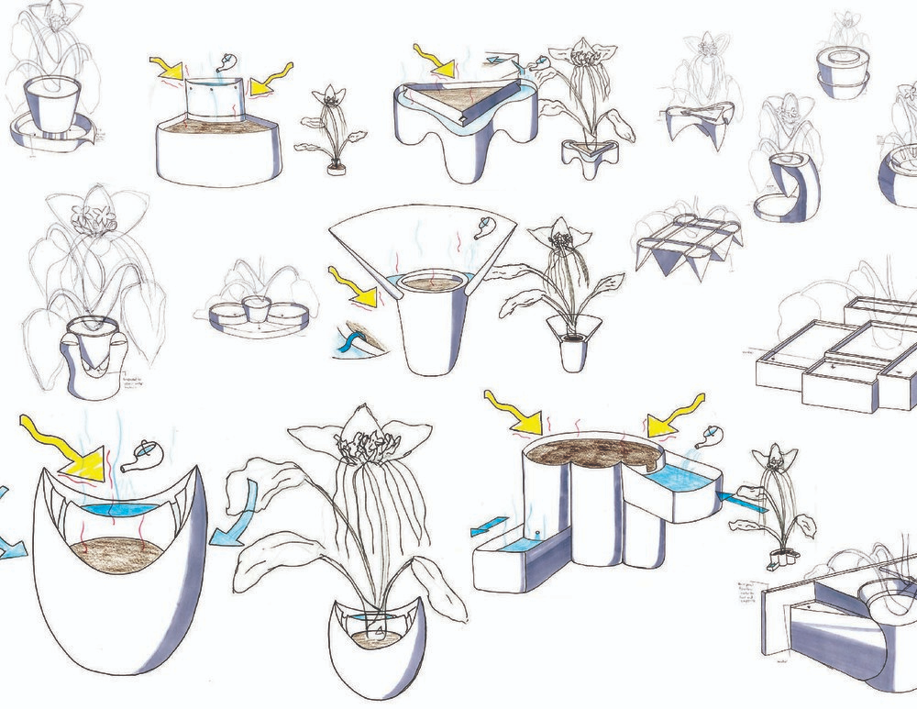
Now select one of your ideas and draw it in 3D using shading and annotations – explain why you have selected this idea.
The following videos will help you with concept sketching
https://www.youtube.com/watch?v=_uzSMAI5AuE&t=291s
https://www.youtube.com/watch?v=zPDbca83V5Y
https://www.youtube.com/watch?v=FLrCO4K2Wkw
https://www.youtube.com/watch?v=hdTTz6ZaCXs

Slide 9
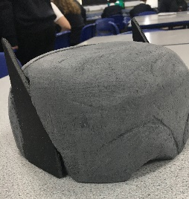
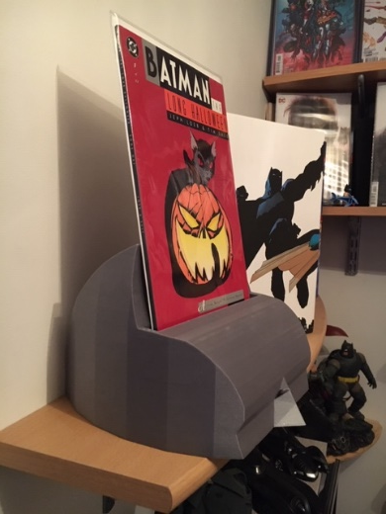
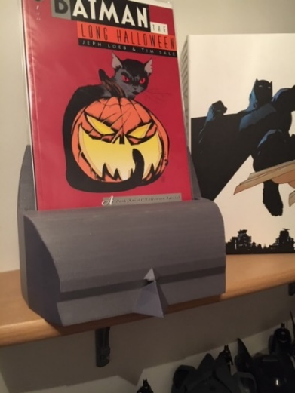
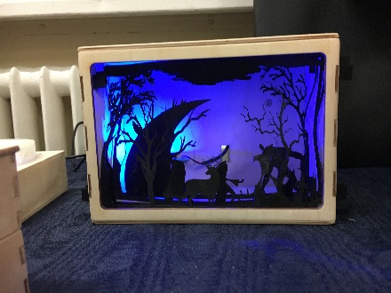
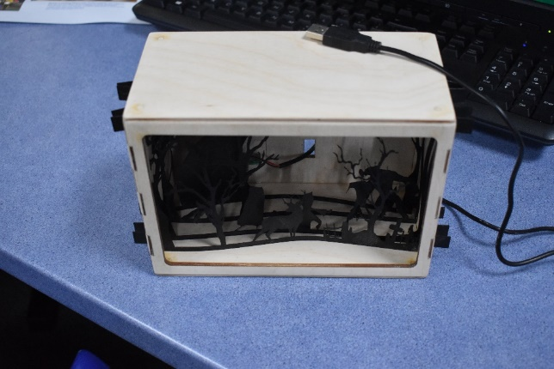
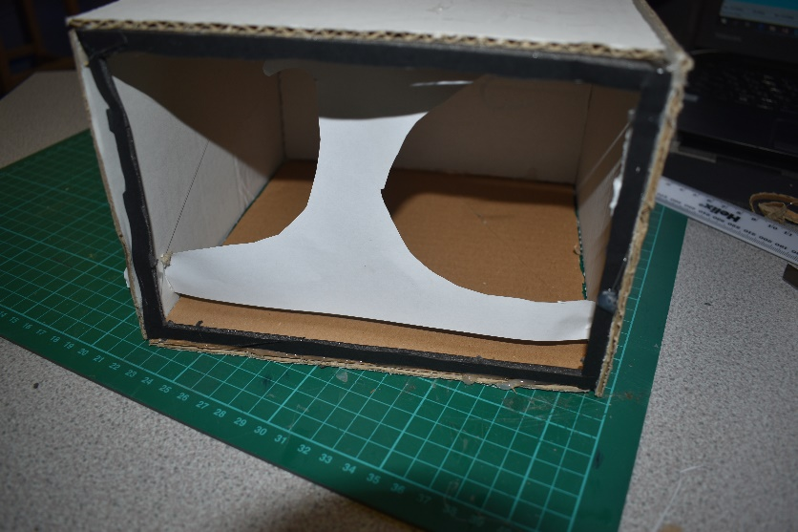
Rapid prototyping
Normally in design technology this skill would be essential to go on and lead to high quality products check out these examples!!
However in our case, the final material is the recycling, so we need find what we've got to work with and how we could use the shapes already there to help us.

Slide 10
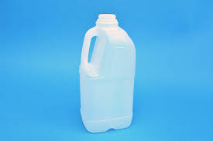
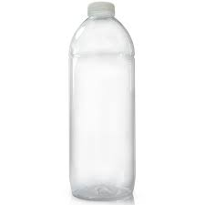
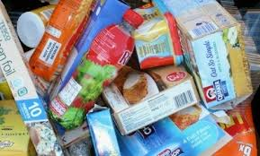
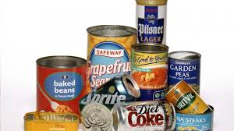
So now you’ve gathered your recycling you may have items such as the following. Your job now is to use scissors carefully! And tape of any kind to start creating your plant pots.
Things to consider;
Is the material waterproof?
Can you hold soil and water in it?
Can it be decorated?
https://www.youtube.com/watch?v=OJJvghf1E7A
This video might help
Plastic bottles | Good for holding soil and waterproof, good shape for rockets, minions etc.
cans | Good for holding soil and water, good for small pots.
tins | Good for holding soil and water medium sized pots
cardboard | Good for decorating the outsides with shapes and features.
You should test the materials first before using them

Slide 11
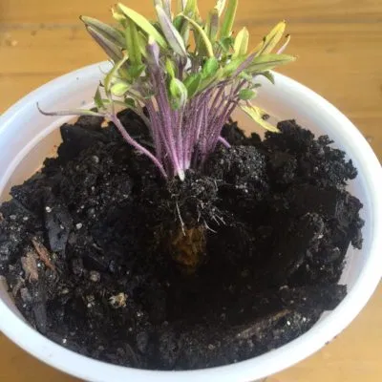
So, now its time to test and evaluate your product!
You need to get some soil and pop it in your plant pot. Then if you have seeds pop them in, if you have just 1 tomato then that will work also.
https://www.gardeningknowhow.com/edible/vegetables/tomato/planting-tomato-slices.htm
This article explains how a tomato sliced can grow into a plant.
So you now need to plant the seeds and water them. That’s it! At least for a few days anyway!

Slide 12
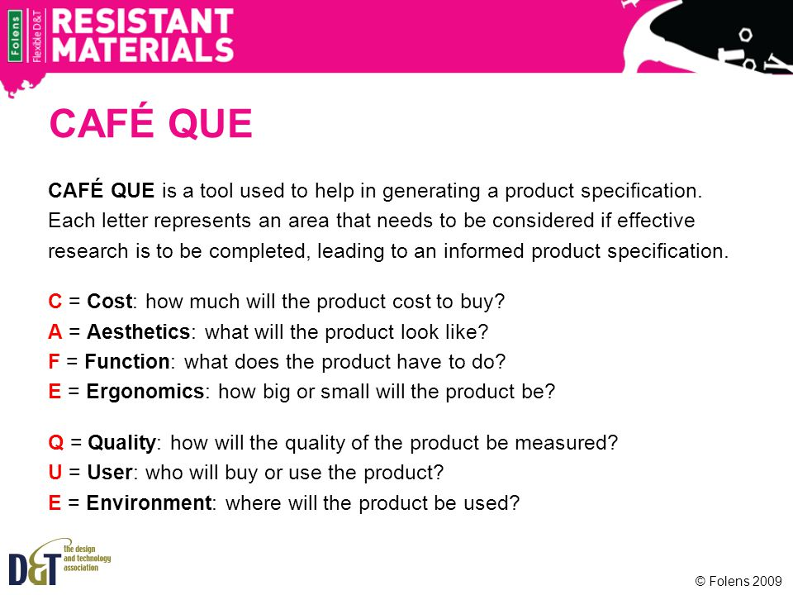
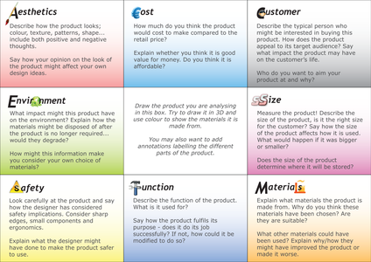
evaluation
Now its time to evaluate our product, this is really useful incase we decide to make changes or improvements or incase it didn’t work.
So using either of the following two methods evaluate your product in the workbook.
https://www.youtube.com/watch?v=5K2njaL5Qd0
Café que method
https://www.youtube.com/watch?v=GdVciAt51QM
Access FM method
Larger image on next slide

Slide 14
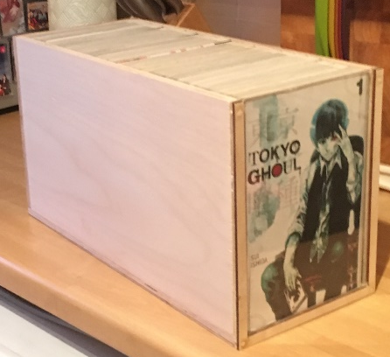
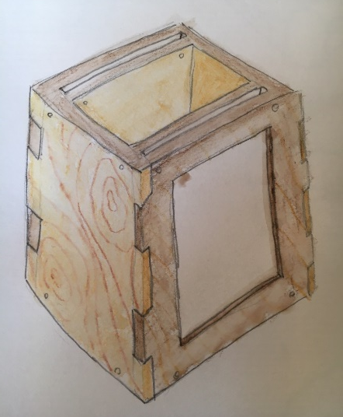
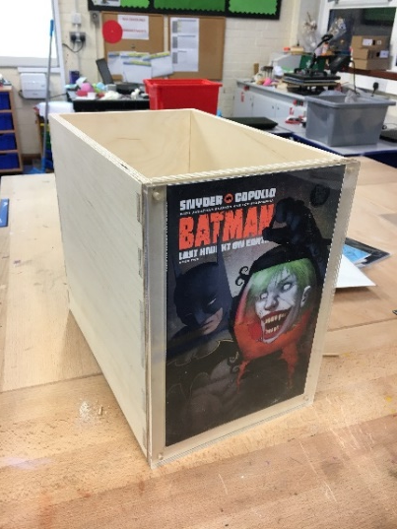
The most important part of evaluation is what you take away – no one gets it perfect first time!
The final step for you is to decide what changes you would make to improve your product if you could start again and do it all with knowledge you now have.
Here’s an example from GCSE, an idea, prototypes led to a final product but after evaluation more improvements were made.
Complete your booklet.

Slide 15

And… your done! Well done, enjoy your tomatoes.

