Slide 1
Suggested timeline
Week 1 | Week 2 | Week 3 | Week 4 | Week 5
Complete all research tasks | Create design ideas | Gather materials and test materials | Make product and test product | Evaluate product and make improvements.

Slide 2
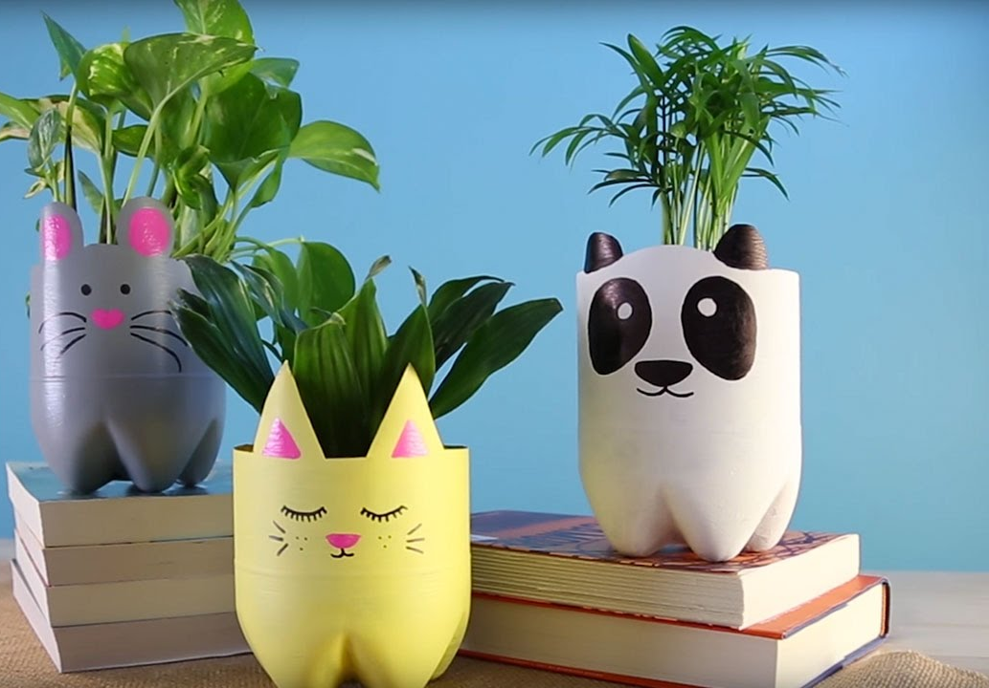
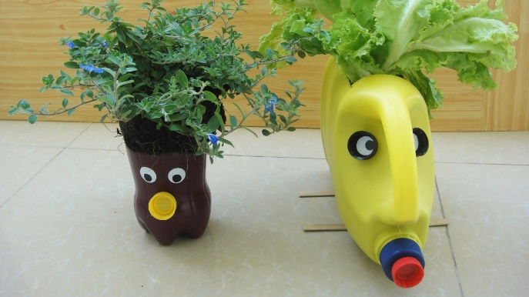
Planter Project
Name
Class
Lesson Objectives
To learn and apply effective research techniques.
To develop communication of ideas and apply creative thinking techniques.
To apply rapid prototyping skills to a physical model.
To evaluate effectiveness of design solutions and make improvements.

Slide 3
Activity 1
Using the table and information you have seen list all of the good things about recycling and the bad things.
Good | Bad
In your opinion is recycling good or bad? Justify your answer in the box below.

Slide 4
Activity 1
Using the table and information you have consider all the ways you could apply the 6 R’s to your normal life, look at things around your house. I some examples in the table to help you.
The 6 R’s | example | Your answers
Reduce | I probably don’t need to use plastic bags when I go shopping I could reduce the amount I use or buy.
Refuse | I will not buy small plastic water bottles.
Repair | I could sew torn clothes to make them last longer.
Recycle | I should make sure I wash all food packaging.
Re-use | I could repurpose some old products.
rethink | Maybe I don’t need to always drive to the gym. I could walk instead.

Slide 5
List all of the benefits of vertical farming when compared to normal farming.
Vertical farming | Normal farming

Slide 6
Which of the 6 R’s will our planter product help to achieve?
The 6 R’s | How will the planter affect this?
Reduce
Refuse
Repair
Recycle
Re-use
rethink
In the space below create a mind map of the best places to keep your plant pot, think about access to light and ability to water.
Kitchen window
Places for plant

Slide 7
ideas
Remember – if possible use colour and use shading with colouring pencils. Also add annotations these are labels that explain your ideas more clearly.

Slide 8
Make sure you draw in 3D with shading then upload the images here.
Idea development

Slide 9
Model. List the materials you have and what you are going to use them for. Then upload a photo of the model here.
Recycling items | What I will use them for | Test of material to check suitability
Pop your photo here of your product.

Slide 10
Evaluate your product
Cost
Aesthetics
Function
Ergonomics
Quality
User
environment
Top tip
Google the words if your still not sure what they mean
Aesthetics
Cost
Customer/client
Environment
Size
Safety
Function
materials

Slide 11
What changes would you make and why?

