Slide 1
Suggested timeline
Week 1 | Week 2 | Week 3 | Week 4 | Week 5
Complete all research tasks | Create design ideas | Gather materials and test materials | Make product and test product | Evaluate product and make improvements.

Slide 2
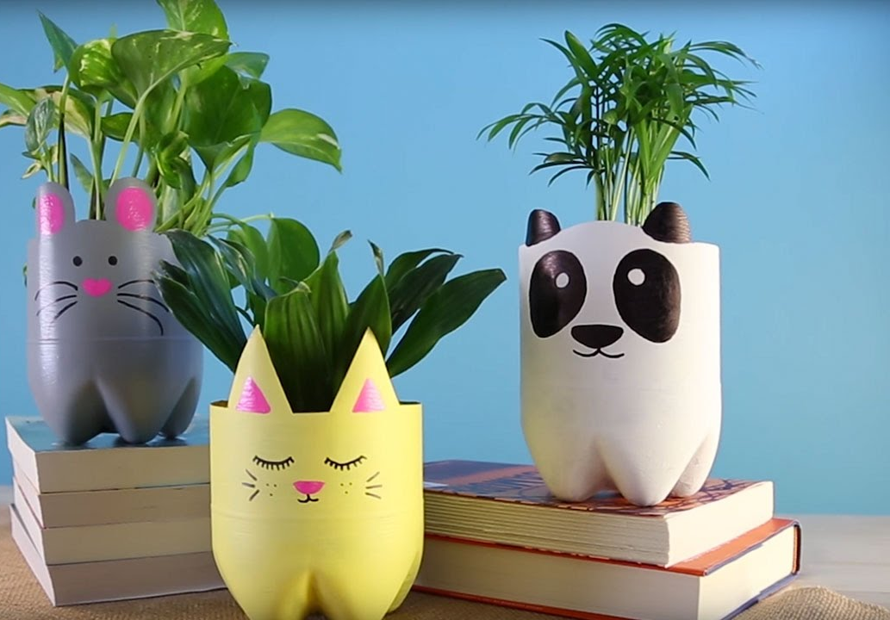
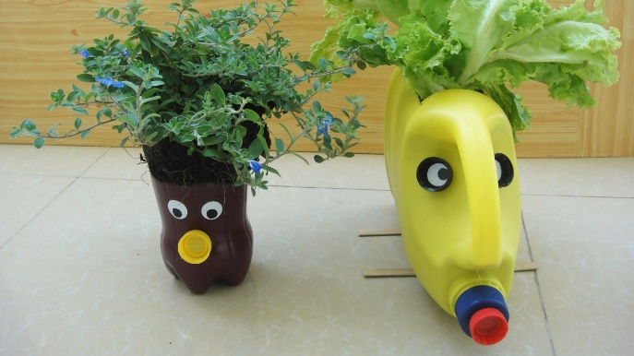
Planter Project
Name
Class
Lesson Objectives
To learn and apply effective research techniques.
To develop communication of ideas and apply creative thinking techniques.
To apply rapid prototyping skills to a physical model.
To evaluate effectiveness of design solutions and make improvements.

Slide 3
Activity 1
Using the table and information you have seen list all of the good things about recycling and the bad things.
Good | Bad
In your opinion is recycling good or bad? Justify your answer in the box below.

Slide 4
Activity 1
Using the table and information you have consider all the ways you could apply the 6 R’s to your normal life, look at things around your house. I some examples in the table to help you.
The 6 R’s | example | Your answers
Reduce | I probably don’t need to use plastic bags when I go shopping I could reduce the amount I use or buy.
Refuse | I will not buy small plastic water bottles.
Repair | I could sew torn clothes to make them last longer.
Recycle | I should make sure I wash all food packaging.
Re-use | I could repurpose some old products.
rethink | Maybe I don’t need to always drive to the gym. I could walk instead.

Slide 5
Which of the 6 R’s will our planter product help to achieve?
The 6 R’s | How will the planter affect this?
Reduce
Refuse
Repair
Recycle
Re-use
rethink
In the space below create a mind map of the best places to keep your plant pot, think about access to light and ability to water.
Kitchen window
Places for plant

Slide 6
ideas
Remember – if possible use colour and use shading with colouring pencils. Also add annotations these are labels that explain your ideas more clearly.

Slide 7
Model. List the materials you have and what you are going to use them for. Then upload a photo of the model here.
Recycling items | What I will use them for
Pop your photo here of your product.

Slide 8
Evaluate your product
Cost
Aesthetics
Function
Ergonomics
Quality
User
environment
Top tip
Google the words if your still not sure what they mean
Aesthetics
Cost
Customer/client
Environment
Size
Safety
Function
materials

