Slide 1
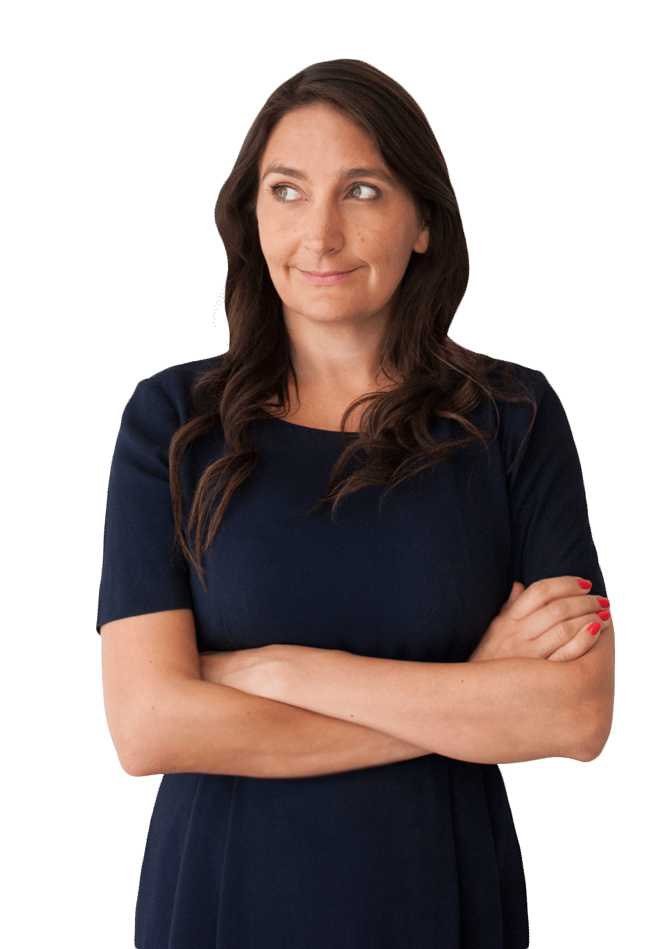
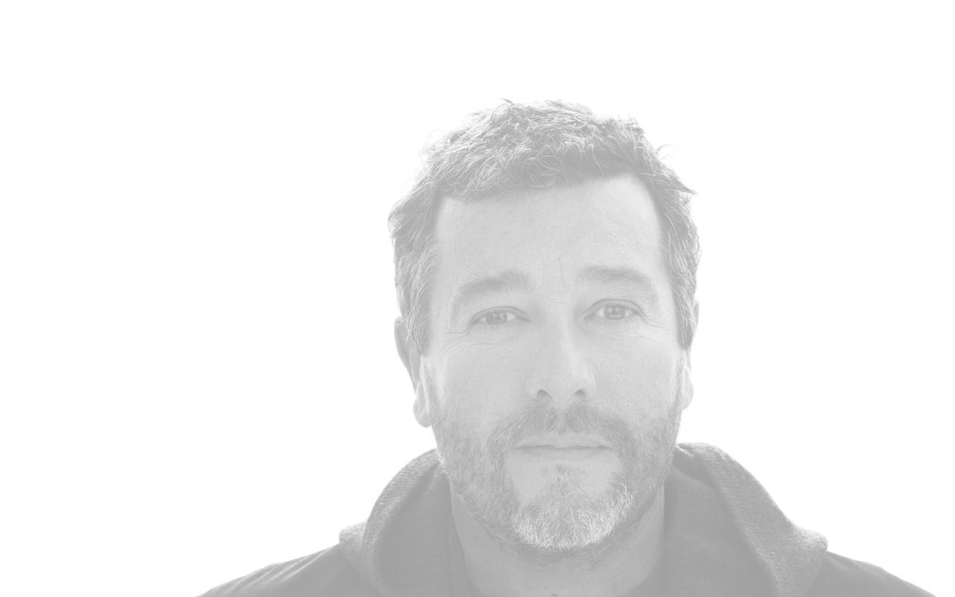
Learning objectives
Produce a 5 to 10 slide presentation or 2 page revision document about Bethan Grey and Philippe Starck.
Include 10 facts about each designer.
Add a picture of the designer and include 3 pictures of each designer's work.
Write in your own words.

Slide 2


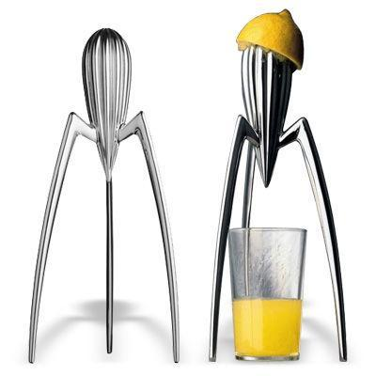


Tomorrow will be less
Pattern, colour and form

Slide 3
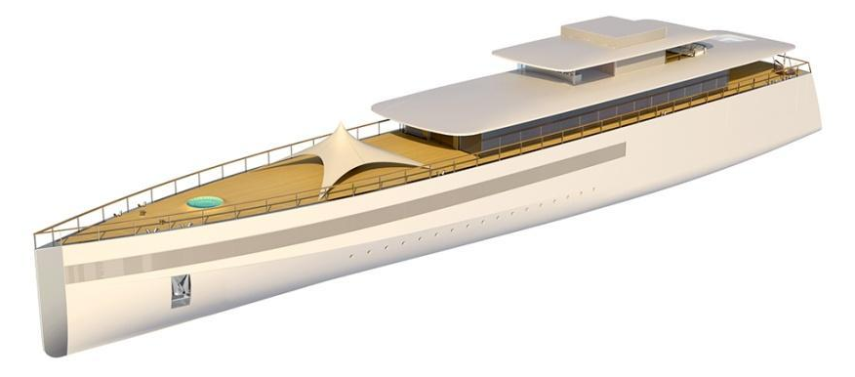
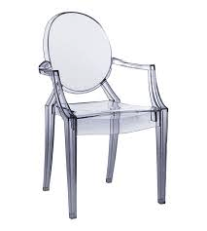
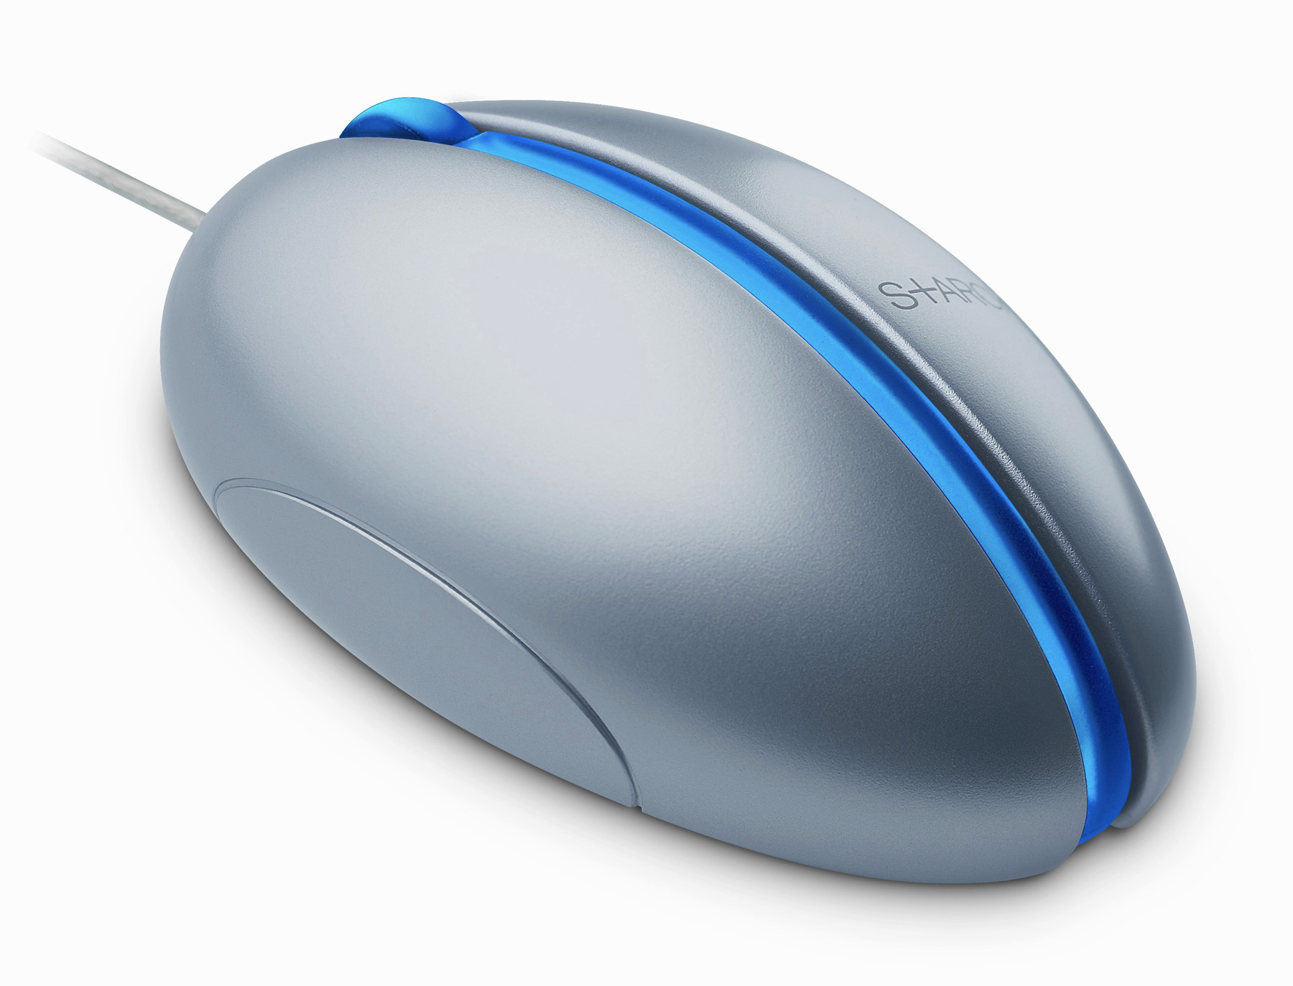
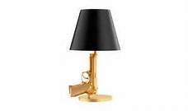
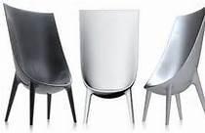
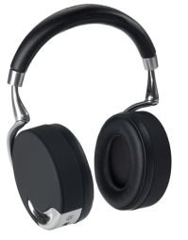
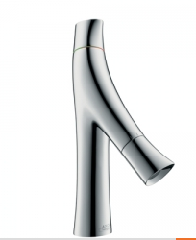
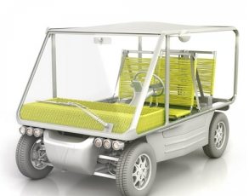
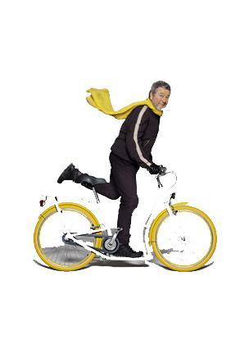
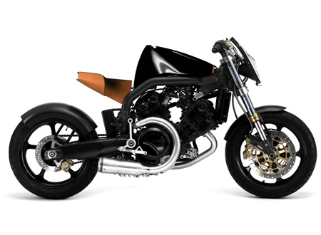
"The more materiality there is, the less humanity there is"
Notes:
Discuss the images with a partner.
What does he mean when he says "The more materiality there is, the less humanity there is" ?

Slide 4
Has produced some of the iconic
shapes of the 20th century, including:
Chrome juice squeezers,
Emeco aluminium chairs,
Louis ghost polycarbonate chair,
Venus a boat for Steve Jobs.
When Starck turns his bold vision toward a chair, a shoe,
a toothbrush, it's clear he thinks deeper than the glossy surface.

Slide 5
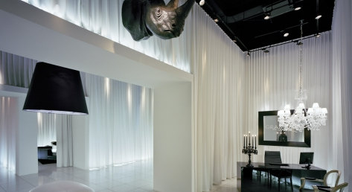
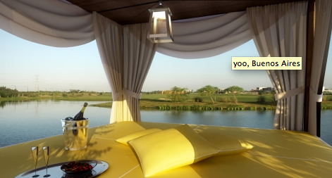
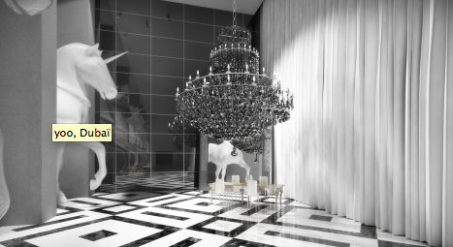
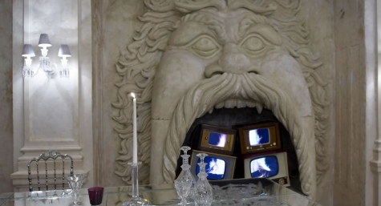
"My interest in the environment has neither beginning nor end, it is a state of mind.
Philippe Starck is a legend of modern design.
He's known for his luxurious hotels around the world
    Peninsula Hotel in Hong Kong,
    Teatron in Mexico,
    Hotel Delano in Miami,
    Mondrian in Los Angeles,
    Asia de Cuba restaurant in New York
Where he has designed the total environment from layout to furniture to linens.
Notes:
Philippe Starck is a legend of modern design.
He's known for his luxurious hotels around the world
Peninsula Hotel in Hong Kong,
Teatron in Mexico,
Hotel Delano in Miami,
Mondrian in Los Angeles,
Asia de Cuba restaurant in New York
Where he has designed the total environment from layout to furniture to linens.

Slide 6
Born in France.
Son of an aircraft designer.
Millionaire product designer.
Has designed products for major companies including Aprilla, Microsoft,
Hotels, watch companies and his own company.
Believes in sustainable design and the importance of doing more with less.
Designs and develops mass produced products.
Does not use too much colour in designs.
Had his own company aged 20.

Slide 7
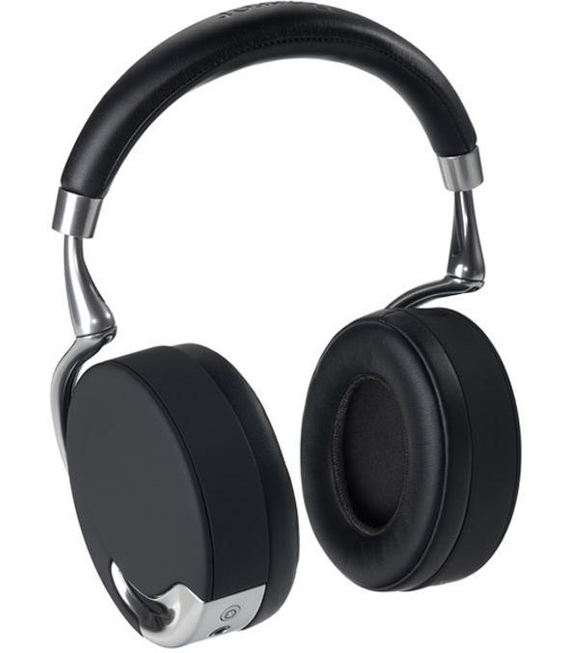
Zik Headphones

Slide 8
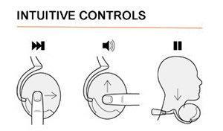
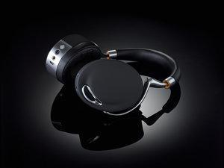
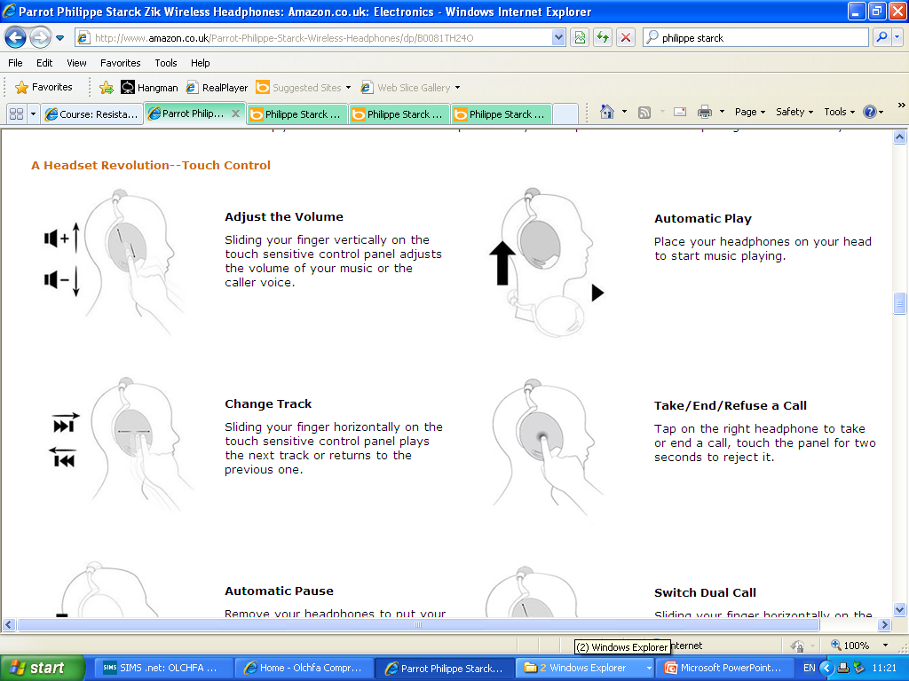
Zik Headphones
Take/End/Refuse a Call Tap on the right headphone to take or end a call, touch the panel for two seconds to reject it.
Switch Dual Call Sliding your finger horizontally on the control panel to switch between calls.

Slide 9
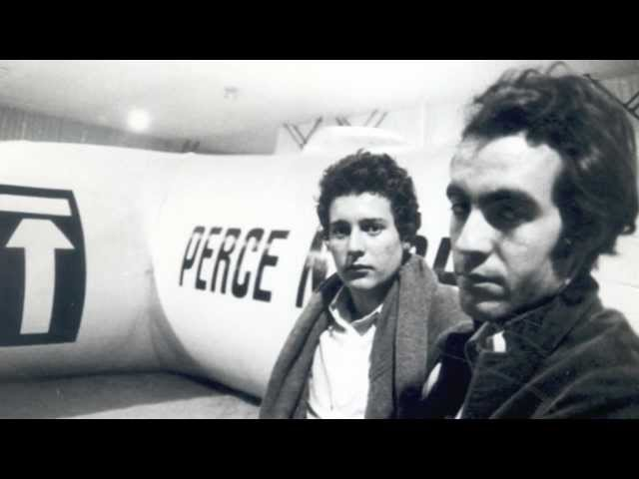

Slide 10
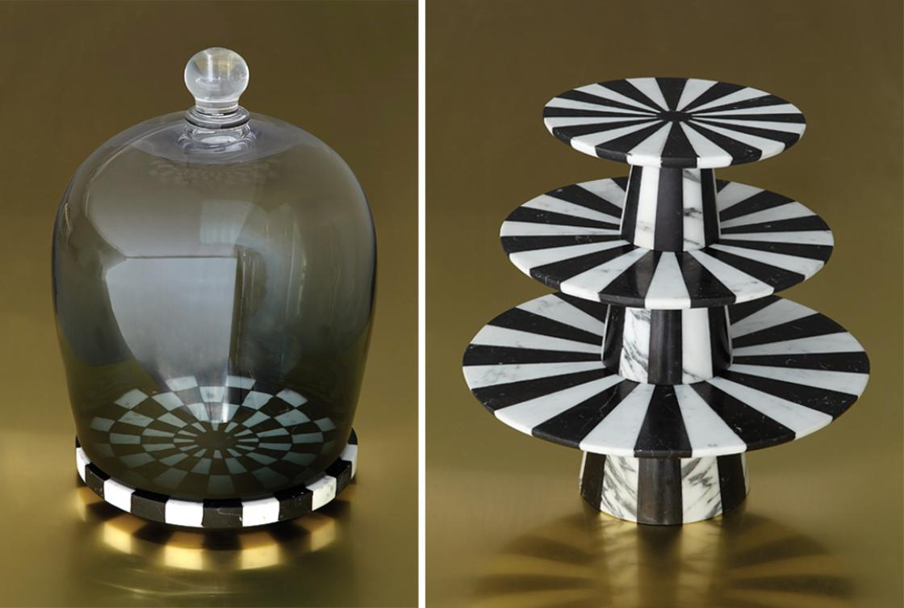
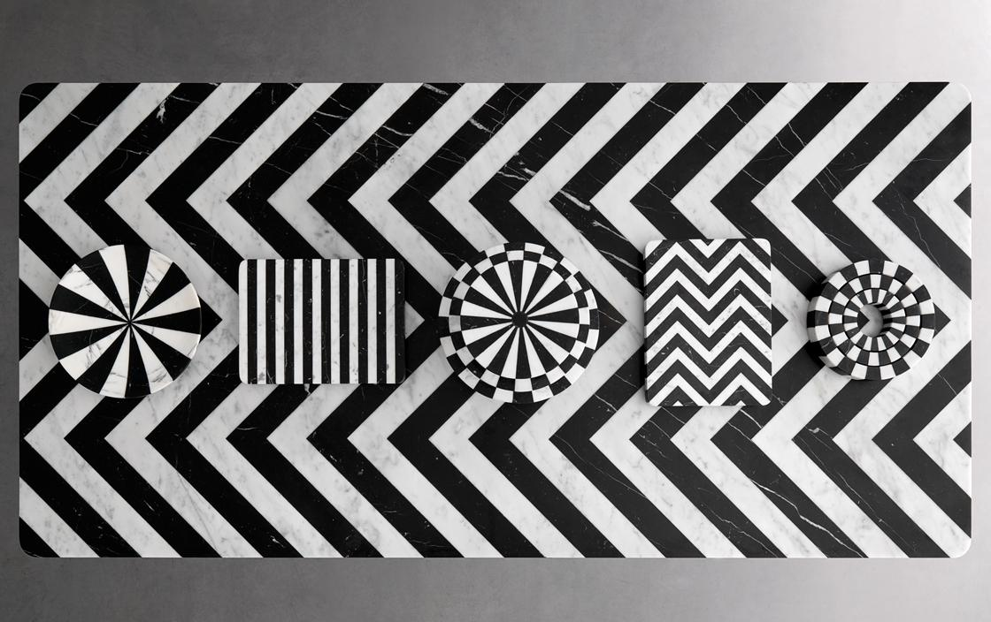
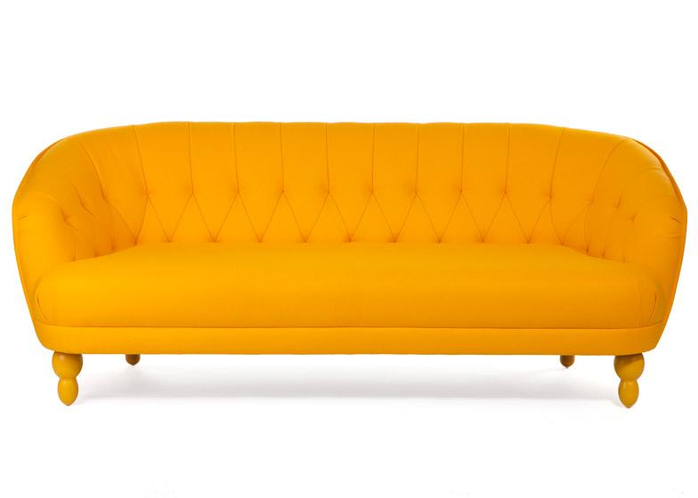
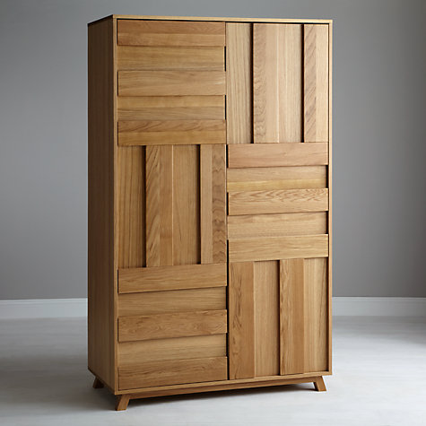
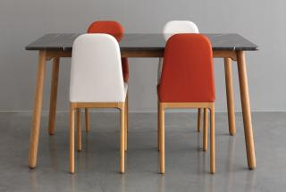
Pattern, colour and form

Slide 11
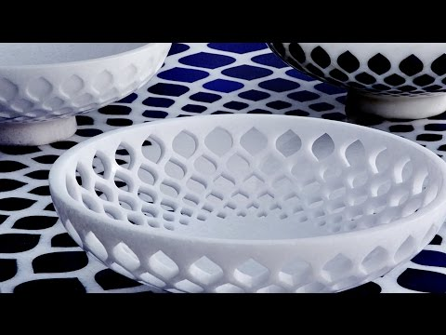

Slide 12
Who designed these products?
Notes:
Pictures to cut up for matching exercise.

Slide 13
Who designed these products?
Notes:
Pictures to cut up for matching exercise.

