Slide 1

Inspiring young people to help
reach the
Global Goals
practicalaction.org/design-for-a-better-world

Slide 2
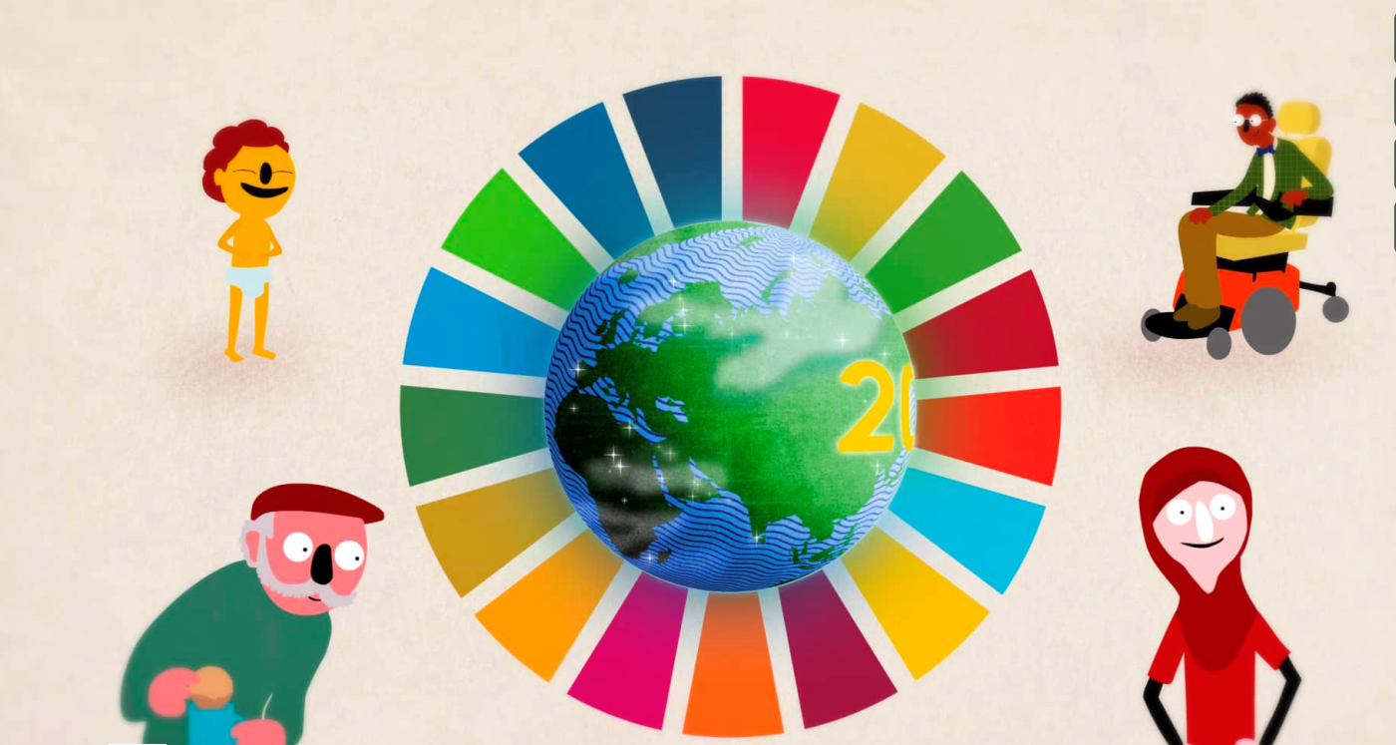
The Global Goals
Make notes while you watch the World’s Largest lesson video introduced by Malala Yousafzai.
https://vimeo.com/138852758
Notes:
The activity sheet Notes on the World’s Largest Lesson is available for students at practicalaction.org/design-for-a-better-world.

Slide 3





Goals and targets
Activity: Match five of the Global Goal symbols to their world facts and targets.
Which facts were you most surprised by?
Notes:
The activity sheet World facts and Global Goals is available to run this activity.

Slide 4
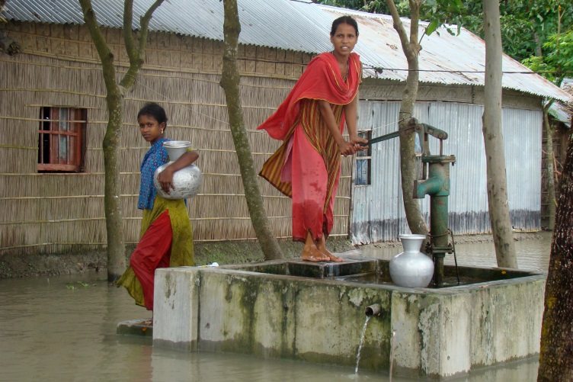
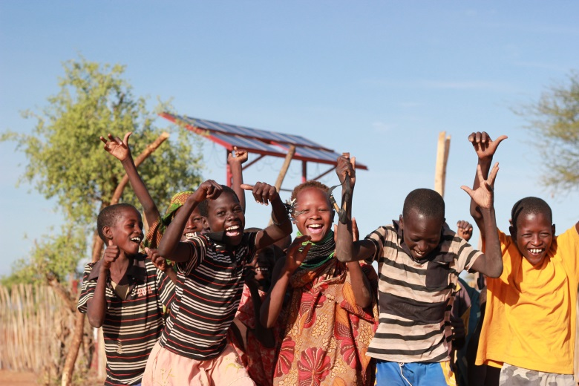
Global Goals:
Technology solutions?
Practical Action believes that everyone in the world has the right to the technologies that enable people to lead a decent qualify of life.
Activity: Select any pictures from Practical Action’s work that you think can help reach the Global Goal target that you are exploring.
Notes:
The activity sheets Global Goals : Technology solutions is available to support this activity.

Slide 5
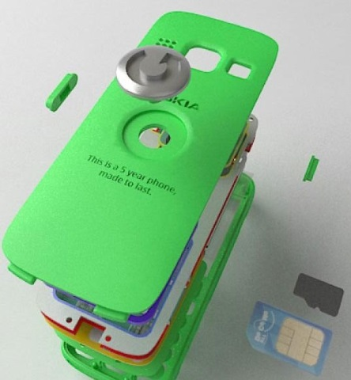
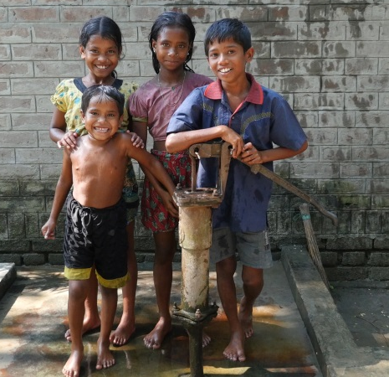

Technology solutions
Many of the technologies you’ve explored so far aim to improve the
lives of people with little or no access to the technologies needed to lead a decent quality of life.
To reach the Global Goals targets, we all need to take action now to ensure that everyone in the world has access to suitable technologies by 2030.
Research activity
Find out about the sustainable products and technologies that people are using and developing in the world today.
Notes:
A research findings sheet is available for students to record their research findings.

Slide 6
Design for a Better World
Now that you’ve looked at technologies that help people around the world we’re hoping you’re feeling inspired to develop your own ideas.
Competition
Practical Action is looking for fifty innovative ideas from young people aged 11-14 years for a technology or product that could help reach a Global Goal target.
Information sheets are available to help you with the following five Global Goals:
- Zero hunger
- Clean Water and Sanitation
- Affordable and Clean Energy
- Sustainable Cities and Communities
- Climate Action

Slide 7
Competition guidelines
The judges will be looking for evidence of your work in the following areas:
Research: You should present work that shows that you have explored:
- A Global Goal and identified a problem to solve
- Existing technologies that could help reach the Global Goal targets
Design ideas: You need to develop a design specification and produce a range of annotated designs that include the advantages and disadvantages of each.
Final design: You need to present a final design that includes annotations about how the technology works and will help reach the Global Goal target.
Your teacher will provide you with sheets to present your work.

Slide 8

Thank you for taking part in…
We look forward to sharing your design ideas with young people worldwide.
practicalaction.org/design-for-a-better-world

