Slide 1
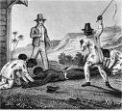
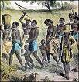
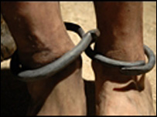
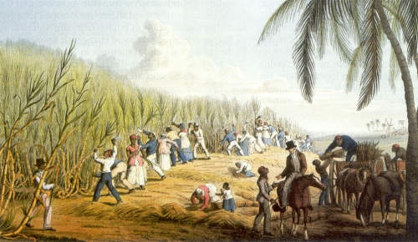

Slave character reflection…
Create a diary entry in your booklets about rebellion you have seen/ joined in/ started. This can be at any point of the slave journey (middle passage, auction, planation).
Ideas:
Would they start a rebellion?
Join in a rebellion?
Avoid a rebellion?
Warn the overseer/ master in the hope of a reward?
Were they successful or not? Were they punished for rebelling?
Remember to connect your ideas using words like:
Active resistance
Passive resistance
Broken
Fear
Danger
In addition,
Additionally,
Moreover,
Furthermore,
Another point is,
Starter sentence: It was a usual miserable day with my jobs starting when the sun rose at 5.30am. When I got to the field, I heard some other slaves whispering about…

