Slide 1
Erosion, Transportation and Deposition
Define erosion, transportation and deposition
Understand how transportation works
Analyse the features which are created because of deposition

Slide 2
Can you define any of these words??
EROSION
TRANSPORTATION
DEPOSITION

Slide 3
Test your knowledge: Developing
Write a definition of the following key terms (you can do this independently or research it, obviously the answer is on the next slide if you struggle!):
  - Erosion
  Transportation
  Deposition

Slide 4

Define erosion, transportation and deposition
You should have known this one from our last few lessons!
EROSION
Material being worn away from the coast by the waves
TRANSPORTATION
Eroded material being moved along the coast by the waves
DEPOSITION
Material being deposited (dropped off) further down the coast by (constructive) waves

Slide 5
Transportation
What do you already know about how waves move on and off the beach?
THINK:
Waves
Swash
Backwash

Slide 6
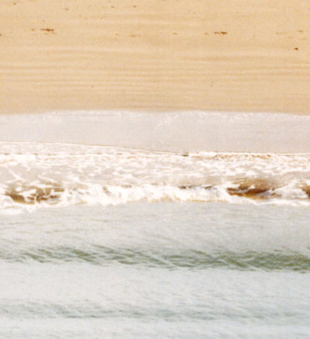
SWASH
The water rushing
up the beach.
BACKWASH
The water rolling
back down the beach.
Swash
Backwash

Slide 7
Test your knowledge: Secure
2) Try to explain what could have happened here:
When I was younger I went on holiday to Wales with my Gran, Grandad and my older brother, Andy.
One day we were at the beach and Andy took off his favourite Man United shorts so he could go swimming in the sea… (don’t worry- he had swim shorts on underneath!)
Unfortunately, the shorts disappeared and Andy was devasted!
However, we all visited the beach later that day and, to Andy’s great surprise and relief, the shorts turned up about a mile down the beach from where we had been earlier in the day…
How do you think they got there?

Slide 8
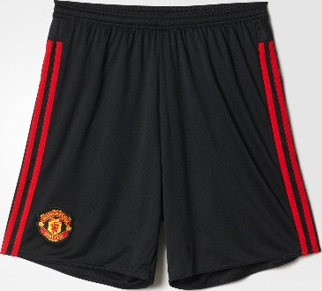
How did it get here?

Slide 9

Swash
Swash
Swash
How did it get here?
Backwash
Backwash
Backwash

Slide 10
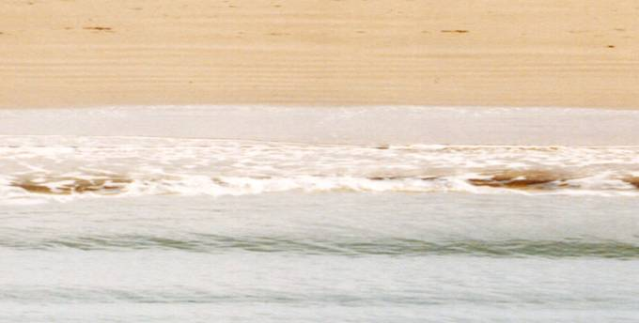

This process is ‘transportation’, because material is being transported! It’s known as ‘Longshore drift’
Direction of longshore drift movement
Backwash is always at right angles to the beach
swash
Backwash
Direction of prevailing wind

Slide 11
Test your knowledge: Secure
3) Draw your own diagram to show longshore drift

Slide 12
Deposition
When the sea loses energy, it drops the material it has been carrying. This is called deposition.
How can you relate this to your previous knowledge?
  What do you know about waves?
  What type of waves create deposition?
  What part of the waves needs to be stronger for deposition to happen?

Slide 13
Deposition
When the sea loses energy, it drops the material it has been carrying. This is called deposition.
How can you relate this to your previous knowledge?
  What do you know about waves?
  There are two types- constructive and destructive
  What type of waves create deposition?
  Constructive waves create deposition because they leave material on the beach
  What part of the waves needs to be stronger for deposition to happen?
  The swash needs to be bigger as this pushes material onto the beach

Slide 14
Explain why deposition is more likely to occur in the following situations:
Waves enter an area of shallow water.
Waves enter a sheltered area, eg a bay.
There is little wind.
There is more erosion which means a good supply of material

Slide 15
Explain why deposition is more likely to occur in the following situations:
Waves enter an area of shallow water.
Shallow water will have less energy so the swash will be bigger than the backwash (creating more deposition of sand onto the beach)
Waves enter a sheltered area, eg a bay.
Sheltered areas are protected from the wind so the waves will be much smaller, smaller waves are likely to be constructive waves
There is little wind
Wind creates the type of wave, constructive wanes are needed for deposition and this will happen if we don’t have much wind
There is more erosion which means a good supply of material
If there is more material in the water the is more material to be deposited onto the beach.

Slide 16
So, when we have bays, lots of deposition is likely to occur.
Not only will this create a beach inside the bay, but it will create a new features called spits and bars.
Watch the following animation to see how they are created…

Slide 18
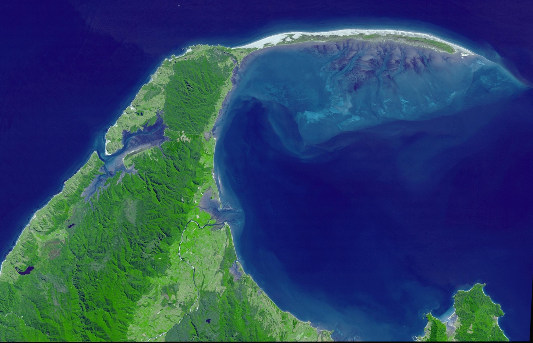
What this looks like in real life:
Look how the material (sand) has been deposited so much that over time it has built a sort of sand hill which eventually shows above the waters surface. This is what we call a spit. When the spit goes all the way from one headland to another (totally covering the bay) we call this a bar.

Slide 19
Test your knowledge: Secure+
4) Try to draw your own diagram to show a spit and bar :
  It could be a diagram for each or a single diagram showing both
  Have a go at created your own but if you’re struggling look at the next slide for some ideas
  When you’ve finished, check on the next slide to make sure your diagram is accurate.

Slide 20
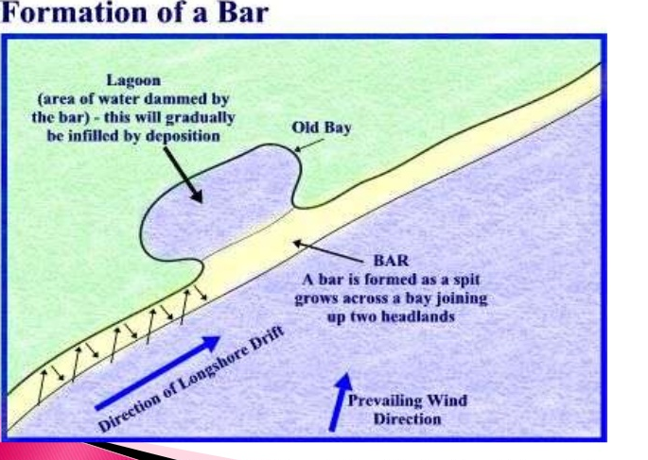
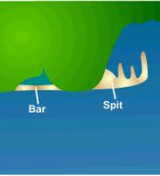
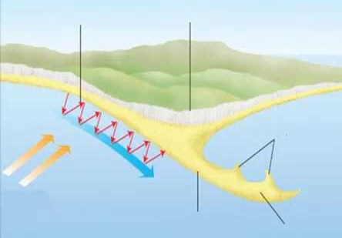
Longshore drift
Headland
Spit
Deposited sand builds up over time and spit gets bigger

Slide 21


Finally….
If you think the picture is a
Spit do the LIGHTNING BOLT
If you think the picture is a
Bar do the MO BOT
SPIT
BAR

Slide 22
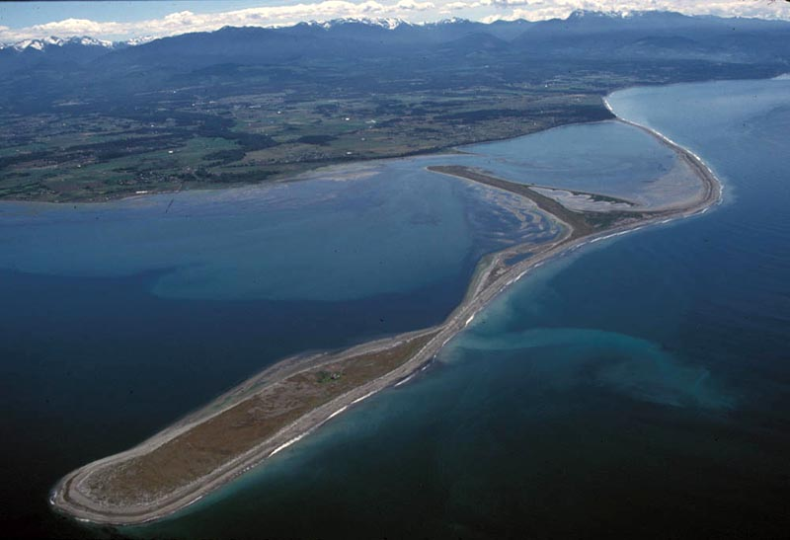
SPIT
BAR

Slide 23
SPIT
It doesn’t go all the way along from one headland to another so it is a spit!

Slide 24
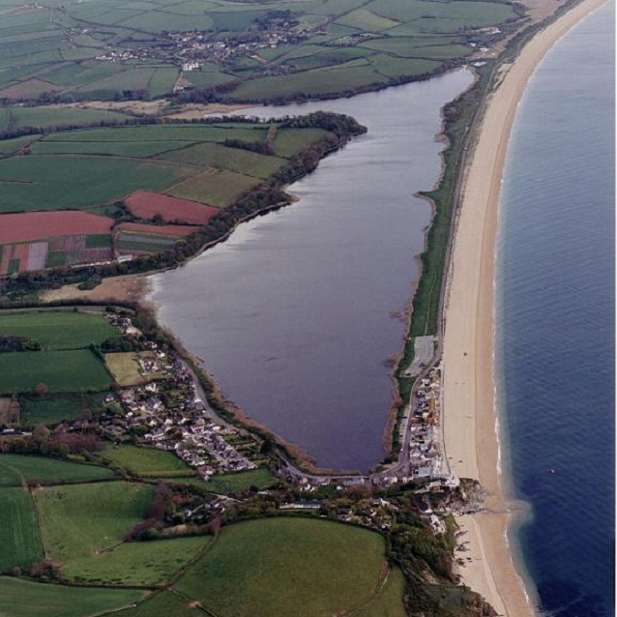
SPIT
BAR

Slide 25
It connects the two headlands and totally cuts the bay off meaning it’s a bar!
BAR

Slide 26
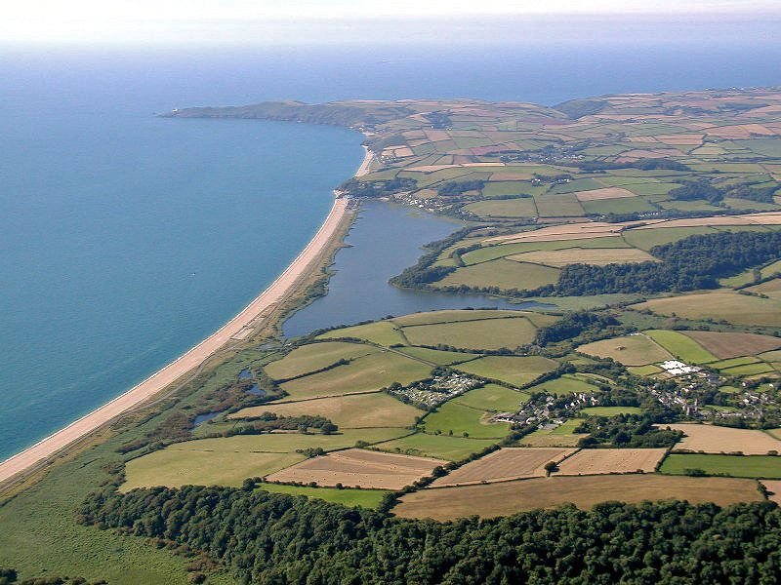
SPIT
BAR

Slide 27
It connects the two headlands and totally cuts the bay off meaning it’s a bar!
BAR

Slide 28
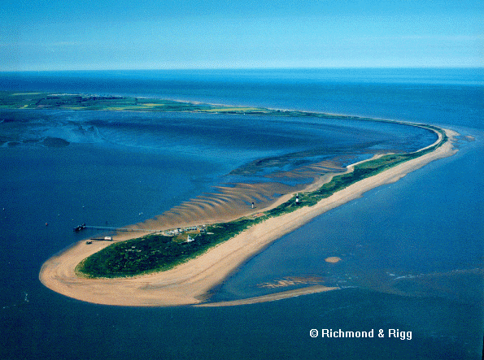
SPIT
BAR

Slide 29
SPIT
It doesn’t go all the way along from one headland to another so it is a spit!

Slide 30
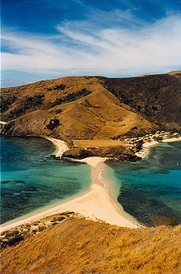
SPIT
BAR

Slide 31
Even though we can’t see the bay behind, it has to be a bar because it connects two bits of land.
BAR

Slide 32
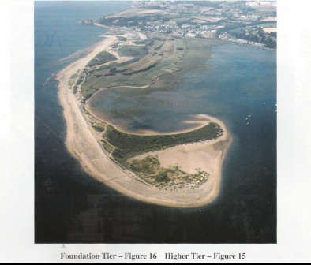
BAR
SPIT

Slide 33
It doesn’t go all the way along from one headland to another so it is a spit!
SPIT

Slide 34
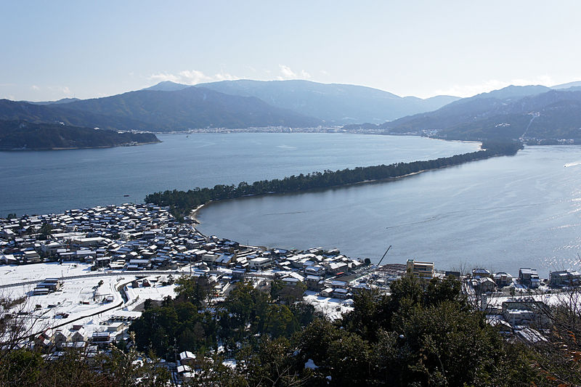
SPIT
BAR

Slide 35
It connects the two headlands and totally cuts the bay off meaning it’s a bar!
BAR

