Slide 1
Test your knowledge: Developing
Write a definition of the following key terms (you can do this independently or research it, obviously the answer is on the next slide if you struggle!):
  - Erosion – Material being worn away from the coast by the waves
  Transportation- Eroded material being moved along the coast by the waves
  Deposition- Material being deposited (dropped off) further down the coast by (constructive) waves.

Slide 2
Test your knowledge: Secure
2) Try to explain what could have happened here:
The shorts has been transported along the beach through the process of longshore drift… look at the diagram on the next slide to understand this process….

Slide 3

Swash
Swash
Swash
How did it get here?
Backwash
Backwash
Backwash

Slide 4
Test your knowledge: Secure
3) Draw your own diagram to show longshore drift…

Slide 5
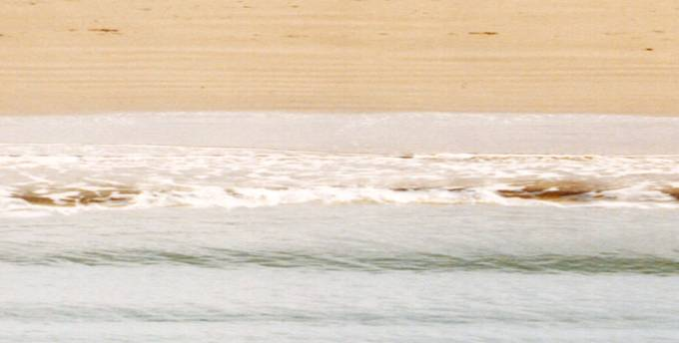

This process is ‘transportation’, because material is being transported! It’s known as ‘Longshore drift’
Direction of longshore drift movement
Backwash is always at right angles to the beach
swash
Backwash
Direction of prevailing wind

Slide 6
Test your knowledge: Secure+
4) Try to draw your own diagram to show a spit and bar :
  It could be a diagram for each or a single diagram showing both
  Have a go at created your own but if you’re struggling look at the next slide for some ideas
  When you’ve finished, check on the next slide to make sure your diagram is accurate.

Slide 7
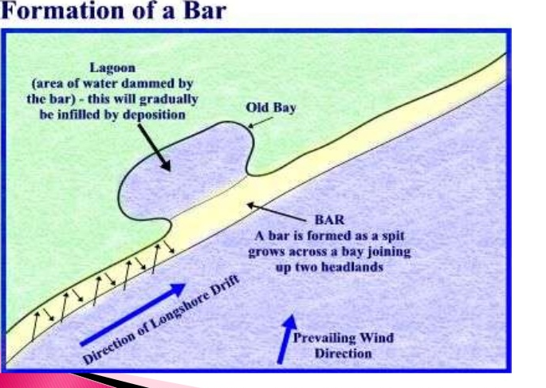
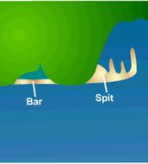
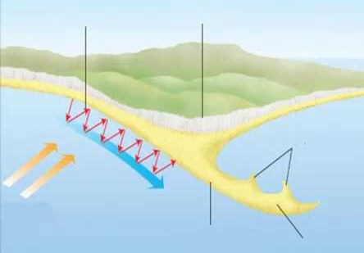
Longshore drift
Headland
Spit
Deposited sand builds up over time and spit gets bigger

