Slide 1
What coastal features does erosion create?
Identify common features created because of erosion
Draw diagrams to show how these features have been created
Evaluate different coastal images to suggest how the features were created.

Slide 2
Ordering Task:
The images on the next slide were taken of the same cliff that sticks out into the sea (we call this a headland)
They were taken at different times showing how the headland changes
Try to put them in the correct order, from earliest to latest
You must think logically about which pictures came after erosion had had an effect

Slide 3
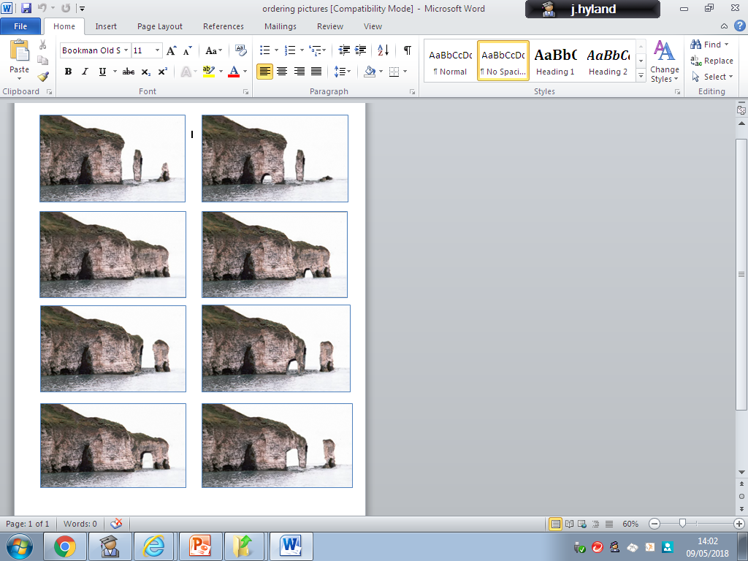

Slide 4
1) The headland is completely whole but it does have cracks which have been caused by the water and are being eroded into caves…

Slide 5
2) You can see those caves have now gotten bigger and bigger until eventually, one has eroded all the way through to create something called an arch …

Slide 6
3) The arch is still being eroded and is getting much bigger…

Slide 7
4) Eventually, the top of the arch cannot be supported anymore and it falls into the water. It leaves a piece of rock standing on it’s own by the cliff. We call this a stack…

Slide 8
5) Whilst this has all been happening, the water has been eroding the other caves and has now created another arch…

Slide 9
6) The arch is continuing to grow, and you should notice the stack is getting thinner and shorter (both happening due to erosion)

Slide 10
7) Once again, the arch has been eroded so much that the top has fallen into the sea and another stack has been created. But, the original stack has now been eroded so much that it is small enough to be classes as what we call a stump…

Slide 11
8) As you can see, the whole process will happen over and over again, creating more stacks and then stumps. Eventually, the stumps will erode away completely…

Slide 12
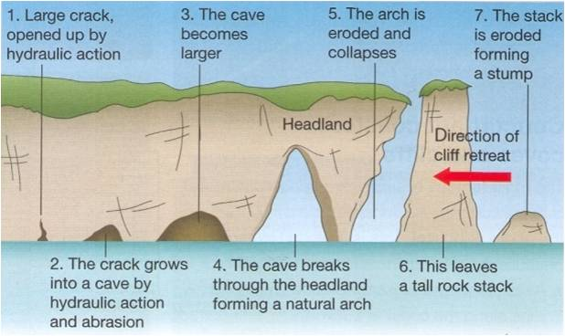

Slide 13
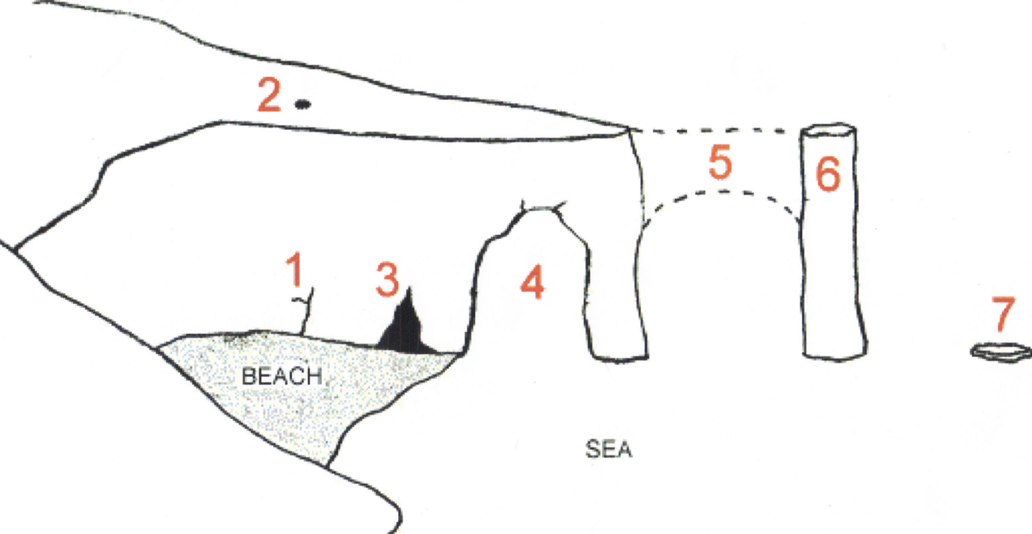
1)
Test your knowledge: Developing
1) Copy and complete the diagram below adding the following key terms to the correct numbers: stump, headland, cave, stack, crack, arch, roof of arch collapses

Slide 14
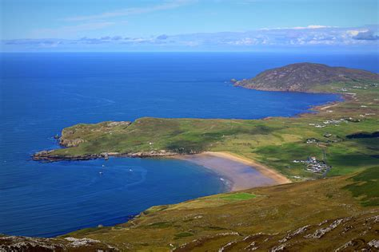
What's happened here?
What’s it got to do with erosion?

Slide 15
The headland here is made of much stronger, more resistant rock which will not be eroded as easily.
The bits in the middle are made of much weaker rock which is eroded easily.
This has created what we call a bay. As you can see, inside the bay a beach is created. This is because the sheltered water loses energy and deposits it’s material inside the bay.

Slide 16
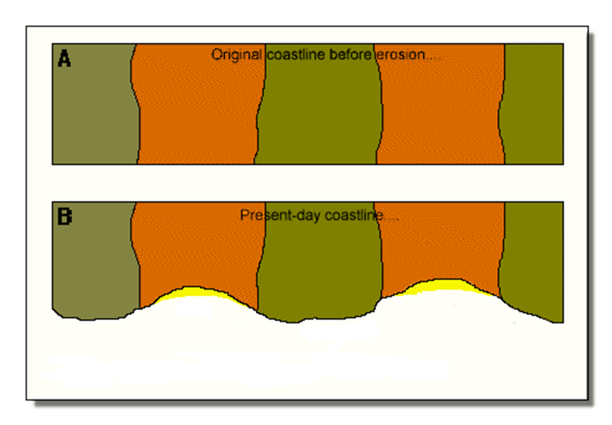
Test your knowledge: Secure
2) Copy the diagram below to show an original headland and then how it will look when erosion has occurred.
Add the following labels:
Bay
Headland
Hard, resistant rock.
Softer, less resistant rock
Beach

Slide 17
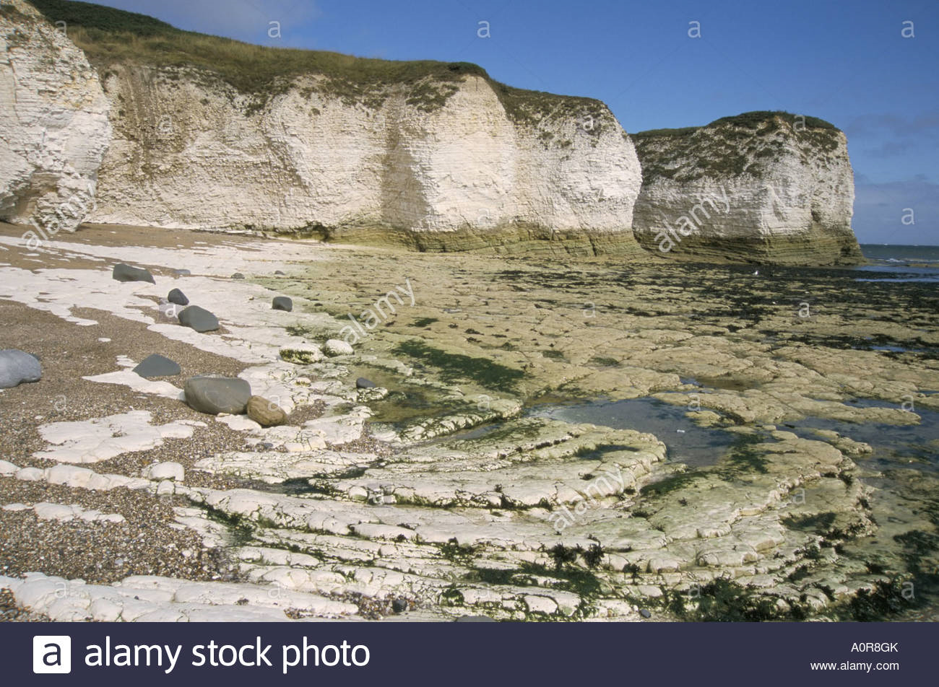
What do you notice?
What could this have to do with erosion?

Slide 18
Watch the animation to see a wave cut platform and cliff being created.

Slide 19
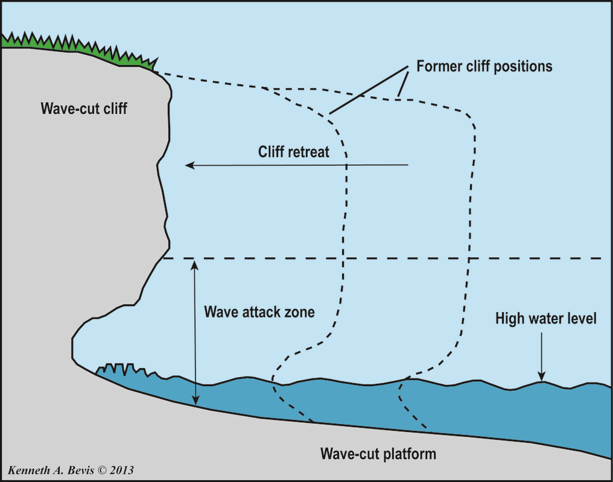

Slide 20
How are these features created?
A wave cut cliff is the type of cliff that is created when the water attacks the bottom of the cliff.
The water (especially the strong, destructive waves) erode the bottom of the cliff which means it can no longer support the heavy rock above, and so a whole section of the cliff will fall into the water.
This process happens over and over again, meaning the cliff is continuously retreating (moving backwards)
The wave-cut platform is the layer of rock right at the bottom of the cliff which is being eroded more slowly as it is under the water so the waves are not crashing against it.

Slide 21
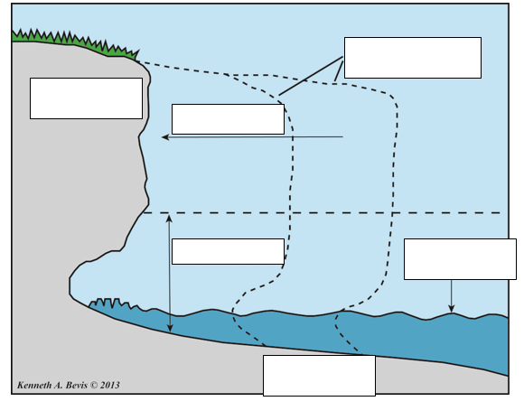
Test your knowledge: Secure
3) Copy the diagram below adding the following labels:
Cliff retreat (moves backwards)
High water level
Former cliff positions (where the cliff used to be)
Wave cut platform
Wave attack zone
Wave cut cliff

Slide 22
Test your knowledge: Secure+
4) Look at the images on the next slide. Pick on and evaluate how the features you can see you have created. Use the boxes below to help:
There are four different types of erosion. One type of erosion is_____ this will have affected the features I can see because…
Another type of erosion is ______ this will have affected the features I can see because…
These features have been created over time by erosion. The features have been caused by…
The coastal features I can see in picture ____ are called…
Key words
Cave, arch, stack, stump, wave cut platform, wave cut cliff, bay, headland, abrasion, solution, attrition, hydraulic action

Slide 23
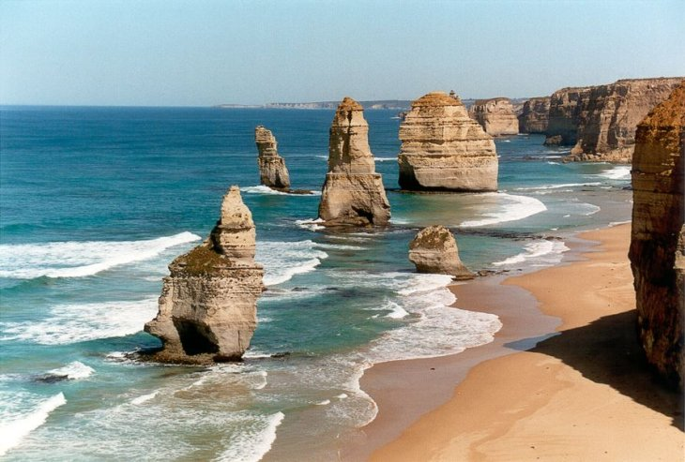
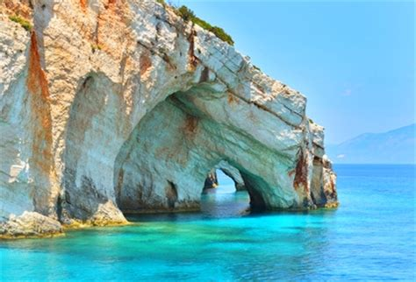
A
B
C
D
Notes:
Quarter

