Slide 1
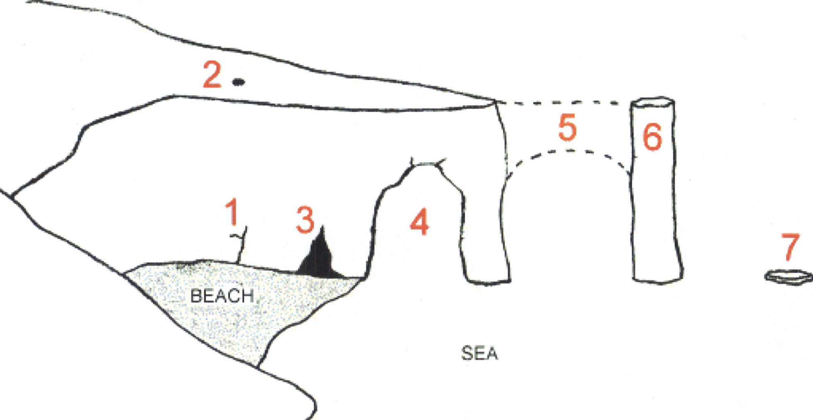
1)
Test your knowledge: Developing
1) Copy and complete the diagram below:
headland
stack
roof of arch collapses
cave
crack
stump
arch

Slide 2
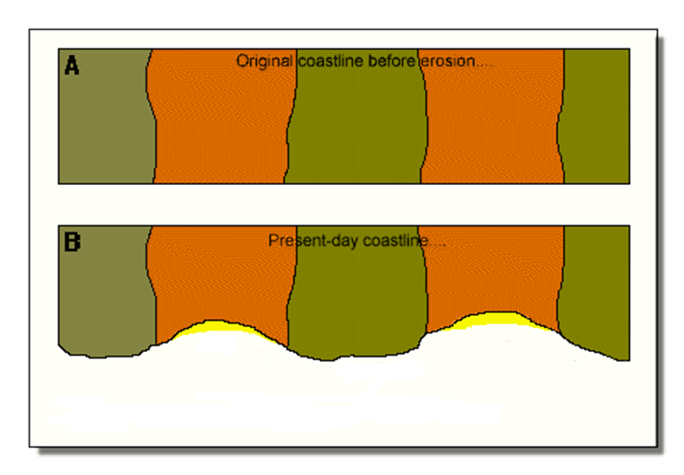
Test your knowledge: Secure
2) Copy the diagram below to show an original headland and then how it will look when erosion has occurred.
Add the following labels:
Bay
Headland
Hard, resistant rock.
Softer, less resistant rock
Beach
Soft rock
Soft rock
Head-land
Head-land
Hard rock
Beach
Bay

Slide 3
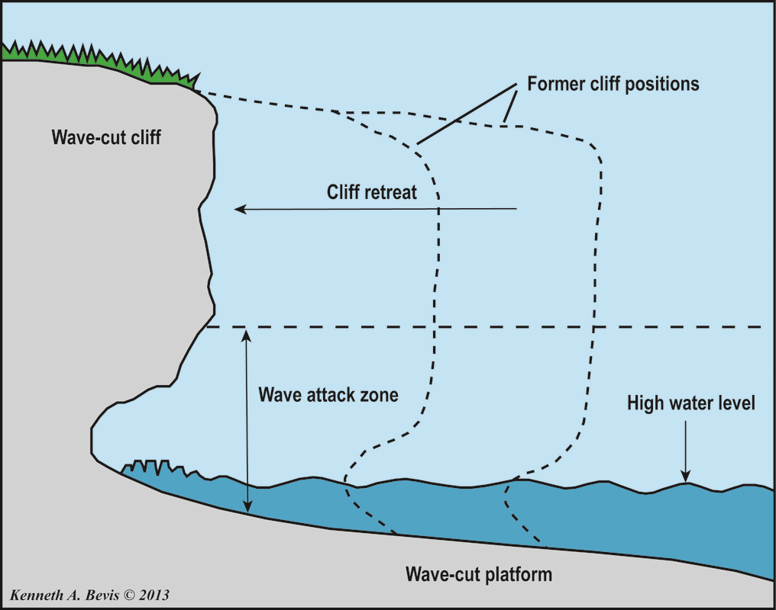
Test your knowledge: Secure
3) Copy the diagram below adding the following labels:
Cliff retreat (moves backwards)
High water level
Former cliff positions (where the cliff used to be)
Wave cut platform
Wave attack zone
Wave cut cliff

Slide 4
Test your knowledge: Secure+
4) Look at the images on the next slide. Pick on and evaluate how the features you can see you have created. Use the boxes below to help:
There are four different types of erosion. One type of erosion is_____ this will have affected the features I can see because…
Another type of erosion is ______ this will have affected the features I can see because…
These features have been created over time by erosion. The features have been caused by…
The coastal features I can see in picture ____ are called…
Key words
Cave, arch, stack, stump, wave cut platform, wave cut cliff, bay, headland, abrasion, solution, attrition, hydraulic action

Slide 5
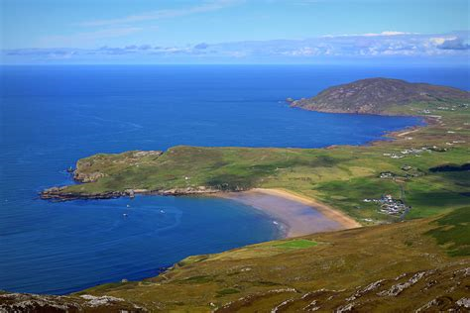
There are four different types of erosion. One type of erosion is hydraulic action. This will have affected the features I can see because the powerful waves will have crashed against the soft rock causing big cracks and huge sections to erode quickly.
Another type of erosion is solution, this will have affected the features I can see because it will have dissolved the softer rock which helped to create the bay
These features have been created over time by erosion. The features have been caused by the hard, resistant rock eroding more slowly leaving headlands sticking out into the sea. Between he headlands the rock is much softer and so have been eroded much more quickly, creating a bay.
The coastal features I can see in picture A are called bays and headlands

Slide 6
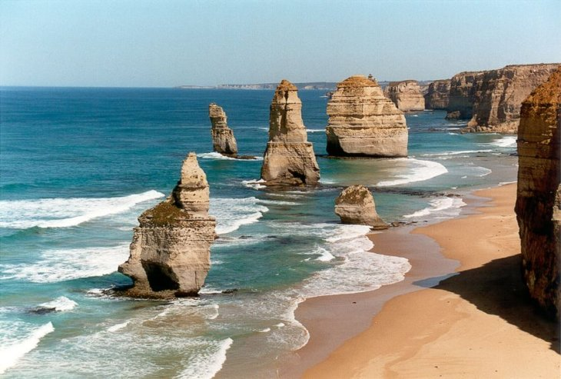
There are four different types of erosion. One type of erosion is hydraulic action. This will have affected the features I can see because the powerful waves will have crashed against the headland and create the cracks which start the whole process.
Another type of erosion is abrasion, this will have affected the features I can see because the small rocks in the water will be thrown against the stack making it smaller until it becomes a stump.
These features have been created over time by erosion. The features have been caused by cracks being created in the headland which are further eroded to make arches. Eventually, the top of the arch collapses leaving a stack behind. The stack is eroded by the water to make it much smaller until it becomes a stump.
The coastal features I can see in picture B are called stacks and stumps

Slide 7
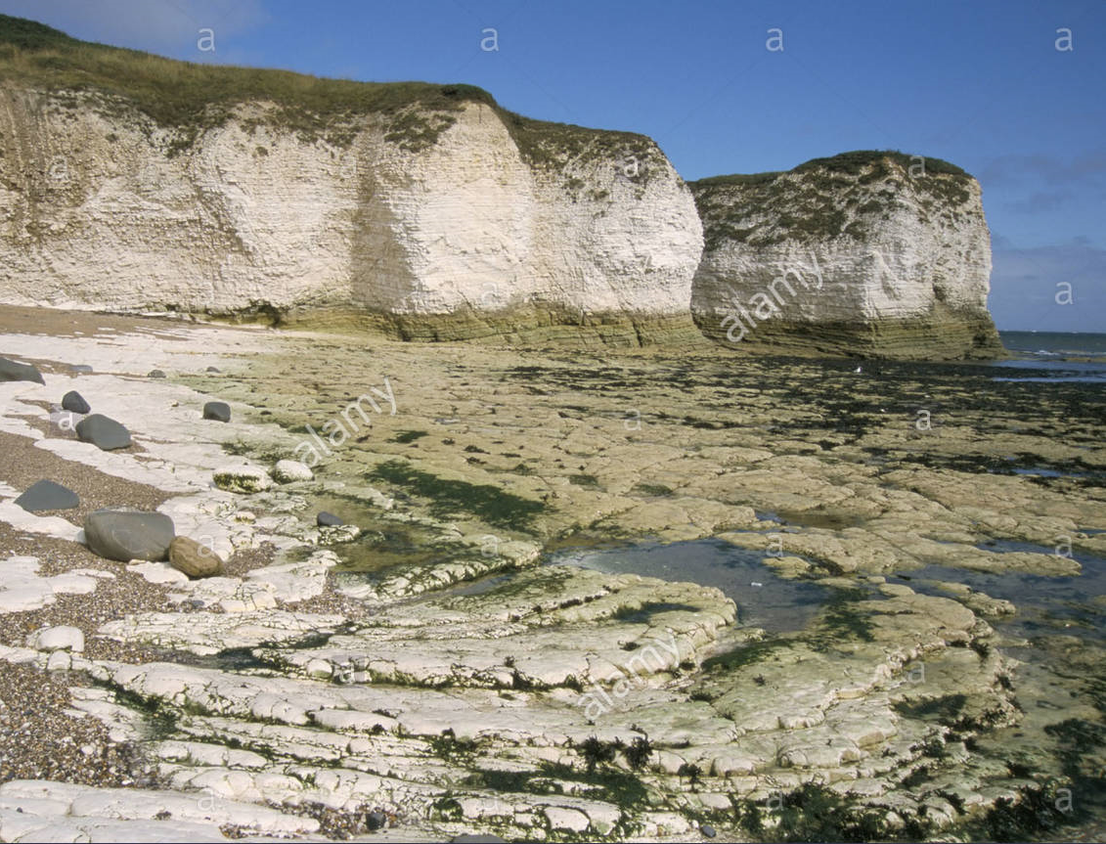
There are four different types of erosion. One type of erosion is hydraulic action. This will have affected the features I can see because the powerful waves will have crashed against the bottom of the cliff eroding it quickly.
Another type of erosion is solution, this will have affected the features I can see the chemicals in the water will dissolve the bottom of the cliff making it erode further so it will not support the top of the cliff.
These features have been created over time by erosion. The features have been caused by the destructive waves hitting the bottom of the cliff and eroding it. Eventually, the top of the cliff cannot be supported so it falls down. The platform at the bottom is eroded more slowly as it is underneath the water.
The coastal features I can see in picture C are called wave cut platforms and cliff.

Slide 8
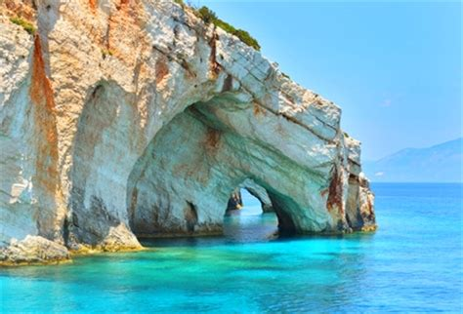
There are four different types of erosion. One type of erosion is hydraulic action. This will have affected the features I can see because the powerful waves will have crashed against headland creating the cracks to start the whole process.
Another type of erosion is abrasion, this will have affected the features I can see because the small rocks in the water will be thrown against the cracks making them bigger until they are caves and arches.
These features have been created over time by erosion. The features have been caused by the water causing small cracks in the headland which erode overtime to become caves. Eventually, the cave will be eroded all the way though and we call this an arch.
The coastal features I can see in picture D are called cracks, saves and arches.

