Slide 1


Maths
Statistics
Year One
Maths | Year 6 | Statistics | Interpret and Construct Charts and Graphs | Lesson 1 of 6: Cycle Ride Line Graphs

Slide 3
Aim
I can read and interpret line graphs.
Success Criteria
I can answer questions about data presented in a line graph.
I can interpret and answer questions about a line graph showing the relationship between two variables.
I can interpret and answer questions about line graphs representing more than one set of data.

Slide 4




Tremendous Charts!
You will have seen some charts and graphs in your maths
lessons and also in the world outside school.
What types of charts and graphs are you familiar with? Can you
describe the way each chart of graph represents information?

Slide 5
Tremendous Charts!
You will have seen some charts and graphs in your maths
lessons and also in the world outside school.
What types of charts and graphs are you familiar with? Can you
describe the way each chart of graph represents information?
A bar chart displays information using bars of different lengths. The bars can be vertical or horizontal. One axis has numbers on and the other axis shows values of something that has been measured.
Students
Back
Type of Pet

Slide 6

Tremendous Charts!
You will have seen some charts and graphs in your maths
lessons and also in the world outside school.
What types of charts and graphs are you familiar with? Can you
describe the way each chart of graph represents information?
A pictogram is a chart that uses pictures to represent data. Each picture represents a certain value, which is defined in the key.
= 1 student
Back

Slide 7
Tremendous Charts!
You will have seen some charts and graphs in your maths
lessons and also in the world outside school.
What types of charts and graphs are you familiar with? Can you
describe the way each chart of graph represents information?
A line graph features points that are connected by a line. Line graphs show how something changes, either over time or as something else changes. They show the relationship between two sets of data.
Temperature (°C)
Back
Day of the Week

Slide 8
Tremendous Charts!
You will have seen some charts and graphs in your maths
lessons and also in the world outside school.
What types of charts and graphs are you familiar with? Can you
describe the way each chart of graph represents information?
A time graph shows how data changes over time. It can
be represented as a
line or as bars.
8
7
6
5
4
3
2
1
0
Back
Distance (km)
Time (24-hour clock)

Slide 9

Cycle Ride Data
Kamil took part in a sponsored cycle ride.
During the afternoon, his fitness tracker recorded how far he cycled.
Here is the table of data showing how far Kamil cycled over two hours.
How would you represent this data as a graph?
Time (24-hour clock) | Distance Cycled (km)
14:00 | 0
14:20 | 1.2
14:40 | 2
15:00 | 3.2
15:20 | 3.6
15:40 | 4.8
16:00 | 5.4

Slide 10
Cycle Ride Graph
Kamil identifies that the data shows the change in how far he cycled over the afternoon.
He knows that a line graph is used
to show changes to measurement
over time, so he decides to draw a
line graph.
He knows that a line graph has a horizontal and vertical axis, and that the time data is usually shown along the horizontal axis.
Looking at the table of data, what scale interval do you think should be used on the horizontal axis and vertical axis?
Time (24-hour clock) | Distance Cycled (km)
14:00 | 0
14:20 | 1.2
14:40 | 2
15:00 | 3.2
15:20 | 3.6
15:40 | 4.8
16:00 | 5.4

Slide 11
Cycle Ride Graph
Kamil decides on a five-minute interval scale for the horizontal time axis and a two-kilometre interval scale for the vertical distance axis.
As he is creating the scales, Kamil makes sure the numbers are positioned on the lines of the axis.
He doesn’t label every interval on
the axis.
Kamil’s line graph also needs a title. What would be a good title for this line graph?
Time (24-hour clock) | Distance Cycled (km)
14:00 | 0
14:20 | 1.2
14:40 | 2
15:00 | 3.2
15:20 | 3.6
15:40 | 4.8
16:00 | 5.4

Slide 12
Cycle Ride Graph
He locates the time values from the data table on the horizontal axis. He finds where these horizontal lines intersect with the distance values on the vertical axis and marks each intersection with a small cross.
Now, Kamil is ready to plot the data from his cycle ride onto the line graph.
He knows that this is similar to plotting coordinates.
×
×
×
×
Time (24-hour clock) | Distance Cycled (km)
14:00 | 0
14:20 | 1.2
14:40 | 2
15:00 | 3.2
15:20 | 3.6
15:40 | 4.8
16:00 | 5.4
×
×
×

Slide 13
Cycle Ride Graph
Finally, Kamil plots the data on the graph and joins the plots together with straight lines to create a continuous line.
He can use the continuous line to find approximate distance measurements for any time during his ride.
Time (24-hour clock) | Distance Cycled (km)
14:00 | 0
14:20 | 1.2
14:40 | 2
15:00 | 3.2
15:20 | 3.6
15:40 | 4.8
16:00 | 5.4

Slide 14





Line Graph Questions
Work with your partner to decide if
Kamil’s statements about his
cycle ride are true or false.
By 14:50, I had cycled 2.6km.
True!

Slide 15
Line Graph Questions
Work with your partner to decide if
Kamil’s statements about his
cycle ride are true or false.
It took me
1 hour to
cycle 4km.
False. It took 90 minutes (an hour and a half) to cycle 4km. Kamil
only cycled 3.2km in 1 hour.

Slide 16
Line Graph Questions
Work with your partner to decide if
Kamil’s statements about his
cycle ride are true or false.
From 14:30 to 15:00, I cycled 2km.
False. Kamil cycled 1.6km
from 14:30 to 15:00.

Slide 17
Line Graph Questions
Work with your partner to decide if
Kamil’s statements about his
cycle ride are true or false.
It took me
30 minutes to cycle from 4km to 4.8km.
False. It took 10 minutes.

Slide 18


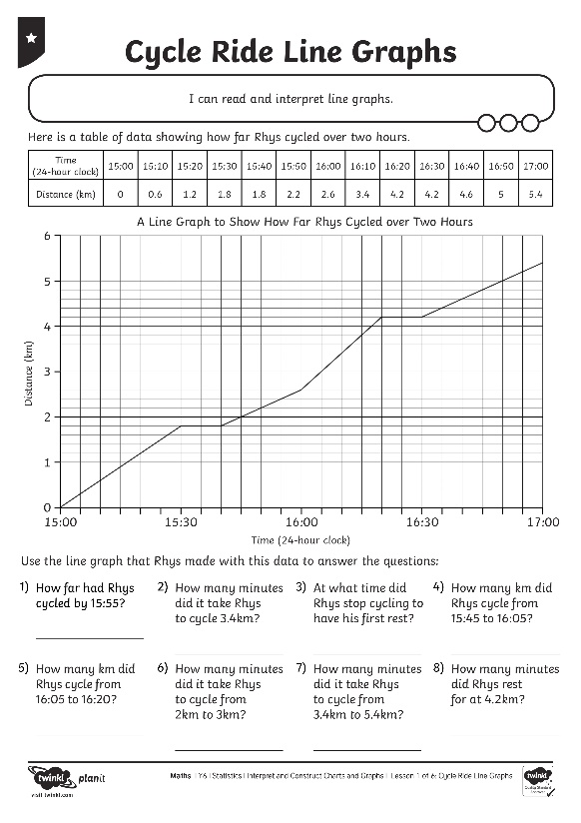
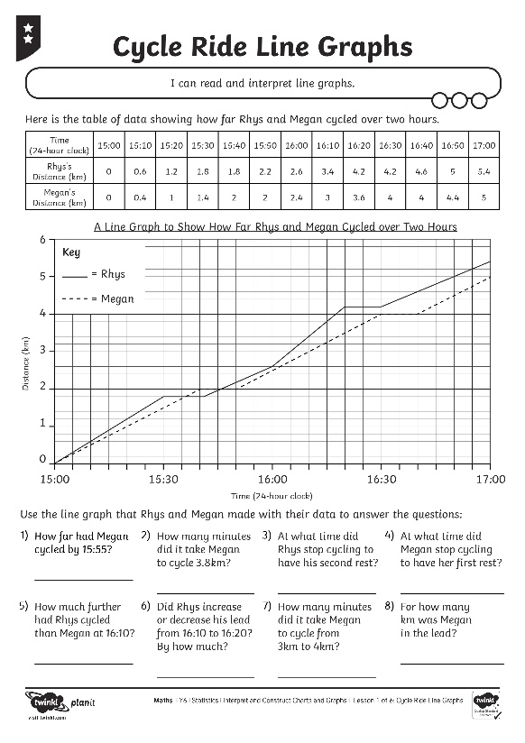
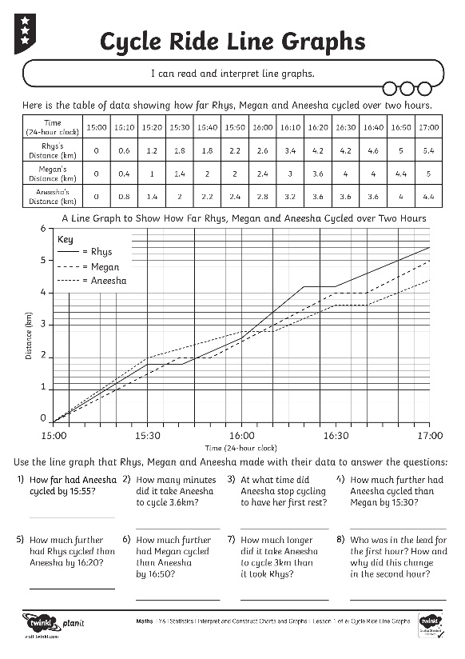
Cycle Ride Line Graphs

Slide 19
Double Data
On a whiteboard, write down five things you can tell from this
line graph.
A Line Graph to Show Kamal
and Holly’s Cycle Race
7
6
5
What does this graph show? What do the two lines represent?
4
Distance (km)
3
2
1
0
8
16
24
32
40
48
56
Time (minutes)

Slide 20

Aim
I can read and interpret line graphs.
Success Criteria
I can answer questions about data presented in a line graph.
I can interpret and answer questions about a line graph showing the relationship between two variables.
I can interpret and answer questions about line graphs representing more than one set of data.

