Slide 1
How Are Waterfalls Created?
Identify what a waterfall looks like
Consider how waterfalls are created
Summarise your understanding in a detailed paragraph to explain the formation of waterfalls

Slide 2

What do you already know?
Draw a quick image of what you think a waterfall looks like and add some labels to explain your ideas.
Identify what a waterfall looks like

Slide 3
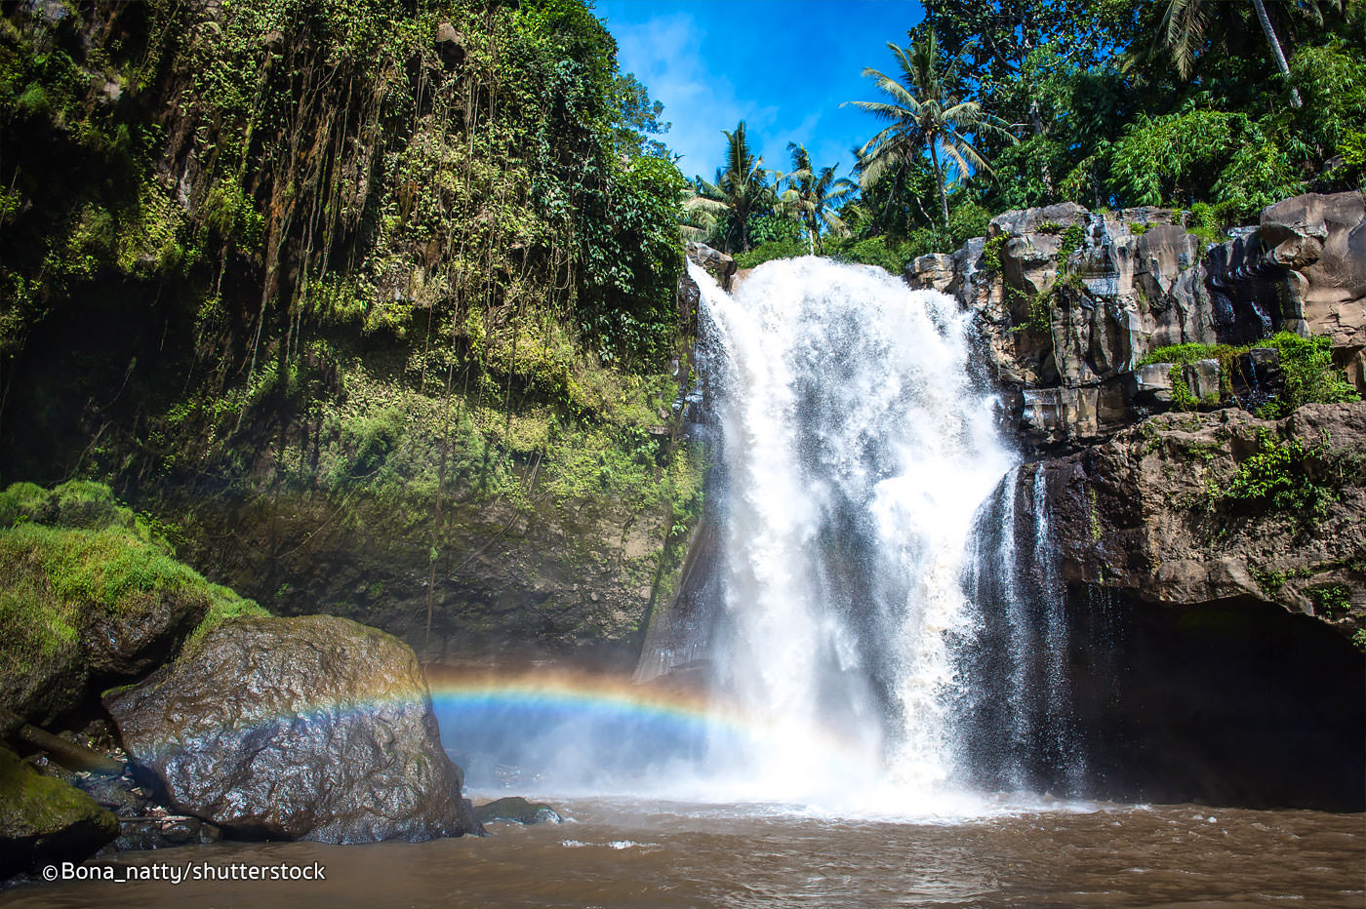
Identify what a waterfall looks like

Slide 4
Look at the information in my diagram below…
A FLOWING RIVER…
HARD ROCK
SOFT ROCK
What is different about the river as it moves along?
What will happen to the river because of these differences?
Can you explain how this will create a waterfall (using key terms)?

Slide 5
Look at the information in my diagram below…
A FLOWING RIVER…
HARD ROCK
SOFT ROCK
What is different?
The rock changes from hard rock to soft rock.
What will happen? the water will erode (wear away) the soft rock.
Can you explain how this will create a waterfall?
The soft rock will continue to erode, creating a steep drop, which the water will fall down!

Slide 6
Consider how waterfalls are created
A FLOWING RIVER…
HARD ROCK
SOFT ROCK
So, eventually, what will happen to the river?
What will the river do to the soft rock?
EROSION

Slide 7
Consider how waterfalls are created
A FLOWING RIVER…
HARD ROCK
SOFT ROCK
SOFT ROCK
SOFT ROCK
SOFT ROCK
SOFT ROCK

Slide 8
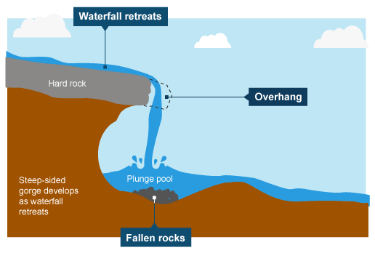
NEW KEY WORDS ALERT!
Consider how waterfalls are created
Plunge Pool, Overhang, Cave
Cave

Slide 9
NEW KEY WORDs ALERT!
Consider how waterfalls are created
Plunge Pool and Overhang
What will happen to the soft rock by the plunge pool?
What will happen to the overhang on top?
Challenge:
What will this do to the waterfall?

Slide 10
NEW KEY WORDs ALERT!
Consider how waterfalls are created
Plunge Pool and Overhang
The soft rock will be eroded by the water crashing and splashing in the plunge pool
The ‘overhang’ will eventually fall into the bottom of the waterfall as there is nothing underneath to support it
Challenge:
This will mean the waterfall moves backwards over time!

Slide 11
https://www.curriculumbits.com/prodimages/details/geography/waterfalls.html
Consider how waterfalls are created
Watch this animation to see the process in action!

Slide 12
Task:
I would like you to draw your own diagram of a waterfall
You need to include ALL of the key terms on the next slide
You can decide if you would like to use the template provided in worksheet 1 and just add labels
OR you can challenge yourself and draw your own diagram!

Slide 13
Add the following labels to your diagram:
When you’ve finished check your diagram is correct by looking at the next slide…
Hard Rock
Soft Rock
Erosion
Plunge Pool
Cave
Fallen rocks (draw them in)
Overhang
Waterfall will move backwards (add an arrow)
Consider how waterfalls are created

Slide 14
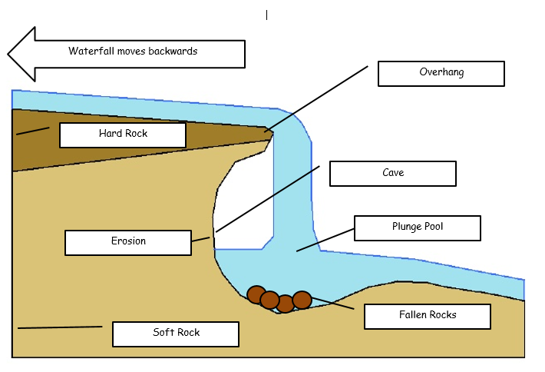

Slide 15
Task: Write a detailed explanation about how waterfalls are formed.
By following the bullet points below you should end up with an excellent paragraph!
Explain which two different types of rocks can be at the bottom of a river
Explain which rock will be eroded
What will happen overtime when that rock is eroded (why doesn’t the rive just flow in a straight line anymore)?
What is a plunge pool?
What does the plunge pool do to the soft rock at the side (and what is created)?
How does this affect the overhang at the top?
How does this affect the waterfall?
When you’ve finished check your work using the answers on the next slide…
Summarise your understanding in a detailed paragraph to explain the formation of waterfalls

Slide 16
Check your work- remember to tick if you’ve included everything, but also add to your description if you’ve missed something!
In order for a waterfall to form, there needs to be two different types of rock at the bottom of the river, hard rock and soft rock.
The water in the river will erode (wear away) the soft rock as this type of rock is much weaker.
Overtime the soft rock will erode so much that a steep drop will be created which the water will fall over
The plunge pool is the name given to the bottom of the waterfall where the water splashes and crashes down
The water from the plunge pool will erode the side of the waterfall which will create a cave behind the water.
Eventually, the overhang at the top of the waterfall will fall down to the bottom as there is nothing underneath to support it. The fallen rocks will sit at the bottom of the waterfall.
Over time, this means that the waterfall will continue to move backwards as the overhang will fall off time and time again.

