Slide 1
The following pictures were all taken in Italy.
What do you think they show?
Justify why you think that!

Slide 2
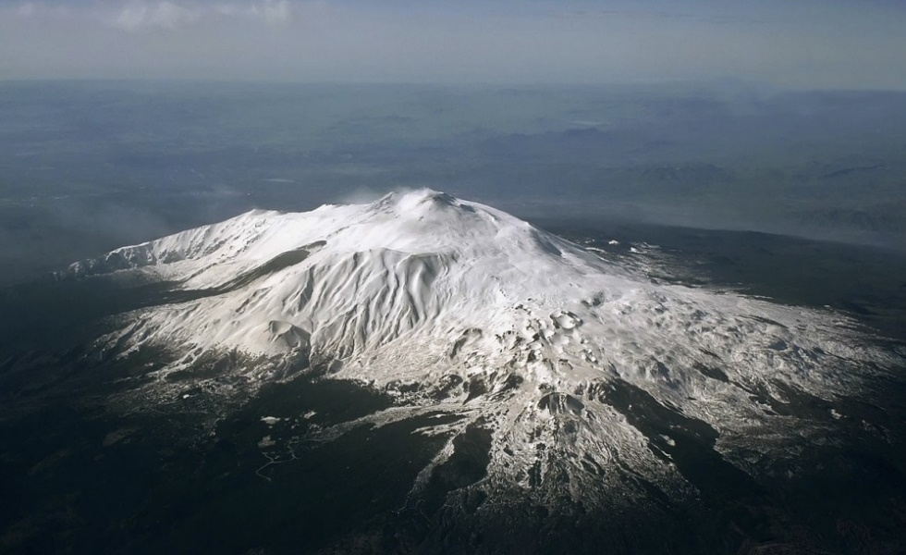
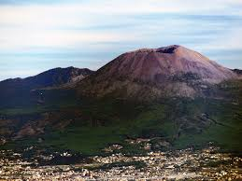
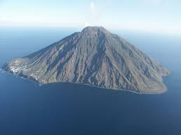

Slide 3
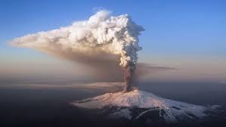
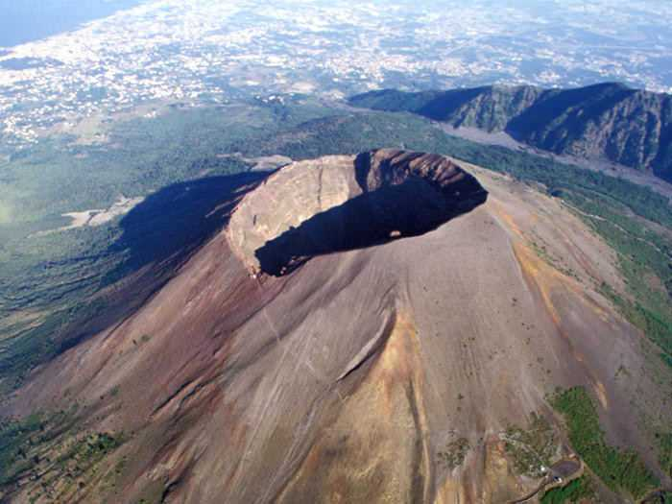
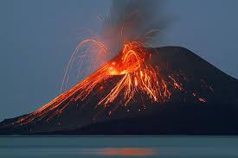
Mount Etna
Mount Vesuvius
Stromboli

Slide 4
They’re all VOLCANOES!

Slide 5
Physical features of Italy- Volcanoes
Explain the key terms active, dormant and extinct
Compare at least two of Italy’s active volcanoes
Make judgements about Italy’s volcanoes using the information you have gathered

Slide 6
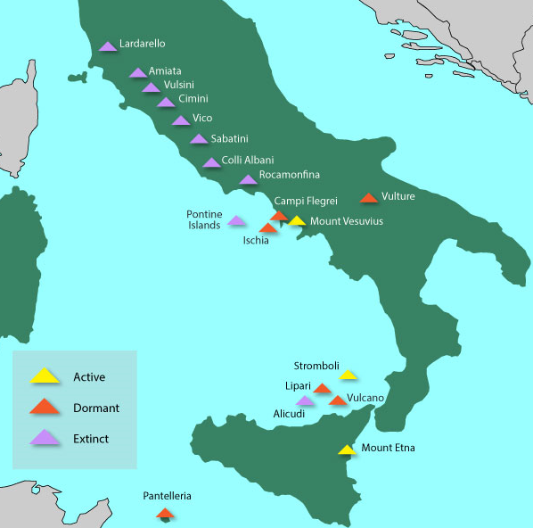
Explain the key terms active, dormant and extinct
Killer Question:
Why do you think Italy has so many volcanoes? Think back to last lesson…

Slide 7
Killer Question:
Why do you think Italy has so many volcanoes? Think back to last lesson…
Remember, Italy has lots of mountain ranges. Millions of years ago when mountains were created, the same processes created lots of volcanoes (we’ll go into this in more detail in year 8!)

Slide 8
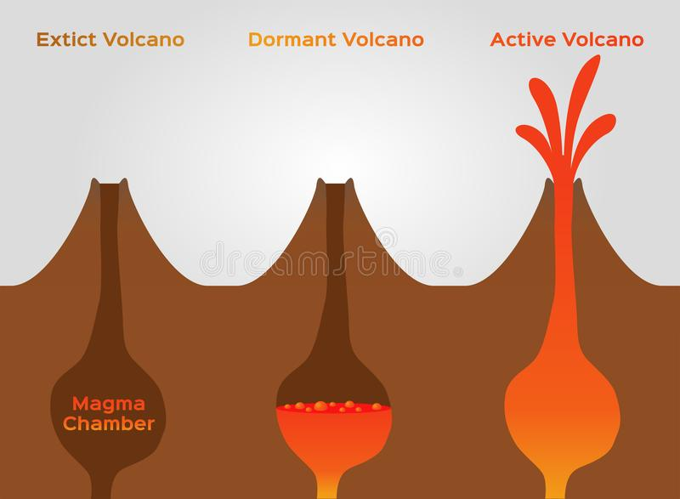
Explain the key terms active, dormant and extinct
EXTINCT
DORMANT
ACTIVE
This means the volcano hasn’t erupted for millions of years and will not erupt again.
This means the volcano hasn’t erupted for thousands of years, but it could erupt again.
This means the volcano has erupted recently and it is very likely that it will erupt again soon!

Slide 9
Compare at least two of Italy’s active volcanoes
Task: Open worksheet 1. Here you will information about the 3 volcanoes, with a fact file to complete after each one.
Use the success criteria below to make sure you’re working to your level!
Developing | I have investigated one of Italy’s main volcanoes
Secure | I have compared two of Italy’s volcanoes
Secure+ | I have analysed all three of Italy’s volcanoes in order to make comparisons

Slide 10
Exit Ticket: Complete the questions below then look at my answers!
Make judgements about Italy’s volcanoes using the information you have gathered…
I think Italy’s most dangerous Volcano is:
Mount Etna/ Mount Vesuvius/ Stromboli (circle your choice)
I think this because:
I think Italy’s least dangerous Volcano is:
Mount Etna/ Mount Vesuvius/ Stromboli (circle your choice)
I think this because:

