Slide 1



l/o: To explain how resistance affects a wire.
Developing
Secure
Secure +
I can: Describe the term ‘resistance’.
I can: Explain how factors affect resistance.
I can: calculate resistance using the equation.

Slide 2
Find the false!
In a series circuit, the potential difference around components adds up to the potential difference of the cells.
In a parallel circuit, potential difference is shared between the branches.
In a parallel circuit, the lamps stay bright because the potential difference is the same in the branches as the cells.
In a series circuit, the lamps get dimmer as you add more to the circuit because potential difference is shared.
Notes:
2

Slide 3

Student model – what is resistance?
l/o: To explain how resistance affects a wire.

Slide 4
What is resistance?
Resistance is measured in _______.
Resistance is when electrons are slowed down (resisted) by _____________ in a conductor.
Resistance can be increased by ______________ because…
Resistance can be decreased by ______________ because…
Key words:
Ohms
Atoms
Electrons
Current
Resist/ slow
l/o: To explain how resistance affects a wire.

Slide 5
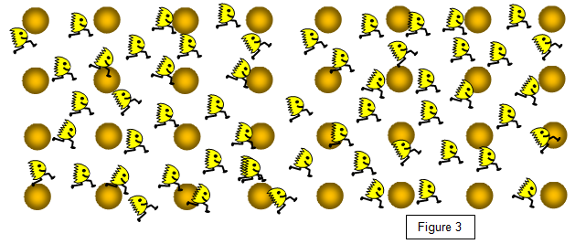
So what affects resistance?
Based on the model, what factors do you think could affect resistance?
l/o: To explain how resistance affects a wire.

Slide 6
Differences in resistance between conducting and insulating components
Materials that have low resistance to electric current are called electric conductors. Many metals—including copper, aluminum, and steel—are good conductors of electricity. Water that has even a tiny amount of impurities is an electric conductor as well.
Materials that have high resistance to electric current are called electric insulators. Examples include most nonmetallic solids, such as wood, rubber, and plastic. Dry air is also an electric insulator.
Q: What do you think lightning rods are made of?
A: Lightning rods are made of metal, usually copper or aluminum, both of which are excellent conductors of electricity.

Slide 7
Rearranging the resistance formula
To find an unknown simply cover the value you are trying to find.
The triangle reveals the formula needed.
V
I x R
l/o: To explain how resistance affects a wire.

Slide 8
Use the equation to complete the blanks.
Voltage (V) | Current (amps) | Resistance (ohms)
230 |  | 6.0
230 |  | 23.0
6 | 3.0
1.5 |  | 15.0
1.2 | 4.0
 | 1.5 | 5.0
Extension: A kettle is plugged into a 240 volts mains socket. There is a current of 10 amps in the heater element.
Calculate the resistance of the element.
l/o: To explain how resistance affects a wire.

Slide 9
Use the equation to complete the blanks.
Voltage (V) | Current (amps) | Resistance (ohms)
230 | 38.3 | 6.0
230 | 10 | 23.0
6 | 3.0 | 2
1.5 | 0.1 | 15.0
1.2 | 4.0 | 0.3
7.5 | 1.5 | 5.0
l/o: To explain how resistance affects a wire.

Slide 10
Questions – choose two to answer
They increase with difficulty as you go down.
What factors affect resistance?
Use the model to explain how factors affect resistance.
Explain how a ‘filament’ bulb uses resistance.
If resistance increases, what will happen to the current?
If resistance increases, what would happen to the appliance?
EXTENSION: Come up with reasons why an electrician need to know resistance in a circuit.

