Slide 1



l/o: Investigate series and parallel circuits
Developing
Secure
Secure +
I can: Explain what happens to the performance of components in a series circuit and a parallel circuit.
I can: List the components of a simple circuit.
I can: Describe what is meant by a series circuit and a parallel circuit.

Slide 2
Which do you think are true?
When the switch is open, there’s a gap in the circuit. This lets the electricity escape.
The wire in the circuit is already full of electricity. The battery just pushes it round the circuit.
The battery is full of electricity. It comes out of one end, flows around the circuit and back to the battery to refill it.
When the switch is open, the circuit is not complete. The bulb does not light up.

Slide 3
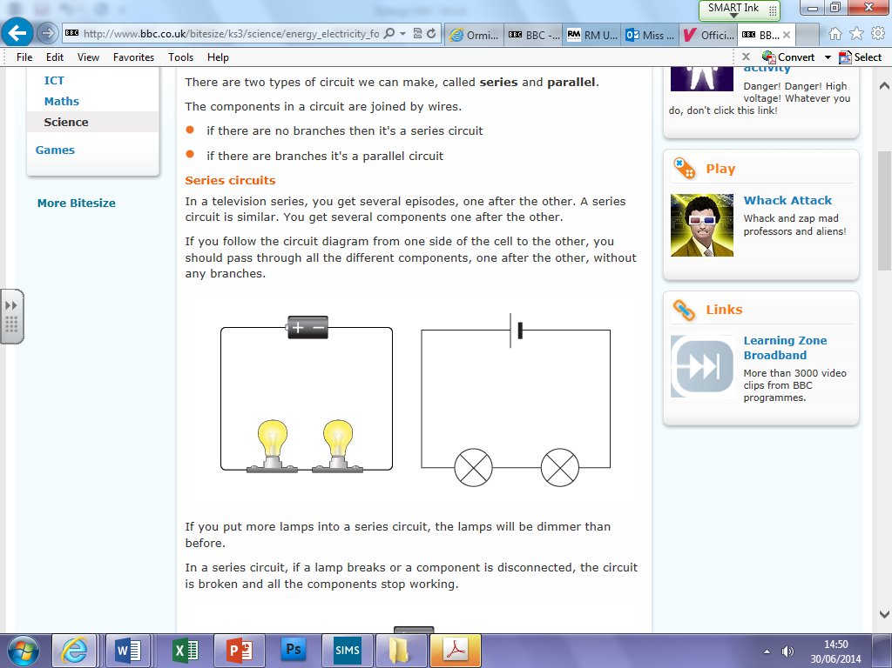
Series circuits- like your favourite TV series one after the other
Circuit diagrams in pencil using a ruler.
l/o: Investigate series and parallel circuits.

Slide 4
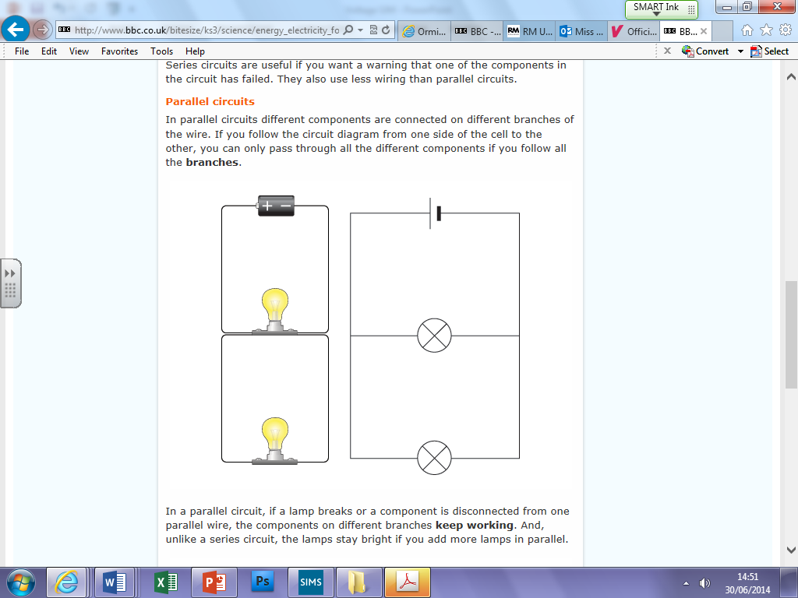
Parallel circuits
Series circuits have the components in a single line.
Parallel circuits have branches so its like the components are on different circuits.
l/o: Investigate series and parallel circuits.

Slide 5
Reflection
WB: List the components of a simple circuit.
Battery pack, wires, crocodile clips, lamp/motor.
D: Describe what is meant by a series circuit.
Components follow each other – one after the other.
S: Explain what happens to the performance of components in a series circuit.
The more bulbs you add the dimmer they all become.
S+: Apply observations to ideas about energy transfer.
The more components there are the less energy each one receives.
Extension: What did you notice about the brightness of the bulbs as you added more branches?
l/o: Investigate series and parallel circuits.

Slide 6
Conclusion
Current is the flow of energy around a circuit - it is not used up the energy is.
This means the current is the same at all points in a series circuit.
In a parallel circuit the amps are shared.
l/o: Investigate series and parallel circuits.
Notes:
Suggest what the observations tell us about current.

Slide 7
Recap
Add the missing current values- explain your answer.
l/o: Investigate series and parallel circuits.

