Slide 1



l/o: Explain the changes in voltage in different types of circuit.
Keywords:
Current
Voltage
Potential difference
Energy
Developing
Secure
Secure +
I can: Describe voltage in series circuits.
I can: Describe voltage changes in series and parallel circuits.
I can: Explain and compare voltage changes to series and parallel circuits.

Slide 2
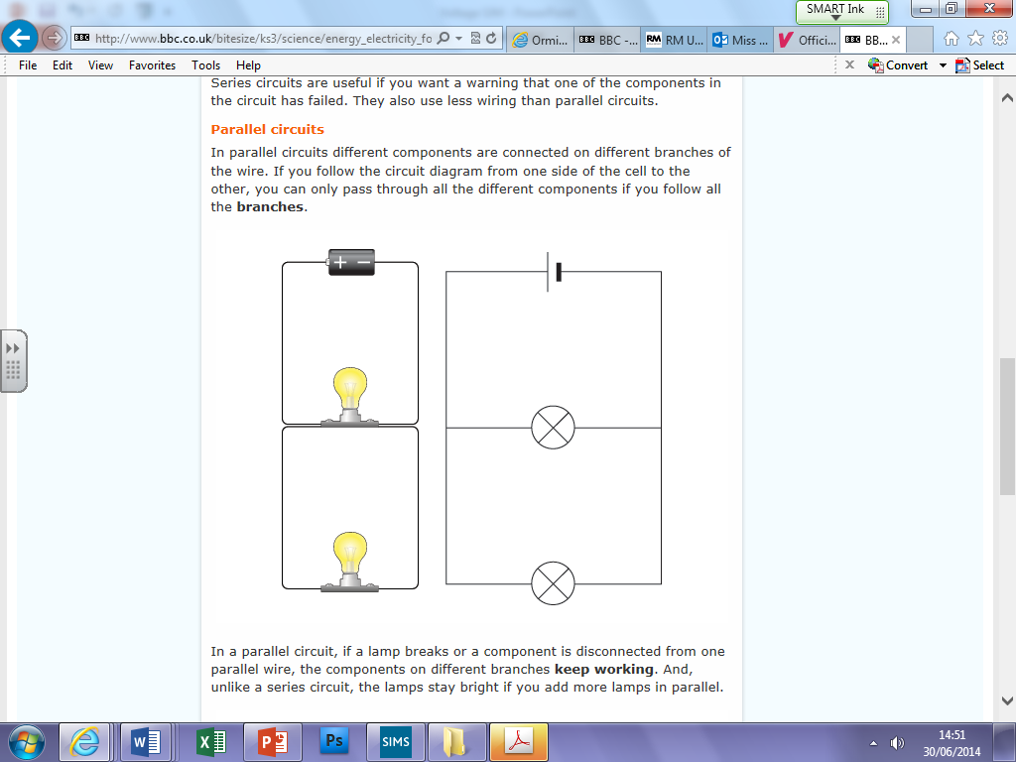
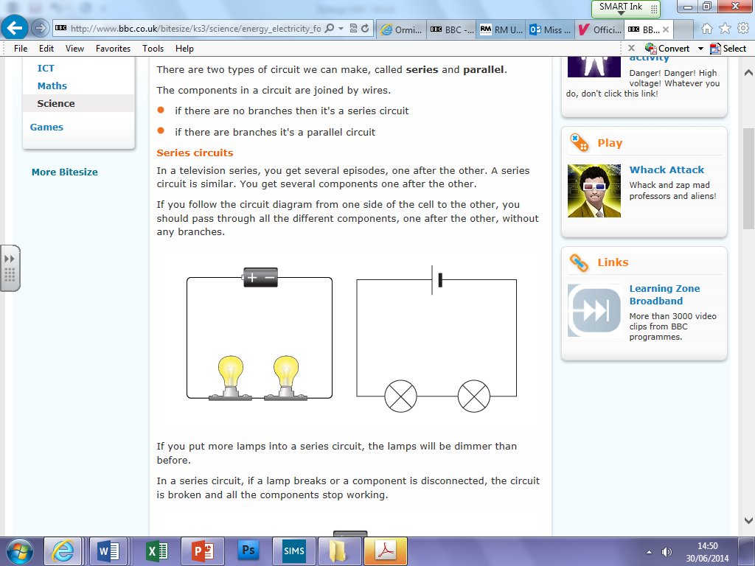
What’s the difference between the circuits?
l/o: Explain the changes in voltage in different types of circuit.

Slide 3
What is voltage?
Voltage is a measure of potential difference.
The difference in energy between 2 points in a circuit.
Voltage is a measure of the ’push’/ energy from the battery on the charges in the circuit.
The higher the voltage - the bigger the push - the brighter the lamp.
l/o: Explain the changes in voltage in different types of circuit.

Slide 4
Prediction: Level Ladder
S - What happens to voltage in a parallel circuit?
S+ - Explain and compare voltage changes to series and parallel circuits using the model (particles).
l/o: Explain the changes in voltage in different types of circuit.

Slide 5
Measuring voltage
Voltmeters are always put in parallel to a component
X
V
l/o: Explain the changes in voltage in different types of circuit.

Slide 6
HOW DID YOU DO?
D - In a series circuit, the voltage is shared.
S - In a parallel circuit, the voltage stays the same in all branches and components.
S+ - In a series circuit the voltage is shared, where as, in a parallel circuit the voltage stays the same because the electrons split across the branches, carrying the voltage.
l/o: Explain the changes in voltage in different types of circuit.

Slide 7
Choose a question
What happens to the voltage in a series circuit?
What is the difference between the voltage in a series circuit to the voltage in a parallel circuit?
What would happen to the voltage if more cells were added?
When you add lots of lamps to a circuit, sometimes they won’t light. Why is this?
l/o: Explain the changes in voltage in different types of circuit.

Slide 8
Key words:
Potential difference: potential difference, also called voltage, across an electrical component is needed to make a current flow through it.
Voltage: energy or potential difference (Volts)
Battery: is a number of cells.
Energy: Light energy, heat energy
l/o: Explain the changes in voltage in different types of circuit.

Slide 9
Extension activity (Level 7)
What affect does adding more cells have on the voltage in the circuit?
The more cells added to the circuit, the brightness of the bulb_____________ because…
What affect does decreasing the number of cells have on the voltage in the circuit?
Decreasing the number of cells in a circuit will _________________ the brightness of the bulb because…
What would happen to the components if you kept adding cells?
The more cells added to a series circuit, the bulb would _____________because…
What would happen if you kept adding components to the circuit?
Include in your answers:
Brightness of the bulb.
Voltage.
Literacy target: Your answers should be in full sentences.
l/o: Explain the changes in voltage in different types of circuit.

Slide 10
HELP SHEET: CONCLUSION WRITING FRAME
My prediction was correct/ incorrect.
LEVEL 2: My results showed that in a ________________ circuit, the potential difference around components was ______________.
LEVEL 3: In a _______________ circuit, the potential difference is________________ because…
LEVEL 4: In a circuit, the potential difference does not exactly total the potential difference around the battery; the reason for this is…

