Slide 1



l/o: Use models to explain electric current.
Keywords:
Energy
Charge
Model
Developing
Secure
Secure +
I can: Describe what is meant by current.
I can: Explain how energy is carried.
I can: Use models to explain current.

Slide 2
Circuits
CURRENT is measured in AMPS using an AMMETER
A
l/o: Use models to explain electric current.

Slide 3
Current – what is it?
Current is the flow of charge.
The battery pushes the charge around the circuit.
The moving charges are electrons.
Electrons flow from negative to positive.
Current is not used up.
l/o: Use models to explain electric current.

Slide 4

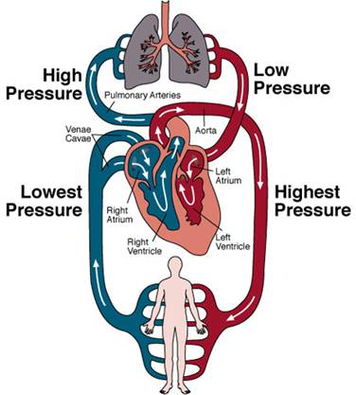

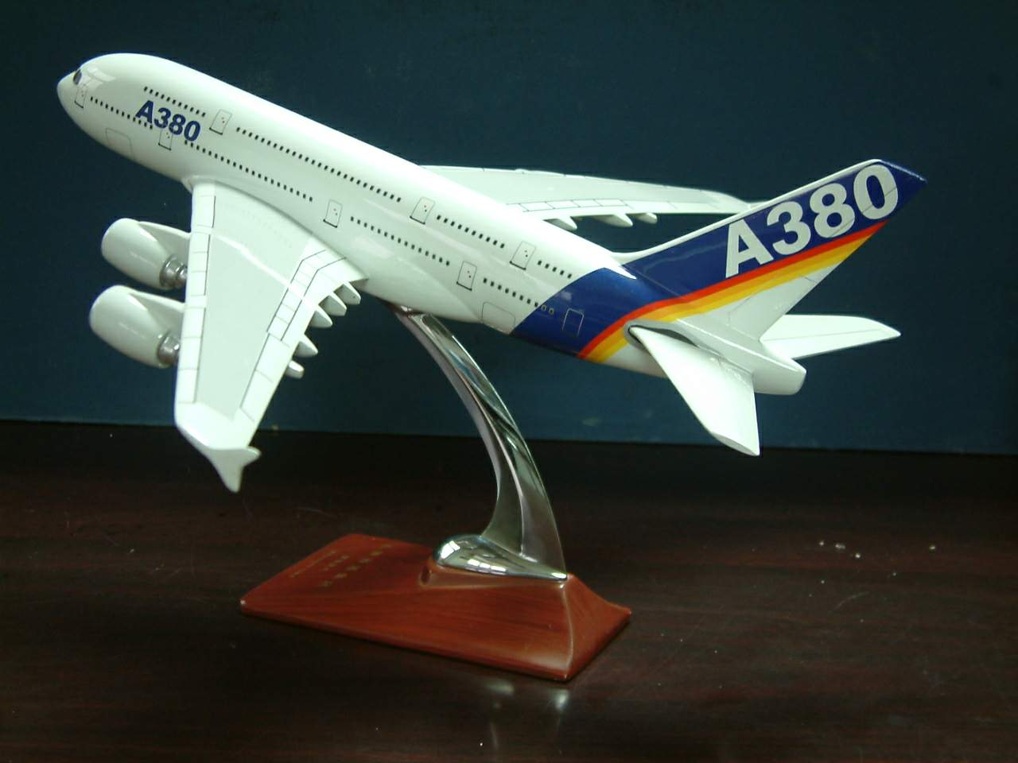
What is a Model?
l/o: Use models to explain electric current.

Slide 5
Central Heating
A circuit is like a central heating system in a house:
There is a pump that pushes water round the system. The water everywhere starts to move AT THE SAME TIME
There are pipes that CARRY the water.
In the pipes the water is FLOWING.
CELL
low pressure
High pressure
Boiler
and
pump
WIRES
Flow
of
water
radiator
COMPONENT/
BULB
l/o: Use models to explain electric current.

Slide 6
Central Heating
CELL
Boiler
and
pump
WIRES
radiator
COMPONENT/
BULB
l/o: Use models to explain electric current.

Slide 7
Central Heating
Advantages?
Boiler
and
pump
Disadvantages?
radiator
l/o: Use models to explain electric current.
Notes:
Advantages – Water is always there so effect is seen straight away
Disadvantages - Losing energy through the pipes. Pipe breaks water flows out

Slide 8
Creating your own models
Use the appropriate level sheet to create your own model for current
l/o: Use models to explain electric current.

Slide 9
Assessment Grid
S+ | S | D
Created their own model of an electric circuit. | Created a model of an electric circuit. | Created a comic strip of the student model of an electric circuit.
Labelled the cell, wires and bulb. | Labelled the cell, wires and bulb. | Labelled the cell, wires and bulb.
Discussed the advantages and disadvantages of the model. | Listed two advantages and one disadvantage of the model. | Gave one advantage of using this model.
Assess your partners work and give one CONSTRUCTIVE comment on how they could improve their work.
l/o: Use models to explain electric current.

Slide 10
True or False?
Electric current is measured in amps. True!
You can measure current using a bulb. False!
Electric current is used up in a bulb or buzzer. False!
All electrons are stored in the cell/battery and only come out when connected in a circuit. False!
Electrons are present in all parts of a circuit before the cell/battery is connected. True!
You can measure current using a bulb. False!
You can measure current using an ammeter. True!
l/o: Use models to explain electric current.

Slide 11
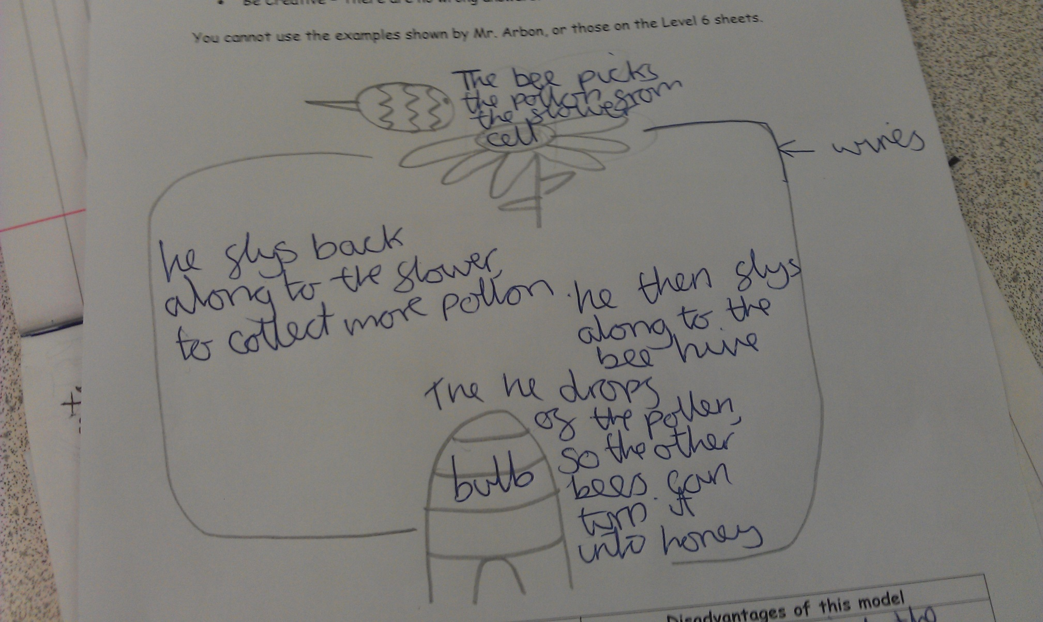
Example 1
l/o: Use models to explain electric current.

Slide 12
ASDA Home Deliveries
A delivery van delivering your food is like a circuit:
At ASDA the van is LOADED with food.
The driver then drives to your house along ROADS.
At your HOUSE the food is UNLOADED.
The empty vans drive back to the supermarket at the SAME SPEED they left.
ASDA
MY HOUSE

Slide 13
ASDA Home Deliveries
CELL
ASDA
WIRES
MY HOUSE
COMPONENT/
BULB

Slide 14
ASDA Home Deliveries
ASDA
Advantages?
Disadvantages?
MY HOUSE
Notes:
Advantages – Get to see electrical energy being dropped off at the bulb.
Disadvantages – Takes a while before the energy gets to the bulb

Slide 15
Cell
Wire
Student without skittle
2
Student with skittles
(number of skittles inside
The circle)
Bulb

Slide 16
Cell
Wire
Student without skittle
Bulb
2
Student with skittles
(number of skittles inside
The circle)

