Slide 1



l/o: To explain how static electricity is created.
Keywords:
Static electricity
Charge
Current
Developing
Secure
Secure +
I can: Describe an electric current.
I can: Explain how static electricity is caused.
I can: Use the idea of delocalised electrons to explain how static electricity is made.

Slide 2
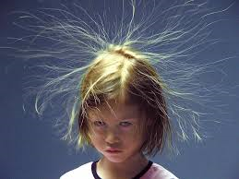
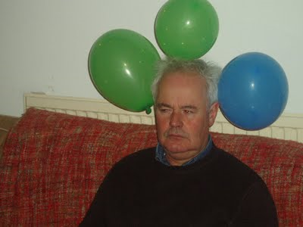
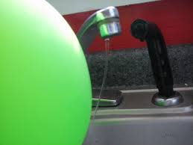
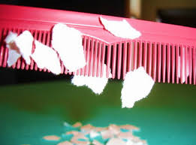
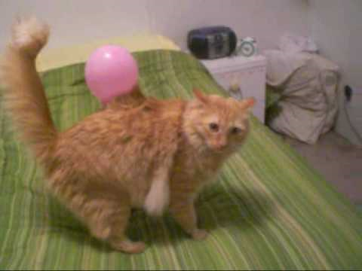
What do all these pictures have in common?
l/o: To explain how static electricity is created.

Slide 3
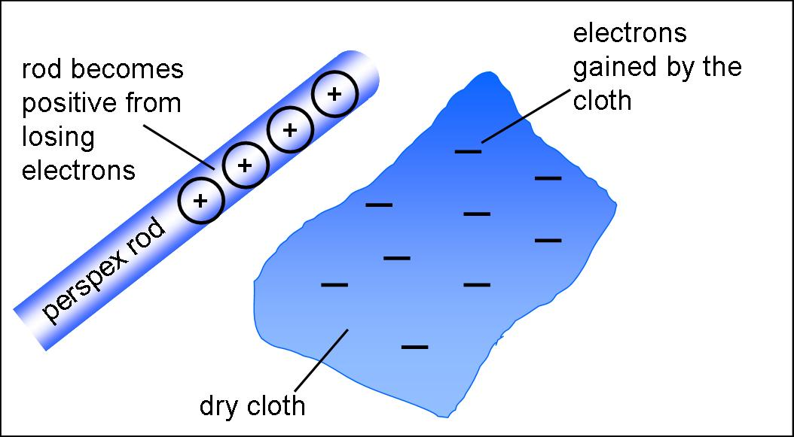
Static electricity
Produced by rubbing 2 materials together.
When the materials are rubbed charges are passed between the 2, one becomes positively charged and the other negatively charged (they both have different charges).
Electrons are transferred from one object to the other.
Electrons are negatively charged
The same type of charges repel
Opposite charges attract
l/o: To explain how static electricity is created.

Slide 4
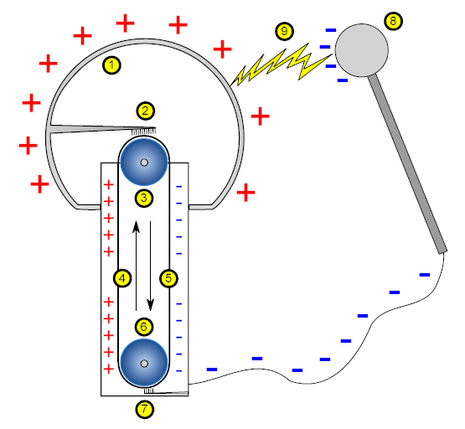
How does a Van Der Graff generator work?
l/o: To explain how static electricity is created.

Slide 5
Van de Graaff
1. Hollow metallic sphere (with positive charges)
2. Electrode connected to the sphere, a brush ensures contact with the belt
3. Upper roller
4. Side of the belt with positive charges
5. Opposite side of the belt with negative charges
6. Lower roller (metal)
7. Lower electrode (ground)
8. Spherical device with negative charges, used to discharge the main sphere
9. Spark produced by the difference of potentials
l/o: To explain how static electricity is created.

Slide 6
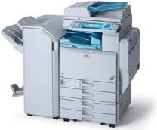
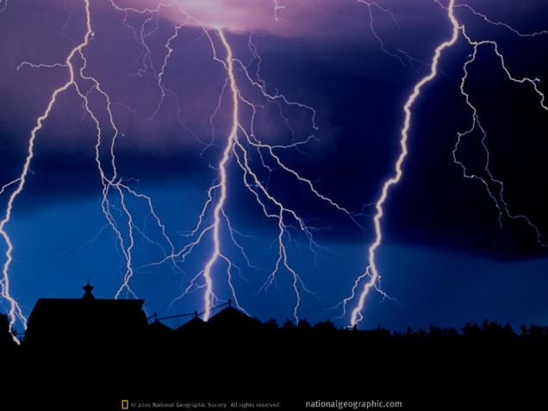
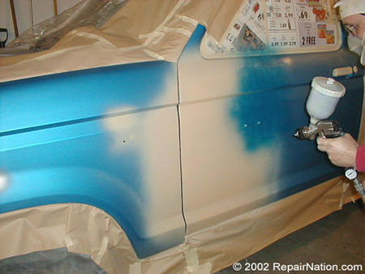

Uses and dangers
1.
2.
3.
4.
For each of the pictures discuss how static electricity is used or is potentially dangerous.
l/o: To explain how static electricity is created.

Slide 7
Questions – choose three to answer
They increase with difficulty as you go down.
What did you find out?
How is static electricity made?
Why would some materials develop charge better than others?
How would you discharge an object from static?
EXTENSION: Come up with reasons why we would need to know what becomes charged by static.
l/o: To explain how static electricity is created.

