Slide 1



The Carbon Cycle
How many electrons has carbon got in its outer shell?
Developing
Secure
Secure +
I can: define the composition of the atmosphere.
I can: describe the changes of atmosphere over time.
I can: explain how atmosphere has changed over time.

Slide 2

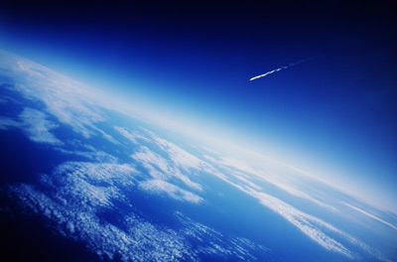
What is the atmosphere?
What gases does it contain?
What do you think these gases are?
l/o: to understand the composition of the atmosphere and why it changes.

Slide 3
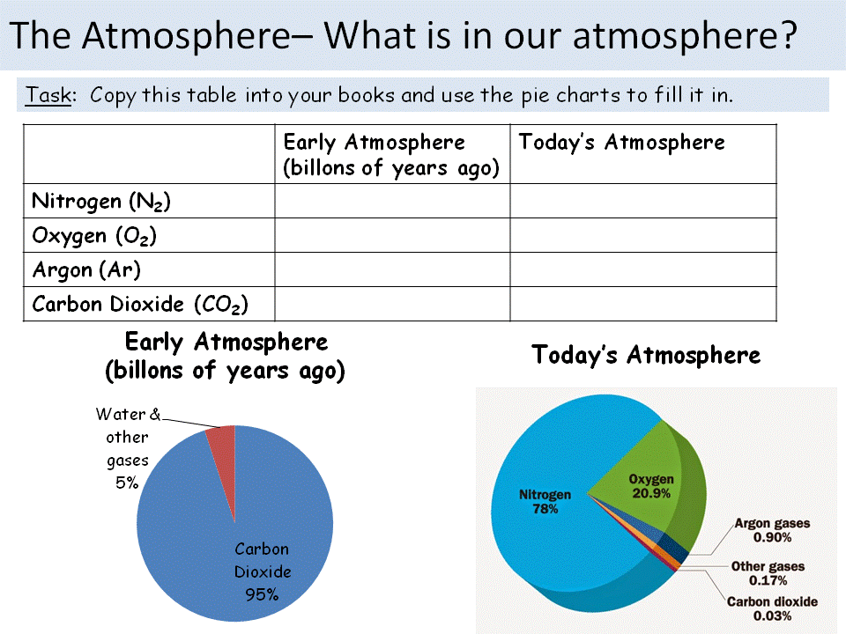
Compare the early atmosphere with todays atmosphere.
Can you describe why the atmosphere has changed?

Slide 4

Phase 1:
Volcanoes = Steam & CO₂
Volcanoes kept erupting giving out Steam and CO₂
The early atmosphere was nearly all CO₂
The earth cooled and water vapour condensed to form the oceans
l/o: to understand the composition of the atmosphere and why it changes.

Slide 5

Phase 2:
Green Plants = Oxygen
Green plants ran riot!
Some CO₂ dissolved into the oceans
Green plants steadily converted CO₂ into O₂ by the process of photosynthesis
Nitrogen released by denitrifying bacteria
l/o: to understand the composition of the atmosphere and why it changes.

Slide 6
Phase 3:
Ozone Layer = Animals & Us
The build up of O₂ killed off early organisms - allowing evolution of complex organisms
The O₂ created the Ozone layer (O₃) which blocks harmful UV rays from the sun
Virtually no CO₂ left
l/o: to understand the composition of the atmosphere and why it changes.

Slide 7
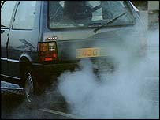
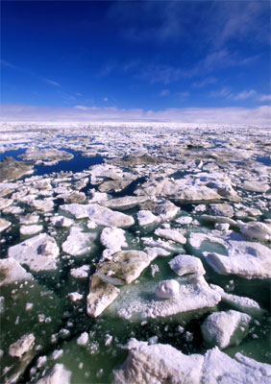
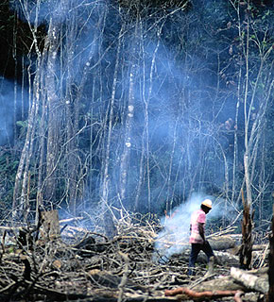
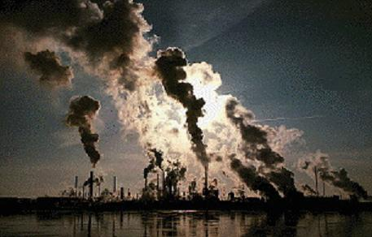
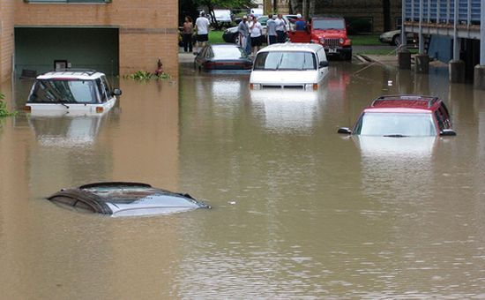
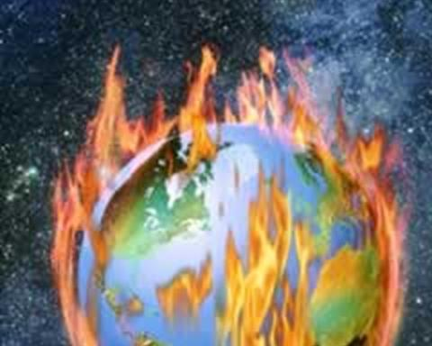

What activities do humans do to alter the atmosphere?
l/o: to understand the composition of the atmosphere and why it changes.
Notes:
Teacher notes
This image covers many of the topics in relating to the Earth’s atmosphere and can be used to start discussion.
Discussion points:
Boy taking inhaler: Air pollution is sometimes blamed for the rise in asthma levels in the UK. However, there is not conclusive evidence this is the case. Air pollution can act as a trigger for people who already have asthma, but it is unclear if air pollution causes people to have asthma.
Gas boiler behind boy: Faulty gas appliance can produce toxic carbon monoxide due to incomplete combustion.
Woman smoking by bus stop: Cigarette smoke adds pollutants to the atmosphere, including carbon monoxide.
Van: road vehicles produce pollution including carbon dioxide and dust. There is a thick layer of particulates on the side of the van
Cyclist: Cycling does not pollute the environment and can be used to reduce the use of fossil fuels. Cyclist sometimes wear protective face masks so that they do not breath in fumes.
Statue: Acid rain, caused by sulfur dioxide and nitric oxides, erodes limestone. The features of this statue have become less distinct over time due to erosion by acid rain.
Aeroplane: Air travel is responsible for a large amount of air pollution.
Factory: Factories are a source of air pollution.

Slide 8
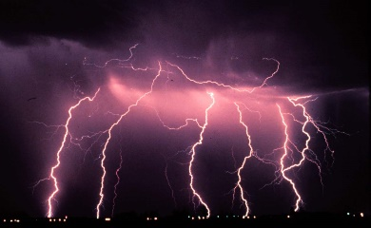
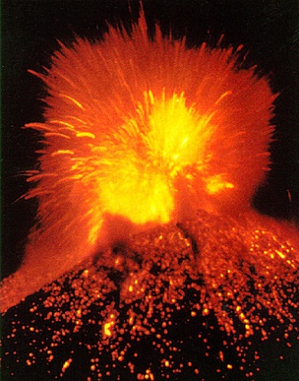
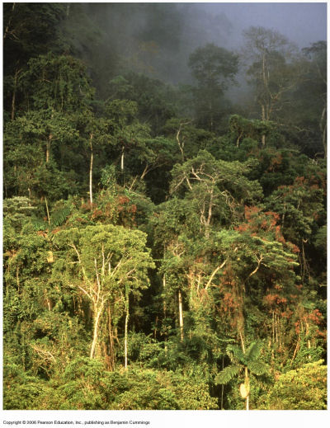
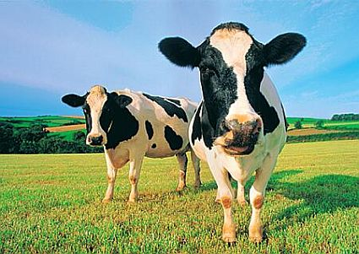
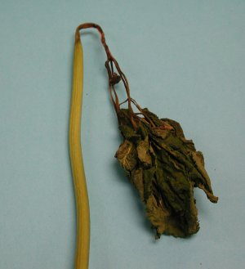
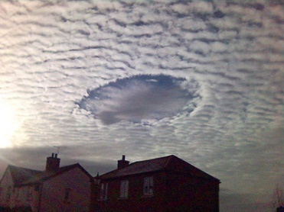
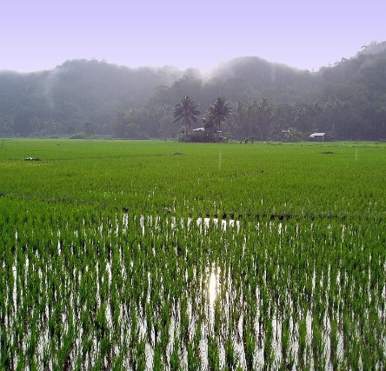
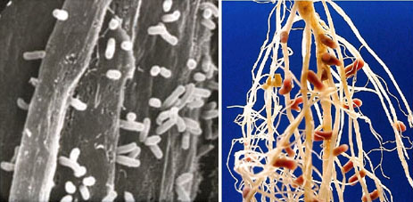
How do natural phenomena affect the atmosphere
Lightning
Volcanoes
Rain forests
Cows and rice fields
Photosynthesis
Decay
Ozone
Nitrogen fixing
l/o: to understand the composition of the atmosphere and why it changes.

Slide 9
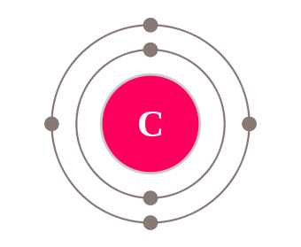
The Carbon Cycle
l/o: to understand the composition of the atmosphere and why it changes.

Slide 10

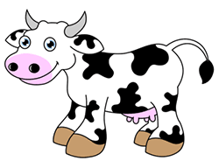



Carbon compounds are contained in every living organism.
We can follow carbon as it moves through living things, into the Earth’s atmosphere and back. This is called the Carbon Cycle.
l/o: to understand the composition of the atmosphere and why it changes.

Slide 11
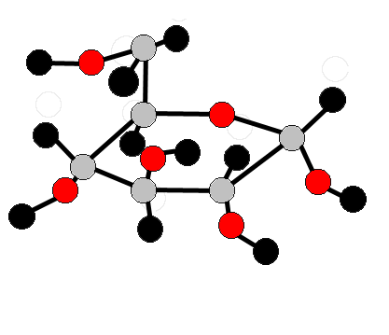
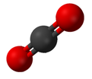
Plants absorb carbon dioxide from the atmosphere and turn it into glucose using photosynthesis
Animals eat the plants for the energy in glucose and then release carbon dioxide back into the atmosphere.
l/o: to understand the composition of the atmosphere and why it changes.

Slide 12


PLANTS
PHOTOSYNTHESIS
RESPIRATION
DEATH & DECAY
l/o: to understand the composition of the atmosphere and why it changes.

Slide 13
ANIMALS
RESPIRATION
FEEDING
DEATH & DECAY
EXCRETION

Slide 14
DECOMPOSERS
RESPIRATION
DEATH & DECAY
FUNGI AND BACTERIA

Slide 15
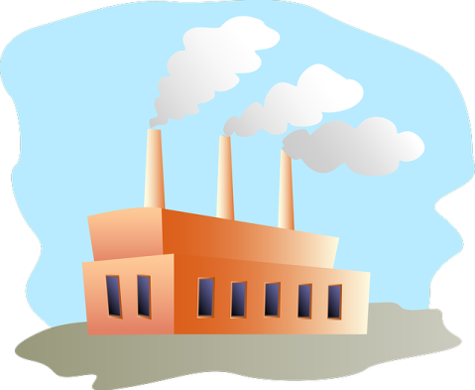

FOSSIL
FUELS
COMBUSTION
DEATH AND
FOSSILISATION

Slide 16
Use todays key words to label the diagram
G.
A.
B.
B.
B.
C.
F.
D.
D.
E.

Slide 17
Use todays key words to label the diagram
G.
A.
B.
B.
B.
C.
F.
D.
D.
E.

Slide 18
ANSWERS
PHOTOSYNTHESIS
COMBUSTION
RESPIRATION
RESPIRATION
RESPIRATION
FEEDING
DEATH & DECAY
DEATH & DECAY
EXCRETION
DEATH AND
FOSSILISATION
FUNGI AND BACTERIA

Slide 19
Use your diagram to answer the following sentences...
For thousands of years the carbon cycle stayed the same because....
The organisms that remove carbon dioxide are....
The organisms that add carbon dioxide are....
Carbon dioxide has increased over the last 200 years because...
l/o: to understand the composition of the atmosphere and why it changes.

