Slide 1



The Earth
What is the chemical formula for carbon dioxide?
Developing
Secure
Secure +
I can: Describe properties of the different layers of the Earth’s structure.
I can: Describe the composition of the atmosphere.
I can: compare the advantages and disadvantages of a given model of the Earth’s structure.

Slide 2
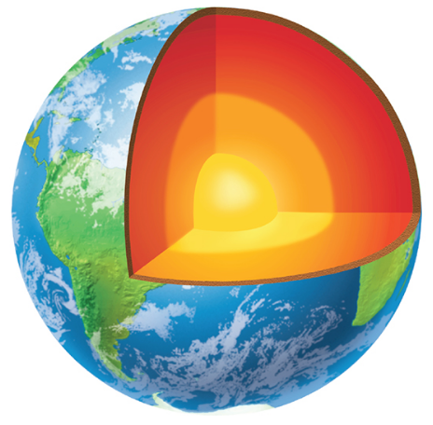
Prepare to Learn
What is today’s lesson about?
l/o: to describe the structure of the Earth.

Slide 3
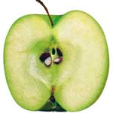
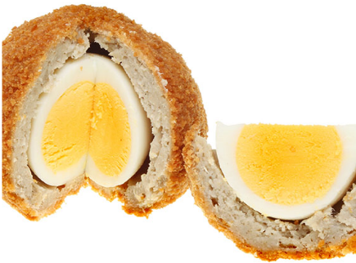
Which is most like the Earth? Why?
l/o: to describe the structure of the Earth.

Slide 4
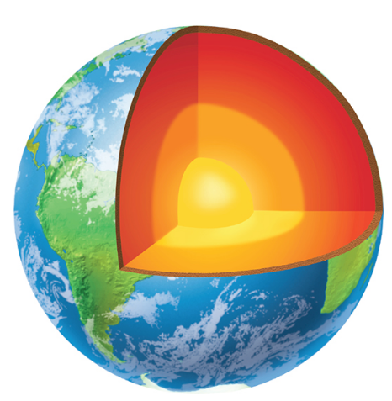
Describing the Earth
What facts can you write down about each of these layers:
Inner core
Outer core
Mantle
Crust
Troposphere
Atmosphere
l/o: to describe the structure of the Earth.

Slide 5
The Composition of the Earth
1) The atmosphere
2) The hydrosphere (oceans and seas)
3) The lithosphere (crust)
l/o: to describe the structure of the Earth.

Slide 6
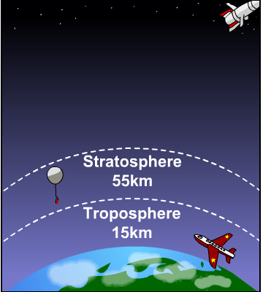
l/o: to describe the structure of the Earth.

Slide 7
The Structure of the Earth
A thin crust - 10-100km thick
A mantle – has the properties of a solid but it can also flow
A core – made of molten nickel and iron. Outer part is liquid and inner part is solid
l/o: to describe the structure of the Earth.

Slide 8
The Earth’s Atmosphere
Present day atmosphere contains 78% nitrogen, 21% oxygen, 1% noble gases and about 0.03% CO₂
Carbon dioxide,
water vapour
Oxygen
Nitrogen
Noble gases
l/o: to describe the structure of the Earth.

Slide 9
Modelling Earth’s structure
The Earth contains many different layers that all have different properties.
Someone has made a model of the Earth by cutting a tennis ball in half and filling the middle with scrunched-up red tissue paper.
Is this a good model of the Earth?
Describe how you would create your own model of the Earth. Are there any problems with your model?
l/o: to describe the structure of the Earth.

Slide 10
Pick one question to answer.
Describe properties of the different layers of the Earth’s structure.
Describe the composition of the atmosphere.
Compare the advantages and disadvantages of your model of the Earth’s structure.

