Slide 1
Choropleth Map of China’s Population Distribution
Understand what a choropleth map is
Calculate the population data for different regions in China
Create your own choropleth map showing the population distribution in China

Slide 2
Understand what a choropleth map is
Today your task is to make your own choropleth map…
First, let’s find out what one is!

Slide 3
Choropleth Maps
Understand what a choropleth map is
Choropleth maps are maps that use different colours to show different themes.
First you collect information, or data, about somewhere.
Then you colour code the information
The you colour the relevant bits of the map depending which category they fall into
The following slides will show you some examples…

Slide 4
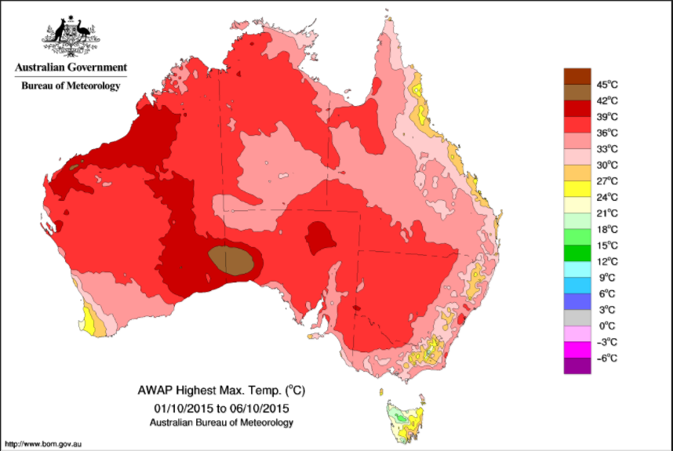
What information do the colours on this map show us about Australia?
Understand what a choropleth map is

Slide 5
The different colours show the highest temperature in different parts of Australia.
Understand what a choropleth map is

Slide 6
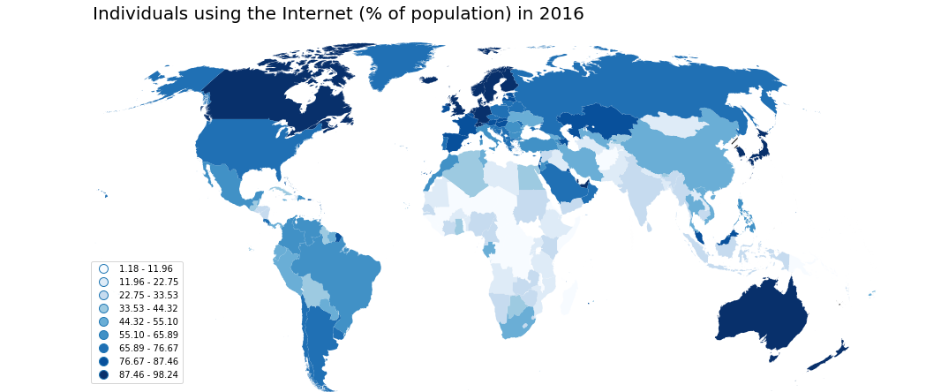
What information do the different colours tell us about the world?
Understand what a choropleth map is

Slide 7
The colours show us which countries use the most internet. The darker the colour, the higher the percentage of people in that country use internet.
Understand what a choropleth map is

Slide 8
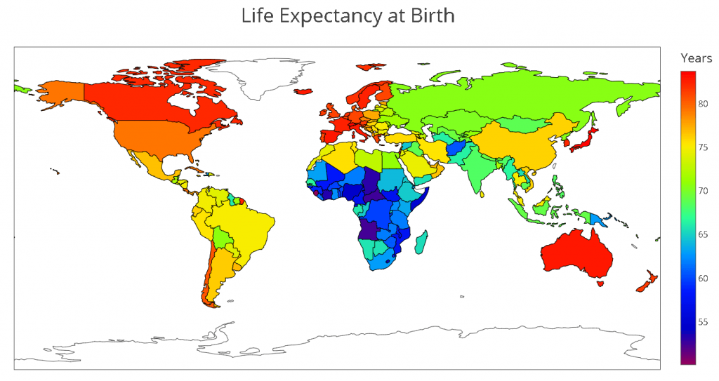
What do these colours tell us about the world?
Understand what a choropleth map is

Slide 9
The different colours show the average age people are likely to live to in different countries.
Understand what a choropleth map is

Slide 10
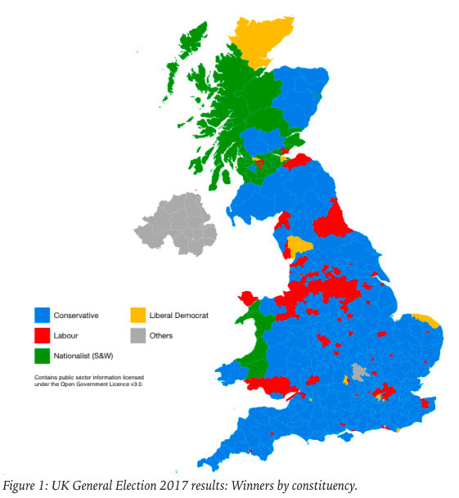
What information do the colours give us about the UK?
Understand what a choropleth map is

Slide 11
The colours show which political party different places in the UK voted for in the 2017 election.
Understand what a choropleth map is

Slide 12
Test your knowledge: Developing
What is a choropleth map?
Give an example of something a choropleth map could show.
Use one of the maps to tell me, on average, how long people live for in Russia
Use one of the maps to tell me which continent uses the least internet
Use one of the maps to tell me which political party most people voted for in 2017
Use one of the maps to tell me the highest temperature in Australia

Slide 13
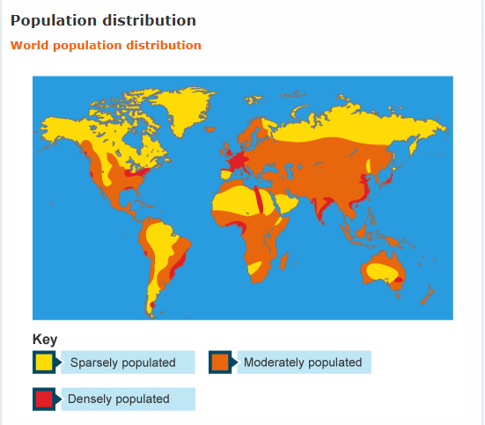
You are going to create a choropleth map to show population distribution (like this map). However, your map will be far more detailed using lots more colour and focusing just on China!

Slide 14
Test your knowledge: Secure
7) You are going to create a choropleth map of China to show how the country’s population is distributed.
To do this you need shade each region of China a different colour based on how many people live there.
Your first task is to complete worksheet 1…
Follow the instructions carefully!
Note: you can change the colours to ones you have at home as you’ll need to use the colours for the next task.

Slide 15
Test your knowledge: Secure+
8) Create your own choropleth map.
To do this you need to print worksheet 2 and colour each region in the colour you identified in worksheet 1.
If you cannot print the map, try adding a coloured dot using the word on the computer!

Slide 16
Test your knowledge: Secure+
9. When you have finished shading your map, add a key to show what the different colours mean:
  Densely populated: red, blue
  Moderately populated: yellow, orange
  Sparsely populated: green
  (or whichever colours your changed it to)

