Slide 1
Entrance Ticket
Why do we breathe?
Why do we breathe more when we exercise etc?
What do you think happens to your breathing when you go to sleep?

Slide 2



l/o: To understand fully the process of inhaling and exhaling.
Developing
Secure
Secure +
I can: State what happens to the ribcage and diaphragm during inhaling and exhaling.
I can: Describe the processes of inhaling and exhaling.
I can: Explain how the actions of the ribcage and diaphragm lead to inhaling and exhaling.

Slide 3
What is breathing?
The process by which you take IN oxygen and give OUT carbon dioxide.
When you breathe in:
Your diaphragm goes down/up
Your ribs expand/move inwards
Lungs get bigger/smaller
When you breathe out:
Your diaphragm goes down/up
Your ribs expand/move inwards
Lungs get bigger/smaller
Notes:
IN:
Diaphragm goes down
Ribs expands (move outwards)
OUT:
Diaphragm moves up
Ribs move inwards

Slide 4
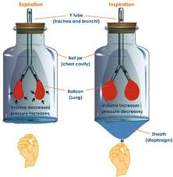
Bell Jar Lungs
Strengths
Weaknesses
Improvements?

Slide 5

Exercise and breathing rate
What changes take place while we exercise?
Discuss for few minutes with a partner.
Write down your ideas.

Slide 6
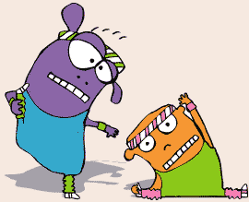
What changes take place when we exercise??
Heart
Rate
Increases
Breathe
faster
Breathe Muscles Sweaty Hot
Deeper get tired

Slide 7

What happens to our breathing
rate when we exercise?
  Students measure their resting breathing rate for 1 minute
1- squats
2- jogging on the spot
3- star jumps
4- Fast punching in air
Write down your breathing rate before and after exercise

Slide 8
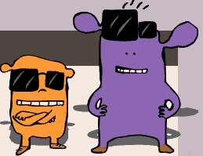
Breathing Rate
Breathing rate= Number of breaths per minute
Resting Breathing rate= _____________Breaths/min
Squats=___________________________
Jogging on the spot=____________________
Star Jumps=________________________
Punching in air=_____________________

Slide 9
Breathing and exercise
Can you explain why we must breathe quicker and deeper during exercise?
Hint – what do we need more of?

Slide 10
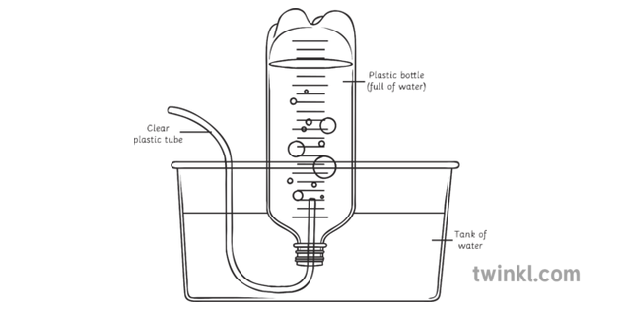
Measuring Lung Volume

Slide 11
Lung Volume
Can you see a relationship between lung volume and certain characteristics in people?
What do you think affects the volume of your lungs?

Slide 12
Keeping the lungs clean
Special cells help remove dust and other particles from the lungs to prevent disease
  cilia
  Cells which produce mucus
The mucus traps the harmful substances and the cilia sweep it up and out of the lungs into the throat

Slide 13
I am really pleased with...
Today I have tried to...
To progress I need to...
Today I have learned that...
In these questions I have learnt that…
I have been able to…
But I got stuck on...
Self Assessment
(SA)
Before this lesson I could already...
Now I can also...
One thing I need to remember from today’s lesson is...
I was successful when I…
I did not know how to…
But now I can…
The most important thing I learned today is...
I can see the link between...

