Slide 1



l/o: to understand the structure of the gas exchange system
Developing
Secure
Secure +
I can: Explain how the adaptations of the parts of the gas exchange system help them perform their function.
I can: Name the parts of the gas exchange system.
I can: Describe how parts of the gas exchange system are adapted to their function.

Slide 2
Draw me a quick sketch of what you think the lungs look like!

Slide 3
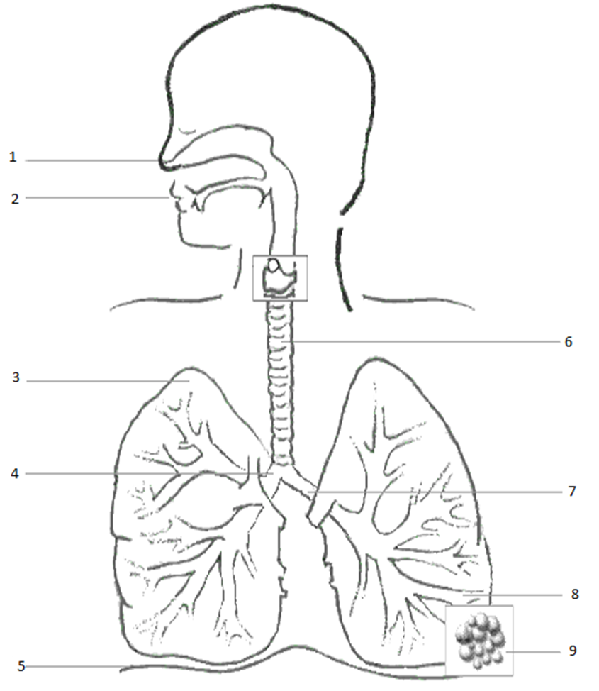

Slide 4
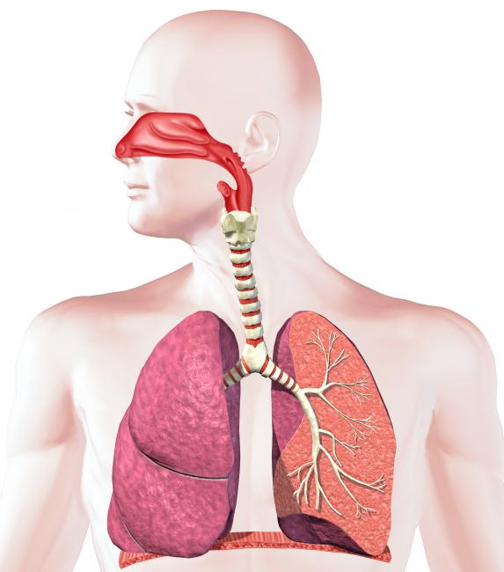
The respiratory system
Trachea
Bronchioles
Bronchus
Lung
Alveoli
(“air sacs”)
Diaphragm

Slide 5


Why do we breathe?
  Why is breathing important?
  What gases are involved?

Slide 6
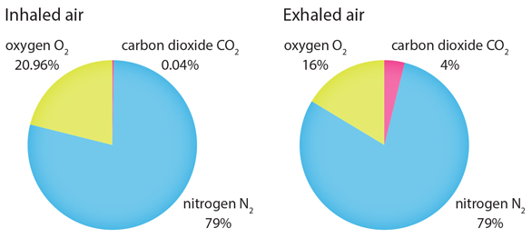

Slide 7
The Earth’s Atmosphere
Present day atmosphere contains 78% nitrogen, 21% oxygen, 1% noble gases and about 0.03% CO₂
Carbon dioxide,
water vapour
Oxygen
Nitrogen
Noble gases

Slide 8
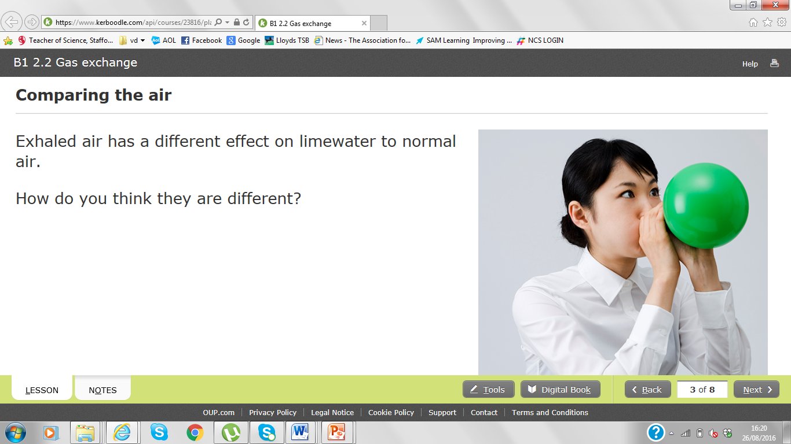

Slide 9
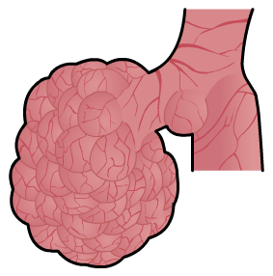
Gas exchange at the alveoli
The alveoli are bunches of tiny air sacks inside the lungs.
When you breathe in, they fill with air.

Slide 10
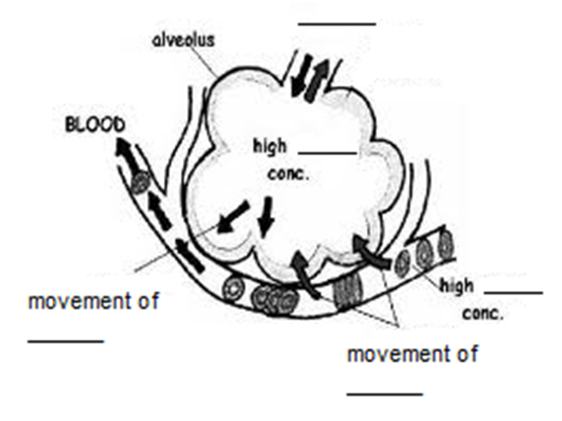

Slide 12
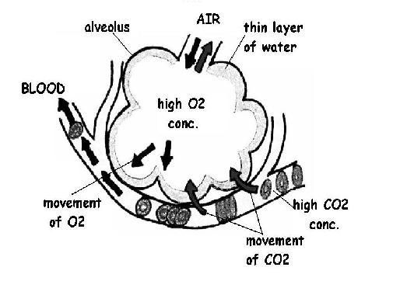

Slide 13
Alveoli
Why do alveoli have this shape?
How could you simply investigate the surface area of alveoli?

Slide 14
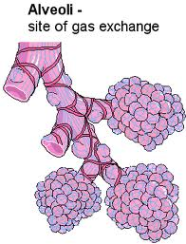
Review
Why do they need to have a large surface area?
Your lungs are amazing. They are about the size of a pair of footballs with a surface area that could almost cover a tennis court!!

Slide 15
Lungs
The lungs are important in breathing
Breathing is when oxygen is taken into the blood
The lungs are protected by the ribs
Site of gas exchange

Slide 16
PROGRESS CHECK
Put these in the correct order...
Mouth
Alveoli
Bronchus
Trachea
Bronchioles

Slide 17
PROGRESS CHECK
In the correct order:
Mouth
Trachea
Bronchus
Bronchioles
Alveoli

Slide 18
What are the effects of smoking and asthma on the gas exchange system?

Slide 19
Pick one question to answer.
Name the parts of the gas exchange system
Describe how parts of the gas exchange system are adapted to their function.
Explain how the adaptations of the parts of the gas exchange system help them perform their function.

