Slide 1
B1.2 Structure and function of body systems.

Slide 2



l/o: To understand the hierarchy of organisation in a multicellular organism.
Developing
Secure
Secure +
I can: Explain how the different tissues in an organ, and the different organs in an organ system function together.
I can: Define and state examples of tissues, organs, and organ systems.
I can: Describe the hierarchy of organisation in a multicellular organism.

Slide 3

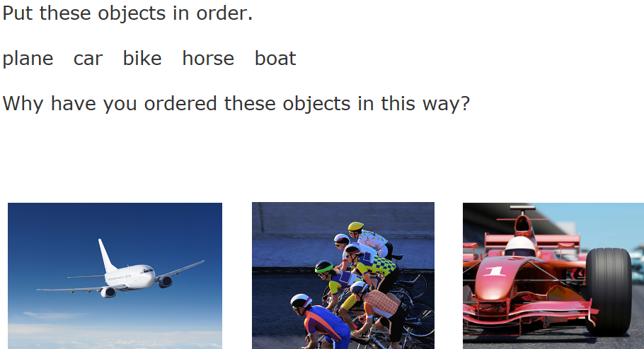
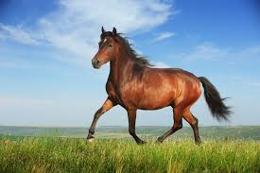
Prepare to Learn

Slide 4
Organisation in multicellular organisms
How do cells work together in the whole organism?
Watch the animation on the organisation of multicellular organisms.
https://www.youtube.com/watch?v=SzKKYYIlJ-c

Slide 5
What is a cell?
What is a tissue?
What is an organ?

Slide 6
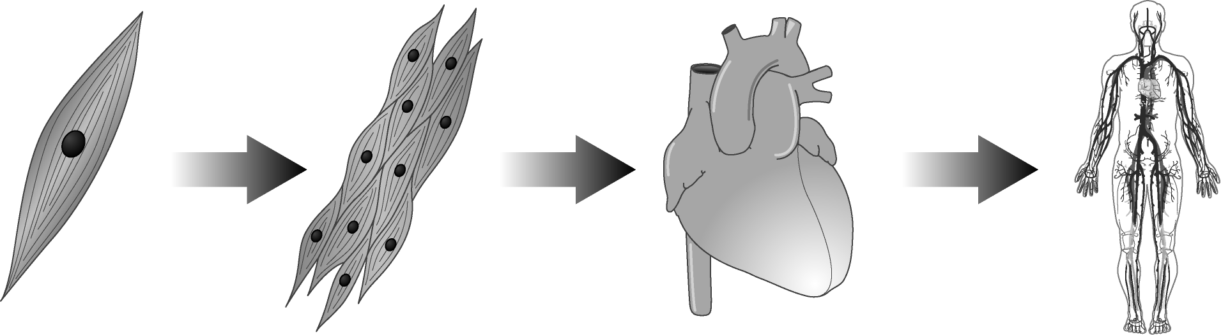
Cell –> tissue -> organ -> organ system

Slide 7
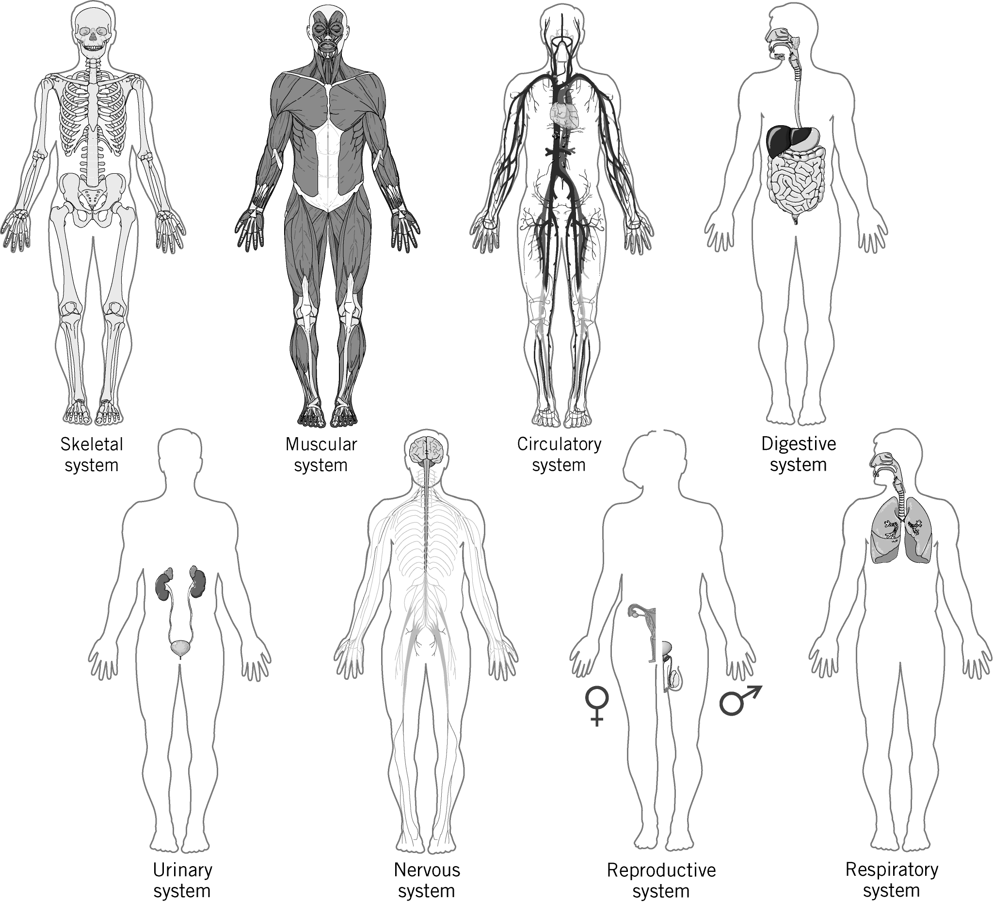

Slide 8
Research and Presentation
Research the organ systems.
Find out what organs are in the system and what the system's function is.

Slide 9
Questions
State what all living things are made from.
Name three parts of all cells.
Name three specialised cells.
What is a tissue?
State the name of a group of tissues working together.
What is an organ system?

Slide 10
Extension
Explain how the organs of the digestive system function together to digest food. (6 marks)

