Slide 1
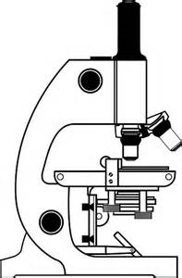
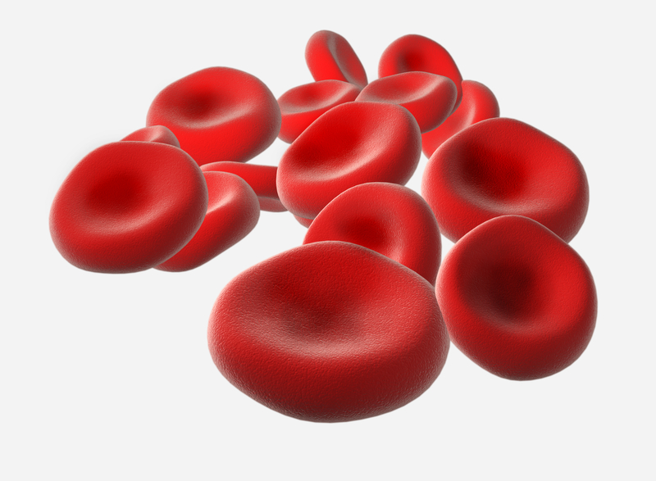
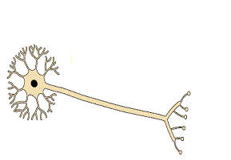
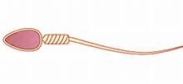
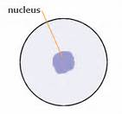
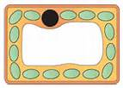

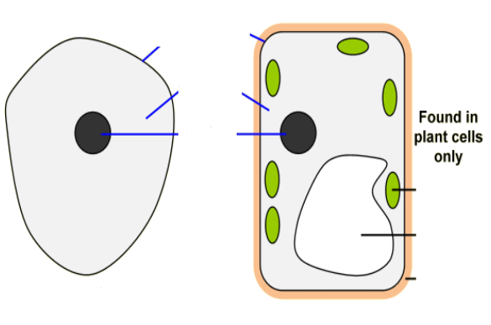
Biology
Label the different parts of a microscope:
What is diffusion?:
Outline how amoeba and euglena reproduce:
Explain how euglena’s structure allows it to carry out photosynthesis:
Suggest 2 safety hazards when using microscopes:
Name these specialised cells:
Match the part of the cell with its function
Organelle |  | Function
Cytoplasm |  | Stores sap
Cell membrane |  | Strength and support
Nucleus |  | Releases energy by respiration
Mitochondria |  | Site of photosynthesis
Cell wall |  | Controls molecules going in or out
Vacuole |  | Contains genes which control cell.
Chloroplasts |  | Where chemical reactions take place
Describe how you would use a microscope to observe onion cells:
Why do plants wilt? (page 21)
Label the animal cell
Label the plant cell

Slide 2


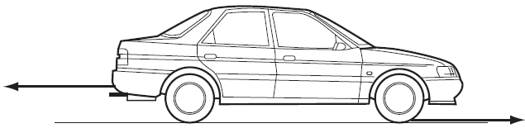
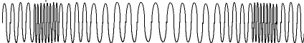
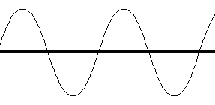
Physics
Label the forces in these diagrams:
1.)
2.)
3.)
Why do we weigh less in space?
What is the difference between weight and mass?
State the range of human hearing and compare it to the range of dolphin hearing:
What are balanced forces?
Describe what happens when a wave hits a barrier:
Describe what happens when waves superpose:
Match the keyword with its definition
Keyword |  | Definition
Newtonmeter |  | The unit of frequency
Elastic limit |  | The bottom of a wave
Frequency |  | When the air particles spread out in a longitudinal wave
Hertz |  | Measures force in newtons (N)
Trough |  | The force that resists movement because of contact between surfaces
Friction |  | The number of waves that go past every second
Rarefaction |  | When a spring will not return to its original length after being stretched with a mass.
If your mass on earth is 50kg, calculate your weight on the following planets:
Using Hooke’s Law, state the length of the spring extension when the following forces are added:
Label the parts of a longitudinal and transverse wave:
Planet | Strength of gravity | Weight on planet (N)
Mercury | 0.38
Venus | 0.91
Jupiter | 2.54
Saturn | 1.08
Force | Extension
1N | 0.5cm
2N
4N
8N
16N
32N

Slide 3

Chemistry
Draw particles in the solid, liquid and gas states:
Solid
Liquid
Gas
Why does gas pressure increase when more particles are added?
How can you check the purity of a substance using its melting point?
Compare the processes of boiling and evaporation:
Which 3 factors affect diffusion speed?
This table shows the boiling and melting points of 4 elements
a.) Which has the highest boiling point?
b.) Name one substance that is a gas at 20°C?
c.) Name one substance that is a liquid at 100°C?
Match the keyword with its definition
Keyword |  | Definition
Gas pressure |  | The change of state from a gas to liquid.
Melting |  | The tiny things that substances are made from
Condensation |  | The change of state from liquid to gas when particles leave the surface of a liquid
Particle |  | The change of state from solid to liquid
Evaporation |  | The force exerted by gas particles per unit area of a surface
Substance | Boiling point (°C) | Melting point (°C)
Bromine | -7 | 59
Mercury | -39 | 357
Silver | 961 | 2210
Neon | -249 | -246
Explain what happens in sublimation:
Estefano says that gas pressure is the result of particles colliding with each other. Is he correct? Explain your answer.
Tommy went camping. He put a can of baked beans on the fire without opening the lid. The can exploded. Using your knowledge on particles, explain why this happened.
Using your knowledge of states of matter, complete this table:
State | Can you compress it? | Does it flow? | Shape
Solid
Liquid
Gas

