Slide 1



Menstruation
Developing
Secure
Secure +
I can: describe menstruation.
I can: explain what happens during the menstruation cycle.
I can: explain what happens at each stage.

Slide 2
60 second challenge!
BACK OF YOUR BOOK
List all of the changes that happen to a female as she goes through puberty.
l/o: To understand and be able to explain the menstruation cycle.

Slide 3
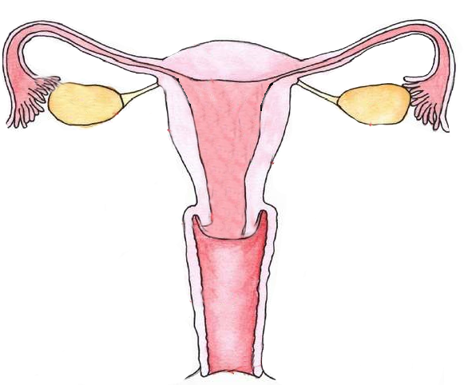
When a girl goes through puberty one of the changes that occurs is that she will begin to have periods.
This is the female body’s way of preparing to reproduce.
A woman’s reproductive system works on a 28 day cycle.
This cycle is known as the menstrual cycle.
The menstrual cycle consists of
a number of stages.
In this lesson we will learn what
those stages are.....
l/o: To understand and be able to explain the menstruation cycle.

Slide 4
Day 1 – 7
The menstruation cycle starts with the first day of a woman’s period. This is the name given to the time of the month when the lining of the uterus comes away and exits through the vagina as blood.
l/o: To understand and be able to explain the menstruation cycle.

Slide 5
Day 1 – 7
The menstruation cycle starts with the first day of a woman’s period. This is the name given to the time of the month when the lining of the uterus comes away and exits through the vagina as blood.
In the back of your book –
take a whole page to....
Write how many millilitres of blood you think a female loses during menstruation.
l/o: To understand and be able to explain the menstruation cycle.

Slide 6
Let’s Vote!

Slide 7
Day 1 – 7
The menstruation cycle starts with the first day of a woman’s period. This is the name given to the time of the month when the lining of the uterus comes away and exits through the vagina as blood.
A female only loses
35 millilitres
of blood during menstruation.
(That’s about an egg-cup full)
l/o: To understand and be able to explain the menstruation cycle.

Slide 8
Day 8 - 13
Around day 7 the blood flow stops.
The lining of the uterus begins to build up again.
At this time an egg starts to mature in one of the ovaries
l/o: To understand and be able to explain the menstruation cycle.

Slide 9
Day 14 (The Middle)
On the 14th day which is the middle of the cycle, an egg is released by an ovary into the oviduct.
l/o: To understand and be able to explain the menstruation cycle.

Slide 10
Day 14 - 17
The egg can last up to 3 days after it is released from the ovary.
During this time the egg travels down the oviduct and into the uterus hoping to be fertilised.
l/o: To understand and be able to explain the menstruation cycle.

Slide 11
Day 18 - 28
If the egg is not fertilised then the lining of the uterus begins to break down.
l/o: To understand and be able to explain the menstruation cycle.

Slide 12
The cycle starts over again...
Day 1 – 7
The cycle starts over again expelling the lining of the uterus and the egg.
Remember this is known as a period or menstruation.
l/o: To understand and be able to explain the menstruation cycle.

Slide 13
10 minutes
Complete the menstruation worksheet.
Don’t forget to label your diagram.
l/o: To understand and be able to explain the menstruation cycle.

Slide 14
Do you know what females use to keep clean during their period (menstruation)?
l/o: To understand and be able to explain the menstruation cycle.

Slide 15

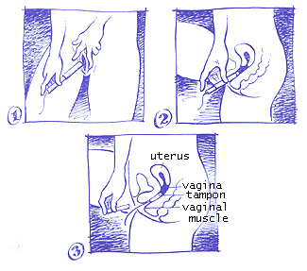
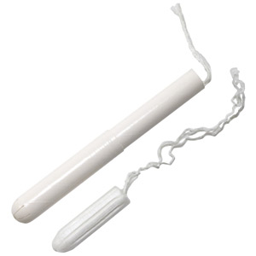
Tampons
l/o: To understand and be able to explain the menstruation cycle.

Slide 16
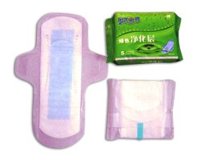

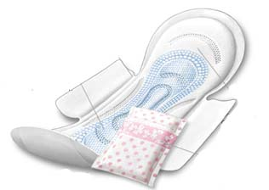
Sanitary Towels (or pads)
l/o: To understand and be able to explain the menstruation cycle.

Slide 17
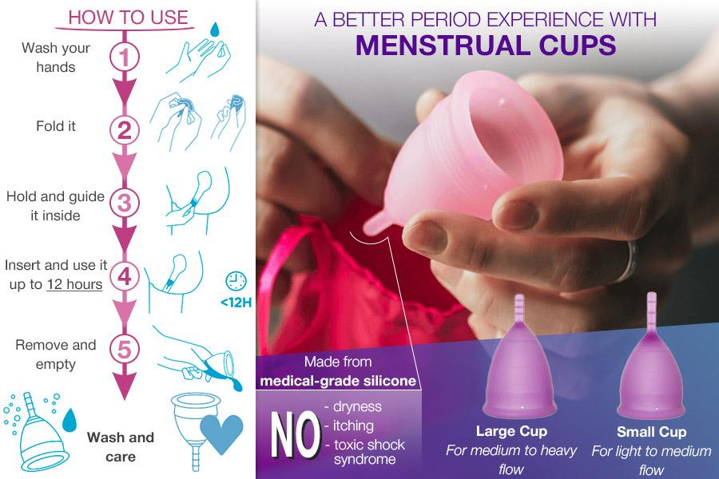
l/o: To understand and be able to explain the menstruation cycle.

Slide 18
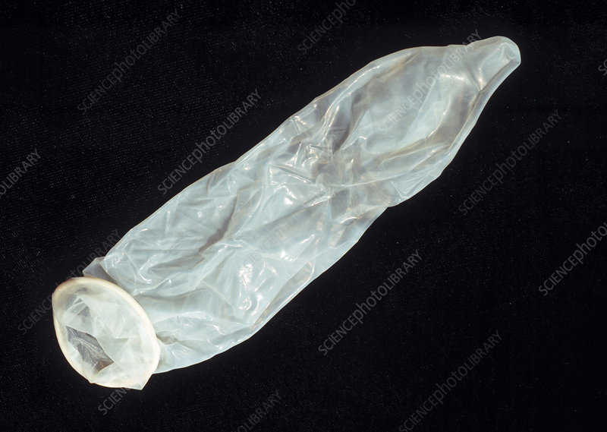
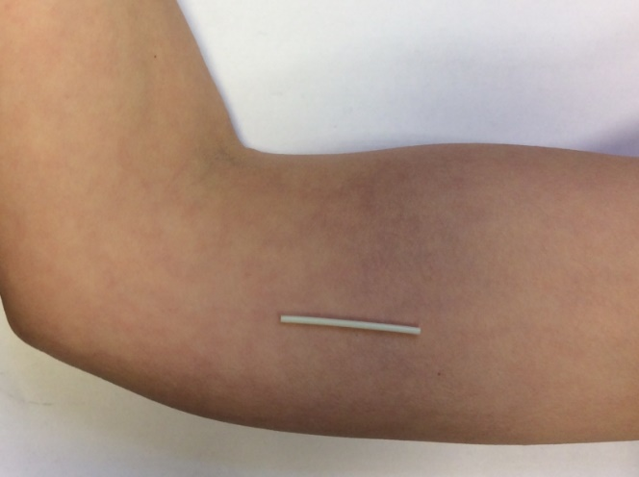
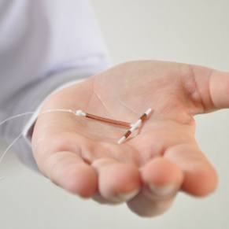
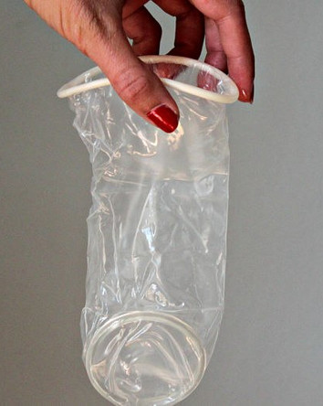
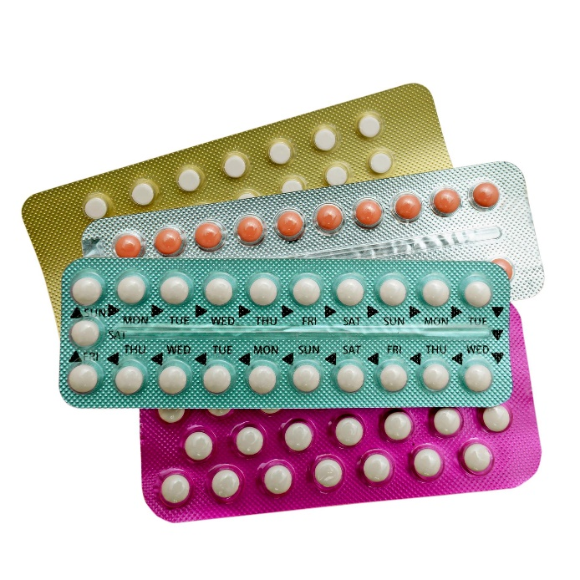
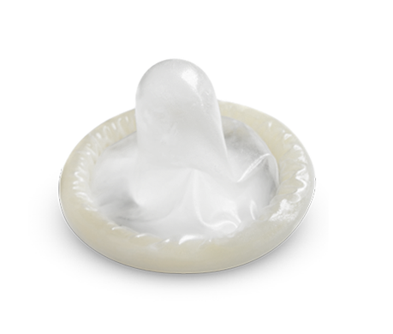
Contraception
l/o: To understand and be able to explain the menstruation cycle.

Slide 19
True or False?
Day 1 of the cycle begins when bleeding from the vagina starts.

Slide 20
True or False?
Day 1 of the cycle begins when bleeding from the vagina starts.

Slide 21
True or False?
A period can last for two weeks.

Slide 22
True or False?
A period can last for two weeks.
(About 4-5 days but it is different for individual women)

Slide 23
True or False?
The cycle lasts 28 days.

Slide 24
True or False?
The cycle lasts 28 days.

Slide 25
True or False?
A girl cannot get pregnant whilst on her period/losing blood.

Slide 26
True or False?
A girl cannot get pregnant whilst on her period/losing blood.

Slide 27
True or False?
At approximately day 14, a mature egg is released – also called ovulation.

Slide 28
True or False?
At approximately day 14, a mature egg is released – also called ovulation.

Slide 29
True or False?
If a sperm cell does not meet an egg cell, the lining breaks down and the cycle starts again.

Slide 30
True or False?
If a sperm cell does not meet an egg cell, the lining breaks down and the cycle starts again.

Slide 31
True or False?
The most fertile period during the menstrual cycle is approximately 14 days into the cycle.

Slide 32
True or False?
The most fertile period during the menstrual cycle is approximately 14 days into the cycle.

