Slide 1



Fertilisation and Implantation
Developing
Secure
Secure +
I can: State what is meant by fertilisation.
I can: Describe the process of fertilisation.
I can: Compare internal and external fertilisation.

Slide 2

What is fertilisation??

Slide 3
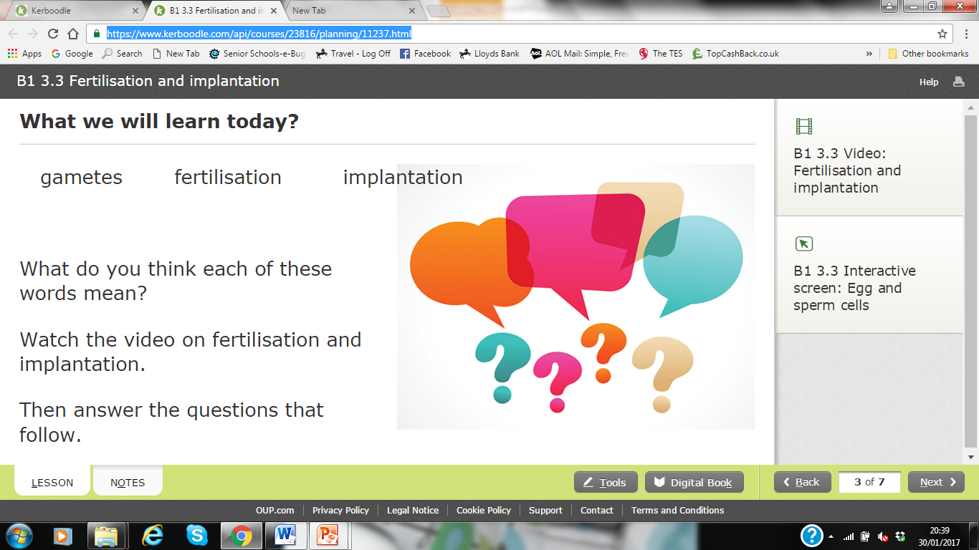
https://www.youtube.com/watch?v=8PFQAYsYXeY
l/o: Describe the process of fertilisation and implantation.

Slide 4
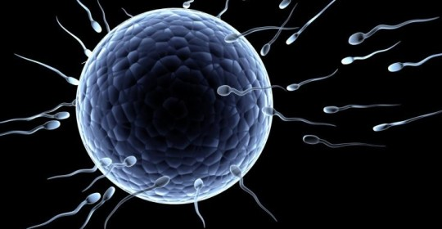
How are babies made?
The male sex cell (sperm) & female sex cell (egg) must join together-FERTILISATION
Male sex cell- Sperm
Female sex cell- Egg
Key word: gametes
l/o: Describe the process of fertilisation and implantation.

Slide 5
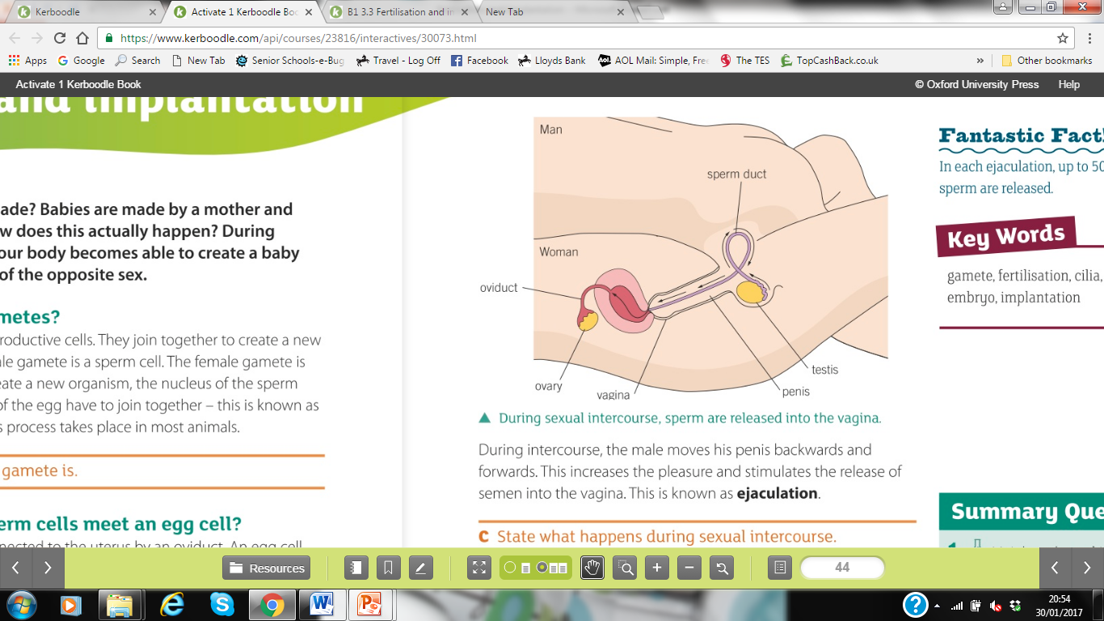
l/o: Describe the process of fertilisation and implantation.

Slide 6
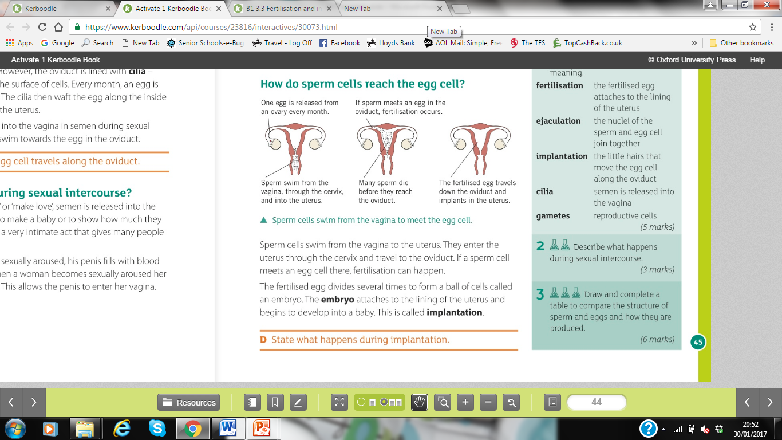
l/o: Describe the process of fertilisation and implantation.

Slide 7
Internal and External Fertilisation
Internal – inside
External – outside
l/o: Describe the process of fertilisation and implantation.

Slide 8

Your job is the create a cartoon that shows the steps of fertilisation and implantation.
The cartoon will help year 6 pupils understand what happens in fertilisation.
-Draw 4 pictures to show the steps of fertilisation.
-Write a sentence to explain what is going on.
-Make it fun and educational!
Extension: Explain why a couple wanting to have a baby may not be successful straight away.
l/o: Describe the process of fertilisation and implantation.

Slide 9

Here’s an example:
An egg is released from the ovary of a woman…
Weeeeeeeee!
Bye-bye egg!
Ovary
l/o: Describe the process of fertilisation and implantation.

