Slide 1
Test your knowledge: Developing
Create a table with the following headings:
Constructive Waves | Destructives Waves | Both
These waves are small and gentle. These waves build the beach up. They have a strong swash which pushed material up the beach This wave has a small backwash so doesn’t take much sand away from the beach | They have a strong backwash because they have plenty of energy left. These waves are big and powerful. They have a weak swash as the don’t travel very far up the beach This wave drags material away from the beach, eroding it (taking it away). | Have a swash and a backwash. Created by the wind. Go back out to sea

Slide 2
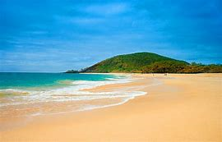
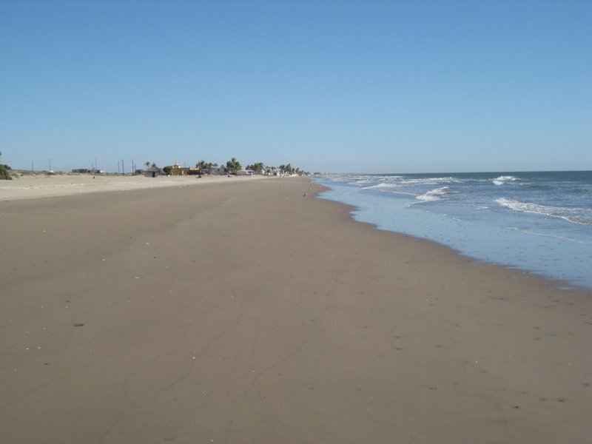
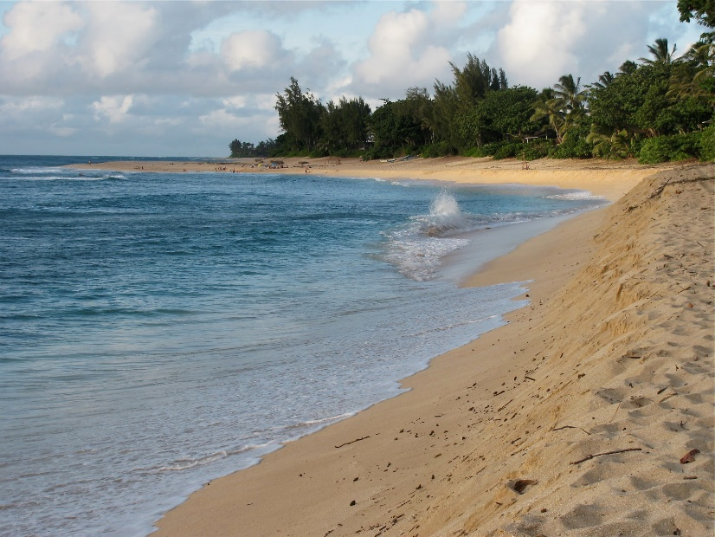
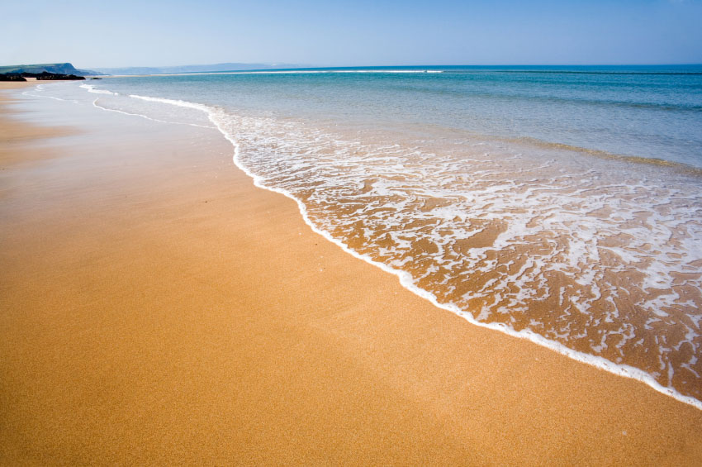
Test your knowledge: Secure
2) Explain which type of wave has created all of these beaches and how you know:
These beaches were all created by constructive waves. We know this because all of the waves are small and gentle which means they push material on to the beach and leave it there. This is also evident in the images as they all have wide sandy beaches.

Slide 3
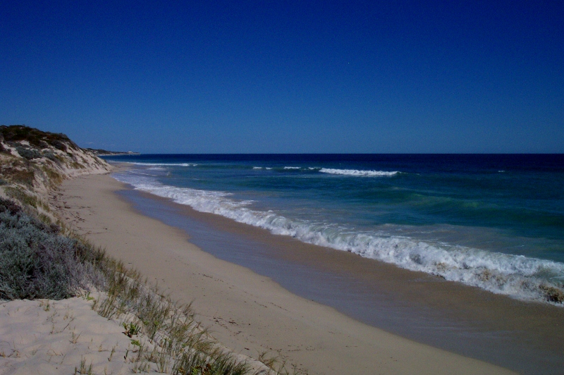
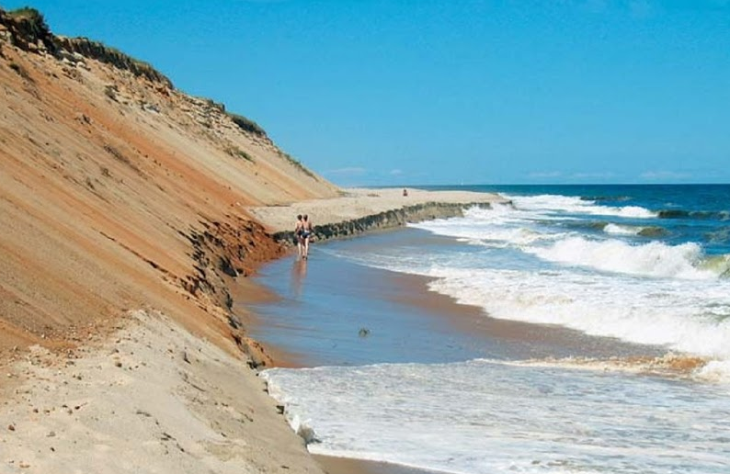
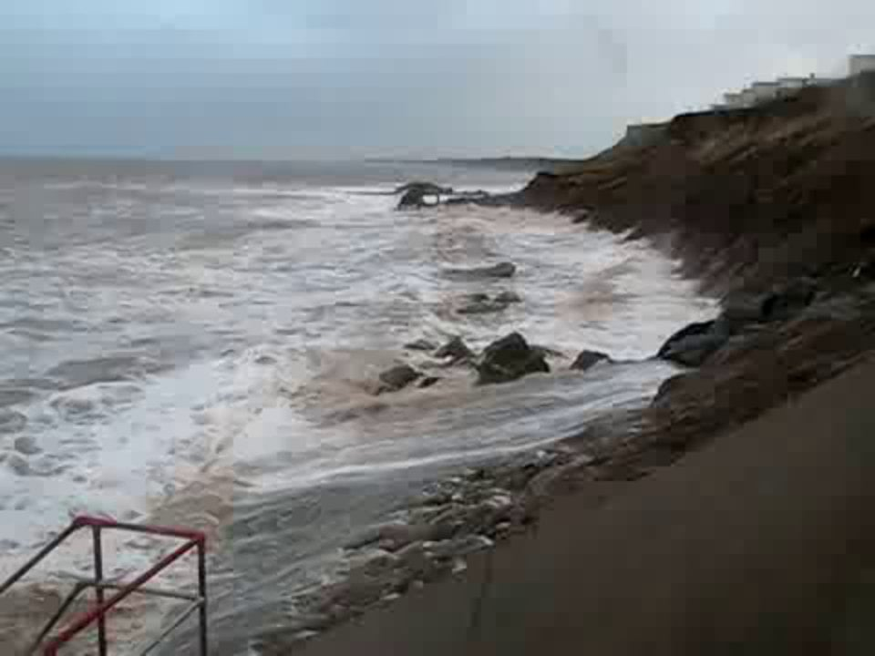
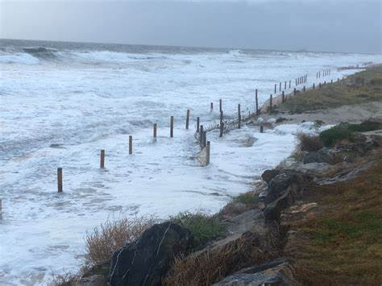
Test your knowledge: Secure
2) Explain which type of wave has created all of these beaches and how you know:
These beaches were all created by destructive waves. We know this because the waves all look big, strong and powerful which means they are taking material away from the beach. This is also evident because the images have either no beach or a very narrow beach. In some cases the land is being attached by the water because there is no beach left.

Slide 4
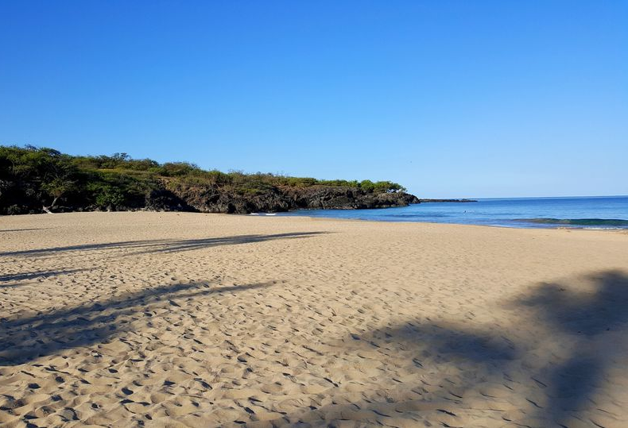
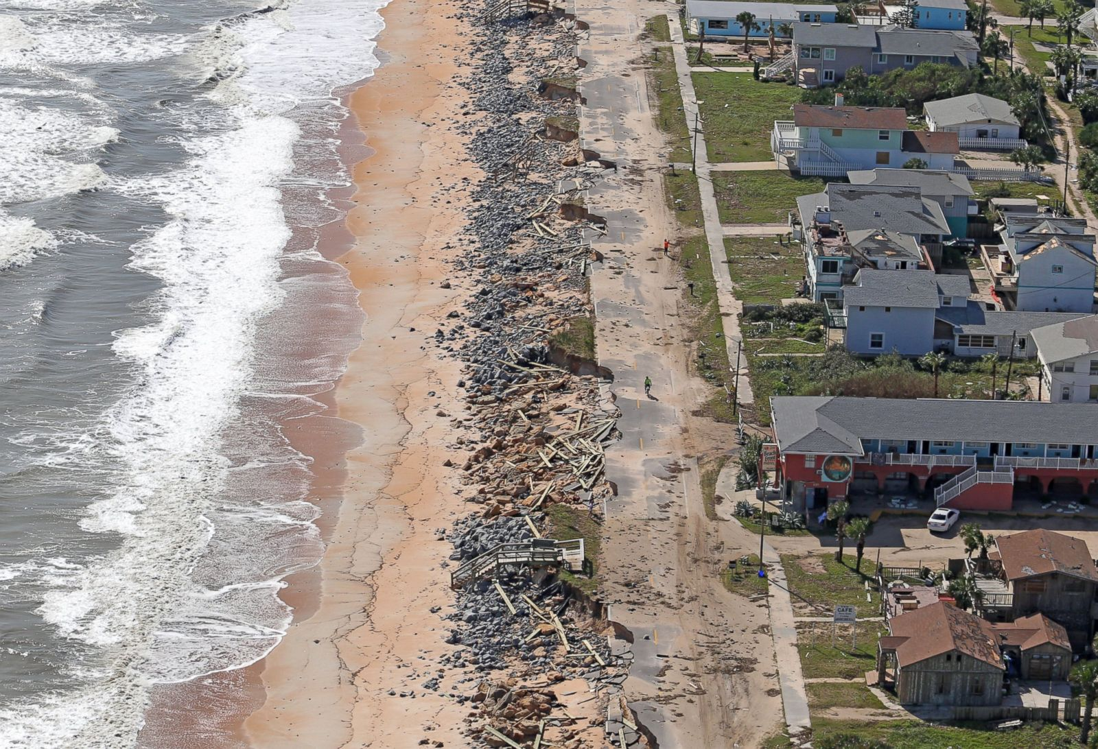
Secure+ Task:
Look at the images and complete the sentence starters. You should be using the boxes to see what level you are working at:
The beach with the constructive waves is A
This is because you can see the beach is very wide and full of sand.
Therefore, the beach has been created by waves which use their swash to push sand onto the beach and have a small backwash so they leave the sand there.
The beach with the destructive waves I B
This is because you can see the beach is very narrow, there is almost no beach left.
Therefore, the beach has been created by waves which have a small swash so they do not put sand on the beach but use all their energy in the backwash to pull the sand away and take it back to the sea.
A
The beach with the constructive waves is A
This is because you can see the beach is very wide and full of sand.
The beach with the destructive waves I B
This is because you can see the beach is very narrow, there is almost no beach left.
The beach with the constructive waves is A
The beach with the destructive waves is B
B

