Slide 1
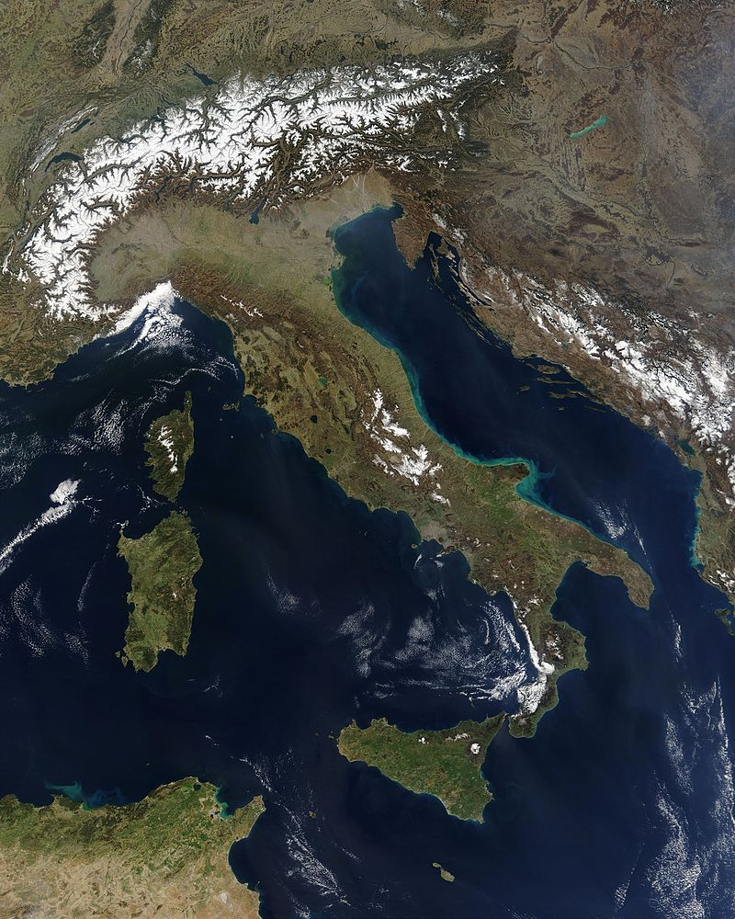
What does this satellite map of Italy tell us about what the land is like in Italy?

Slide 2
Physical Features of Italy- Mountains and Lakes
Identify and locate Italy’s three mountain ranges
Compare the main uses of Italy’s mountain ranges
Analyse how Italy’s lakes have been formed

Slide 3
Identify and locate Italy’s three mountain ranges
Italy has lots of mountains. In fact, mountains make up approximately 40% of Italy.
It has three mountain ranges:
  The Alps
  The Apennines
  The Dolomites

Slide 4
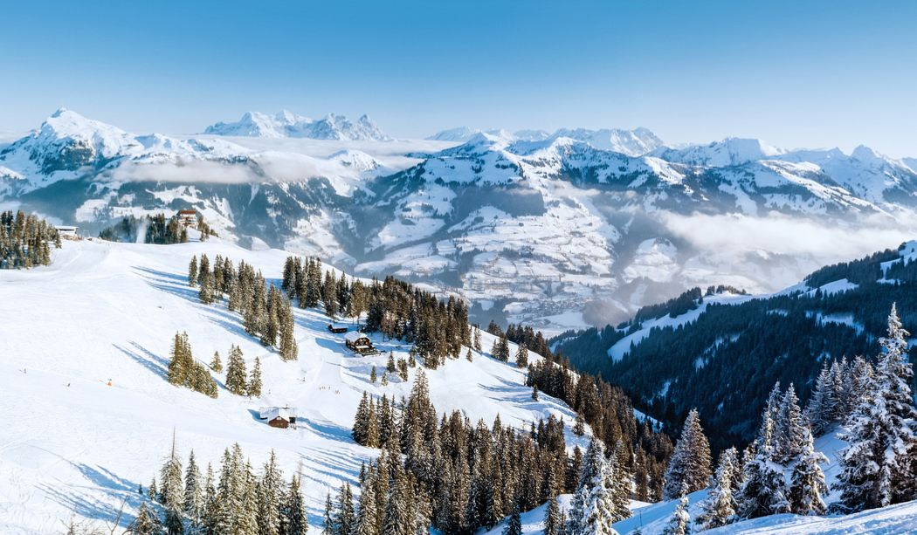
The Alps
Identify and locate Italy’s three mountain ranges

Slide 5
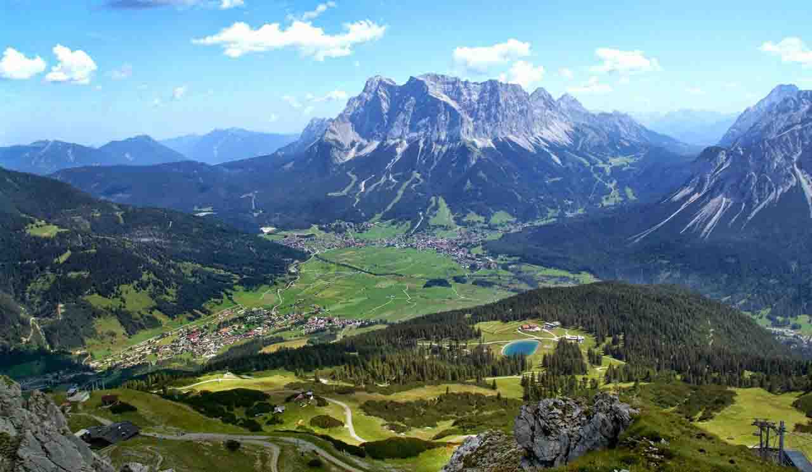
The Apennines
Identify and locate Italy’s three mountain ranges

Slide 6
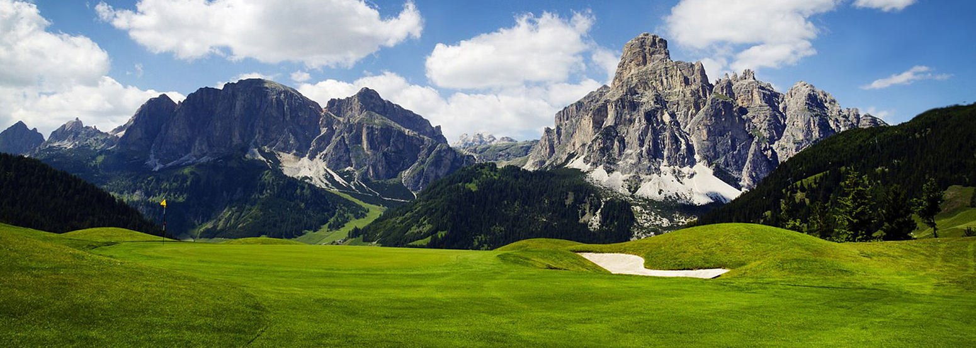
The Dolomites
Identify and locate Italy’s three mountain ranges

Slide 7
Task 1:
Identify and locate Italy’s three mountain ranges
-Use google maps to find the location of each of the mountain ranges.
The Alps, The Apennines, The Dolomites

Slide 8
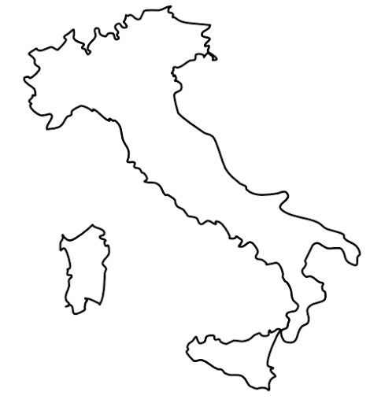
THE DOLOMITES
THE ALPS
THE APENNIES

Slide 9
Task 2:
Compare the main uses of Italy’s mountain ranges
Open worksheet 1 to find lots of information about the 3 mountain ranges
Open worksheet 2 and complete the table using the information you find in worksheet 1:
Name of mountain range | Highest peak (what is it called and how high is it?) | What are the mountains used for?

Slide 10
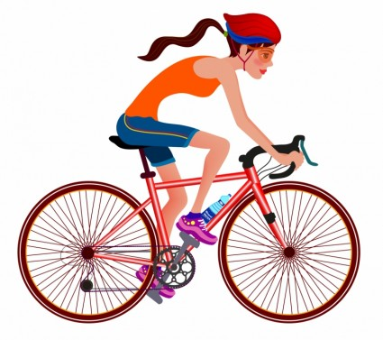


Compare the main uses of Italy’s mountain ranges
Task 3: Explain which mountain range you think would be most suited to these people, and why you think this.
This is Sophie, she’s a very keen and experienced cycler.
This is Mario, he lives in Italy and really needs a job!
This is Paul, he’s a train driver.
Answers on the next slides…

Slide 11
This is Sophie, she’s a very keen and experienced cycler.
You could have picked either The Alps, or The Dolomites for Sophie to visit. This is because mountain biking is a popular activity in both of these mountain ranges.

Slide 12
This is Mario, he lives in Italy and really needs a job!
This was a bit of a trick question. You could have picked any of the mountain ranges as they all provide jobs for the Italian people!

Slide 13
This is Paul, he’s a train driver.
The best mountain range for Paul would be The Apennines as it has railways which means Paul could get a job if he needed to! (If he just wanted a holiday, he’d probably prefer visiting the Apennines as he’d be interesting in seeing the trains go through the mountains!)

Slide 14
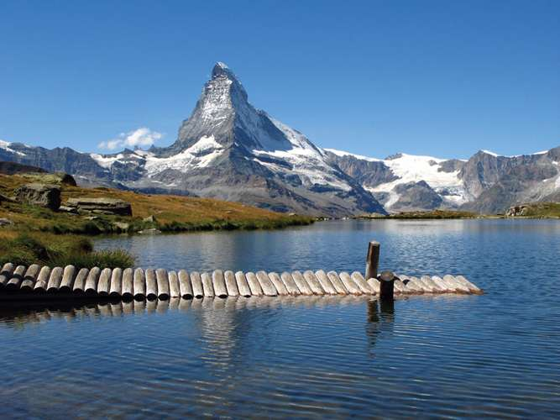
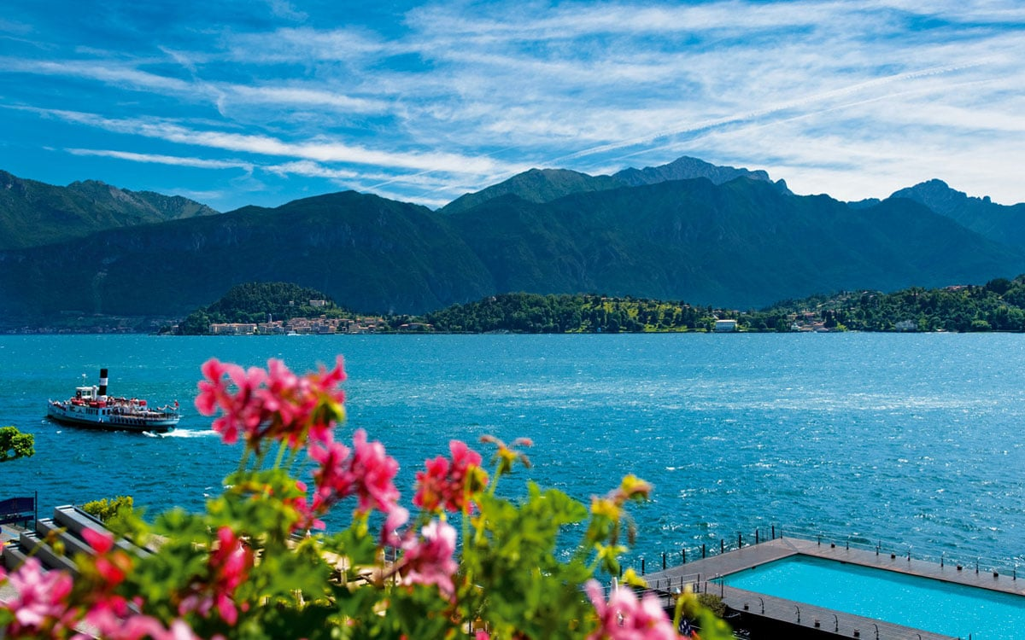
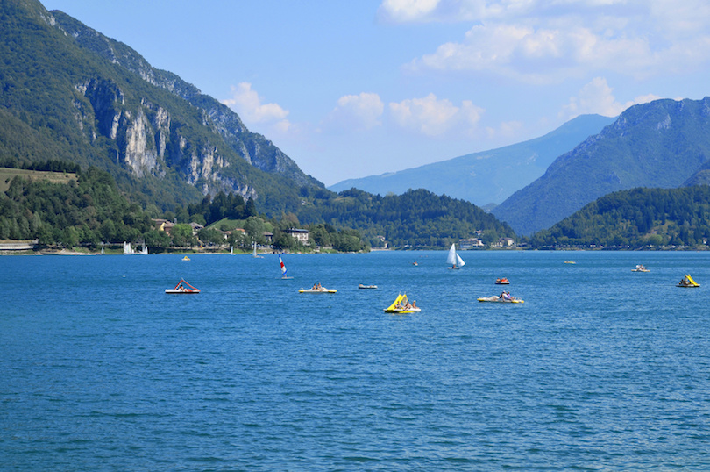
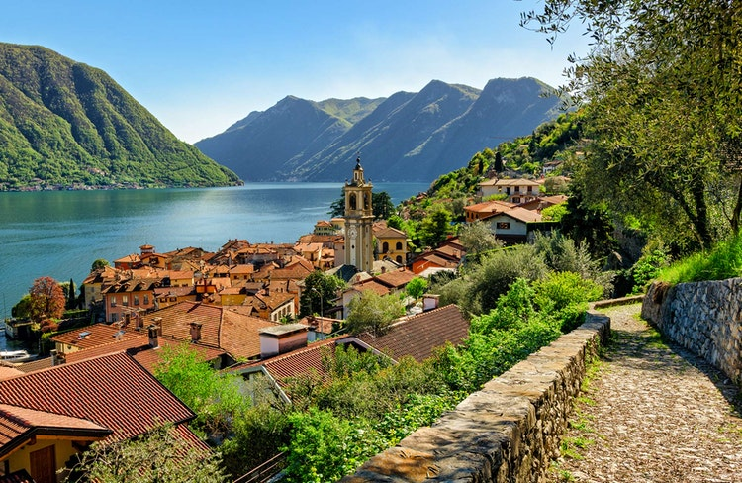
Italy is also famous for it’s great lakes!
What do all of these images have in common?

Slide 15
So, what did they all have in common?
All of the famous Italian lakes in the images have mountains in the background!
They have all been created by activity from the mountain
They are called glacial lakes
A glacier is a large area of thick ice
Thousands of years ago the mountains in Italy were covered in thick glaciers which slowly moved and melted to create lakes… look at the following slides to find out what happened!

Slide 16

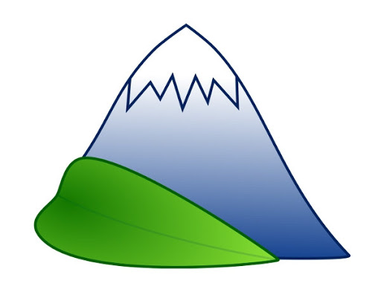
1) The top of mountains have their own climate where it cold and often snowy
Analyse how Italy’s lakes have been formed

Slide 17

2) The snow piles on top of each other and the stuff at the bottom turns into ice! This is called a glacier.
Analyse how Italy’s lakes have been formed

Slide 18
3) As the glacier (ice) is so heavy, it very slowly moves down the mountain
Analyse how Italy’s lakes have been formed

Slide 19

4) The climate at the bottom of the mountain is much warmer than at the top of the mountain which means the glacier (ice) melts…
Analyse how Italy’s lakes have been formed

Slide 20
5) When the glacier (ice) melts, a lake is formed at the bottom of the mountain.
Analyse how Italy’s lakes have been formed

Slide 21

6) These lakes are special and beautiful which means lots of tourists want to go and visit them- this means they make lots of money!
Analyse how Italy’s lakes have been formed

Slide 22
Task 4:
Analyse how Italy’s lakes have been formed
Complete worksheet 3 by describing what is happening in each of the diagrams
Stretch and Challenge:
  Justify why these lakes are so important to Italy.
  (answer on the next slide)

Slide 23
Stretch and Challenge answer:
The lakes are so important to Italy for lots of reasons including:
  They are beautiful landmarks in the country and something that the people are proud of. The way they were made is very special and Italian people love to visit them
  As the lakes are so special they bring lots of tourists to Italy. Tourist’s spend money in the country which is good for the economy.
  The amount of tourism also provides jobs for Italian people.

