Slide 2
Aim
To be able to calculate internal angles of a:
  Square and rectangle
  trapezium

Slide 3



Calculate Lengths and Angles in Shapes - Quadrilaterals
Diving
Match the properties to the correct shape.
Are some properties true for more than one shape?
Opposite angles are equal.
Opposite sides are equal.
Has parallel sides.
Adjacent sides are equal.
Has right angles.
Which quadrilateral has the most of these properties?

Slide 4


Calculate Lengths and Angles in Shapes - Quadrilaterals
Diving
What is the sum of the interior angles of a square and rectangle?
The interior angles have a sum of 360°.
Tear off the corners of a square and then a rectangle. If you arrange these by placing them around a point, you can prove that this is true.

Slide 5
Calculate Lengths and Angles in Shapes - Quadrilaterals
Diving
What quadrilaterals can you name?
x
The rhombus is similar
to a rectangle as it has
two pairs of congruent
and parallel sides. It is different from a rectangle as the angles are not always right angles.
The trapezium is similar
to a rectangle as it has four sides and four vertices. It is different because all the sides and corners can have different measurements.
x
The square is similar to
a rectangle as it has 4
right angles. It is different from a rectangle as all the sides are the same length.
x
The kite is similar to a rectangle as it has two longer and two shorter sides, but different because the congruent sides are adjacent instead of opposite.
The parallelogram is similar to a rectangle as opposite sides are the same length and parallel. It is different because the angles are not right angles.
x
x
How are they similar and different to the rectangle?

Slide 6

Calculate Lengths and Angles in Shapes - Quadrilaterals
Deeper
How can you find the missing angles in this trapezium?
100°
95°
85°
80°
The sum of the interior angles in a quadrilateral is 360°.
The three given angles have a total of 280°.
360° - 280° = 80°

Slide 7
Calculate Lengths and Angles in Shapes - Quadrilaterals
Deeper
How can you find the missing angles in this parallelogram?
125°
55°
55°
125°
Opposite angles of parallelograms are equal.
The sum of the interior angles in a quadrilateral is 360°.
360° - (125°× 2) = 110°
110° ÷ 2 = 55°

Slide 8
Calculate Lengths and Angles in Shapes - Quadrilaterals
Deeper
How can you find the missing angles in this kite?
70°
210°
40°
40°
Horizontally opposite angles of a kite are equal.
The sum of the interior angles in a quadrilateral is 360°.
(40° × 2) + 70° = 150°
360° - 150° = 210°

Slide 9

Calculate Lengths and Angles in Shapes - Quadrilaterals
Deepest
Does the rhombus with the longest sides have larger angles?
No. The angles are the same.

Slide 10
Calculate Lengths and Angles in Shapes - Quadrilaterals
Deepest
What shapes can be made by tessellating this kite shape?
What will the perimeters and angles be?
90°
8cm
105°
105°
11cm
60°

Slide 11
Calculate Lengths and Angles in Shapes - Quadrilaterals
Deepest
What shapes can be made by tessellating this kite shape?
What will the perimeters and angles be?
Perimeter = 72cm
Perimeter = 88cm
210°
210°
60°
90°

Slide 12

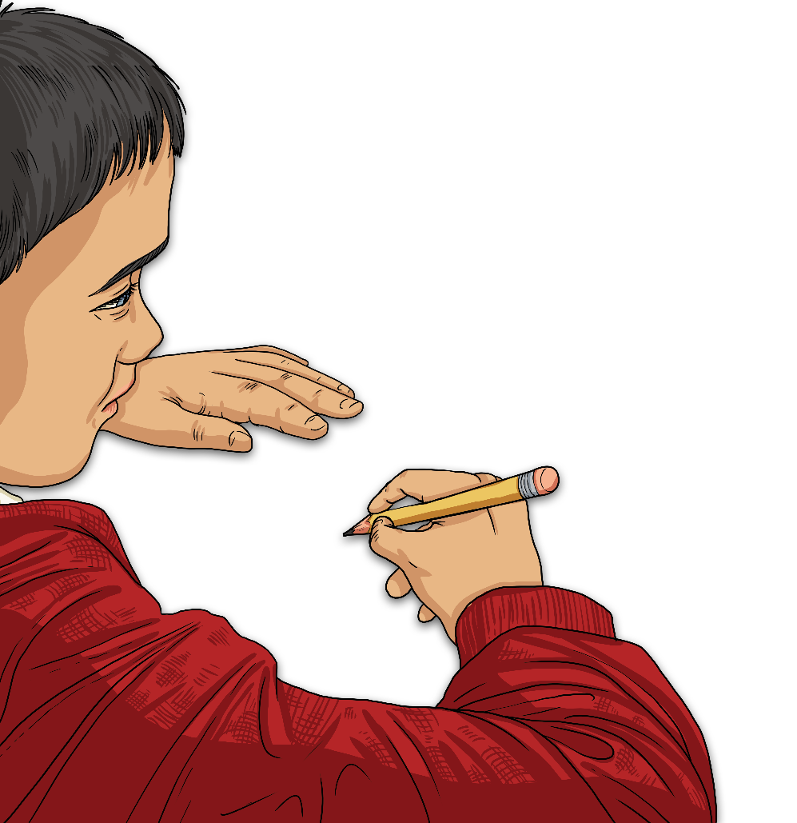
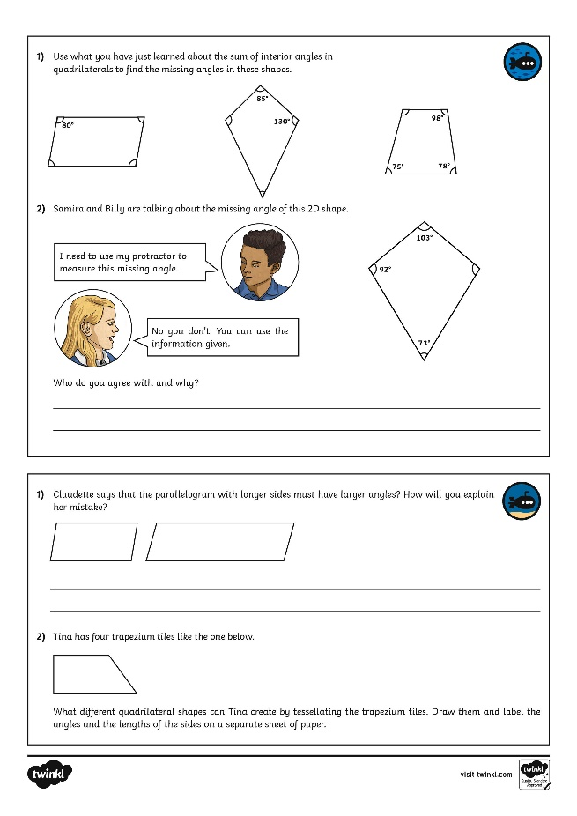
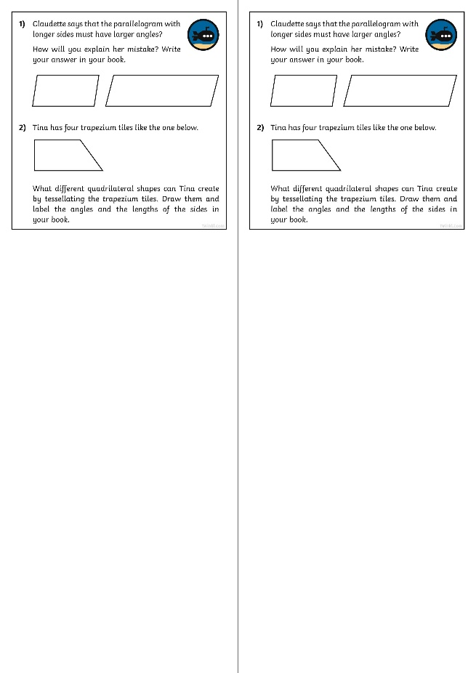
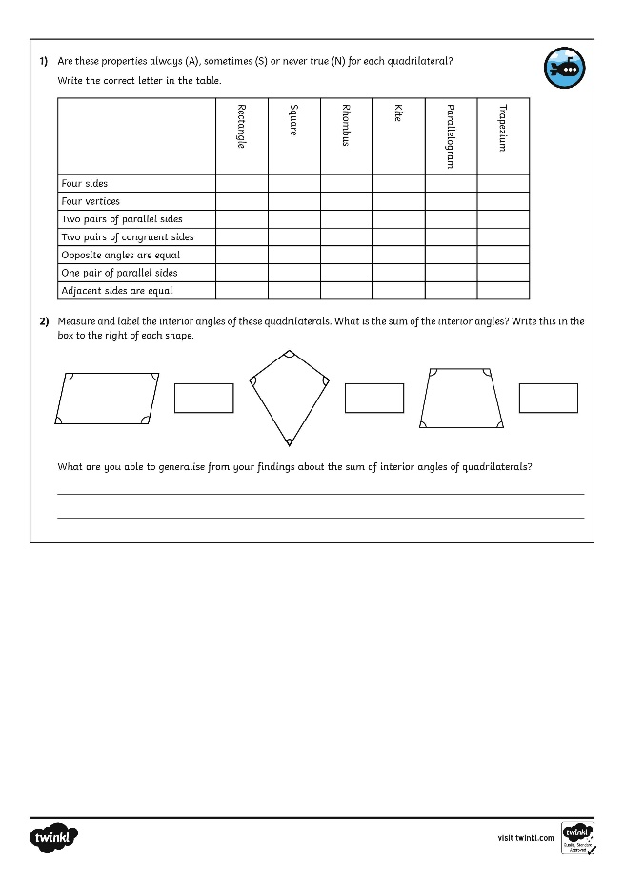
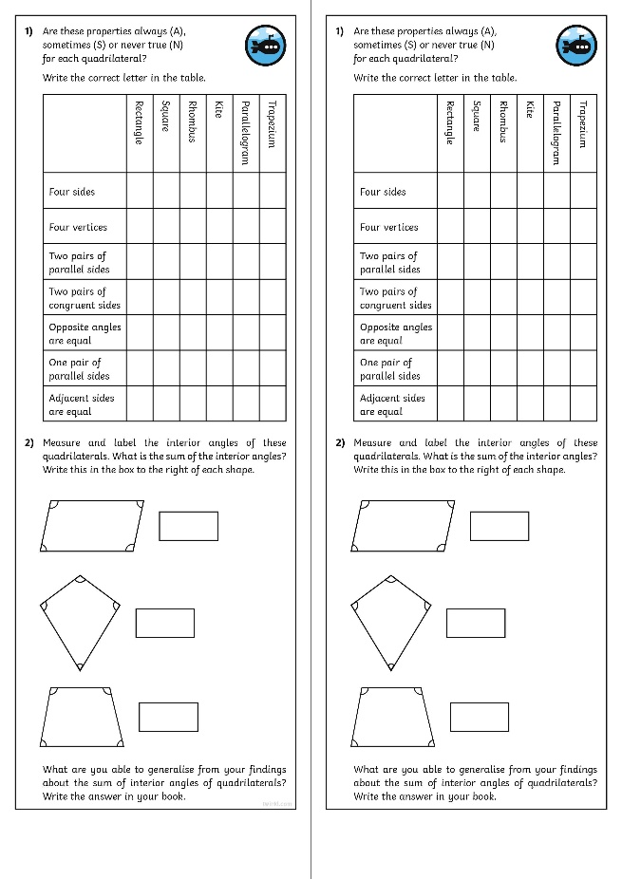
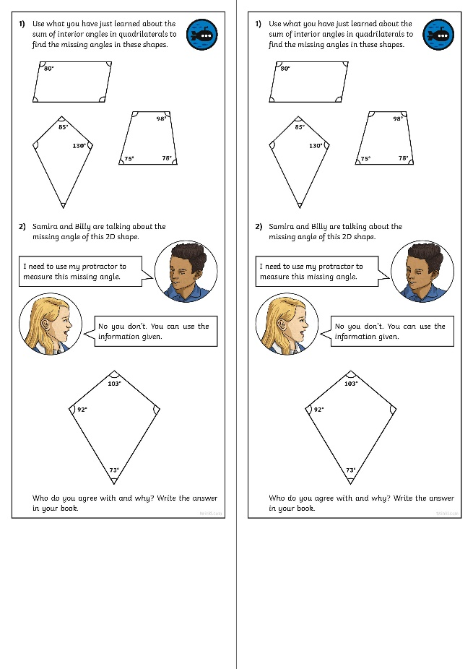
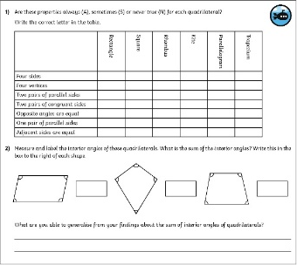
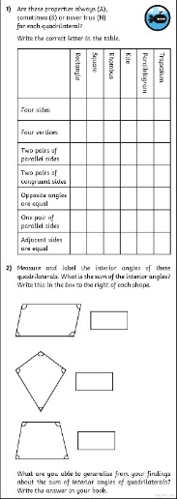
Calculate Lengths and Angles in Shapes - Quadrilaterals
Dive in by completing your own activity!

Slide 13
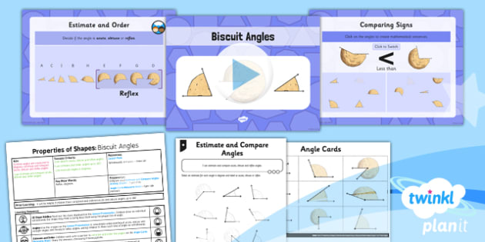
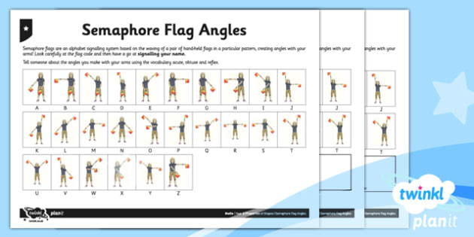

Need Planning to Complement this Resource?
National Curriculum Aim
Use the properties of rectangles to deduce related facts and find missing lengths and angles.
For more planning resources to support this aim, click here.
Twinkl PlanIt is our award-winning scheme of work
with over 4000 resources.

