Slide 1
A River’s Journey
Identify the key features found at each stage of a river’s journey
Describe the features found at each stage of a river’s journey
Create a detailed diagram of a river’s journey

Slide 2
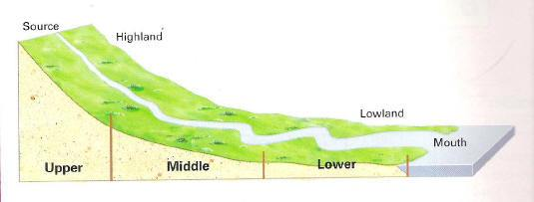
A river can be split into 3 sections:
The Upper Course
The Middle Course
The Lower Course

Slide 3
The Upper Course
The following slides show you the important parts of the upper course of the river.
Remember, this is where the river begins…

Slide 4
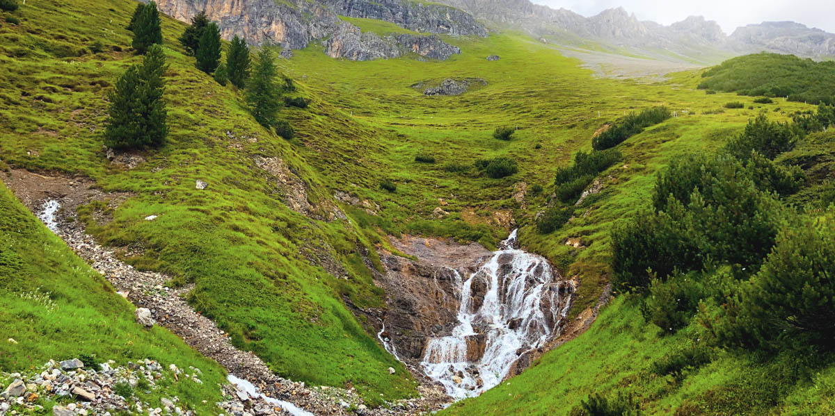
THE SOURCE
This is the very start of the river! It’s the place where the first spring begins high up in the hills or mountains…

Slide 5
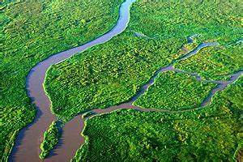
TRIBUTARY
This is the proper name for all of the smaller streams which join the main river.

Slide 6
CONFLUENCE
A confluence is the exact place where streams, or smaller rivers join the main river.

Slide 7
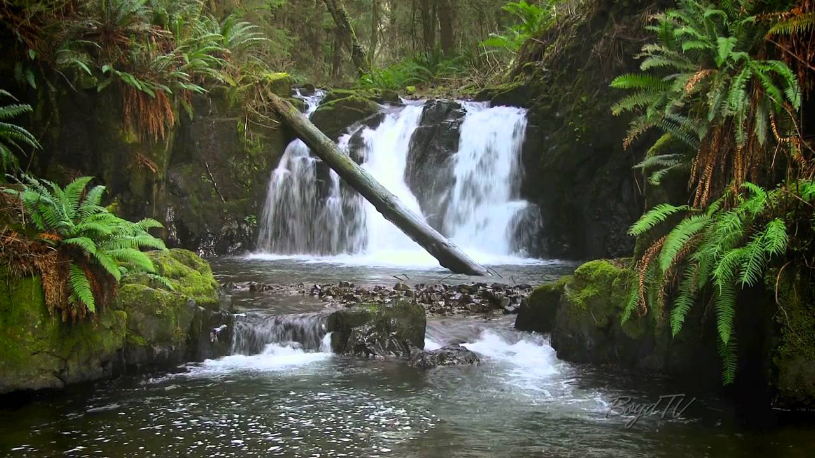
WATERFALL
Waterfalls can often be made in the upper course of a river. This is when the water falls over a steep drop. We’ll look at these in more detail in the next couple of lessons!

Slide 8
The Middle Course
The following slides show you the important parts of the middle course of the river.
Remember, this is when the river has got much bigger and is traveling quickly downhill.

Slide 9
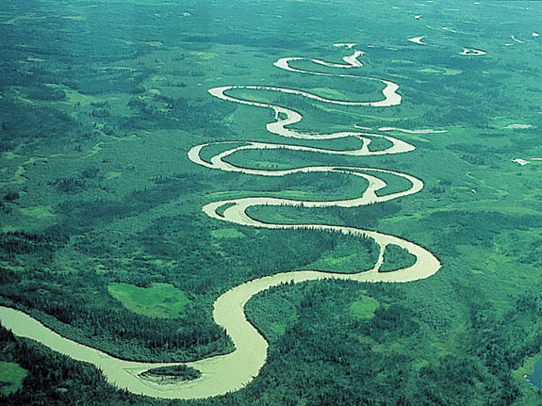
MEANDER
As the river travels downhill it doesn’t go in a straight line, rivers tend to snake and bend like you see in the picture. The proper name for a bend in a river is a meander.

Slide 10
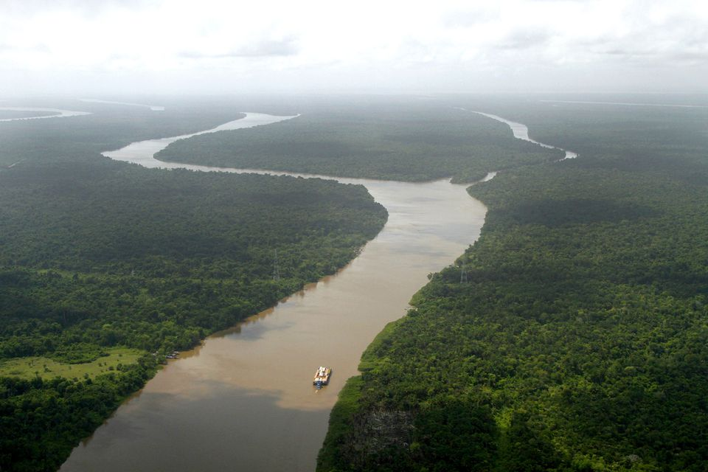
FLOODPLAIN
The floodplains are simply the bits of land either side of the river that will be flooded if the river ever gets too full!

Slide 11
The Lower Course
The following slides show you the important parts of the lower course of the river.
Remember, this is when the river has nearly finished it’s journey.

Slide 12
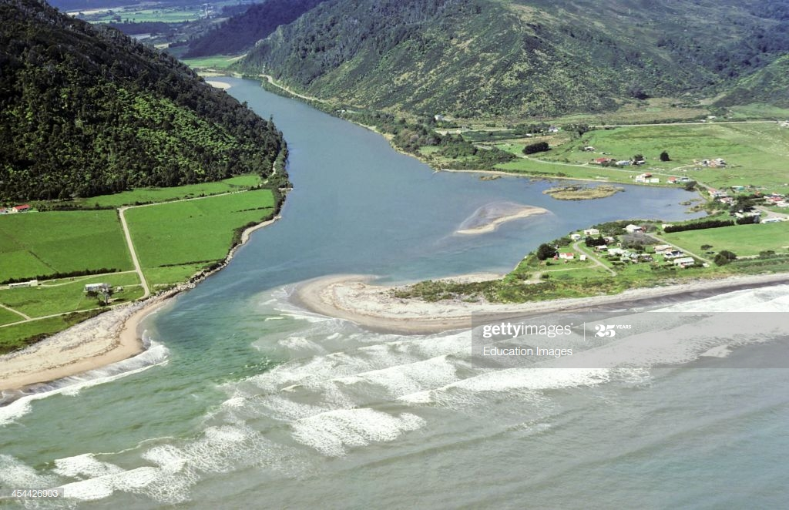
Mouth
The most important thing which happens in the lower course is that the river will eventually finish it’s journey and flow into the sea or ocean. Where the river meets the sea or ocean is called the mouth.

Slide 13
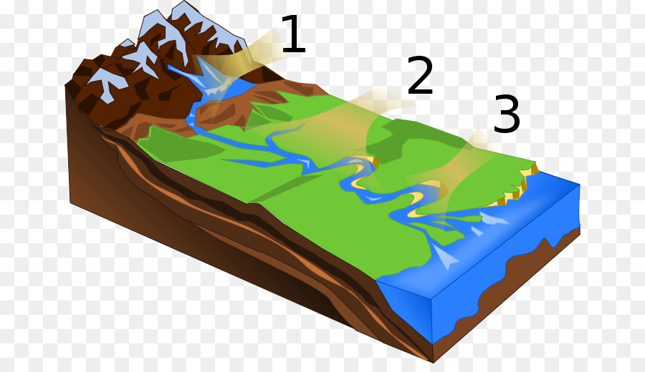
Let’s put it all together:
SOURCE
CONFLUENCE
WATERFALL
MEANDER
TRIBUTARY
FLOODPLAINS
MOUTH

Slide 14
Now you’ve got all the knowledge you need for this lesson, have a go at the questions on the next slides to test your knowledge…
Write your answers down then use the answers (on the answers PPT) to check if you were right.
If you got one wrong don’t worry- do as we always do and correct it! (yes- you should do this in purple pen at school, but don’t worry if you don’t have one of those, any colour will do!)
Remember you should all do the developing and secure questions. If you are targeted S+, or you would like to challenge yourself, do those questions too!

Slide 15
Test your knowledge: Developing
What features can be found in the upper course of a river?
What features can be found in the middle course of a river?
What features can be found in the lower course of the river?

Slide 16
Test your knowledge: Secure
4) Describe what the following key features:
Source
Tributary
Confluence
Waterfall
Meander
Floodplain
Mouth

Slide 17
Test your knowledge: Secure+
5) Create your own detailed diagram to show a rivers journey from the source at the start to the mouth at the end.
Try to include:
-All of the key terms
Clear arrows to show where your labels are pointing to
Labels to show the 3 courses of the river
Draw in pencil and write in pen
Add colour if you would like to!

