Slide 1
Test your knowledge: Developing
What features can be found in the upper course of a river?
Source, Tributary, Confluence, Waterfalls
2) What features can be found in the middle course of a river?
Meanders, Floodplains
3) What features can be found in the lower course of the river?
Mouth

Slide 2
Test your knowledge: Secure
4) Describe what the following key features:
Source- The very start of the river (the first spring)
Tributary- A stream or smaller river which joins the main river
Confluence- The exact point where a tributary joins the main river
Waterfall- When the water in a river falls down a steep drop
Meander- A bend in the river
Floodplain- The land either side of the river which will flood if the river gets too full
Mouth- The end of the river where it flows into the sea or ocean

Slide 3
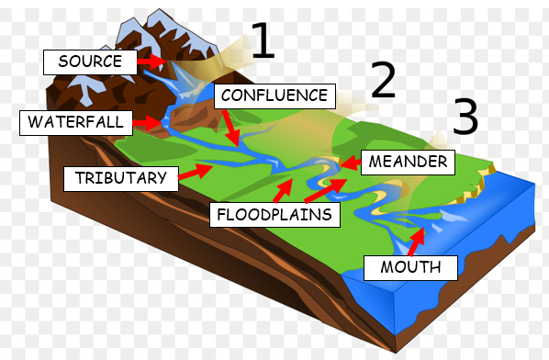
Test your knowledge: Secure+
5) Create your own detailed diagram to show a rivers journey from the source at the start to the mouth at the end.
Upper Course
Middle Course
Lower Course

