Slide 1
How are Rivers Formed?
Recap the water cycle
Compare the differences between river images
Analyse how all rivers begin and end

Slide 2
Recap the water cycle

Slide 3
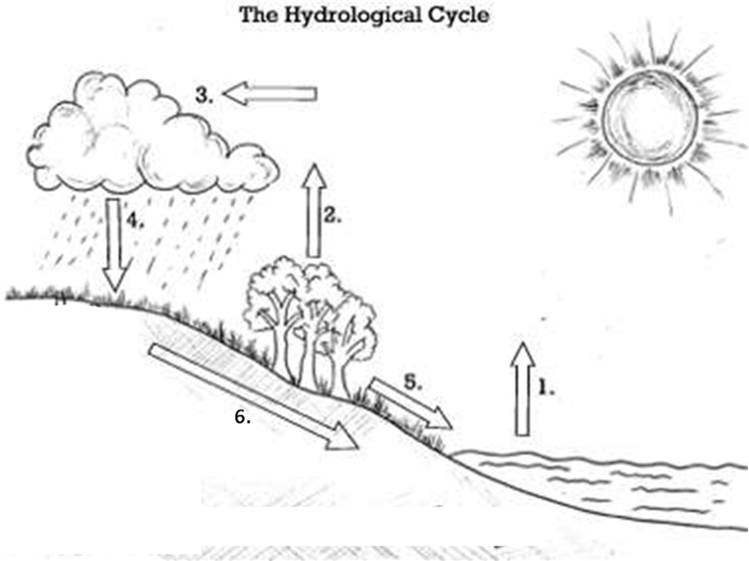
Recap the water cycle
Condensation
Transpiration
Precipitation
Evaporation
Ground water
Surface water
Can you remember all of the key terms? Test yourself!

Slide 4
Rivers= Surface water
So, rivers make up the surface water in the water cycle because they are made up of water that is on top of the ground.
They help rain water (precipitation) to make it’s way back to the seas and oceans.
Recap the water cycle

Slide 5
Compare the differences between river images
Look at the two pictures on the following slide
Describe what the rivers look like using adjectives
What is the difference between the two pictures?
  Killer Question: Can you justify (give reasons why) the rivers might look this way?

Slide 6
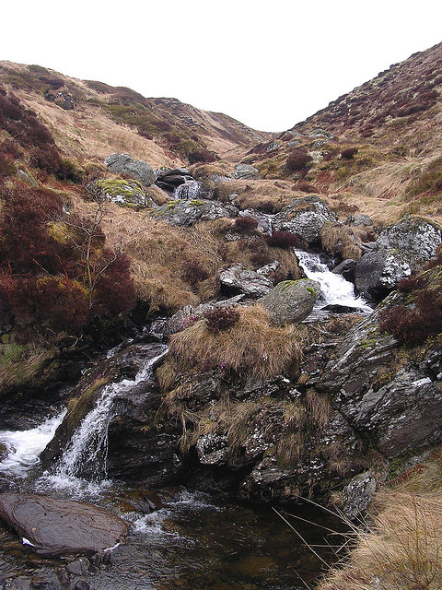
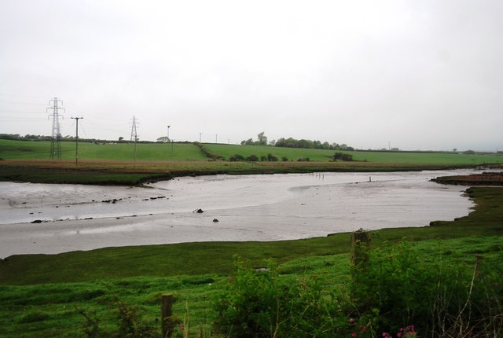
Compare the differences between river images

Slide 7
Grassy banks
Hilly
Wide
Much less water
Lots of water
Narrow
Rocky
Flat

Slide 8
  Killer Question: Can you justify (give reasons why) the rivers might look this way?
The two pictures are both of rivers but they show rivers at completely different stages. The picture on the right is the very start of a river, whereas the picture on the left is much further down the river. A river will look very different at the start compared the end. Imagine it like a baby- it’s very small at the start without much water in it, by the end it’s had plenty of time to grow and get much, much bigger and faster!

Slide 9
Analyse how all rivers begin and end
Watch this short clip:
BBC - Learning Zone Class Clips - Rivers and the water cycle - Geography Video
After watching the clip, try to explain in your own words how a river is formed.

Slide 10
1) Clouds release their rain (precipitation) over the hills.
2) Most of this soaks into the ground to become groundwater.
3) Some groundwater comes to the surface to form springs.
Can you tell me how rivers begin?
4) Springs join together to make streams.
5) As the streams trickle down the hillside they join together, getting bigger as they go, until they become rivers.

Slide 11
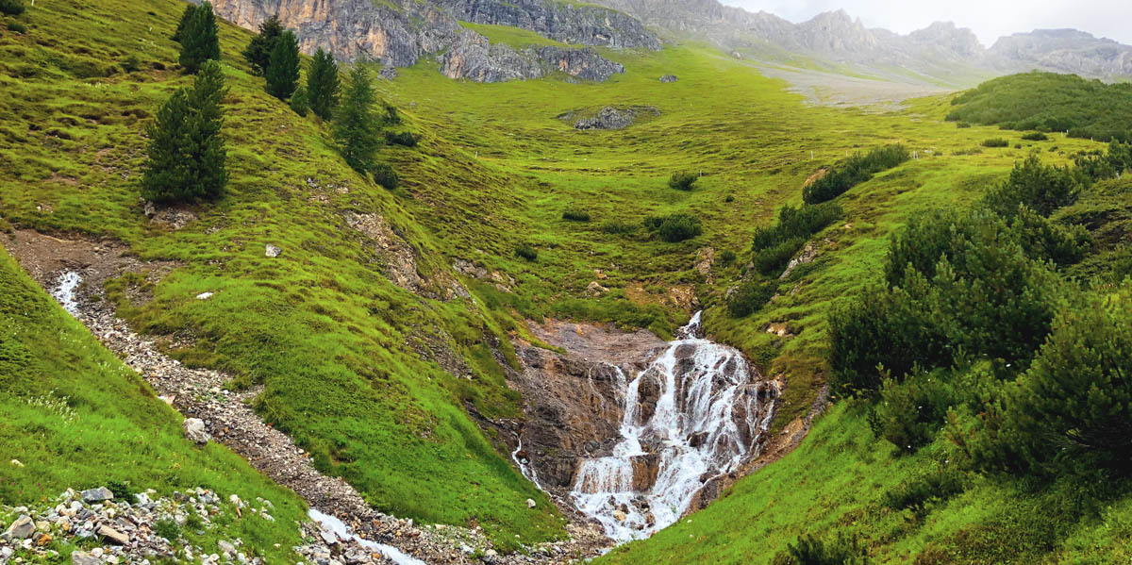
A Spring- The ground water being forced up to the surface high up in the hills…
Analyse how all rivers begin and end

Slide 12
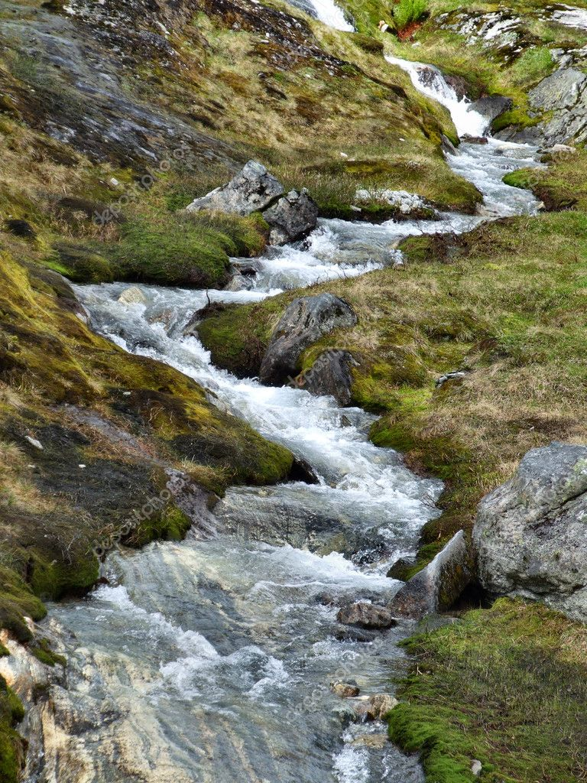
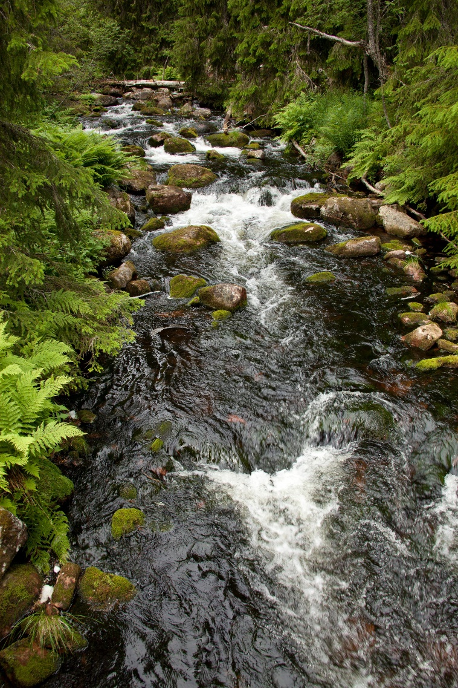
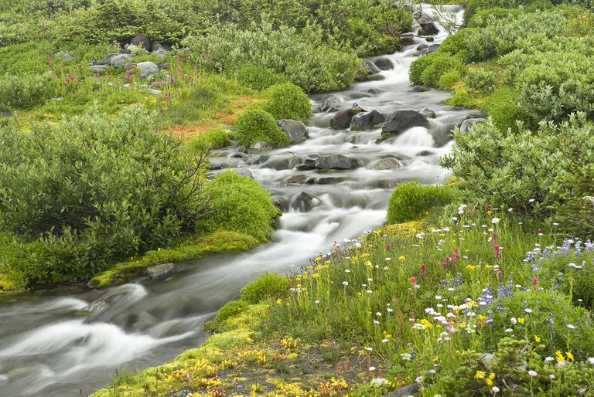
Streams- When spring water collects together and runs down the hillside. Streams also join together and get bigger as they go…
Analyse how all rivers begin and end

Slide 13
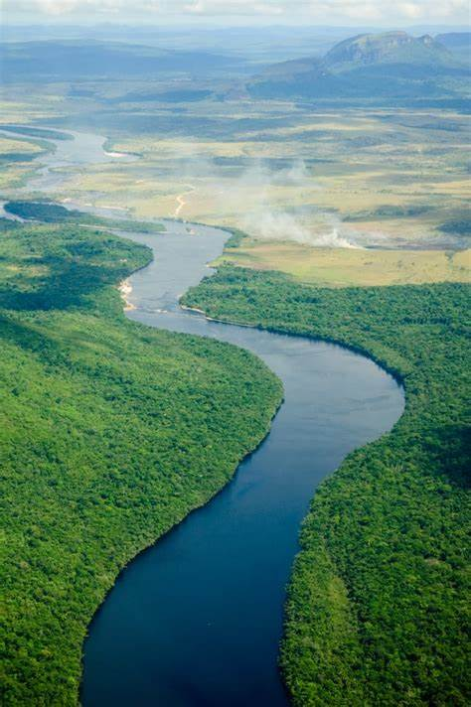
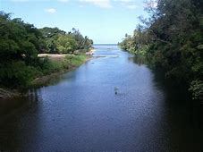
Rivers- When the streams join together they make a much bigger body of water called a river. Rivers travel down hill to flatter areas (in order to make their way to the sea!)
Analyse how all rivers begin and end

Slide 14
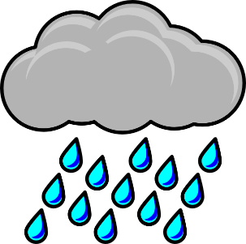
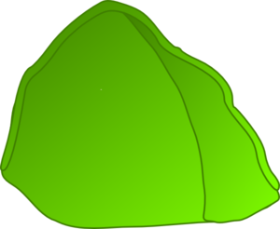
Precipitation
Springs
Stream
Ground water
River
Sea/Ocean
Analyse how all rivers begin and end

Slide 15
Now you’ve got all the knowledge you need for this lesson, have a go at the questions on the next slides to test your knowledge…
Write your answers down then use the answers (on the answers PPT) to check if you were right.
If you got one wrong don’t worry- do as we always do and correct it! (yes- you should do this in purple pen at school, but don’t worry if you don’t have one of those, any colour will do!)
Remember you should all do the developing and secure questions. If you are targeted S+, or you would like to challenge yourself, do those questions too!

Slide 16
Test your knowledge: Developing
What are the 6 water cycle key terms?
Describe which part of the water cycle rivers would be found in.

Slide 17
Test your knowledge: Secure
3) What are some adjectives to describe how a river may look at the start of it’s journey?
4) What are some adjectives to describe how a river may look further down it’s journey?
5) Explain why rivers don’t look the same all the way along from the start to the finish.

Slide 18
Test your knowledge: Secure+
6) Define the following key terms:
Springs
Streams
Rivers
7) Draw a diagram to show how all rivers are formed
8) Now write an explanation to show you understand how and where all rivers start, how they grow, and where they end.

Slide 19
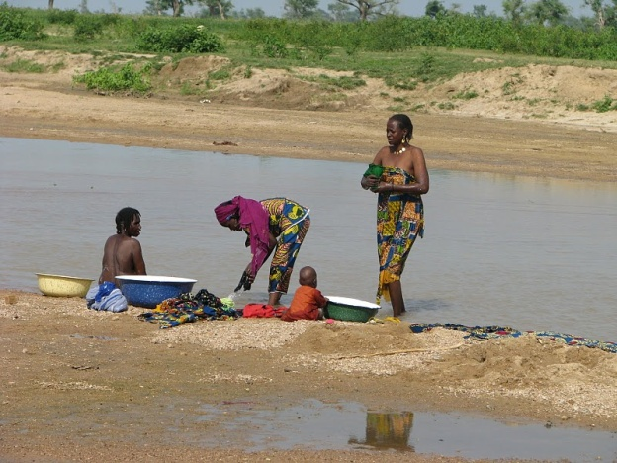
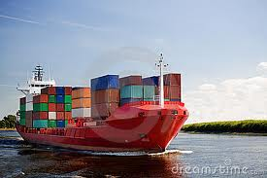
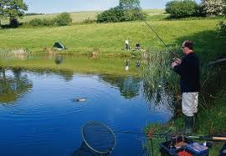
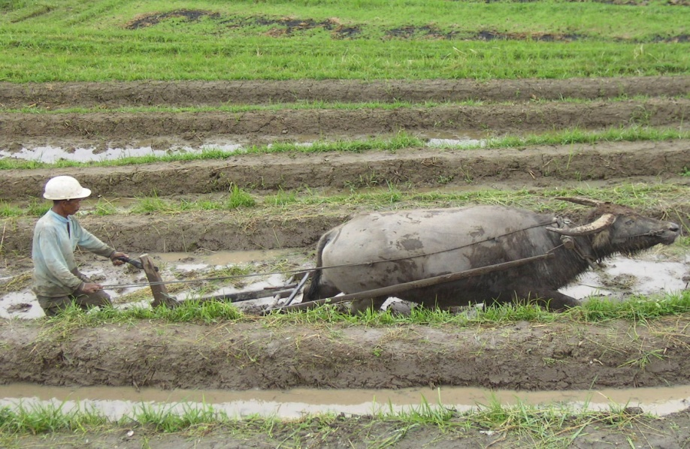
Test your knowledge: Secure+
STRETCH AND CHALLENGE TASK:
Why are rivers so important in Geography? Choose a picture and say how the picture highlights the importance of Rivers.
A
B
C
D

