Slide 1
Test your knowledge: Developing
What are the 6 water cycle key terms?
Evaporation, Condensation, Transpiration, Precipitation, Ground Water, Surface Water
2) Describe which part of the water cycle rivers would be found in.
Rivers make up the surface water in the water cycle because they are made up of water that is on top of the ground. They help rain water (precipitation) to make it’s way back to the seas and oceans.

Slide 2
Test your knowledge: Secure
3) What are some adjectives to describe how a river may look at the start of it’s journey?
Hilly, rocky, narrow, less water
4) What are some adjectives to describe how a river may look further down it’s journey?
Wide, grassy, flatter, more water
5) Explain why rivers don’t look the same all the way along from the start to the finish.
The way a river looks changes depending on what stage it is in (the beginning, middle or end. A river will look very different at the start compared the end. Imagine it like a baby- it’s very small at the start without much water in it, by the end it’s had plenty of time to grow and get much, much bigger, stronger and faster!

Slide 3
Test your knowledge: Secure+
6) Define the following key terms:
Springs- The ground water being forced up to the surface high up in the hills
Streams- When spring water collects together and runs down the hillside. Streams also join together and get bigger as they go
Rivers- When the streams join together they make a much bigger body of water called a river. Rivers travel down hill to flatter areas (in order to make their way to the sea!)

Slide 4
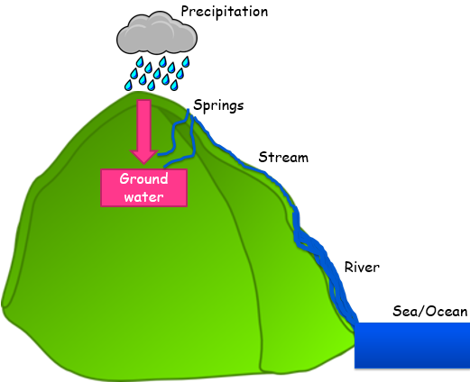
Test your knowledge: Secure+
7) Draw a diagram to show how all rivers are formed

Slide 5
Test your knowledge: Secure+
8) Now write an explanation to show you understand how and where all rivers start, how they grow, and where they end.
All rivers start when clouds burst and their rain (precipitation) falls on the hills. This means all rivers start high up in hills and mountains. Most of the water soaks into the ground, making ground water. Eventually, some ground water will reach the surface and start flowing out making a spring. These small springs flow down the hill and join together to make streams. The streams get bigger and bigger as they join together until they are big enough to be called a river. The river will then continue to travel downwards until it reaches the sea or ocean.

Slide 6
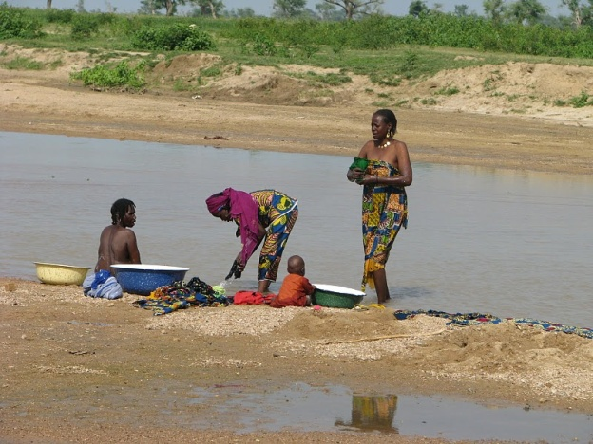
Test your knowledge: Secure+
STRETCH AND CHALLENGE TASK:
Why are rivers so important in Geography? Choose a picture and say how the picture highlights the importance of Rivers.
This picture shows how some people (particularly in poorer countries where they don’t have access to clean water from their own taps) will use rivers for essential day to day tasks such as washing themselves, washing their clothes and washing their pots and pans!
A

Slide 7
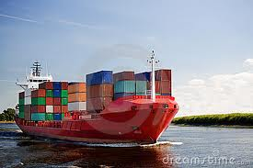
Test your knowledge: Secure+
STRETCH AND CHALLENGE TASK:
Why are rivers so important in Geography? Choose a picture and say how the picture highlights the importance of Rivers.
This picture shows how rivers are important because they are used to transport goods all over the world! Anything could be in those containers such as cars, toys, clothes etc.
B

Slide 8
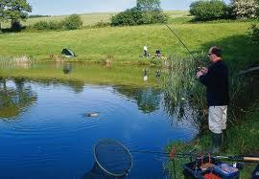
Test your knowledge: Secure+
STRETCH AND CHALLENGE TASK:
Why are rivers so important in Geography? Choose a picture and say how the picture highlights the importance of Rivers.
This picture shows how rivers are important because people used them for recreational activities and hobbies. For example, the man in the picture is fishing, but they can also be used for fun things such as kayaking, canoeing, swimming, rafting and so on.
Don’t forget, the fish he catches can also be used to eat! In poorer countries, some people only eat if they manage to catch their food!
C

Slide 9
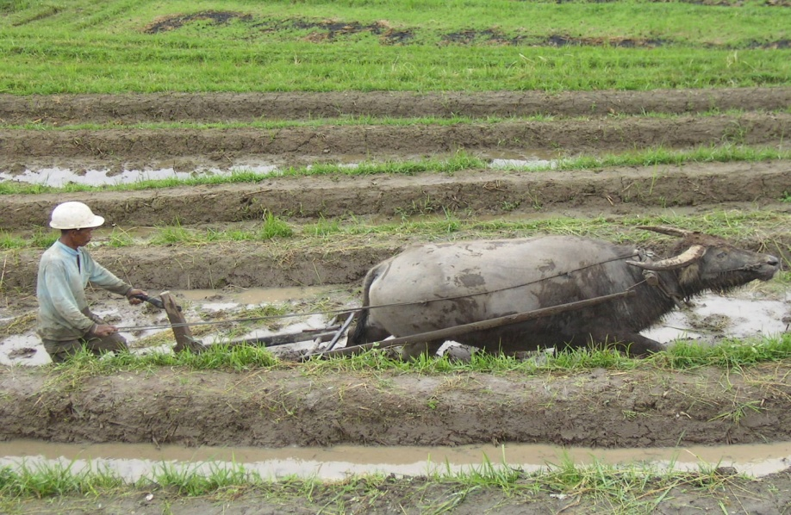
Test your knowledge: Secure+
STRETCH AND CHALLENGE TASK:
Why are rivers so important in Geography? Choose a picture and say how the picture highlights the importance of Rivers.
This picture was the most difficult, but you should be able to see a lot of water on the land the farmer is harvesting. That water has come from when a river has flooded. Most the time we think of floods as bad things but actually, sometimes they can be positive because they can water crops and leave behind lots of important nutrients that help crops to grow much better!
D

