Slide 1

SKETCH BOOKS
The following slides show examples of mature sketch books. It is really important that you look closely at these sketch book pages.
Pay attention to how they have :
Been laid out
Work onto top of images
Rip edges
Annotate when working
Vary font of annotation – cut for magazines
Use the entire page - fill all areas

Slide 2
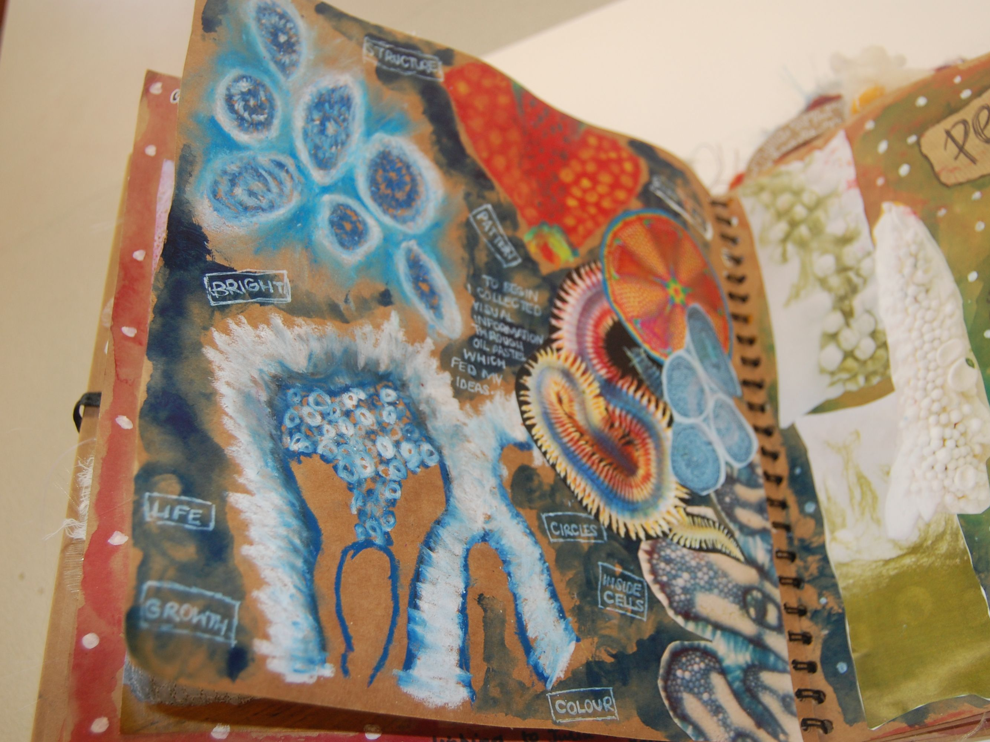

Slide 3
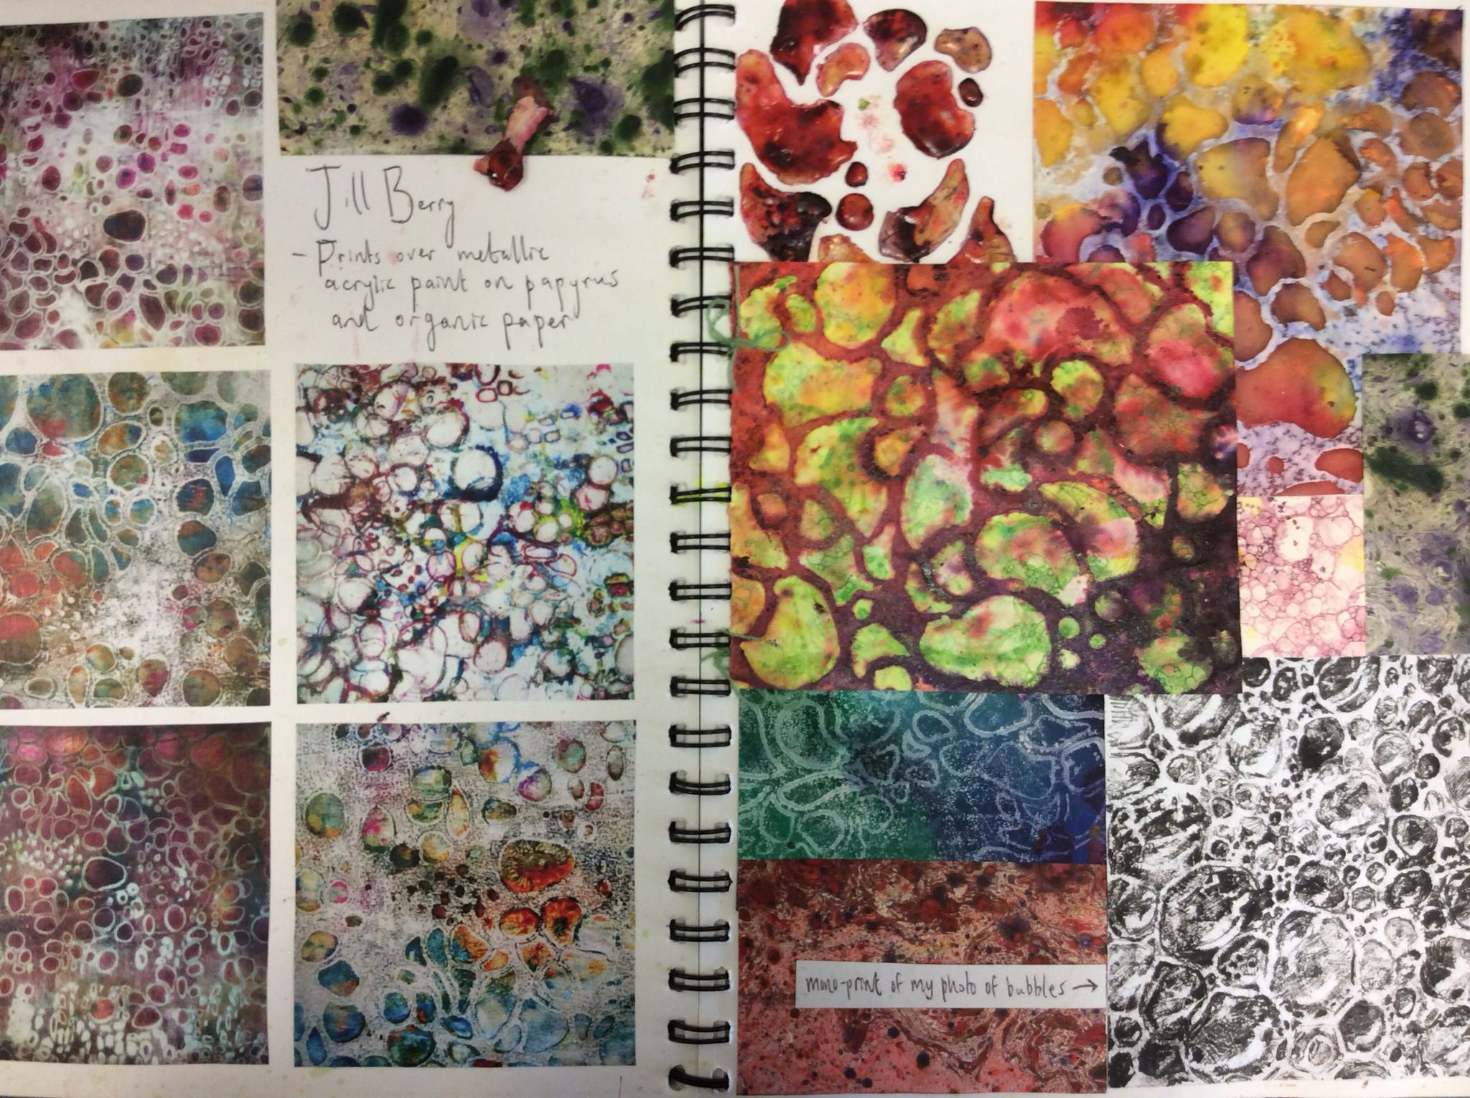

Slide 4
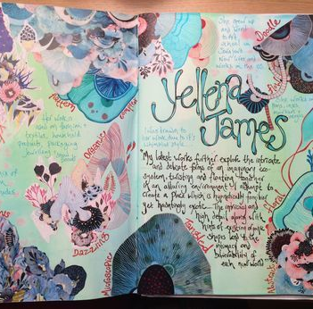

Slide 5

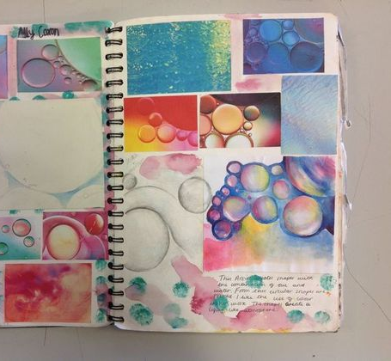

Slide 6
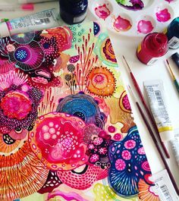

Slide 7


Slide 8
