Slide 1
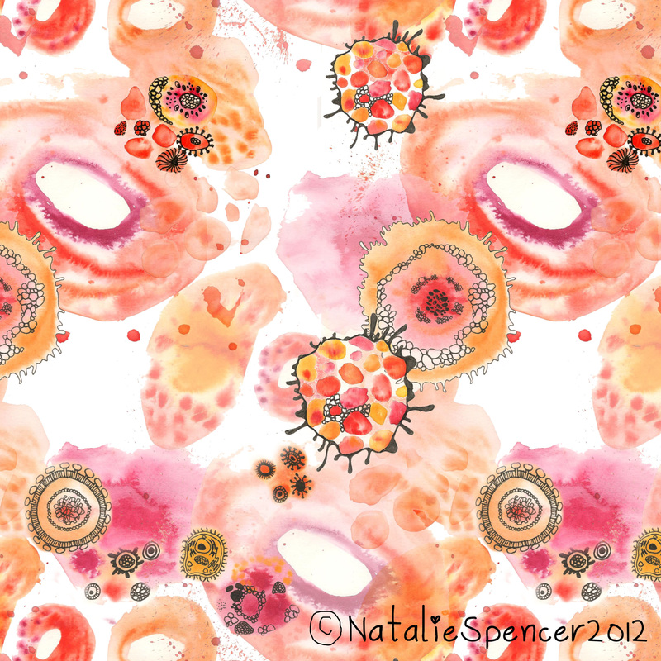
Week beginning | Task | Completed
20th April | Decide upon your sketch book - you may have an old one at home you could use, you could make one form a very old hardbacked book like the ones you see in the art rom, you maybe able to ask who ever goes shopping for the week to see if the supermarket has a CHEAP one. Obviously you cant not and MUST not go out and buy one specifically. You could collect a range of bases to use , from normal paper to old used envelopes, old wallpaper, foil, brown paper. Whatever you have - this is NOT A TASK TO WORRY ABOUT if you cant out your hand on the resources you would really like . A piece of newspaper for each task will be more than acceptable
27th April | Research the artist Natalie spencer. Gather as much information about her as you can , think about your presentation of the research Take a double page spread at least to cover information about her http://www.nataliespencerdesign.co.uk/surface-pattern-designs.html/
4th May | Draw out in biro on an interesting base either some cell images that you have found or one that I have placed on the PPT. Begin to arrange these in you sketch book - look at the PPT for sketch book ideas - think about your layout and composition
11th May | Create a wordle all about cells and Natalie Spencer - cut out letters from a magazine and use a mixture of your own pen work and glued in letters, vary your font and size of letter
18th May | Have a look at the possible ideas PPT - complete one of these Organise and arrange I your sketch book - again refer to the sketch book PPT for ideas - consider your presentation.

Slide 2
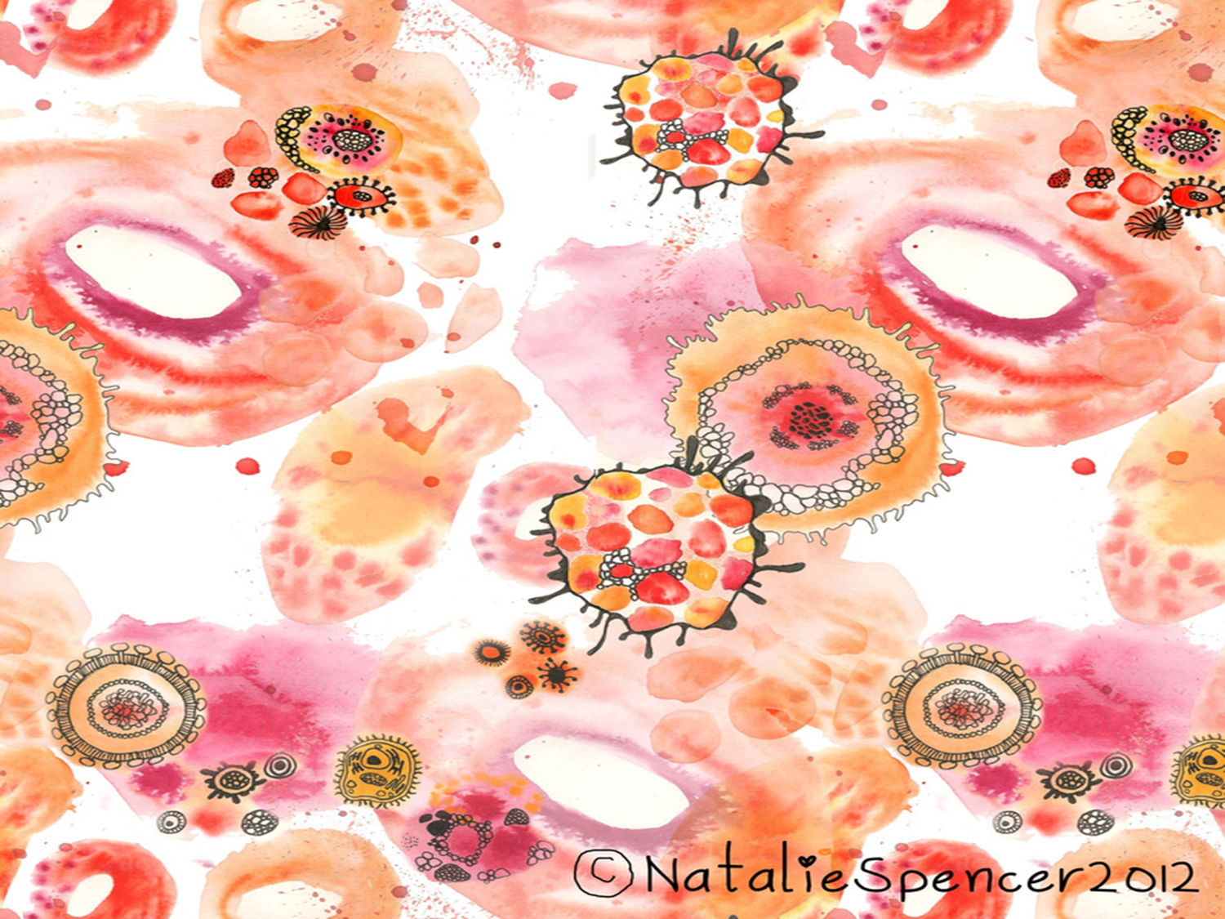
Week beginning | Task | Completed
1st June | Copy some of the patterns that Natalie Spencer creates - use coloured crayon and black biro or fine liner
8th June | Use one cell image -on one page draw out a variety of the cells in a variety of sizes, make an use a view finder if it helps , both zoomed in enlarged images and normal sized images ,and tiny images too – vary our media , think about texture . Annotate your work wen you arrange it in your sketch book . For the start of each sentence start with a letter cur out from a magazine.
15th June | Have a look at the possible ideas PPT - complete one of these Organise and arrange in your sketch book - again refer to the sketch book PPT for ideas - consider your presentation.
22nd June | Create a cell like pattern entirely from ripped papers, cut nothing draw nothing. Once your base of paper is created and glued down draw on the top the intricate cell details in biro or fineliner.
29th June | Consider different outcomes that you could create with a cell pattern design that you have been looking at - sketch out what they could be ? Or list them ? Cushion, bed covers, textiles ideas, bathroom tiles, wrapping paper etc etc

