Slide 1

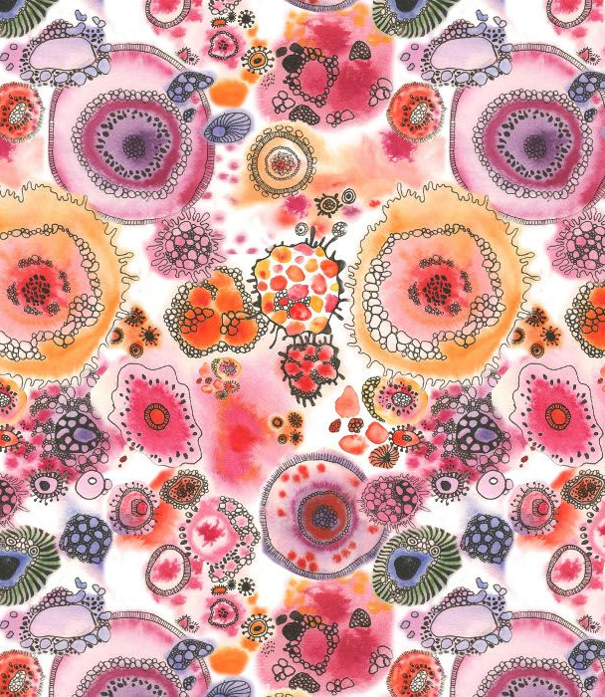
These are just some possible ideas that you may be able to explore. You may be able to do some and not others .
All are restricted by resources which you may or may not have.
Have a dig in the shed or the garage and see what you can find - with permission of course.
These are ideas only - this is all about experimenting. You do not have to stick to these ideas to the letter - how could you change things, recreate things ? Mix things up?
REMEMBER : SOME OF THESE IDEAS MAY JUST BE CREATING A BASE YOU MAY NEED TO CONTINUE TO WORK INTO IT BY DRAWING ON THE TOP, OR SEWING …the options are endless.
POSSIBLE TASKS
Experimental ideas

Slide 2
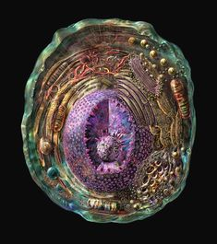
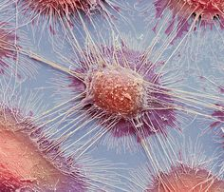
Could you colour a base with paint or pens or just paper collage and then create the lines with thread or string or wool ?
Could you re create something similar with ripped up or cut out cardboard glued onto a piece of cardboard ? Or something like this with wools or string ?

Slide 3
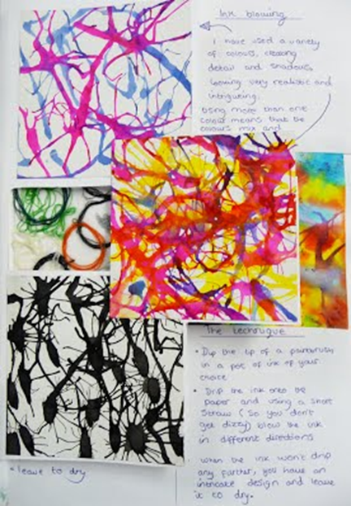
Ink blowing
Try using paints watered down
Or ink from a pen
Use a draw to redirect the flow of the ink
When its is dry draw with a black fine liner the patterns like Natalie Spencer uses on the top.
Or keep it as a plain base and look at the next page to see if you can incorporate any further ideas onto this.

Slide 4
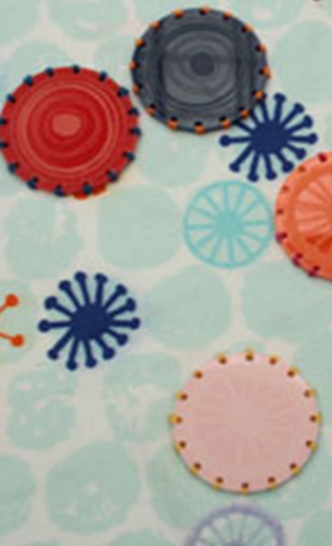
Could something similar be re created by using card board circles - draw on top of them or sew into them- use a mixture of paper and cardboard – add colour to them or leave them plain.
Rip the card board on half to reveal different textures
Do you have any scraps of fabric that you could use ?

Slide 5

Needed :
washing up liquid
Straw
paint
Place a small amount of paint to warm soapy water and blow lots of air into the water through your straw
Place piece of paper on top of the bubbles
When the paper has dry you can draw patterns into the bubble paint pattern

Slide 6
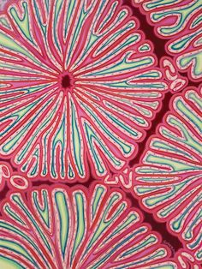
Could this be recreated with string or wool?
If you have lots of PVA glue, dribble the glue on a piece pf card in this pattern and allow to dry fully
Add colour when it has dried fully

Slide 7
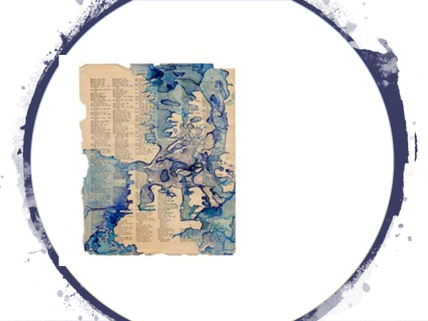
Leave a piece of newspaper or any kind of base by the kettle for a while .
Every time some one makes a coffee or tea they will probably leave a ring mark
See how many you can collect on one page
Go on - make your parents brew – all in the name of art

Slide 8
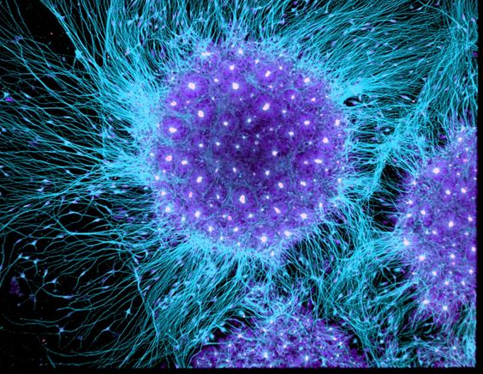
Do you have a price of old cloth, duster , some woollen item that was or is going into recycle?
Cut a circle from it and sit for a while pulling at the edges - see how much you can fray the material
See if you can compete this with a few different sized circles
When they are frayed you can sew into them or draw straight on top of them .

