Slide 1
This is what is exactly what the title suggests!!
This is a brief version of what the assembly by one of the art teachers at BHS would have included.
So run your own assembly - get yourself an audience and away you go - don’t forget to read spilt he beans for all notices in your house for this week!!

Slide 2
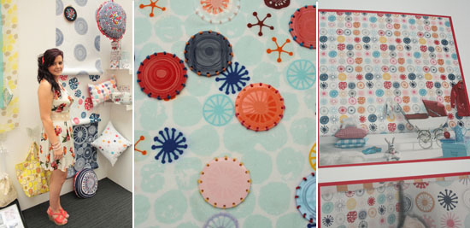
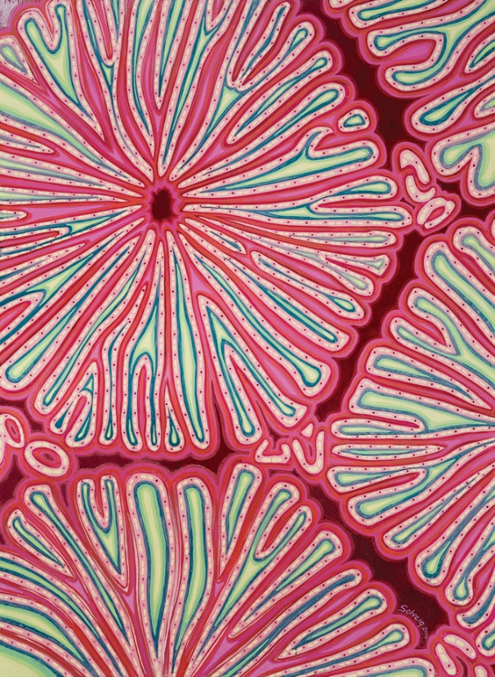
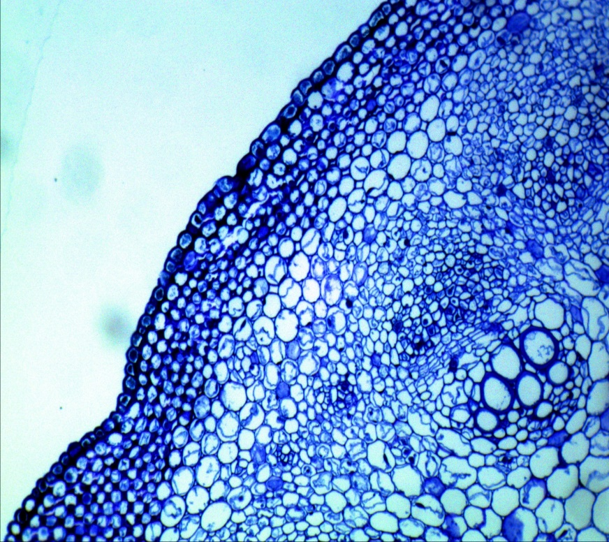
Your Task
Show off your skills and creativity!
Your last project at your middle school has been set by me under the topic of ‘CELLS’
When you are at Biddulph High in September 2020 you will continue with this theme so I want to see your best and most creative work

Slide 3
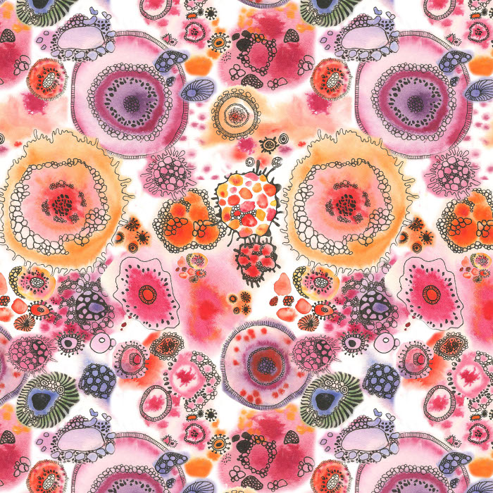
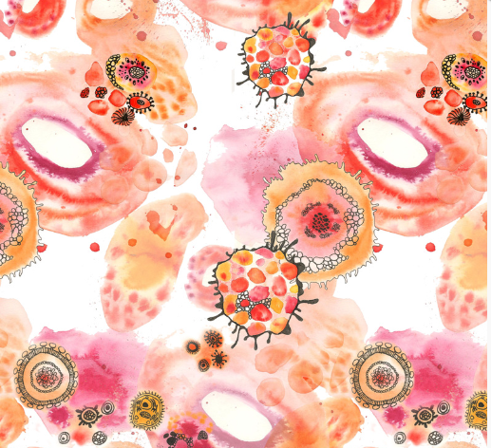
What To Include
In lessons you will be asked to include the following work
Mood and Concept Boards/ sketchbooks - you should present research on the theme of CELLS and show what this means to you
Drawings- use different media to draw from your research and any images of CELLS
Artist Research- Natalie Spencer is an artist who produces beautiful, delicate and colourful artwork on this theme

Slide 4
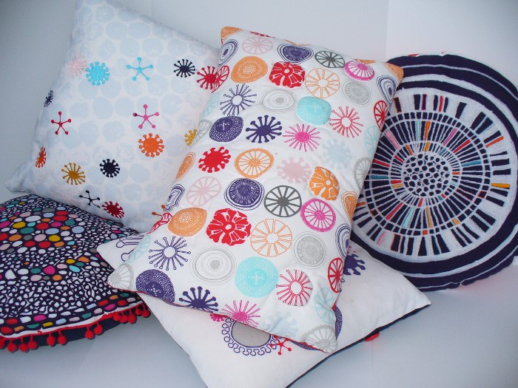
Natalie Spencer’s Work

Slide 5
How To Be Successful
Be creative
Be curious
Try new things where possible
Listen to your teachers advice!
Use the theme and artist research to help and inspire you

Slide 6
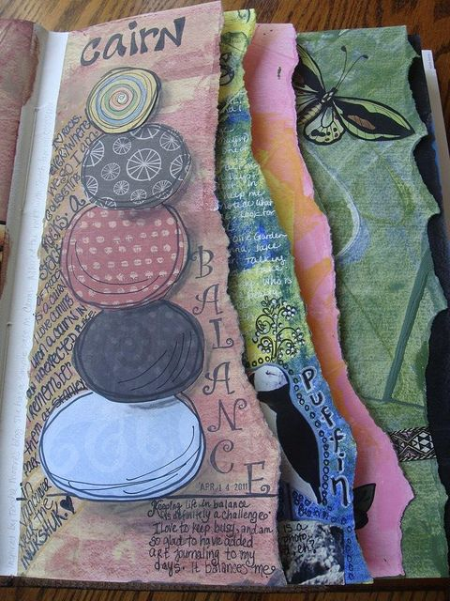
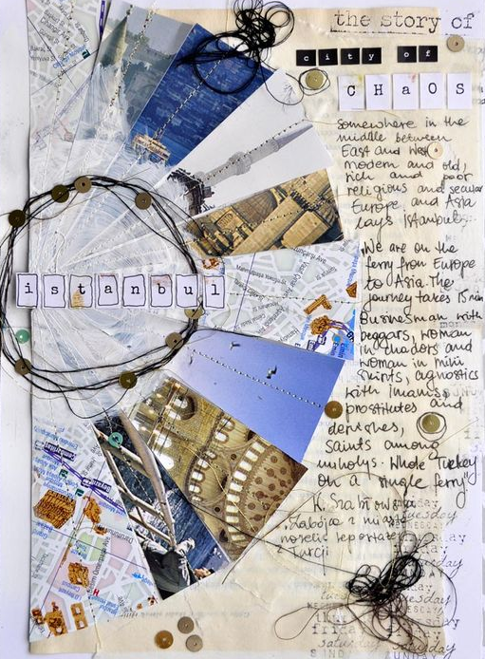
Examples of sketchbook pages

Slide 7
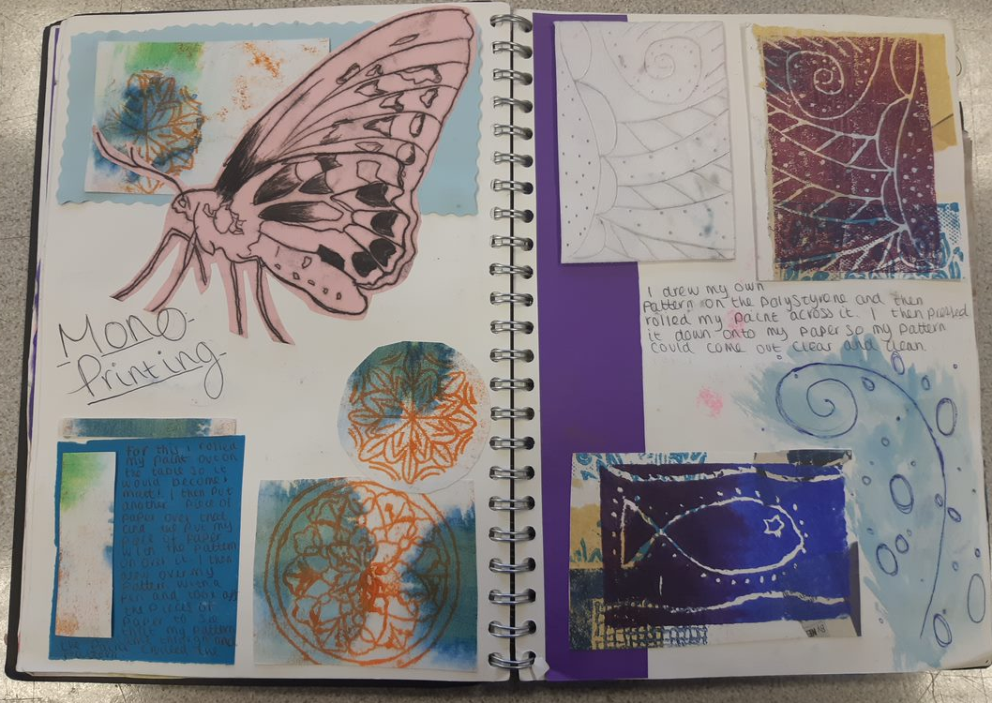
Examples of sketchbook pages

