Slide 1
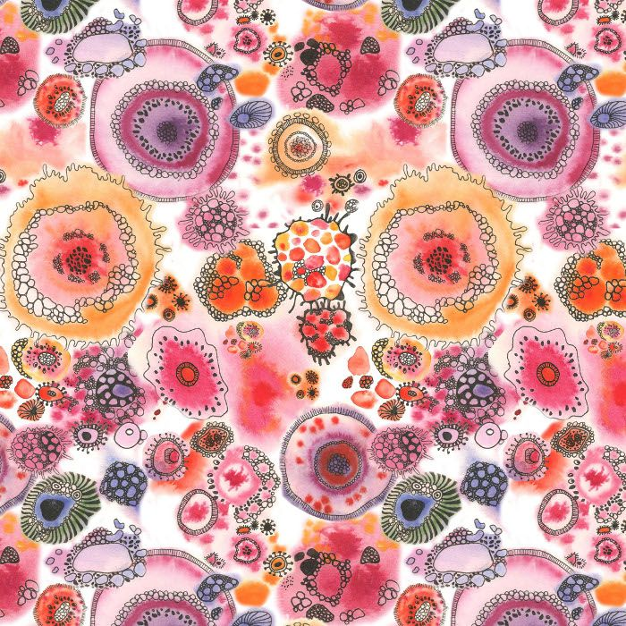
Y8 CELLS PROJECT
Ok Y8, you wonderful lot! I have spoken briefly to you in lesson about this but obviously I wont get the chance to explore things with you properly and explain and demonstrate things to you. This project is something that you will take to the high school with you . You will continue to work on it there. This is your chance to show staff at BHS what you are capable of.
In this cells project you will need to gather information on cells explore and experiment as much as possible, research the selected artist Natalie Spencer and then create work inspired by your findings and related to Natalie Spencer.
I am hoping that in the couple of weeks before Easter that some of you have started to do some work towards this. I understand fully that this will be easier for some than others - some of you will have access to resources and others just a pencil - it doesn’t matter - work with what you have - it is the effort that BHS are concerned with .
So, I have tried to split up presentations on PPT for you in easier sections to understand - look at them in the number order that I have placed them. Try to complete as many tasks as you can on a wide variety of bases. Worst case scenario, newspaper and a pen would make some lovely sketches. Nothing is wrong - have go , if to doesn’t turn out so well, its good learning and maybe be able to be used elsewhere.
I have placed a task list together - this is to help give some guidance to the amount of tasks to complete – they do not have to be completed n this order , you can complete more than I list and you can explore and complete different ones too and not eve complete mine listed - it is merely guidance for the next ten weeks – do not worry over this - complete what you can, when you can .
Ultimately explore the artist and create work similar to hers, explore in as many ways how you could do this - stick to my project task sheet if you like , use it as a guide or don’t and just simply churn out as much as you can in whatever way that you canto show BHS just how good you are.
Important things
Explore the artist Natalie Spencer - surface pattern designer
Keep all work together however you can - in whatever way best for you
All your work needs to be influenced by the artist – how could you achieve this
JUST TRY YOUR BEST AND HAVE A GO …..take lots of rest breaks, stay safe and keep smiling !

