Slide 1
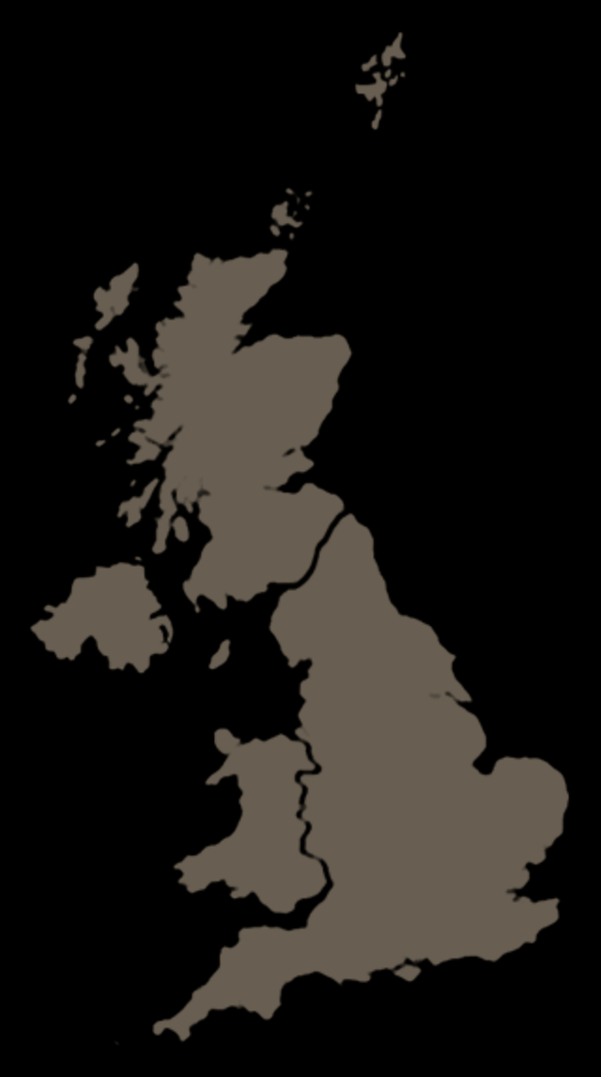
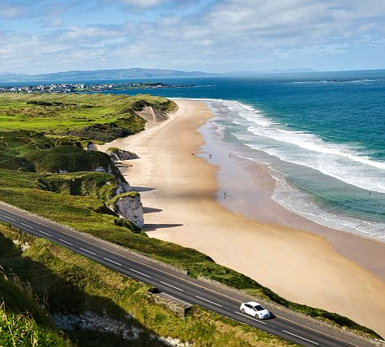
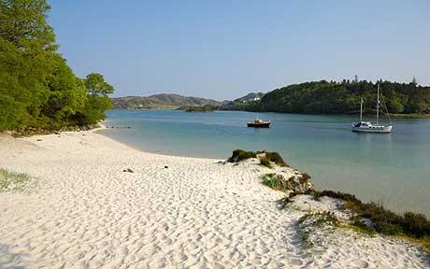
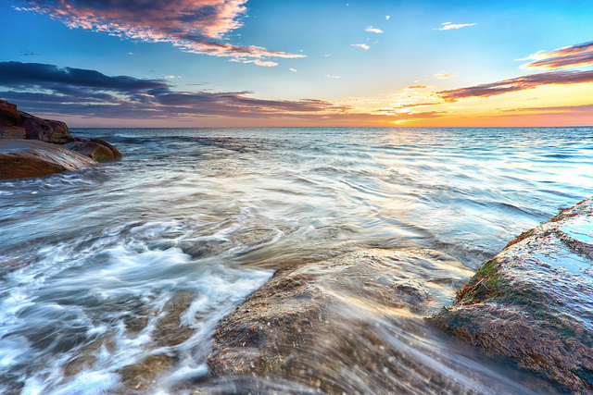
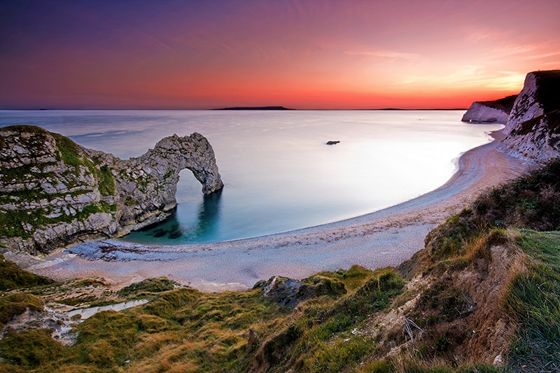
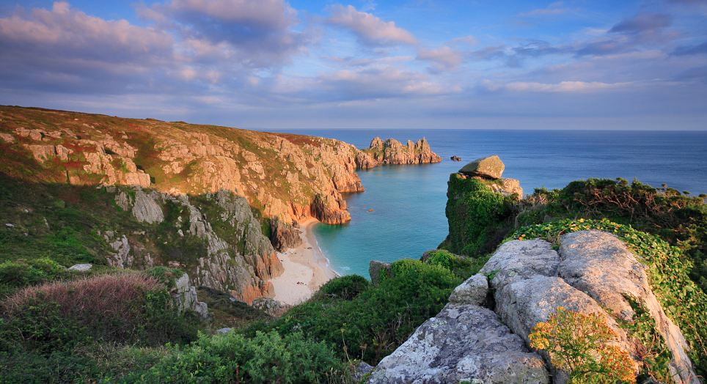
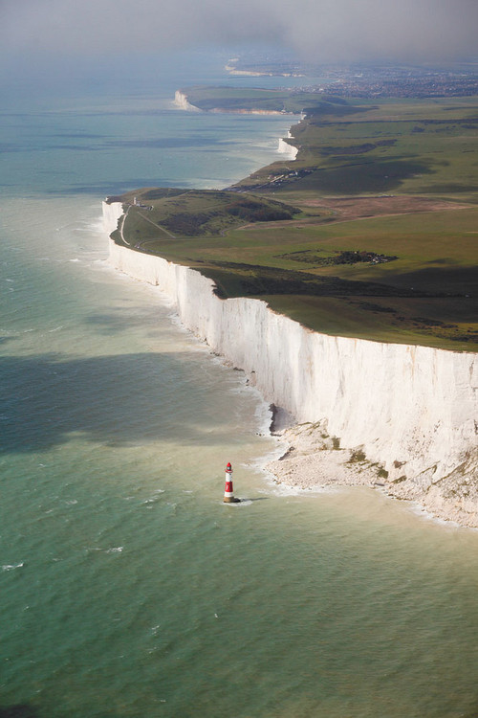
Worksheet 1 answers:
Loch Lomond, Scotland
Runswick Bay, Whitby
Durdle Door, Dorset
Scarborough’s North Bay
Porthcurno, Land’s End
White Cliffs of Dover, Dover
Investigate the location of coastal areas using an atlas

Slide 2
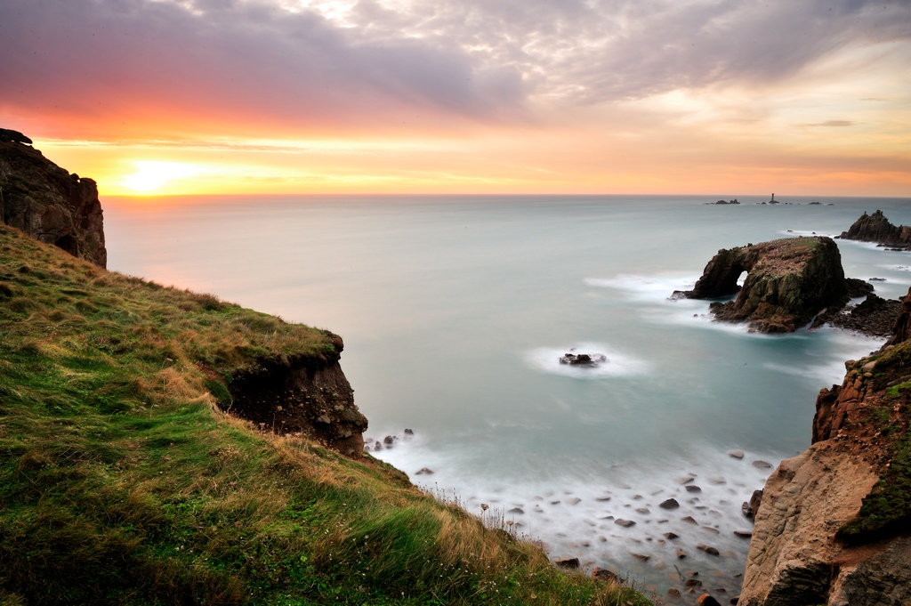
Intelligent guesswork!
Intelligent guesswork: Answers
1.2 billion
The number of visitors to the UK coast every year
11,000
The number of people who live at the coast in the UK
25 Million
The total number of miles of the UK coastline
70
The amount of money spent on fish and chips every year in the UK
3 Million
Nowhere in the UK is further than this number, in miles, from the UK coastline.

