Slide 1
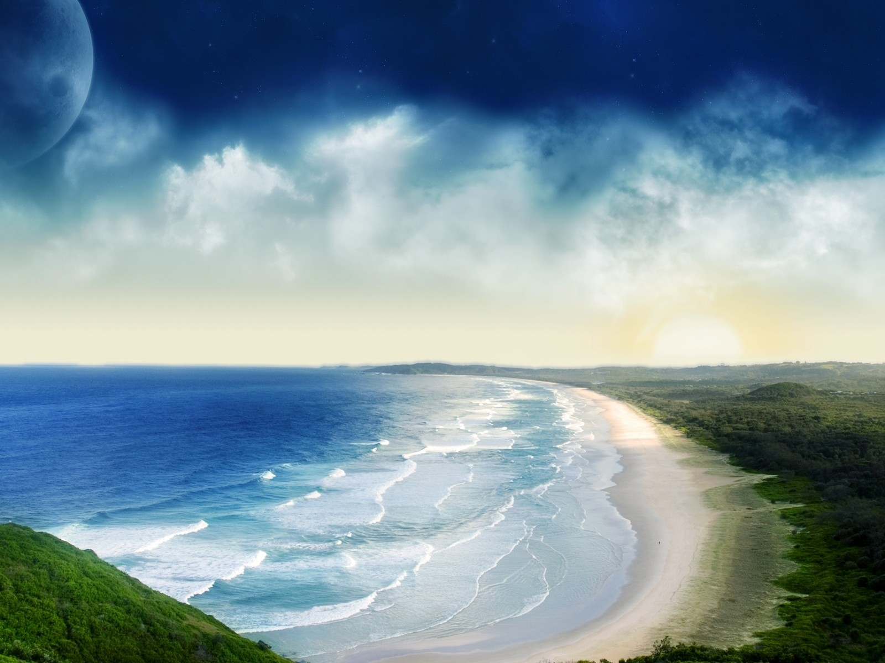



An introduction to The Sea
Identify what the sea (and the coast) is like
Describe a time you have visited the coast and a range of coastal activities
Investigate the location of coastal areas using an atlas

Slide 2
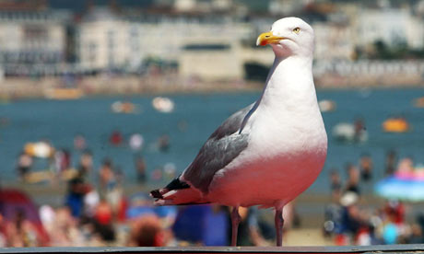
Developing Task:
Write down a short paragraph about a time you have visited the seaside
-Where was it?
-Who did you go with?
-What did it look like?
-Activities you did?
-Funny moments?
-Would you like to go again?
Identify what the sea (and the coast) is like

Slide 3
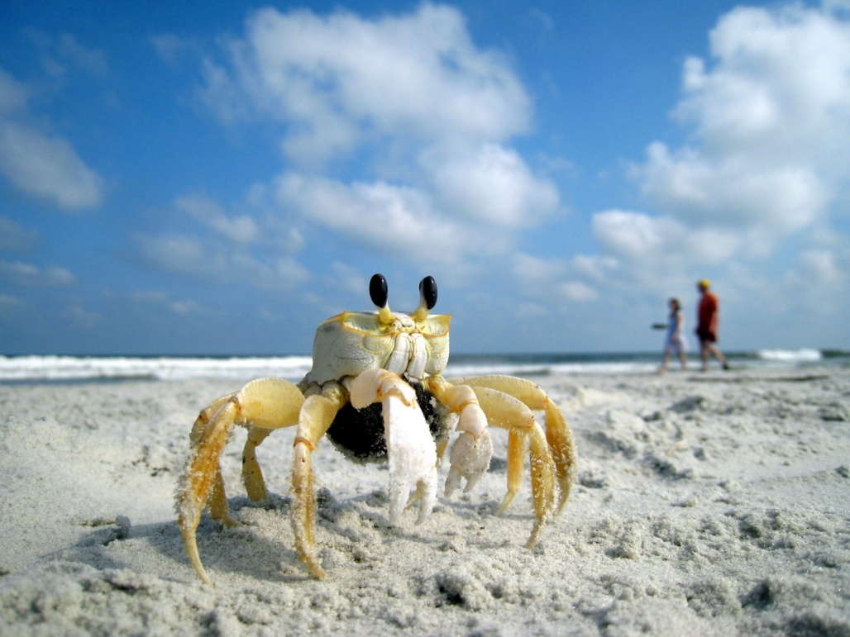
Secure Task:
Make a list of things you can do at the coast.
If needed, you can use the picture examples on the next slide to help…..
Describe a time you have visited the coast and a range of coastal activities

Slide 4
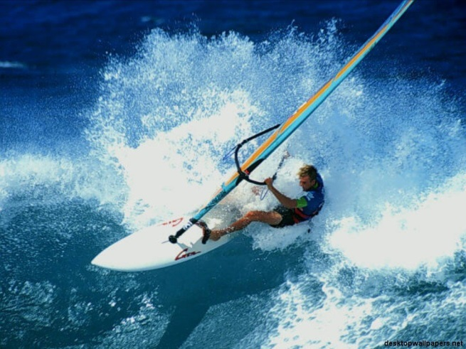
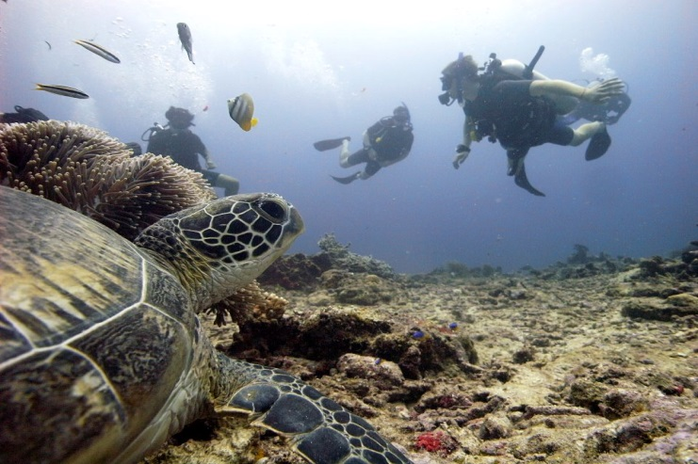
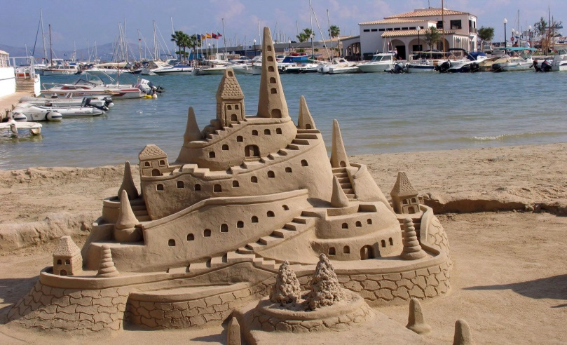
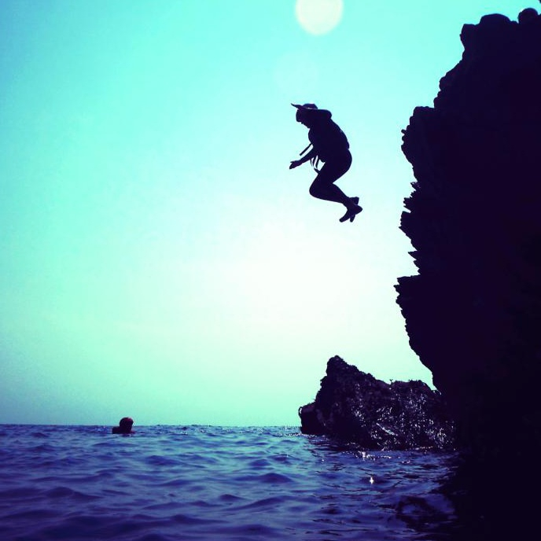
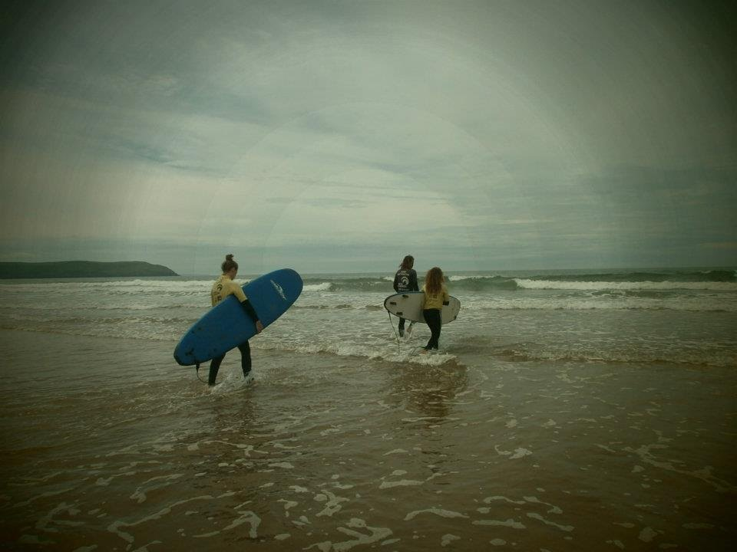
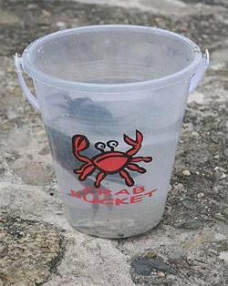
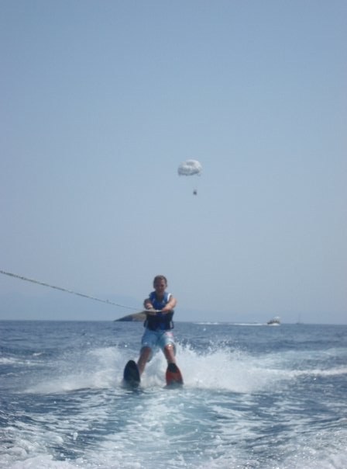
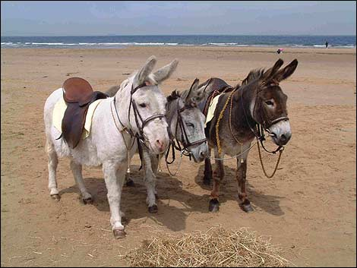
Wind Surfing
Scuba Diving
Sand Castles
Cliff Jumping
Surfing
Para-gliding/Water-skiing
Donkey Rides
Crabbing

Slide 5
Coastlines can look very different depending on where they are located in the world.
Where in the world do you think these eye-catching coastlines can be found?

Slide 6
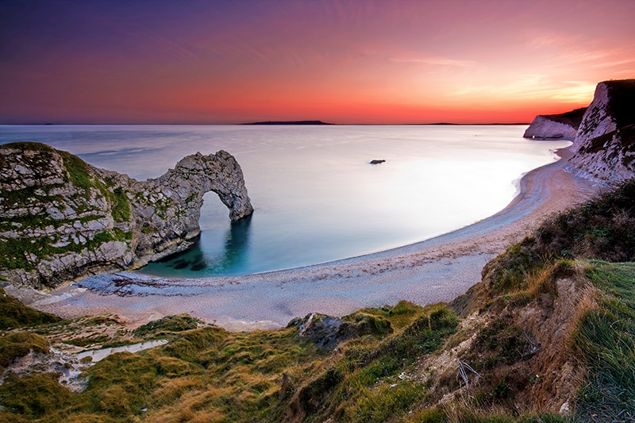
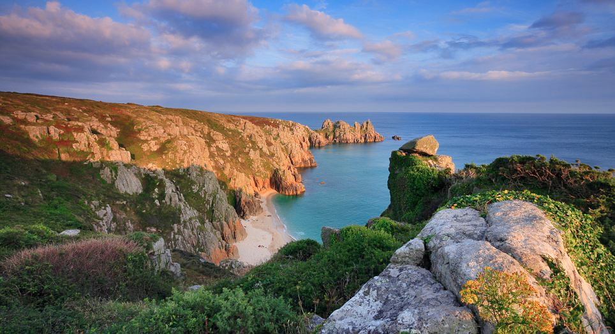
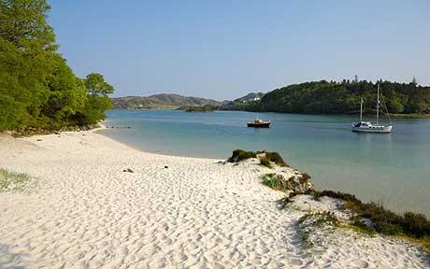
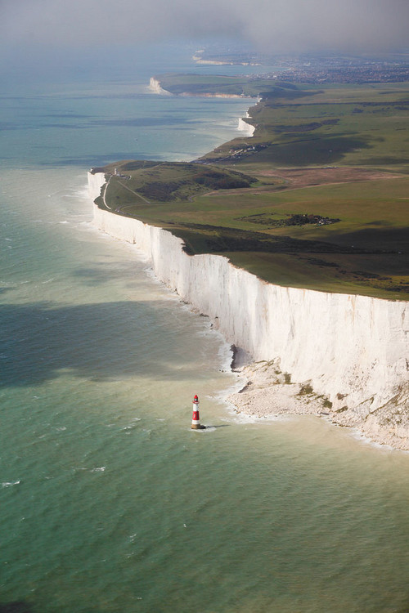
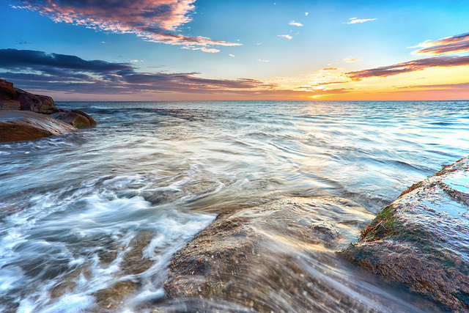
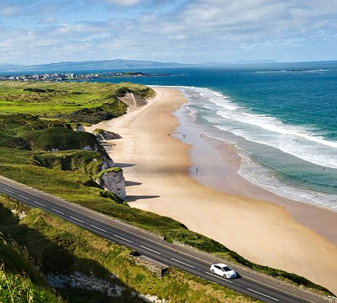
1
2
3
5
4
4
6
Task:
Try to guess where all of these fabulous coasts are

Slide 7
They are all in the UK!
Do you know why the UK is unlike any other country in Europe?
The UK is the only place in Europe that has a coastline running all the way around it!
They’re all in the UK!

Slide 8
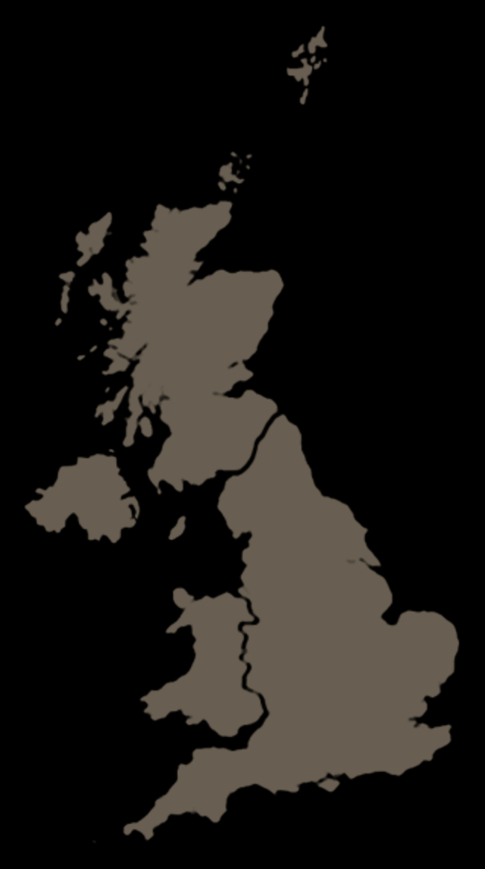
Investigate the location of coastal areas using an atlas
Secure+ Task:
Loch Lomond, Scotland
Runswick Bay, Whitby
Durdle Door, Dorset
Scarborough’s North Bay
Porthcurno, Land’s End
White Cliffs of Dover, Dover
Complete worksheet 1

Slide 9
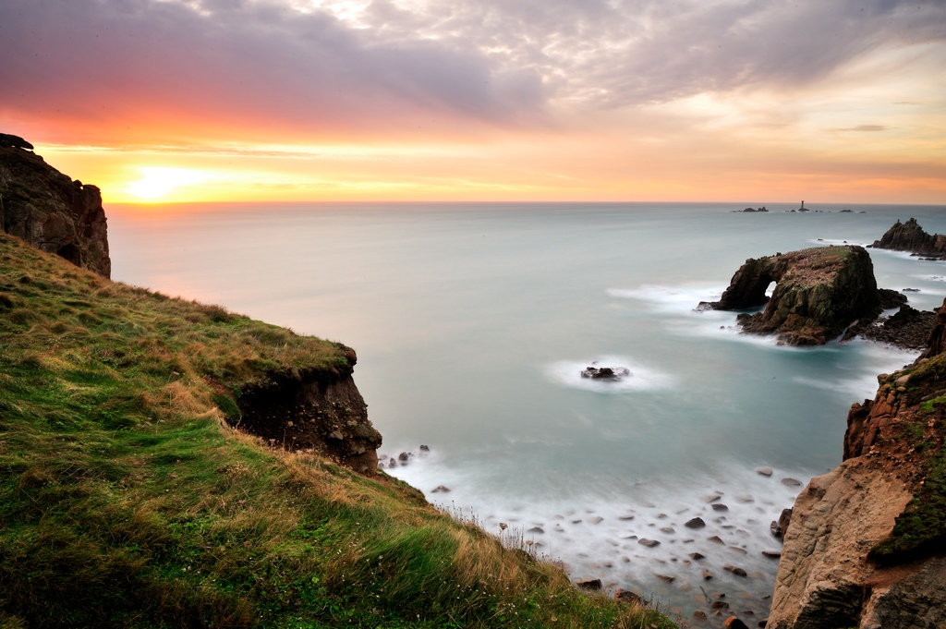
Intelligent guesswork!
Intelligent Guesswork: Can you match the numbers to the statement?
1.2 billion
The number of visitors to the UK coast every year
11,000
The number of people who live at the coast in the UK
25 Million
The total number of miles of the UK coastline
70
The amount of money spent on fish and chips every year in the UK
3 Million
Nowhere in the UK is further than this number, in miles, from the UK coastline.

