Slide 1
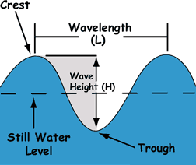
Test your knowledge: Developing
Draw a diagram to show the structure of a wave using all of the appropriate key terminology

Slide 2
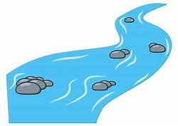




Test your knowledge: Developing
2) What causes waves? The wind
3) Which 3 things affect the size and power of a wave?
The fetch
A River vs. An Ocean
A small fetch means the wind only has a small amount of water to travel over (like a river) so waves will be very small. A big fetch is when there is lots of water for the wind to disturb so it builds up big waves.
The strength of the wind
The stronger the wind, the more power it has to disturb the surface of the water in order to build up big, powerful waves. If the wind is weak, it doesn’t have the strength to disturb the water, so only small, gentle waves are created.
The length of time the wind blows for
The longer the wind blows for the more time it has to build waves up, making them get bigger and bigger. If the wind only blows for a short amount of time, it only has time to build relatively short waves.

Slide 3
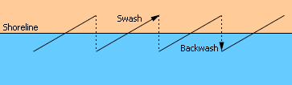
Test your knowledge: Developing
Draw a diagram to show what the key terms ‘swash’ and ‘backwash’ mean

Slide 4
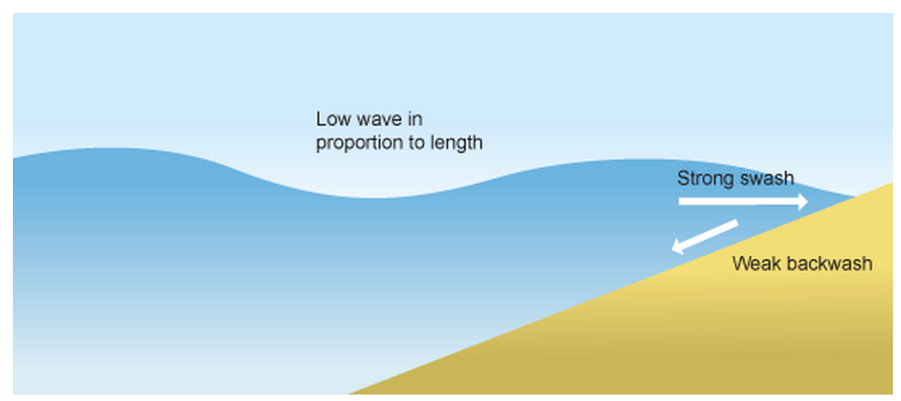
Test your knowledge: Secure
5) Draw a diagram to show a ‘constructive wave’.
Extra sand being pushed onto the beach.
All of the energy in this wave is used in it’s swash. This means that the wave pushes lots of sand on to the beach
These waves are much more calm and gentle
The backwash is very weak as the wave used up all of it’s energy in the swash (this means the backwash doesn’t have the energy to take any sand away from the beach with it.

Slide 5
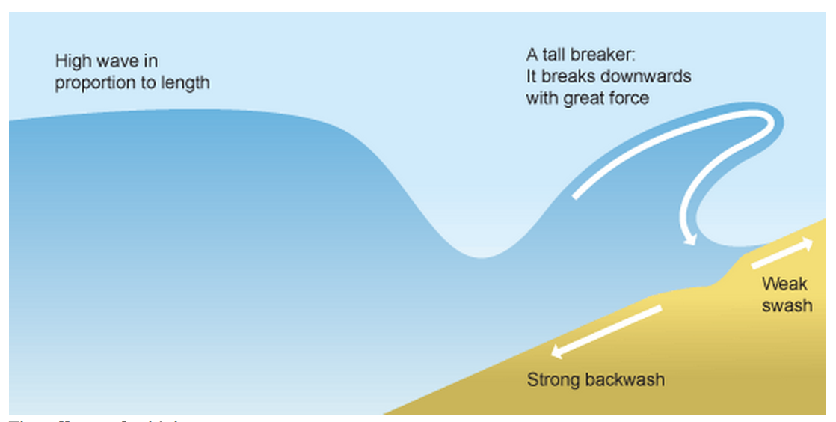
Test your knowledge: Secure
6) Draw a diagram to show a ‘destructive wave’.
The violent wave crashes down onto the beach with force. It does not travel very far up the beach, it slams down and then wants to go back out to sea. This means the swash is relatively small (so no sand is pushed on to the beach)
These waves are much more powerful.
As the wave didn’t use much energy in it’s swash, it uses all of it’s power in it’s massive backwash. This means it scoops lots of sand away from the beach and back into the sea.
Sand being moved away from the beach, making it smaller.

Slide 6
Test your knowledge: Secure+
7) How would a constructive wave effect a beach? What would it do to the beach and why?
Constructive waves help to build up the beach by putting more sand on them making them bigger. They do this by using all their energy in the swash which pushes sand onto the beach. They have no energy left to take the sand away so the beach continues to grow.
8) How would a destructive wave effect a beach? What would it do to the beach and why?
Destructive waves destroy the beach by using their powerful energy to take sand away from the beach and take it back to the sea. They have a very small swash so no sand is taken on to the beach, so they use all of their energy in their backwash which means they pull the sand off the beach (making it smaller). If this continues to happen the beach will get smaller and smaller.

