Slide 1



What are waves like?
Identify key words associated with the structure of a wave
Understand and describe the two different types of wave
Analyse the effects each type of wave causes

Slide 2
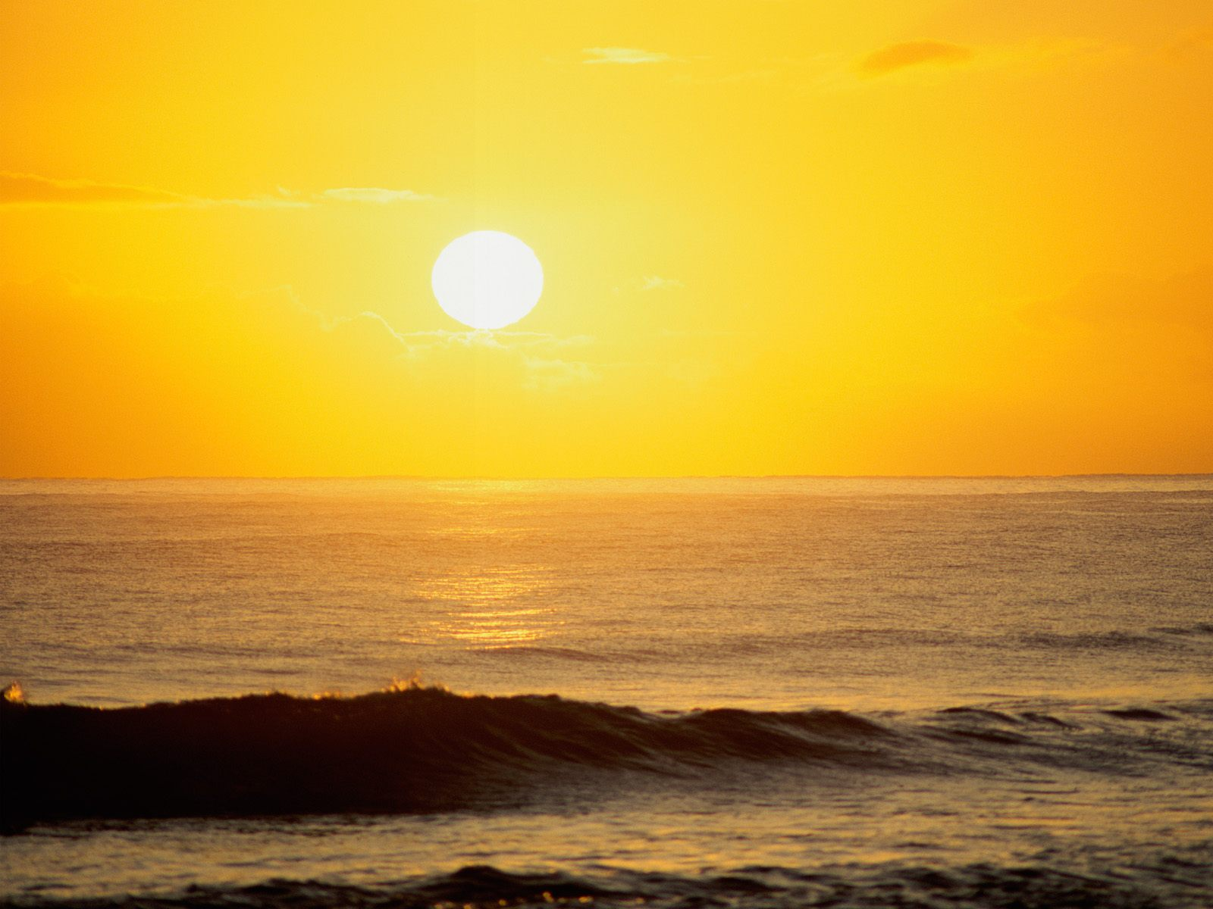
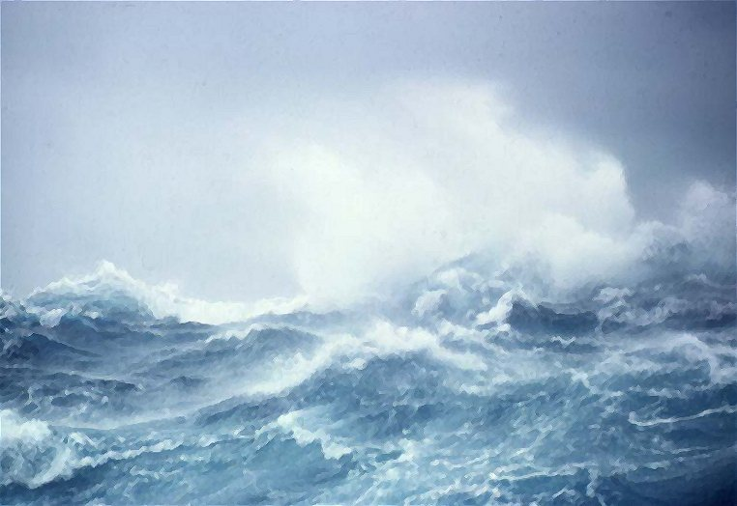
Starter
Spot the difference between the two pictures!
But why is there a difference?
A
B
You can describe two differences between the photos.
You can suggest one reason for the differences.
You can suggest two reasons for the differences.

Slide 3
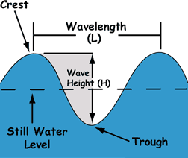
Identify key words associated with the structure of a wave
The Structure of a Wave:

Slide 4
Identify key words associated with the structure of a wave
The waves are caused by the wind dragging
over the surface of the water.
The size and power of the waves are influenced by …
The FETCH (amount of water the wind blows over). If there is a bigger expanse of water, the wind has more time to come into contact with the water and build up much bigger waves)
The STRENGTH OF THE WIND. The stronger the wind, the more it will disturb the water creating bigger waves
The LENGTH OF TIME the wind blows for. The longer the wind blows for, the more time it has to build bigger waves

Slide 5
So, what happens when waves meet the land?
What did you notice when you were at the beach?
How did the water move?

Slide 6
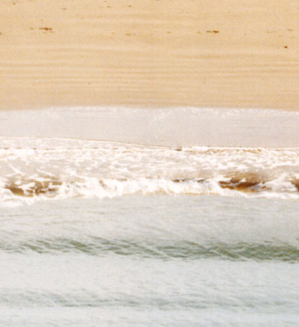
SWASH
The wave pushes up the beach (always at a slight angle). This is called the swash.
BACKWASH
The water then rolls back down the beach and back to the sea.
Swash
Backwash

Slide 7


There are two different types of wave…
Constructive
Destructive
Think about these two words. What does this tell us about the waves?

Slide 8
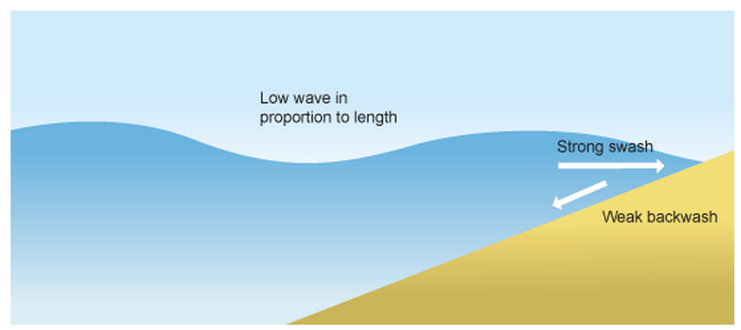
Let’s start with constructive waves.
They build up (or construct) the beach.
Extra sand being pushed onto the beach.
All of the energy in this wave is used in it’s swash. This means that the wave pushes lots of sand on to the beach
These waves are much more calm and gentle
The backwash is very weak as the wave used up all of it’s energy in the swash (this means the backwash doesn’t have the energy to take any sand away from the beach with it.
So, constructive waves help to build up the beach by putting more sand on them making them bigger. They have no energy left to take the sand away…

Slide 9
Killer Questions:
What do you think the diagram for a destructive wave will look like?
What will the waves be like?
What will the swash be like?
What will the backwash be like?

Slide 10
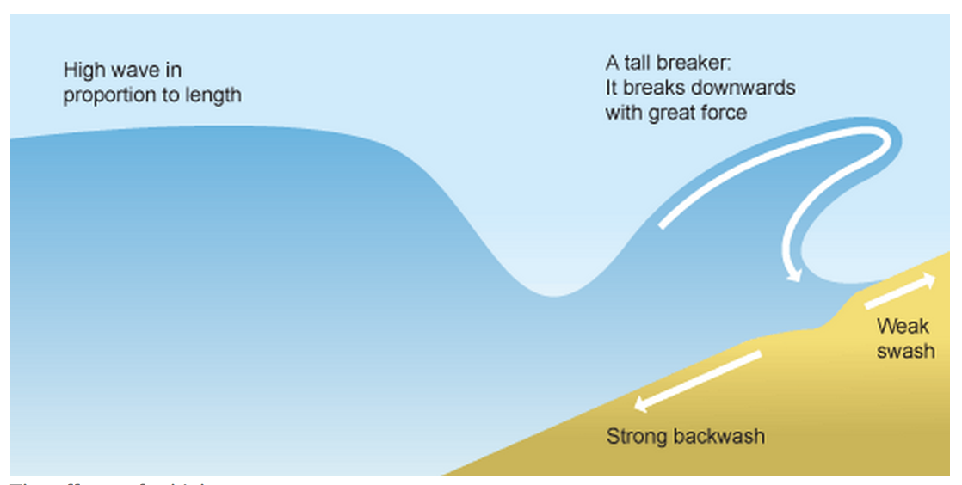
Destructive waves do the opposite, they have more energy and use it to erode (or destroy) the coast.
The violent wave crashes down onto the beach with force. It does not travel very far up the beach, it slams down and then wants to go back out to sea. This means the swash is relatively small (so no sand is pushed on to the beach)
These waves are much more powerful.
As the wave didn’t use much energy in it’s swash, it uses all of it’s power in it’s massive backwash. This means it scoops lots of sand away from the beach and back into the sea.
Sand being moved away from the beach, making it smaller.
So, destructive waves destroy the beach by using their powerful energy to take sand away from the beach and take it back to the sea.

Slide 11
Now you’ve got all the knowledge you need for this lesson, have a go at the questions on the next slides to test your knowledge…
Write your answers down then use the answers (on the answers PPT) to check if you were right.
If you got one wrong don’t worry- do as we always do and correct it! (yes- you should do this in purple pen at school, but don’t worry if you don’t have one of those, any colour will do!)
Remember you should all do the developing and secure questions. If you are targeted S+, or you would like to challenge yourself, do those questions too!

Slide 12
Test your knowledge: Developing
Draw a diagram to show the structure of a wave using all of the appropriate key terminology
What causes waves?
Which 3 things affect the size and power of a wave? (use the success criteria below to structure your answer):
Draw a diagram to show what the key terms ‘swash’ and ‘backwash’ mean
You can identify the three factors that affect waves.
You can draw an image/diagram for each factor.
You can explain how it makes the wave stronger or weaker.

Slide 13
Test your knowledge: Secure
5) Draw a diagram to show a ‘constructive wave’.
6) Draw a diagram to show a ‘destructive wave’.

Slide 14
Test your knowledge: Secure+
7) How would a constructive wave effect a beach? What would it do to the beach and why?
8) How would a destructive wave effect a beach? What would it do to the beach and why?

