Slide 1
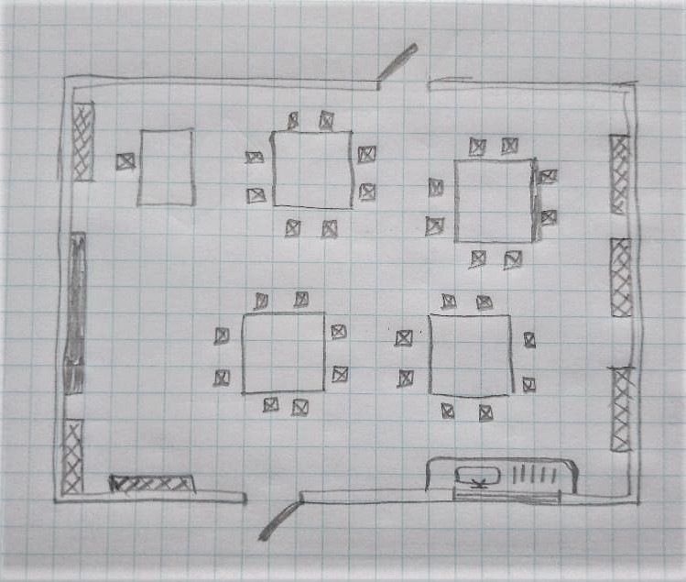


Perfect Plans
How to Draw a Plan View

Slide 2
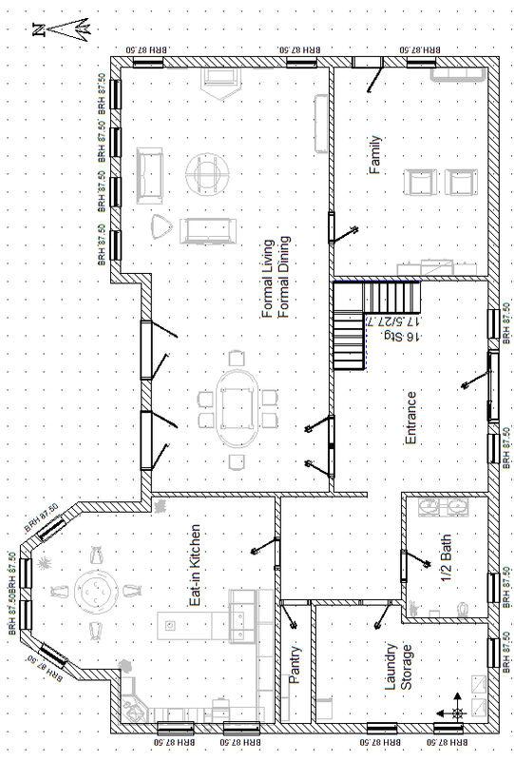
Plan Views
A plan view is a type of 2D drawing.
It shows a section through a building or object, as if you were looking down from above.
Plan views are used to show the layout of rooms or buildings.
We are going to create a plan view drawing of our classroom…
Notes:
Section here means in effect a ‘slice through’; the view shown in most plan views of rooms includes furnishings for example, but does not include items above the section – such as light fittings attached to the ceiling or rooms above the room being drawn.
Image is from Wiki Commons.

Slide 3
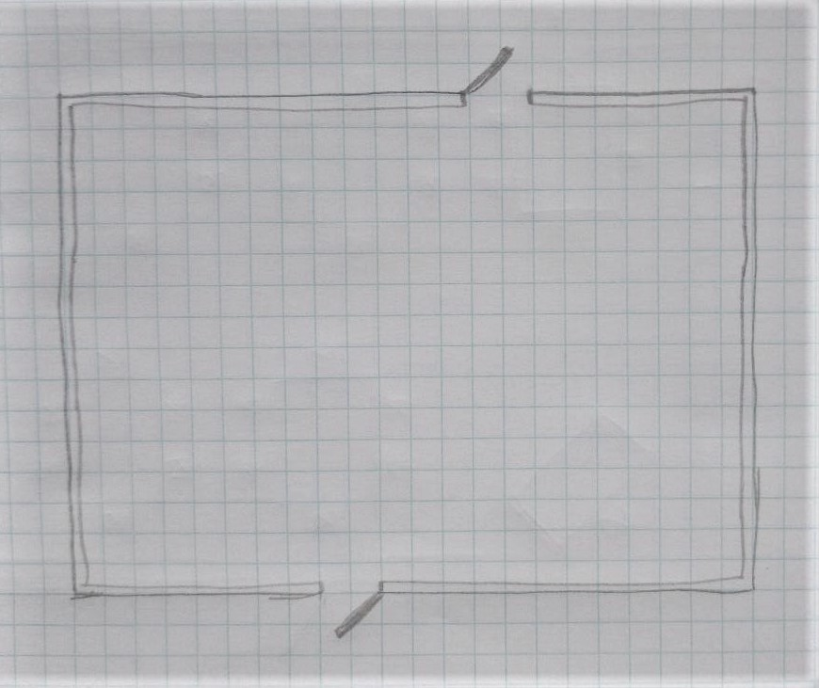
Drawing a Plan View of a Classroom - Start
Door
The drawing used in these examples was drawn by a Year 5 pupil called Sophie.
Draw the outline of the classroom.
Remember to include any doors.
Wall
Door
Notes:
This drawing was produced by Sophie, aged 9, and is used with permission. Pupils could use tape measures to measure the dimensions and determine a scale themselves, or they could be told to use a certain number of squares for each side on the paper. The wall could be drawn as a single line showing the inner face, rather than a double line as shown.

Slide 4
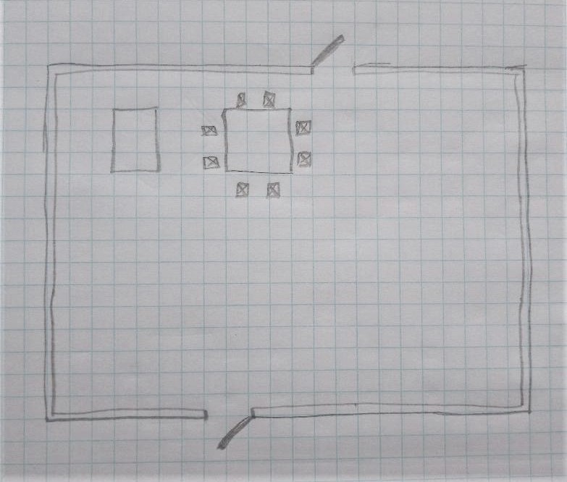
Drawing a Plan View of a Classroom - Features
Choose a feature in the room. Draw this in the correct place.
(Sophie drew Mrs. Wright’s desk)
Draw the next feature
(Sophie drew her table, then the chairs around it)
Mrs Wright’s desk
Chairs
My table
Notes:
It can help to draw based on distances from a specific reference point, such as the top left corner on the drawing or the first feature drawn.

Slide 5
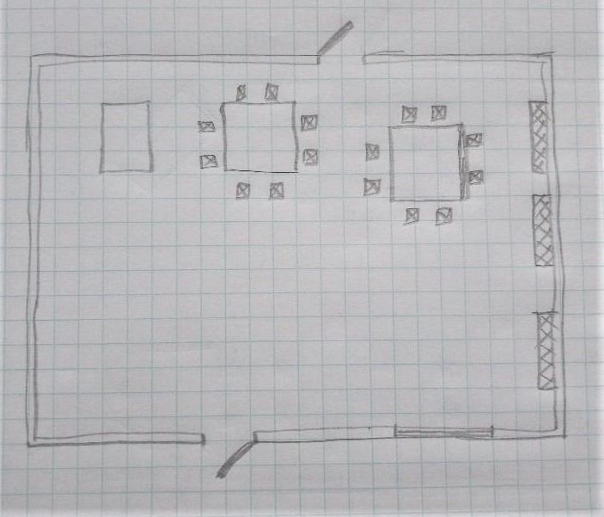
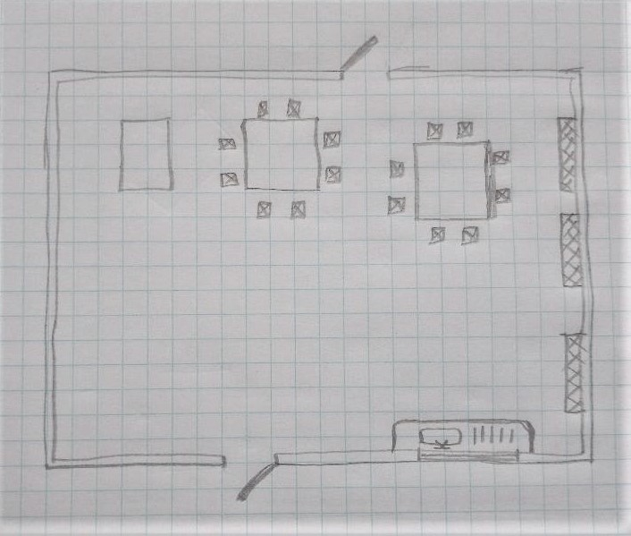
Drawing a Plan View – Adding More Features
Keep adding the other features…
Table
Windows
Sink
Windows

Slide 6
Drawing a Plan View – Finishing the Drawing
Add the remaining features to the drawing.
Label all the features.
Bookcase
Whiteboard
Reading corner bookcases
Reading corner bookcases
Tables
Tables

Slide 7
Now try this…
Produce a plan view of our classroom.
You could extend your drawing by making a plan view of the whole school, which visitors could use as a map.

Slide 8
Drawing a Plan View of a Classroom using CAD...
The drawing used in these examples was a different classroom, drawn on CAD software drawn by a Year 5 pupil called Mohsin.
2)
Notes:
This drawing was produced by Mohsin, aged 9, and is used with permission. CAD stands for computer aided design, a term which applies to both drawing and simulation software.

Slide 9
Completing a Plan View of a Classroom using CAD
The drawing used in these examples was a different classroom, drawn on CAD software drawn by a Year 5 pupil called Mohsin.
3)
4)

